Slide 1
Jayant Gupchup Graduate student, Johns Hopkins University
Representative Slides

Slide 2
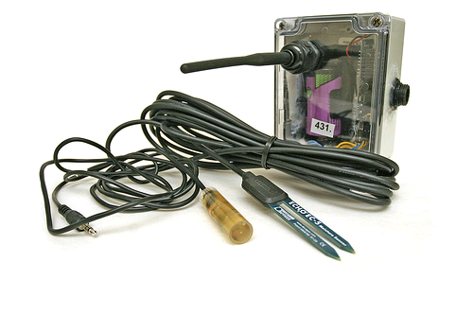
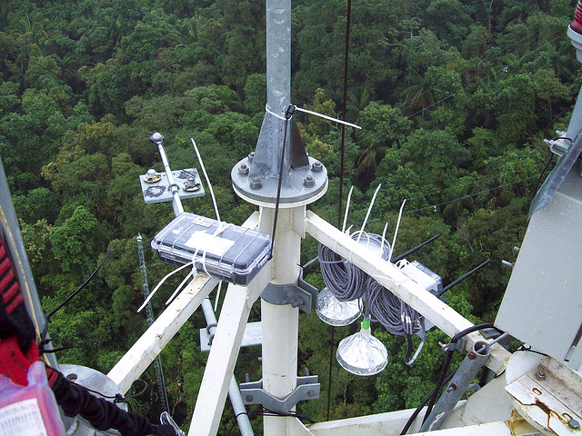
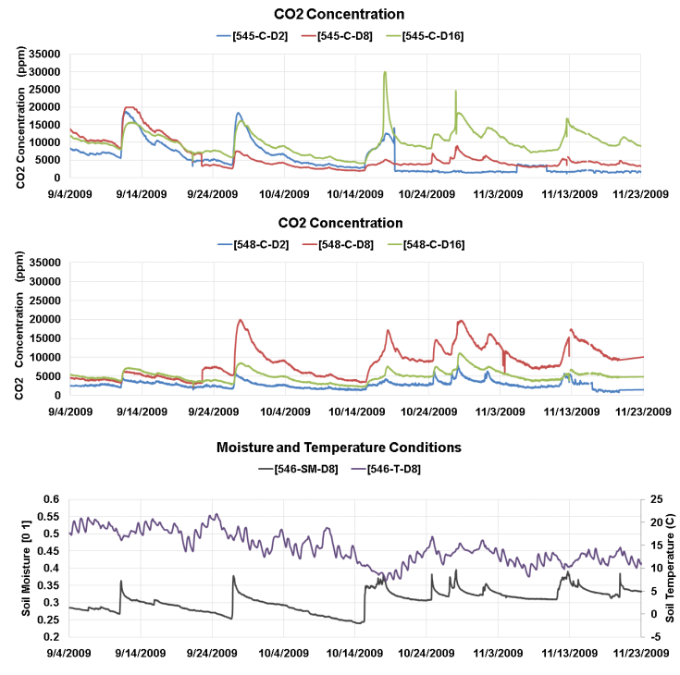
Environmental Monitoring

Slide 3
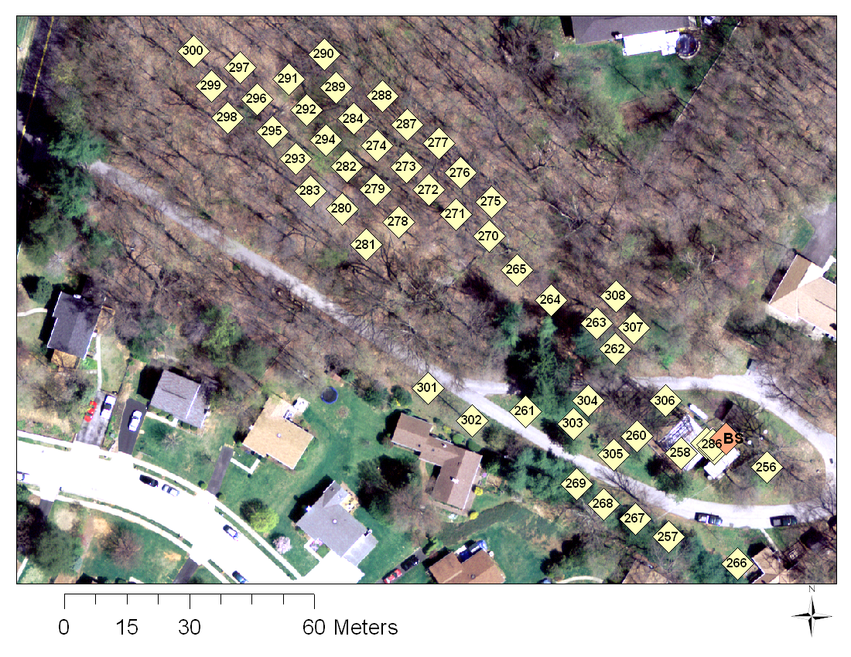
Cub Hill [Dec 2008 to Sep 2009]

Slide 4
Research and Roles
Manage data collected by our sensors
Provide online access to data and graphs to scientists
http://dracula.cs.jhu.edu/luyf/en/tools/VZTool/
Research – I: Time synchronization and validation of measurements
Research – II: Exploit spatial and temporal correlation to
Fault detection and gap filling
Optimize data collection subsystem

Slide 5
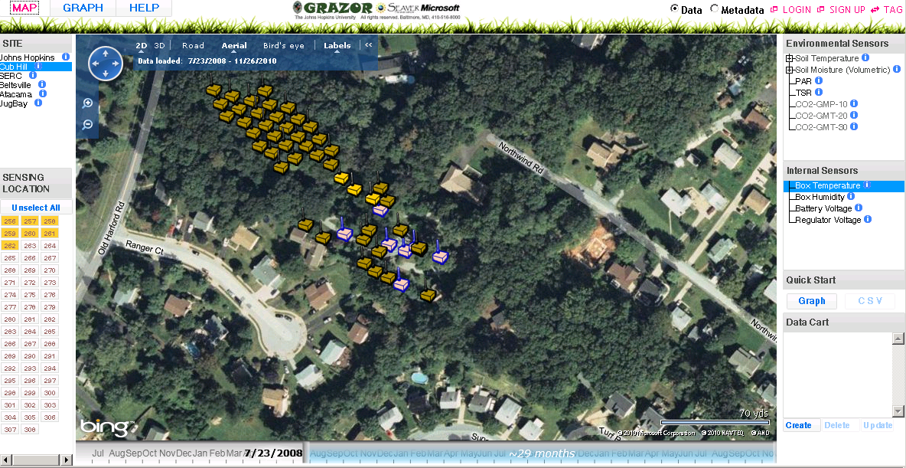
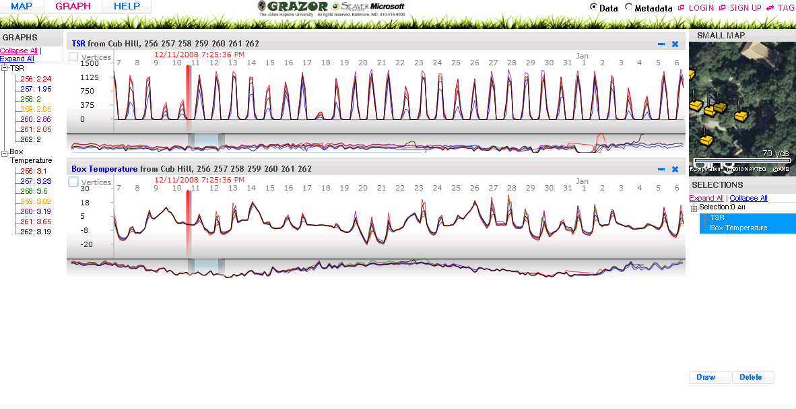
Grazor System
Available
Online
Right now!!!

Slide 6
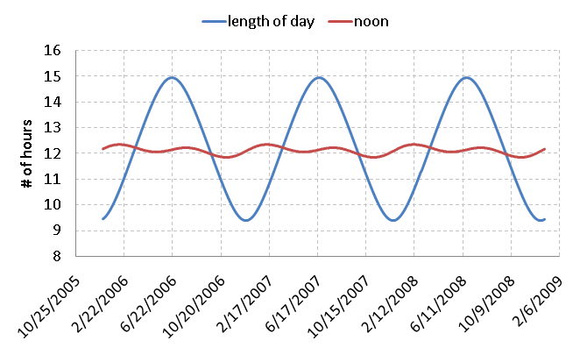
Timestamp Validation: Annual Solar Patterns
<LOD, noon> = f (Latitude, Time of Year)

Slide 7
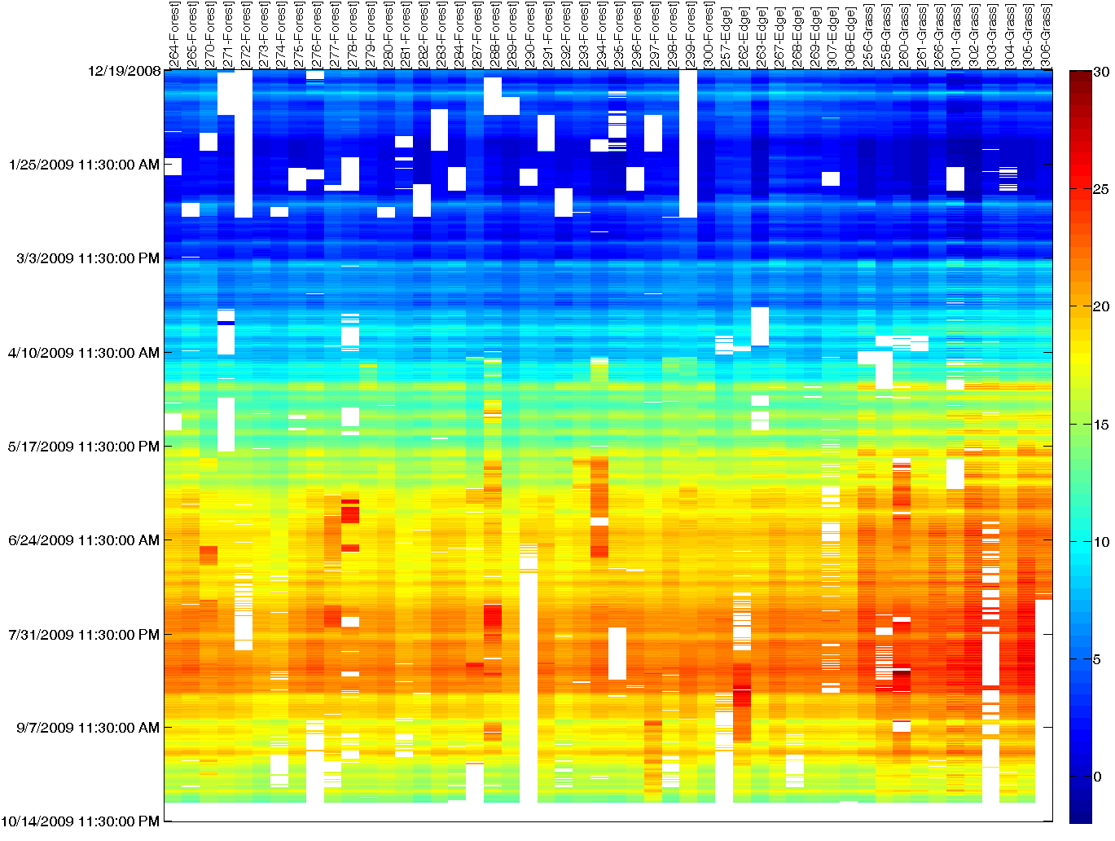
Soil Temperature Dataset [noisy + gappy]

Slide 8
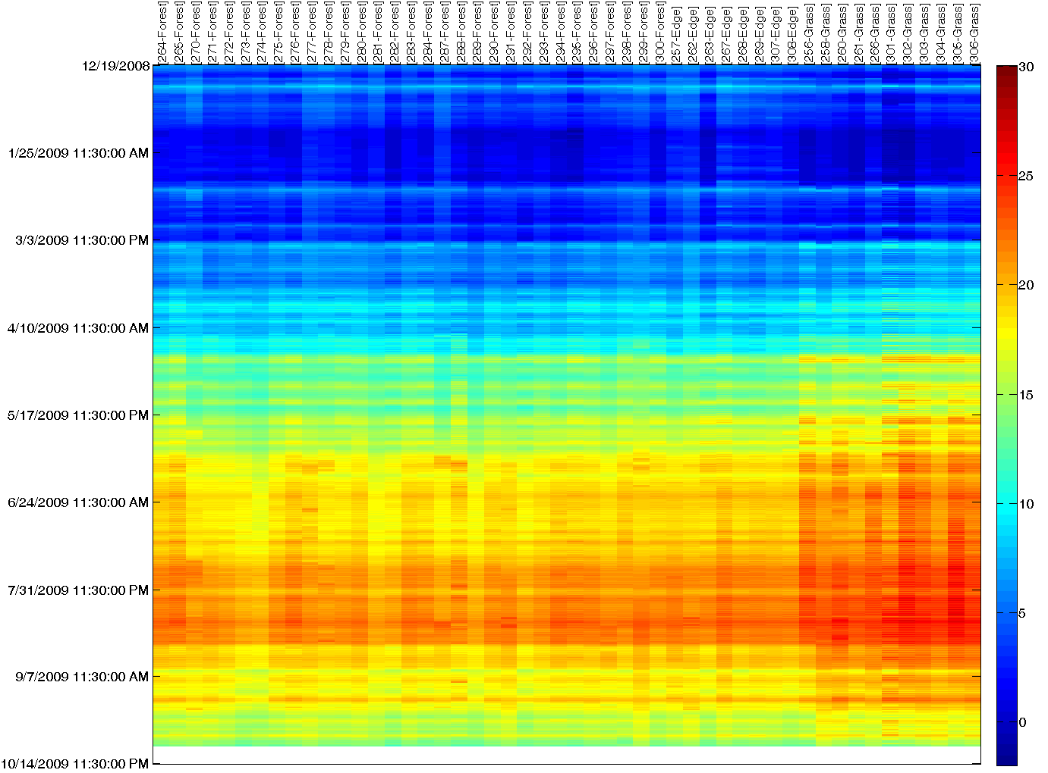
Robust Reconstruction [Clustering+PCA+Regression]

Slide 9
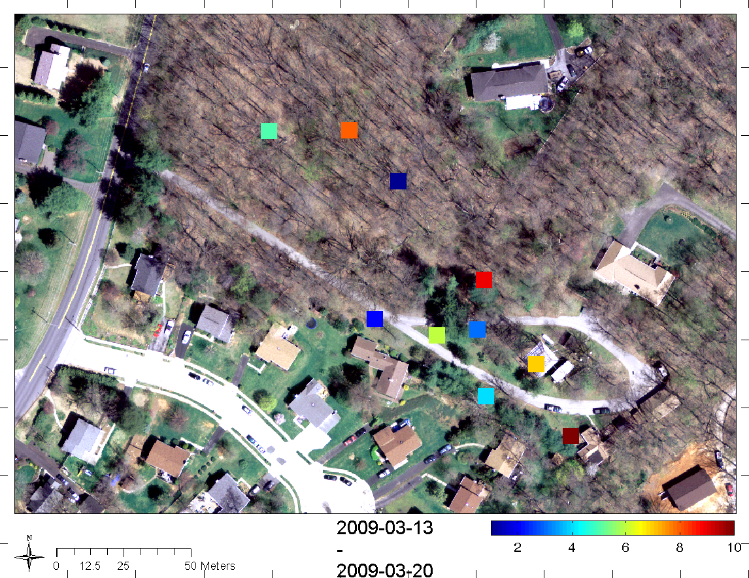
Top 10 Locations

Slide 10
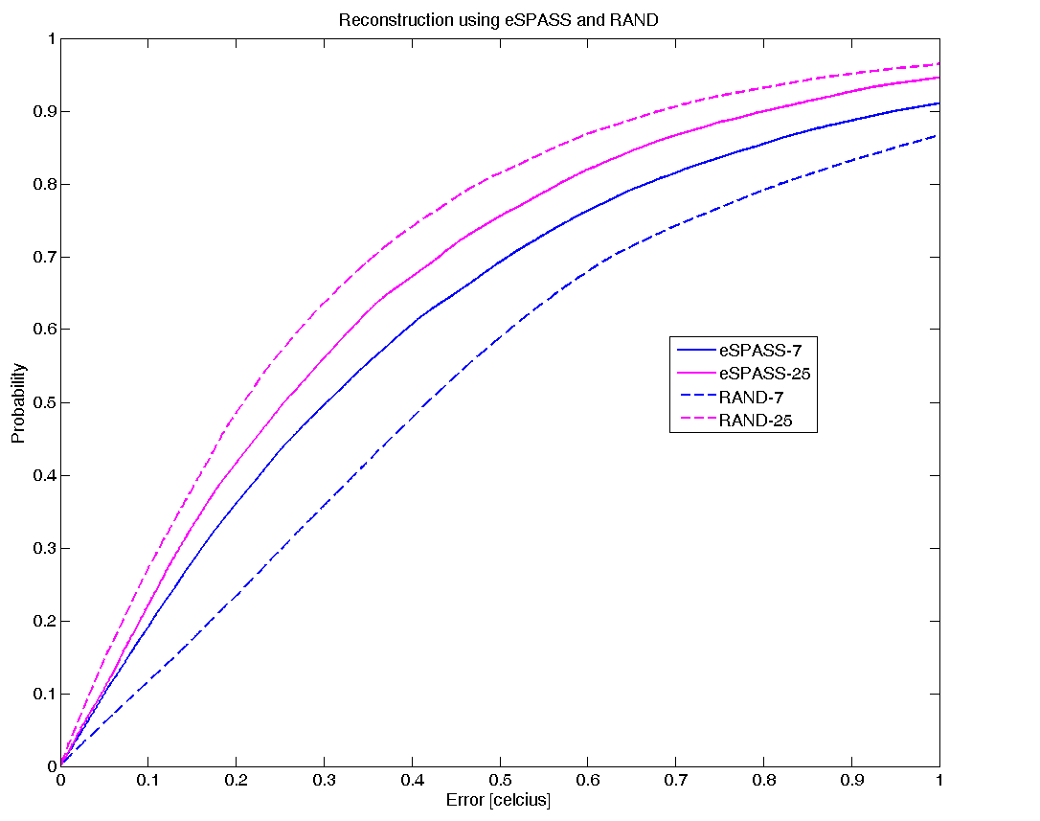
Reconstruction Error vs Locations

Slide 11
Questions

Slide 12
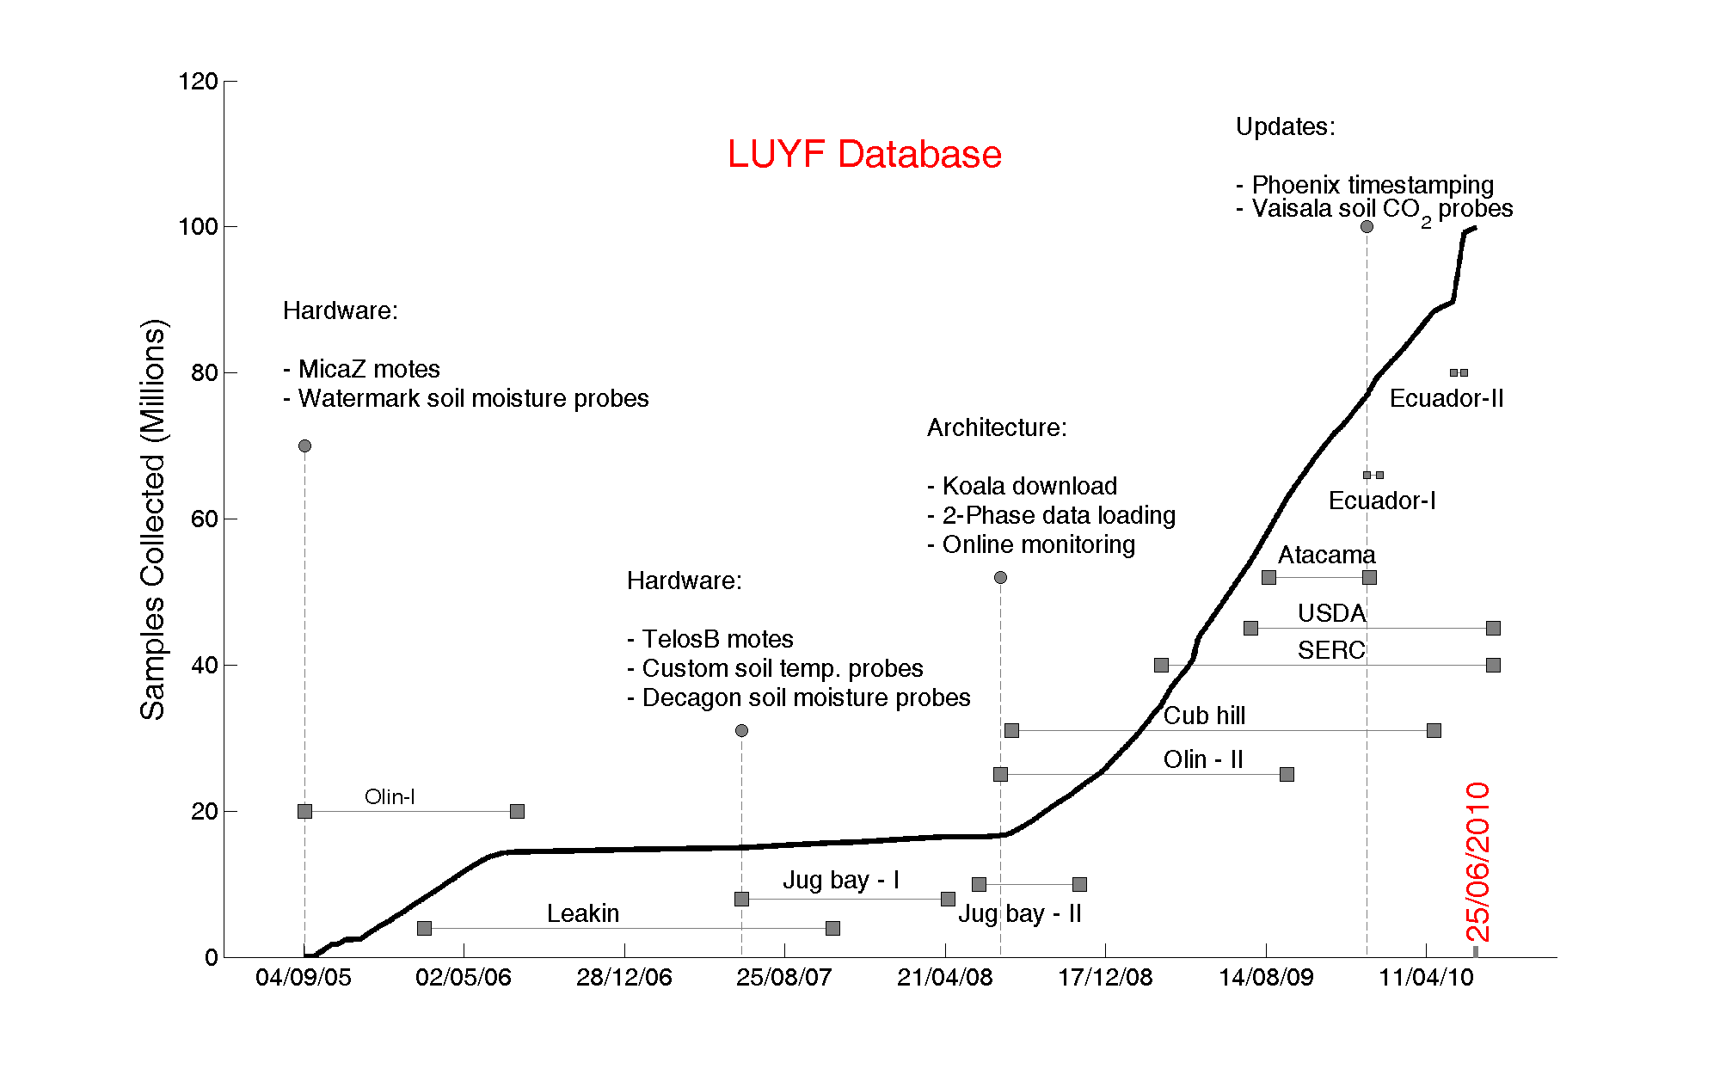
Life Under Your Feet [LUYF]
[LUYF] : http://www.lifeunderyourfeet.org/

Slide 13
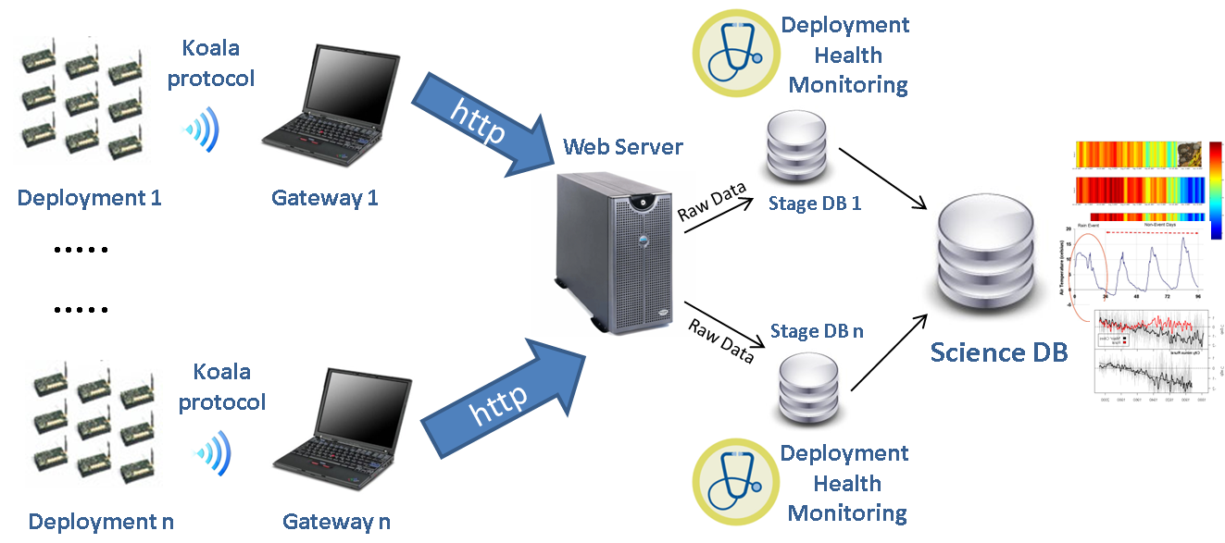
System Architecture [eScience 2008]
[eScience 08] : Microsoft eScience Workshop 2008, Indianapolis

Slide 14
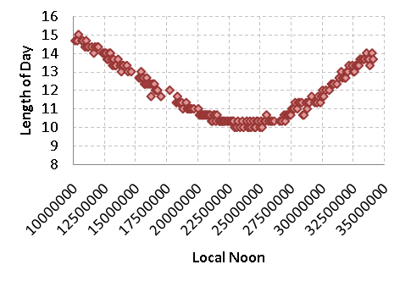
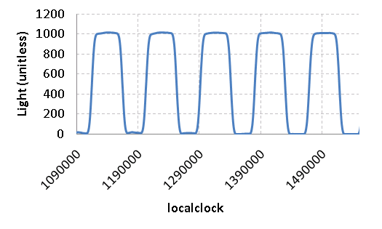
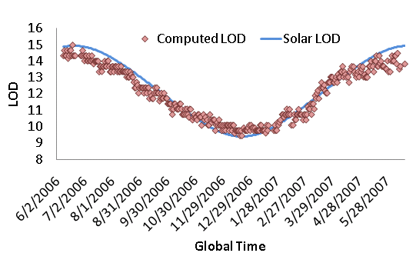
“Time Reconstruction: Sundial” [EWSN 09]
Noon
Length of day (LOD)
argmax _{lag} Xcorr (LOD _{lts}, LOD _{gts}, lag)
Local Noon | Global Noon
Lts ₁ | Gts ₁
Lts ₂ | Gts ₂
… | …
… | …
Lts _{n} | Gts _{n}
“Anchor Points”
[EWSN 09] : European Conference on Wireless Sensor Network 2009, Ireland

