Slide 1


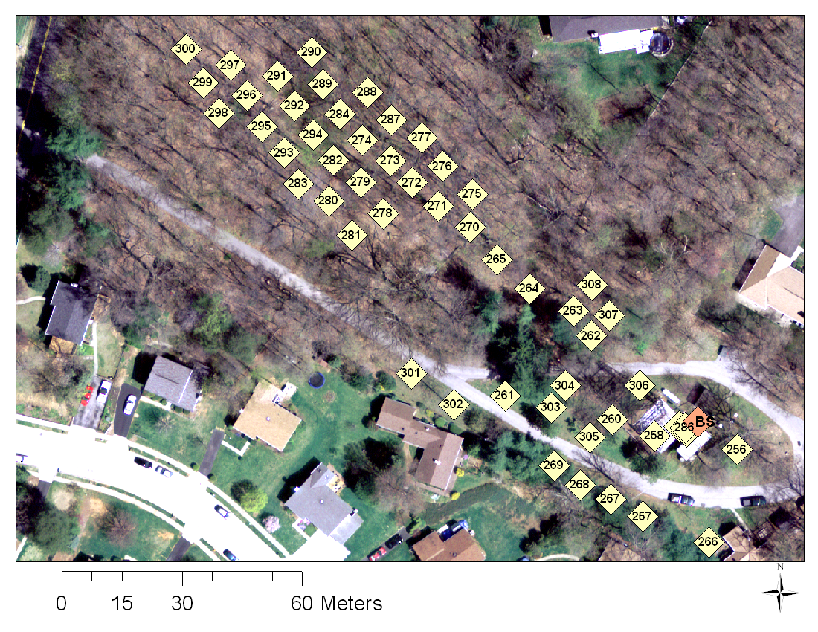
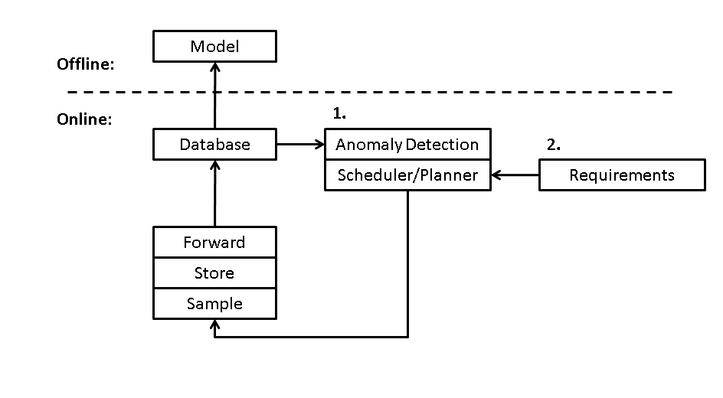
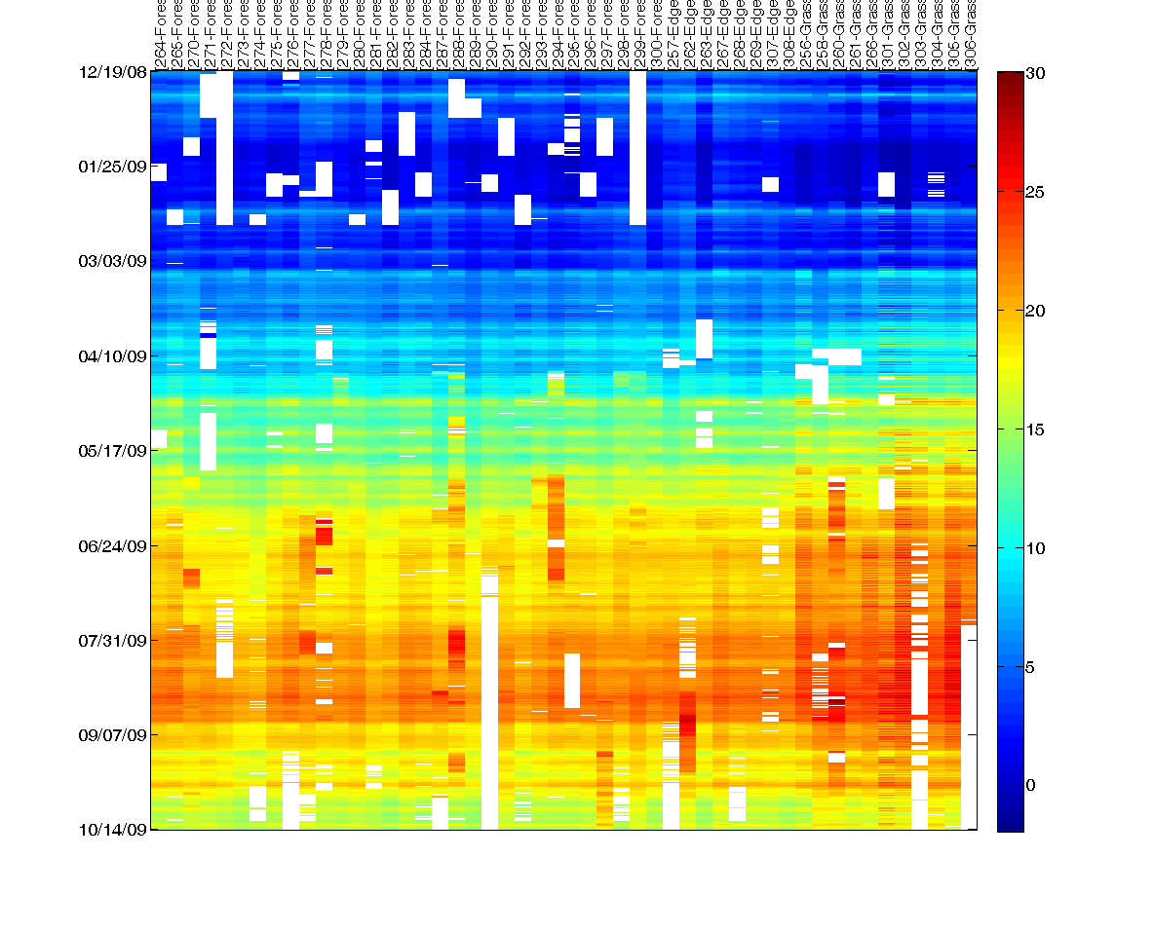
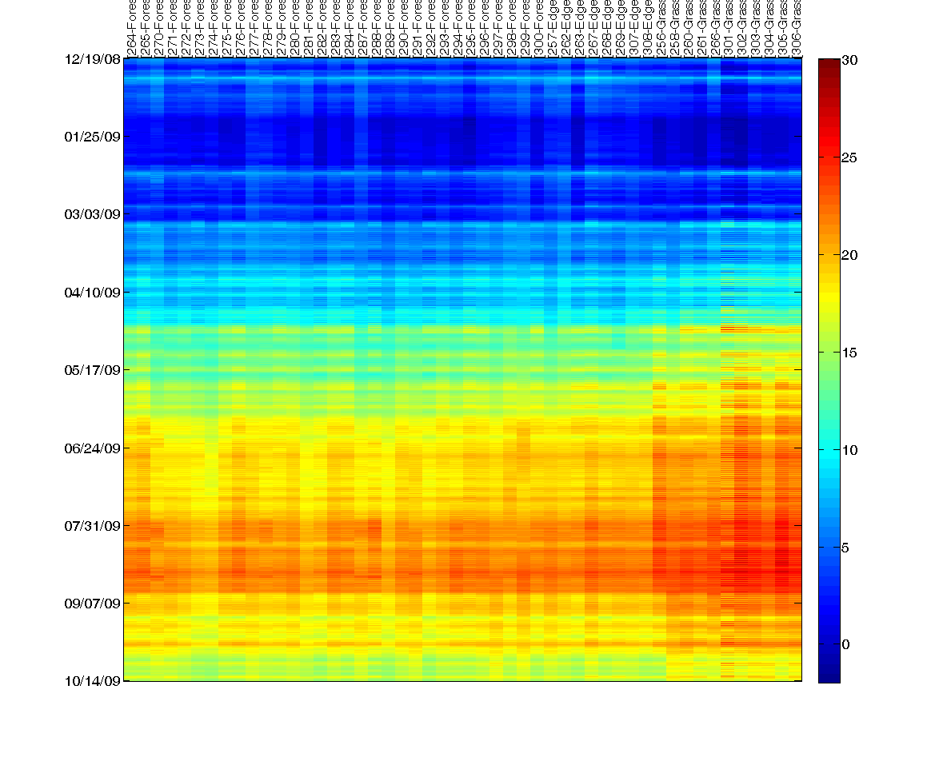

Exploiting Spatiotemporal Correlations in Environmental Monitoring Networks
Marcus Chang,¹ Jayant Gupchup,¹ Doug Carlson,¹ Andreas Terzis ¹ Katalin Szlavecz, ² and Alex Szalay ³
1 – Department of Computer Science, Johns Hopkins University
2 – Department of Earth and Planetary Sciences, Johns Hopkins University
3 – Department of Physics and Astronomy, Johns Hopkins University
Data from real deployments
Data from real deployments tends to
contain faulty readings and missing values
Scientists require fault-free and gap-corrected
data to work with
Spatiotemporal correlations in data allow us
to identify anomalies and interpolate missing
values
Principal component analysis based
methods are employed to “repair” the data
[1]
Cub Hill deployment near
Baltimore
Autonomous data acquisition [2]
Artificial Intelligence (AI)
planner transforms ecologists
requirements into a constraint
optimization problem
Online anomaly detection system
suggests sampling locations
AI solver finds optimal sampling
strategy
Soil temperature dataset
Fault-free and gap-filled
dataset
Fault
Examples
Missing Values
Example
Adaptive sampling successfully tracks moving stratification layer and yields
accurate oxygen distribution
References:
[1] : A Robust Classification of Galaxy Spectra: Dealing with Noisy and
Incomplete Data,Connolly, A. J. and Szalay, A. S., The Astronomical Journal, vol. 117, pp.2052–2062, May 1999.
[2] : Meeting ecologists' requirements with adaptive data acquisition, M. Chang, P. Bonnet, In Sensys 2010
This material is based upon work supported
by the National Science Foundation
under Grant No. EEC-0540832.
www.mirthecenter.org

