Slide 1
Gap-filling and Fault-detection
for the
life under your feet dataset

Slide 2
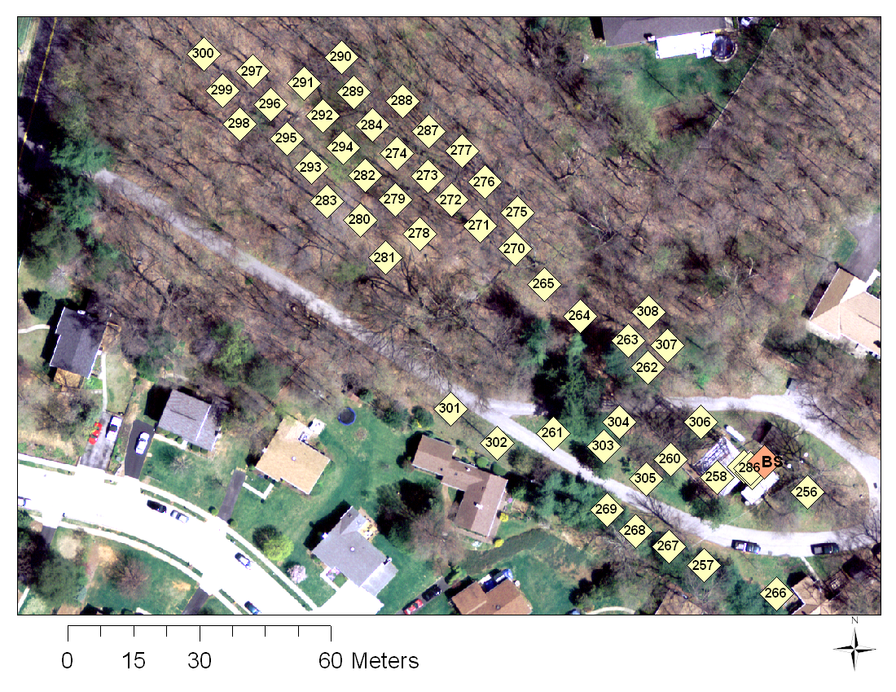
Locations

Slide 3
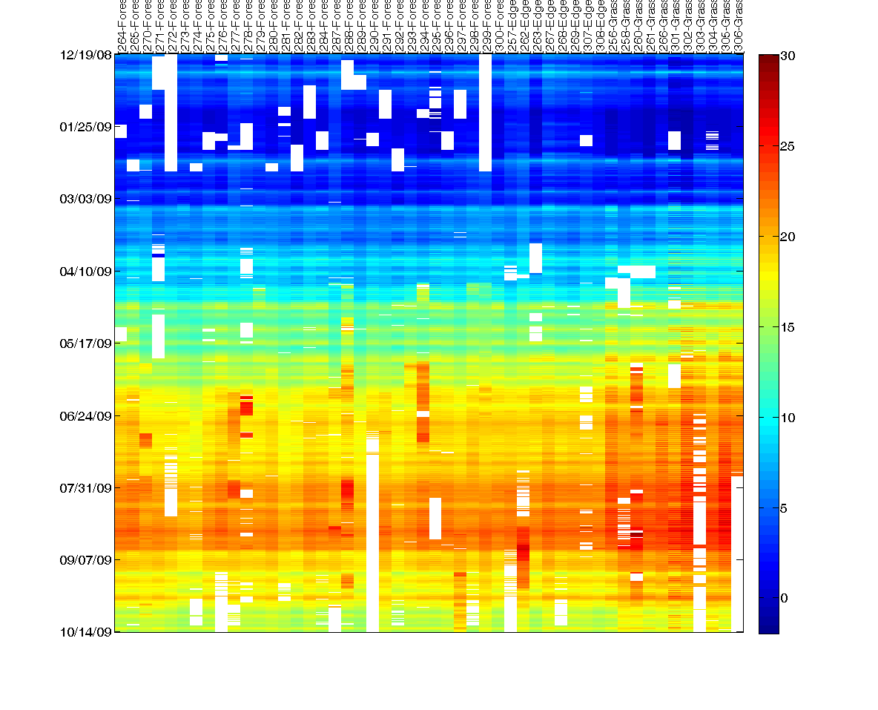
Soil Temperature Dataset

Slide 4
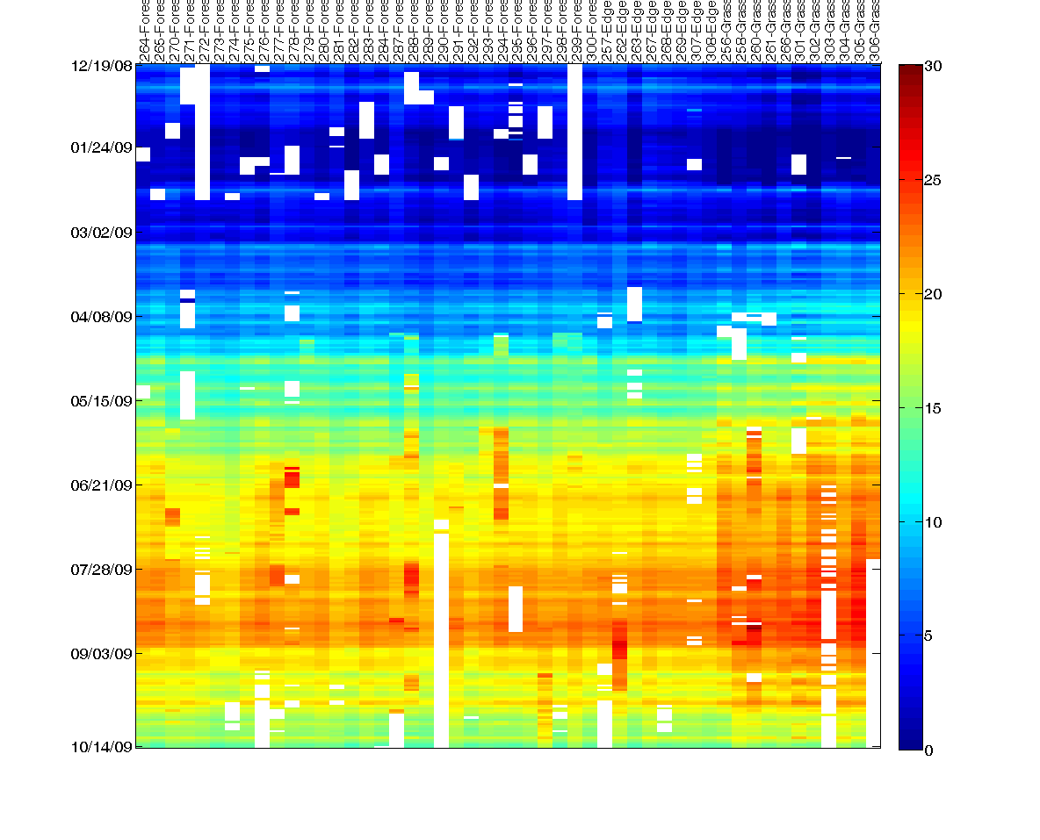
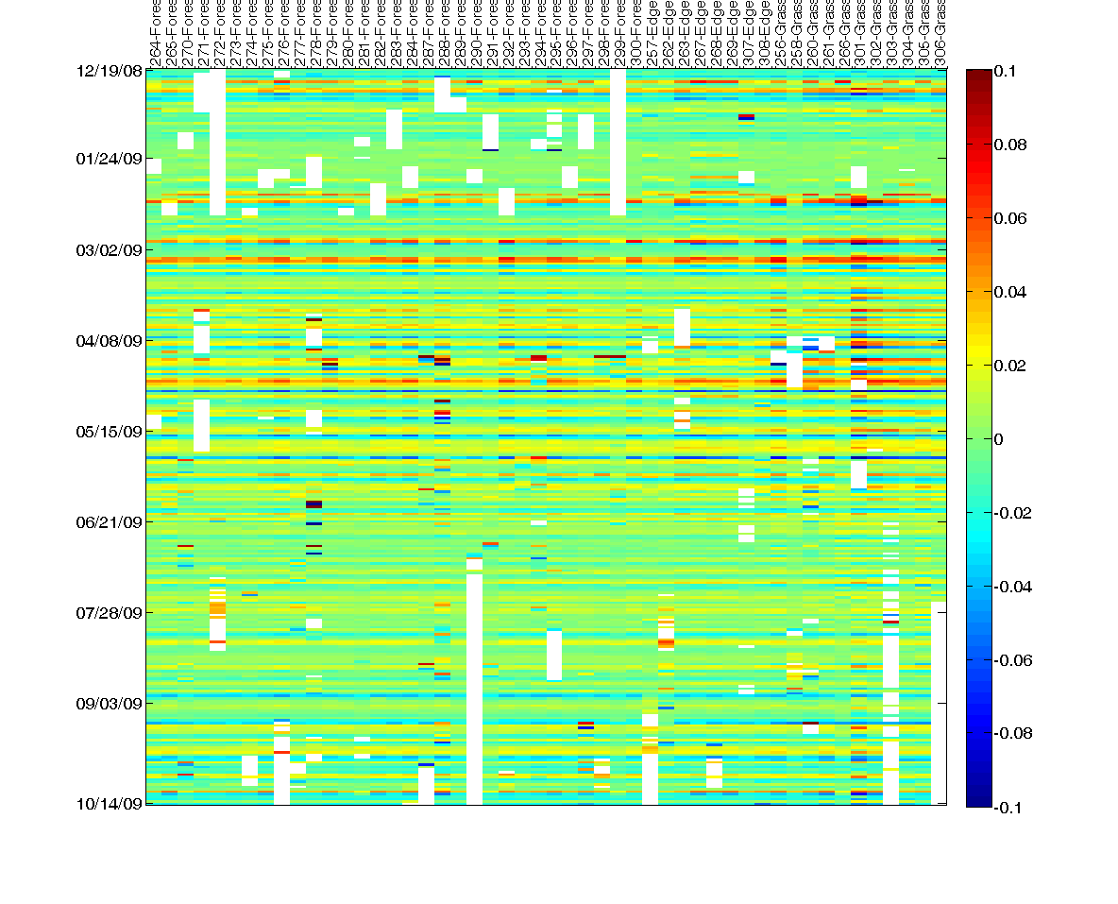
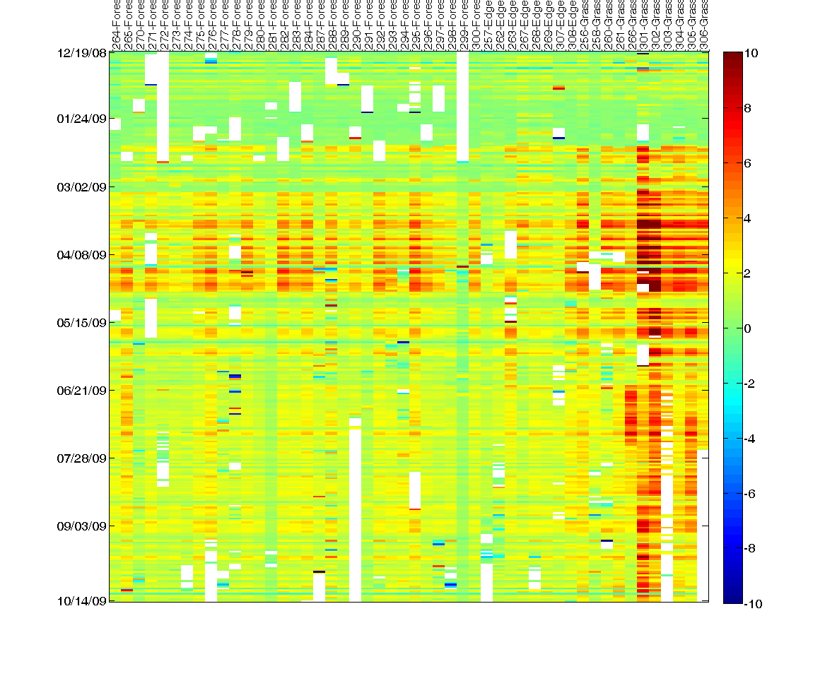
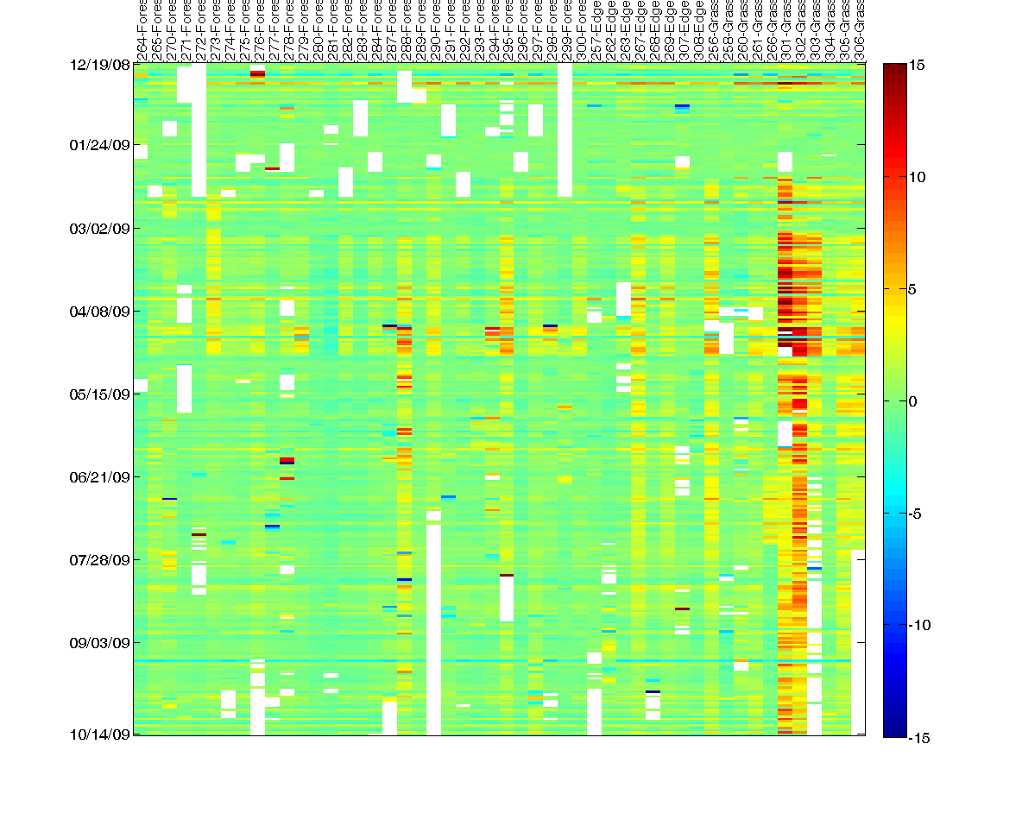
Splitting into PC’s [raw] (notice faults)
mean
slope
PC1
PC2

Slide 5
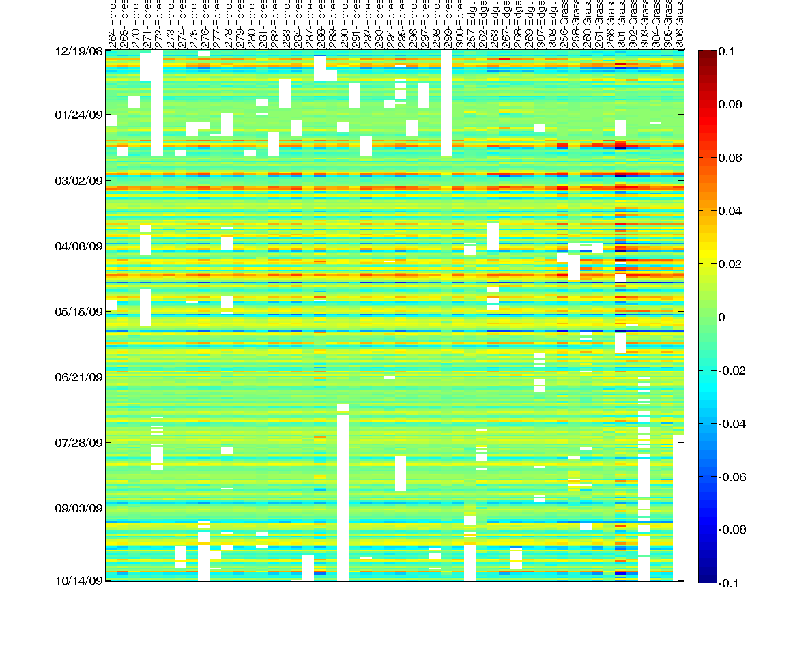
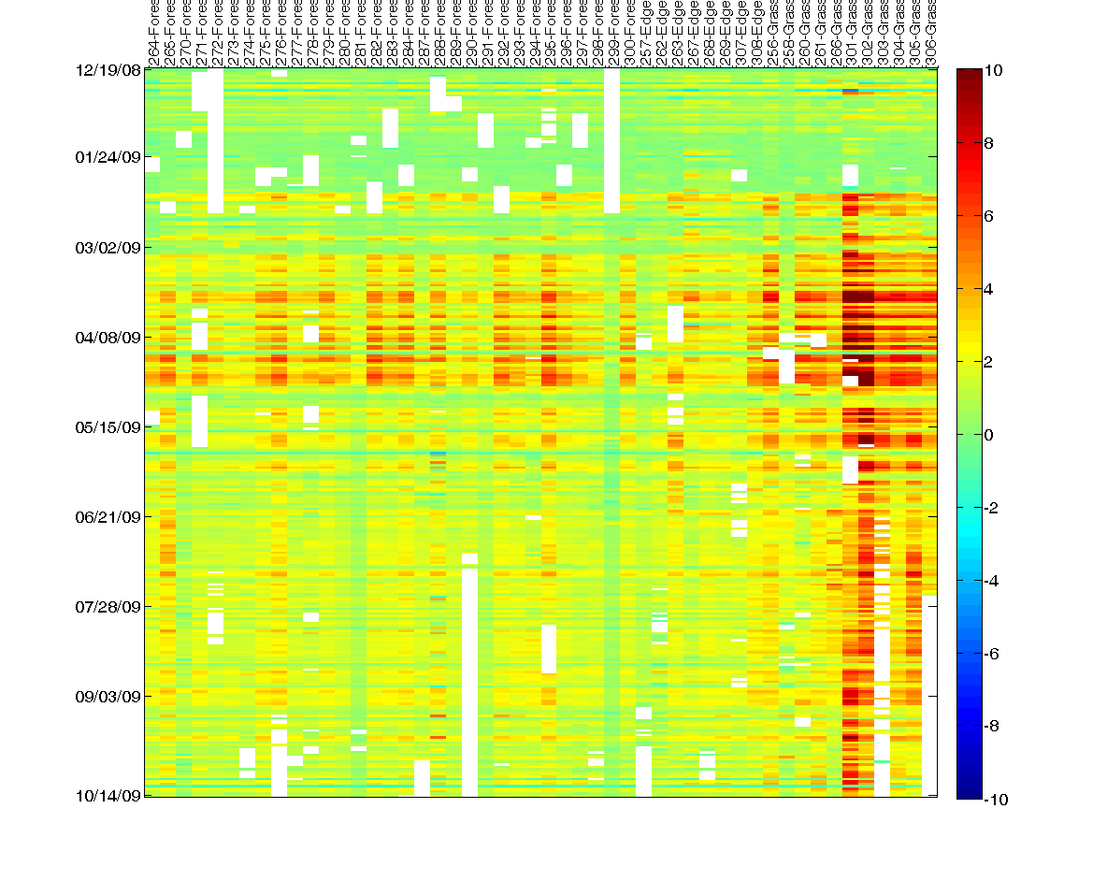
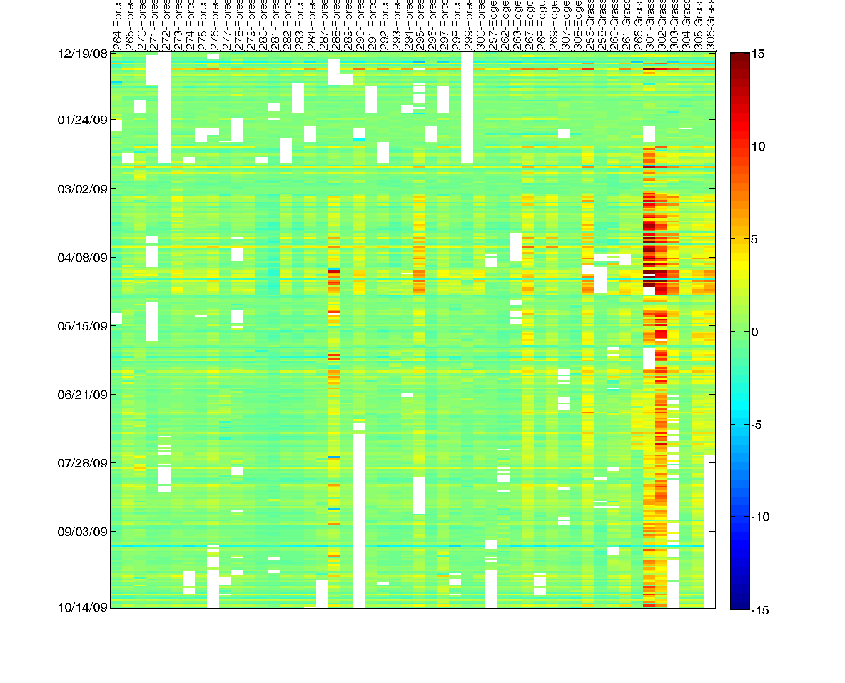
Splitting into PC’s [censor + correct]
mean
slope
PC1
PC2

Slide 6
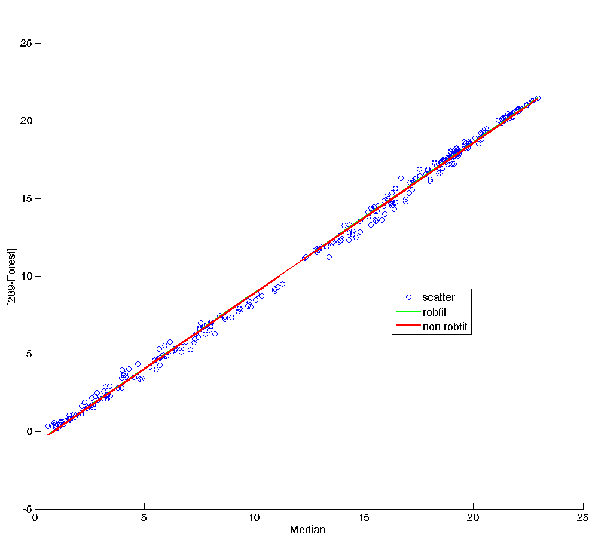
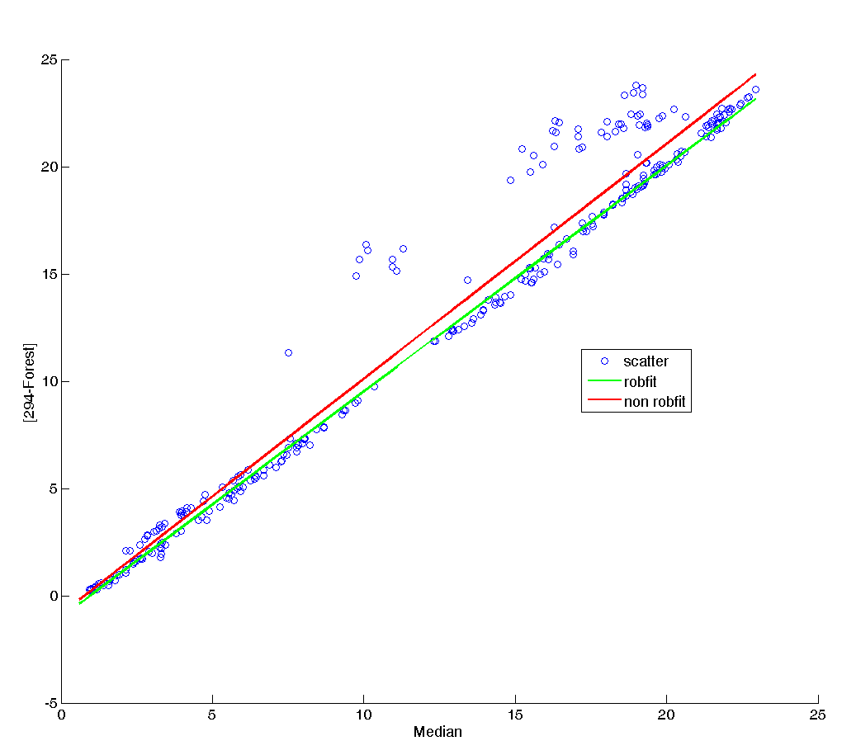
Example of censoring
Good location
Outliers

Slide 7
Reconstruction using first 4 temporal PC’s

Slide 8
With PC’s / Without PC’s

Slide 9
Ciprians approximate trick
Y’Y = VD²V’
Let U = YVD⁻¹
Y = UDV’
YY’ = UDV’VDU’ = UD²U’

Slide 10
Reconstruction using first 4 temporal PC’s

Slide 11
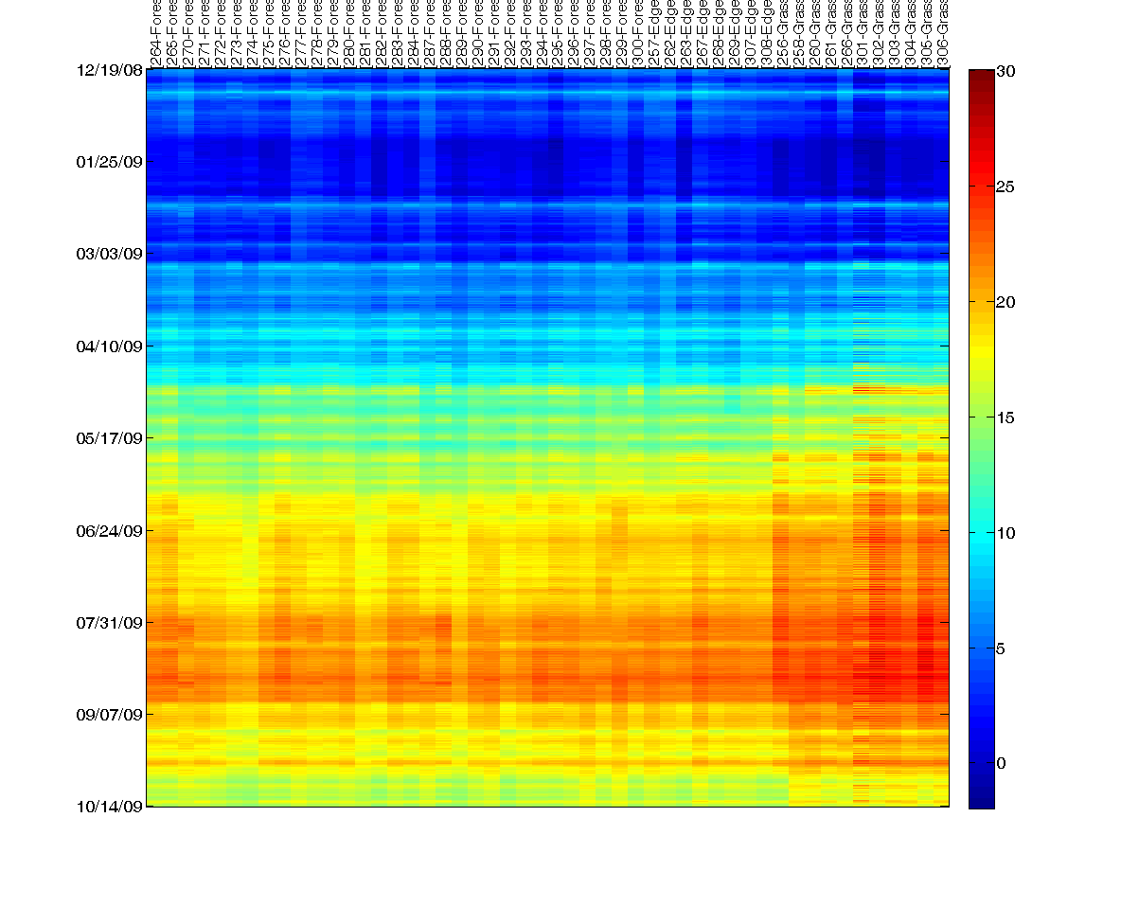
Right eigenvector reconstruction

Slide 12
Left eigenvector reconstruction

Slide 13
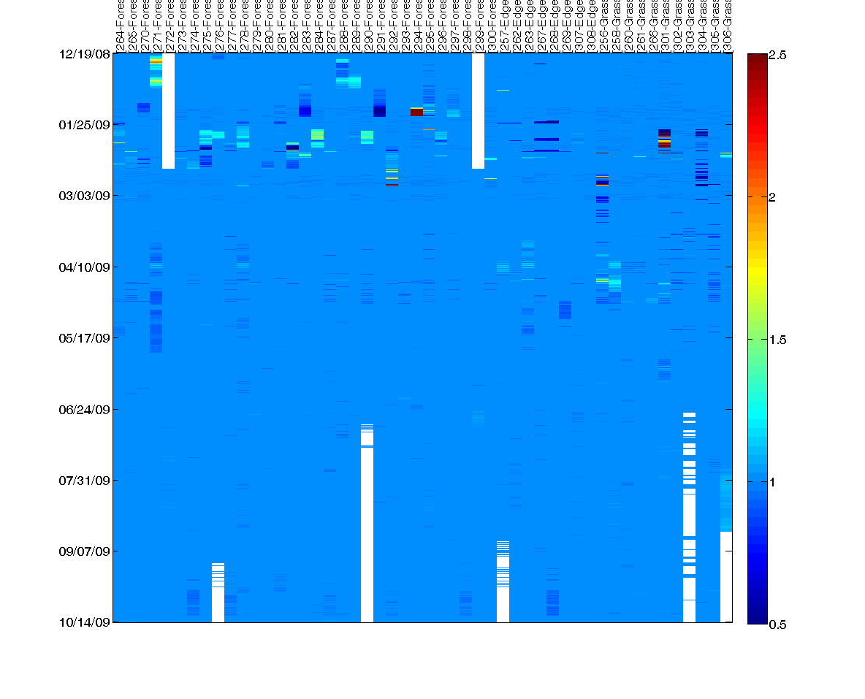
Right vector / Left vector map

Slide 14
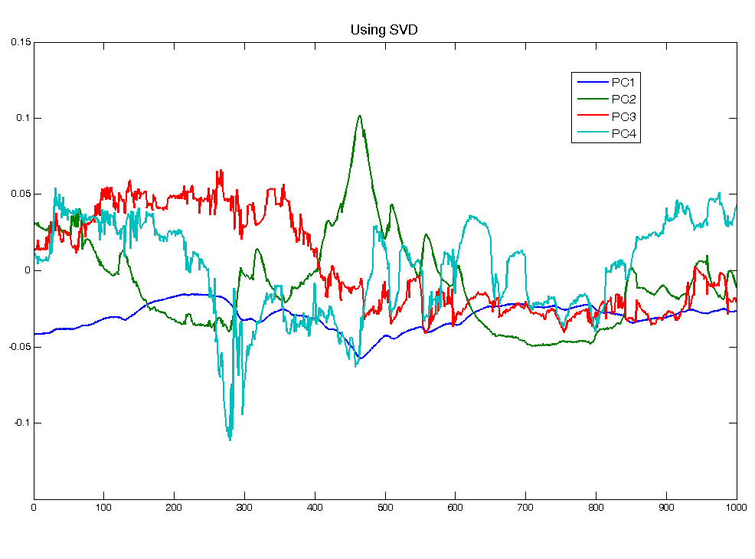
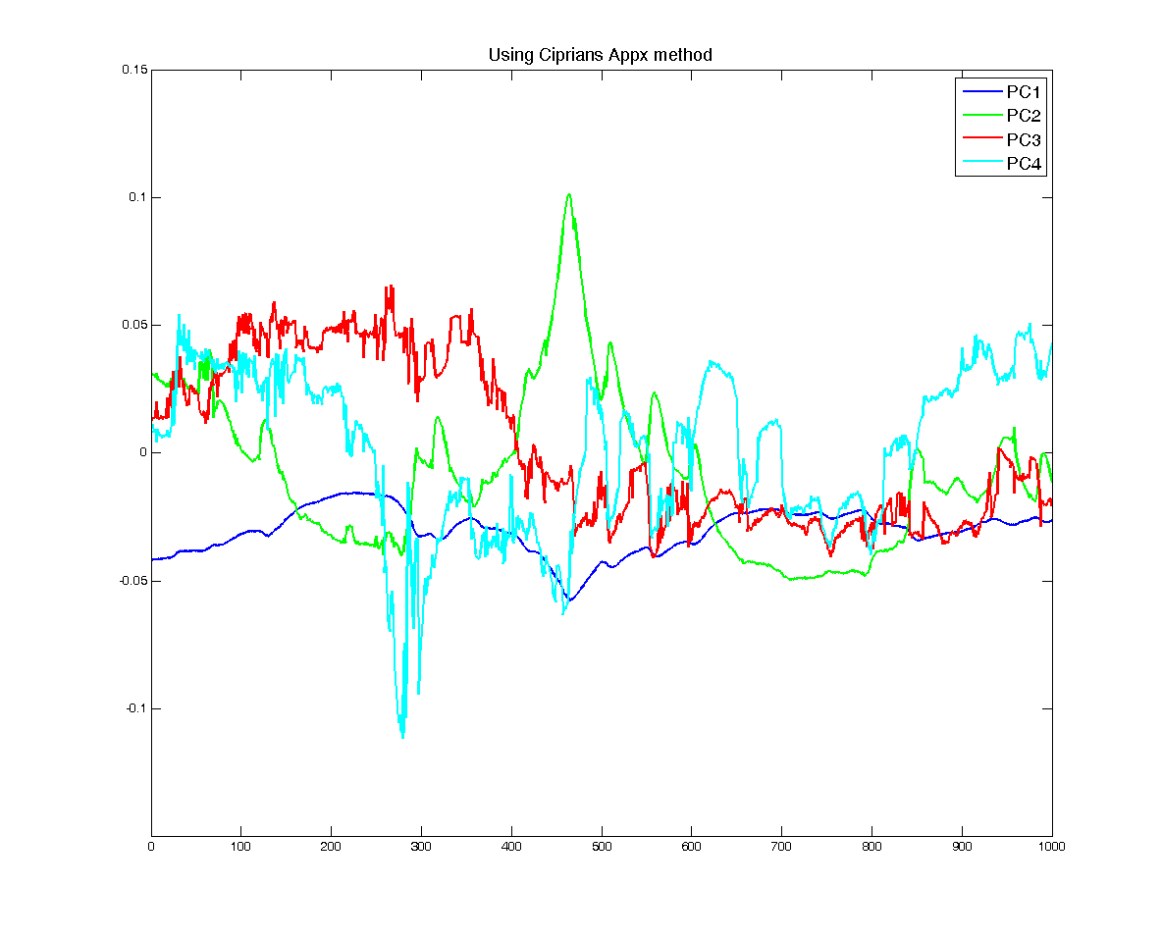

Slide 15
Right Eigenvectors

Slide 16
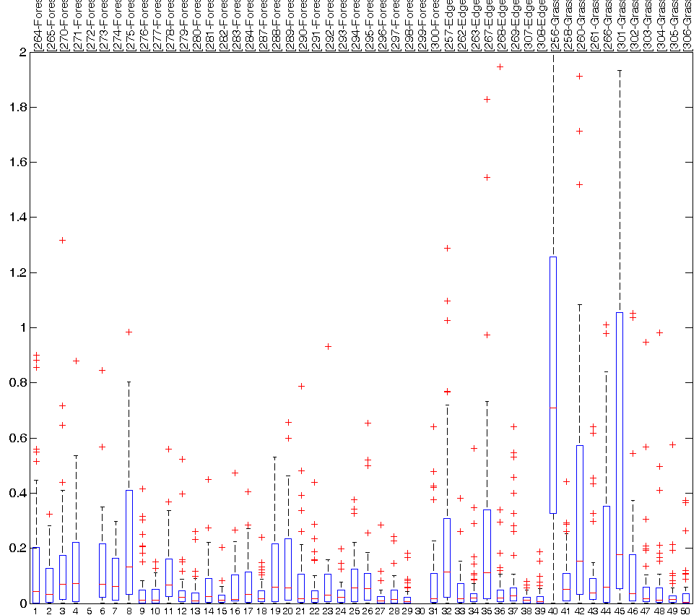
Left Eigenvectors

