Slide 1
Data Management in Environmental Monitoring Sensor Networks
Jayant Gupchup
gupchup@jhu.edu
Dissertation Committee:
Alex Szalay
Andreas Terzis
Carey Priebe
Notes:
Thanks Andreas and thank you all for being here. Please help yourselves to pizza and coffee. The coffee should help you stay awake. The pizza might put you to sleep. If that doesn’t my talk might. Okay, so I’m going to be talking about Data Management in Environmental Monitoring Sensor Networks. First and foremost, I’d like to thank my committee for their time and for being here.

Slide 2
Motivation & Background
Notes:
Before I get into my specific contributions, I’d like to give you a provide some motivation and background

Slide 3
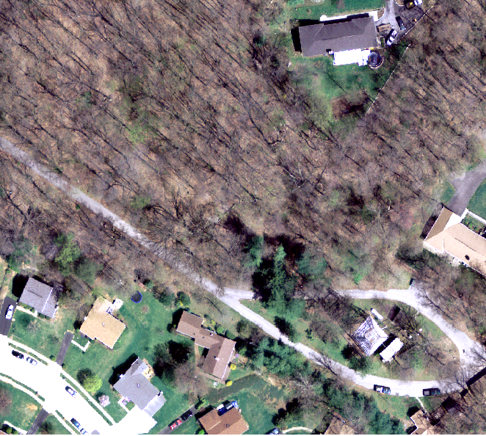
An Environment of Interest
Cub Hill, Parkville, MD
Notes:
Scientists are interested in collecting data to study and understand their environment of interest. For example, soil scientists we work with here at Hopkins are interested in studying soil ecosystems. Specifically, they are interested in collecting data to understand the spatial and temporal heterogeneity of variables such as soil temperature and soil moisture because these variables are one of the biggest drivers of soil respiration and soil fauna.
This is a representative example of a region of interest to the ecologists. What makes it interesting is the variability in the land usage. There is a grass region here and a forest region here.

Slide 4
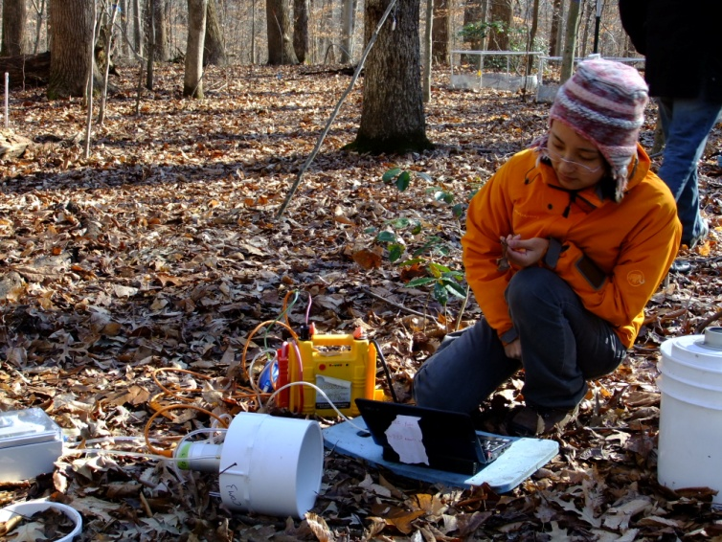
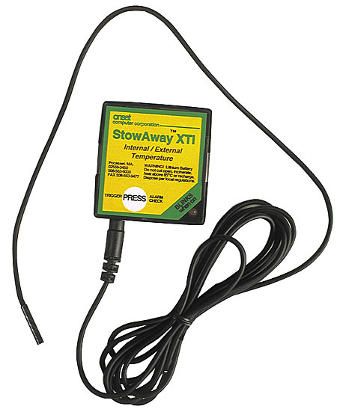
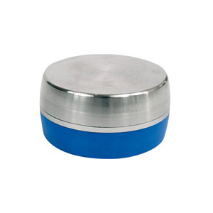
Traditional Approaches
Handheld Devices
High Manual labor
Limited data collection
Difficult in harsh conditions
Intrusive: disturb the environment
Data Loggers
No end-to-end solution
Limited or no programmability
No fault diagnosis
40$ - 3500$ [1]
Courtesy : Lijun Xia, Earth & Planetary Sciences, JHU
http://www.benmeadows.com/HOBO-H8-Data-Loggers_31227329/
http://globalw.com
[1] : http://www.microdaq.com/data-logger/temperature/1.php
Notes:
Traditionally, there have been two approaches at collecting this data. The first one is to use hand held devices. There are some obvious disadvantages. State the disadvantages. Another common approach is to use data loggers. These are devices where data gets logged and you pick up the device and hook it up to a computer to offload the data. This does not provide real-time monitoring. Good commercially available data loggers can be reasonably expensive too so the cost does not scale very well.

Slide 5
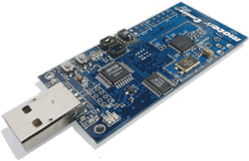
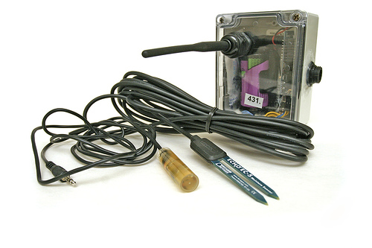
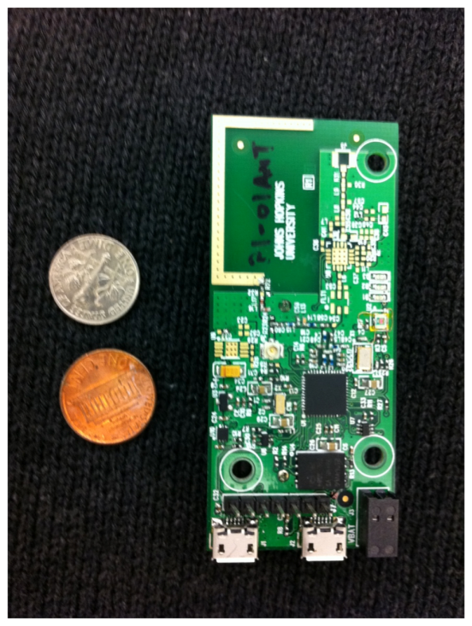
Wireless Sensor Networks (WSNs)
A Network of Nodes + Sensors
~ 100 $ [2005]
Nodes (or “motes”)
Radio (~ 30m)
Microcontroller (16 bit, 10kB RAM)
1 MB External Flash
Expansion board for external sensors
Battery Operated (~ 19 Ah)
No onboard Real-time clock
Programming environment (TinyOS, nesC)
Bacon Mote
Johns Hopkins University
~ 25 $
Notes:
Overcome challenges, researchers looking solutions. Name given sensor networks
Idea: low-power computing device with onboard radio and expansion board to connect external sensors
Figure is representative example of kinda of hardware im taking about. Also known as mote
Motes are battery operated, they are programmable and they have 1 Mb of external flash storage. To keep the costs low, they do not have an onboard real-time
A commercially available mote costs around $100. the cost of the actual components is around 40$. Our group is in the process of creating our own platform that is as low as 25$

Slide 6
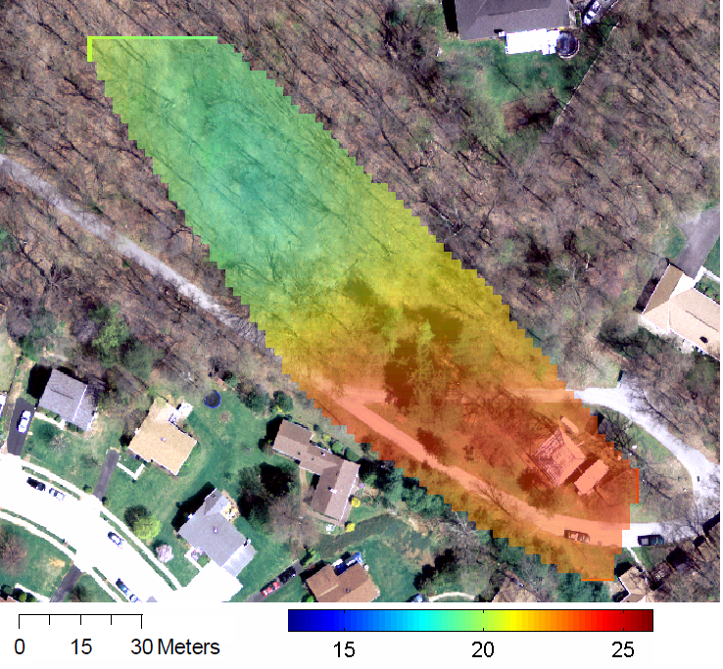
Understanding the Environment
Soil Temperature
Notes:
Sensor networks have proven to be very good instruments to collect data at relevant spatial and temporal resolutions. This is a soil temperature heat map interpolated over the space of interest using data collected by our sensor networks. So let me introduce the basics of environmental monitoring sensor networks.

Slide 7
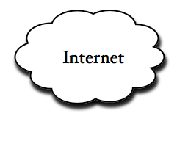
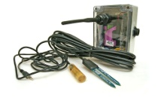
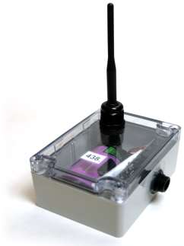
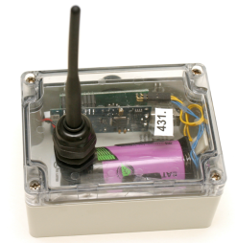
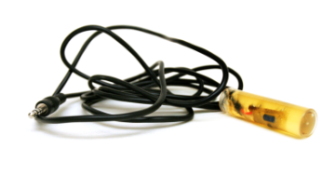
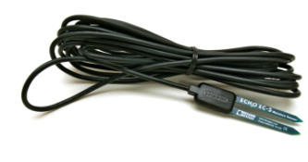
A Typical Sensor Network
Stable
Storage
Gateway/
Basestation
19 Ah
….
R. Musaloiu-E, C.-J. M. Liang, A. Terzis, Koala: Ultra-Low Power Data Retrieval in Wireless Sensor Networks, IPSN 2008
Notes:
These motes are packaged and made water tight. External sensors are then connected and this assembly is placed into the environment of interest. The nodes keep collecting data and logging it to their local flash.
Periodically (once every few hours), a basestation, which is a PC class device wakes them up and requests for all the outstanding data. The motes form a multi-hop network and deliver the data to the basestation using a reliable end-to-end connection. The motes go back to sleep once they have sent the data. The basestation, in turn, ships to a remote database using the internet.
In a nutshell, the advantage of using SN is that you get programmability, you can connect whatever sensors you want, you can form an end to end solution and it is economically viable at scales that match the need of the environmental scientists.

Slide 8
Requirements: Long Term Environmental Monitoring
Expected Lifetime : One year or more
Powered using batteries [~ 19 Ah]
Data Latency : One week or less
Operate unattended for weeks to months
Timestamping Measurements : UTC, second accuracy
Notes:
- So, lets look at the high level requirements for long term environmental monitoring using Sensor Networks.
- The network and motes are expected to last for a period of a year or more using batteries.
- The collected data should be made available to the scientists with a latency of one week or less.
- These networks should be able to operate unattended for weeks or months. For example, if the basestation fails, the motes should still be able to collect data and store the data in their flash. Eventually when the basestation recovers, this data should be made available to the scientists. - Finally, each measurement should be assigned a consistent, unique, universal timestamp.

Slide 9
Dissertation Goals
Design of
Data Processing
Pipeline
Measurement
Timestamping
* Sundial * Phoenix
Data Driven
Data Collection
Notes:
With that introduction, I will now talk about the contribution this dissertation makes: First I will talk about the design of an end to end data processing pipeline to store sensor measurements. Second, I will talk about the challenge of assigning timestamps to measurements, and lastly, I will talk about using the correlations in the data to guide the data collection process.

Slide 10
Data Processing Pipeline Design
Jayant Gupchup, Răzvan Musăloiu-E, Marcus Chang, Alex Szalay, Katalin Szlavecz, Andreas Terzis.
Deploying Advanced Wireless Sensor Networks for Ecological Monitoring,
Proceedings of the Microsoft eScience Workshop 2008

Slide 11
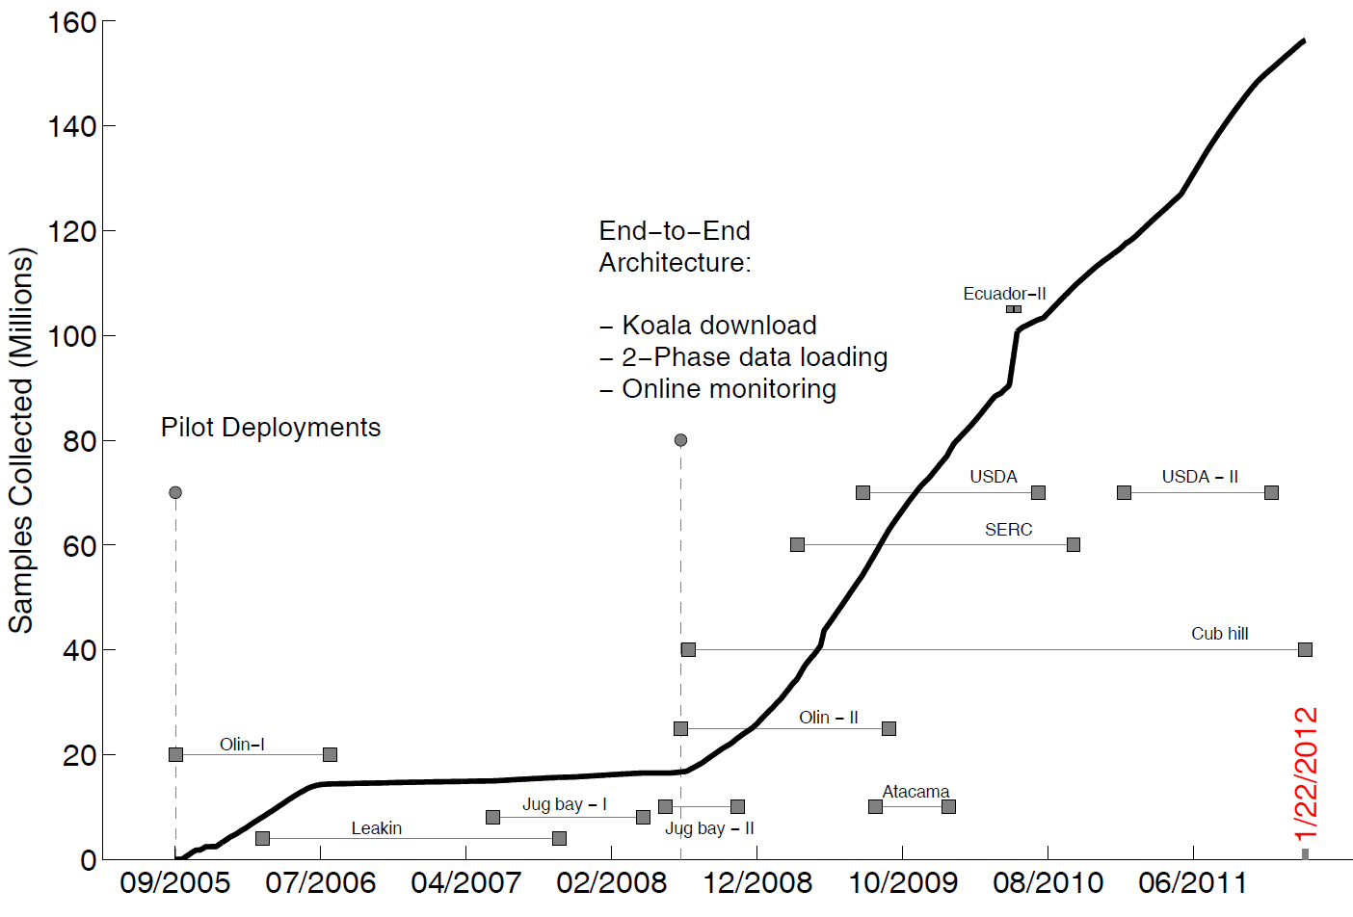
Data Collected So Far …
Notes:
So I thought I’d begin by showing you the history of the amount of data the life under your project have collected so far. The Y-axis shows the number of samples collected. Up until July 2008 we had proof-of-concept pilot deployments. In 2008, using the lessons learned, we designed an end to end system. This was what really lead to our ability to scale up and collect the high volume of data we have collected.
All the collected data was stored in a SQL database

Slide 12
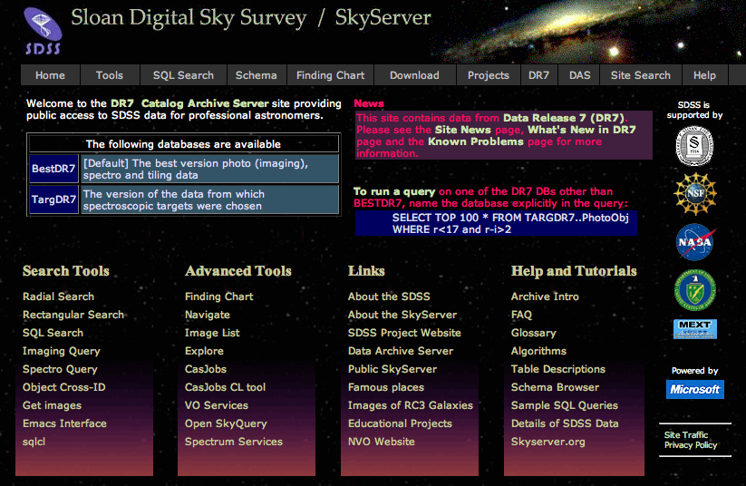
Original Database Design
Alex Szalay and Jim Gray
Based on the SDSS and SkyServer Experience [1]
Modularized components, retrace steps, reprocess from raw data
End to End Design [my contribution]
Protocol for basestation to talk directly to DB
Support for multiple deployments
Design Schema to store
Measurements as stored on mote’s flash
Summary information about network health
Network links and paths used to download data
[1] : http://skyserver.sdss.org/public/en/
Notes:
The original database design to store the data for these pilot deployments was developed by Alex Szalay and Jim Gray based on their Skyserver experience. There was a strong emphasis on modularizing components so that all the processing steps could be retraced and replaced if necessary.
My contribution was to design a protocol so that the basestation and the database could talk directly. Second, Extend the database so that is supports data from multiple deployments and third design a schema that stores raw measurements, health information and networking information.

Slide 13
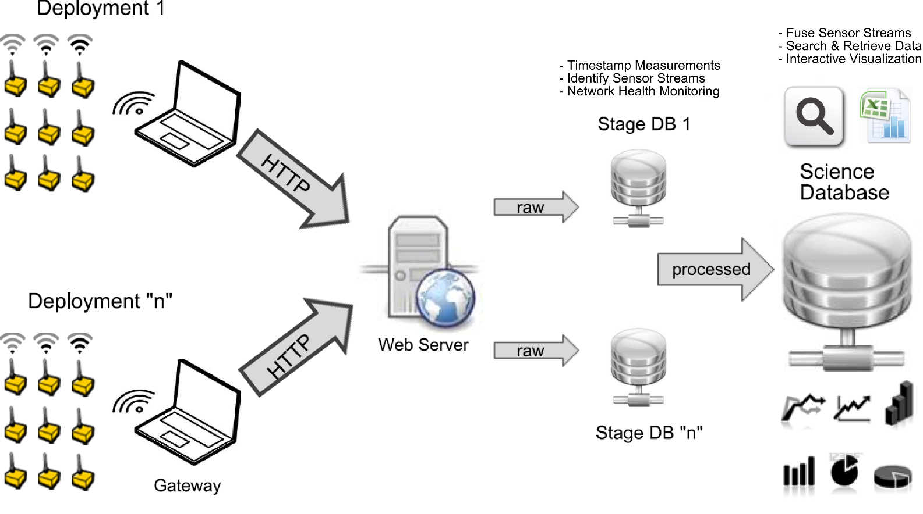
End-to-End Architecture (2008)
Notes:
The overall end-to-end architecture looks like this. The data loading happens in 2-phases. Data from each deployment first flows into the stage database. Here, the raw sensor streams are identified, timestamped and transformed into a timeseries. This data is then pushed into a unified science database where it is resampled, indexed and presented to the scientists. I would like to now talk a little bit about the application that transfers data from the basestation to the database.

Slide 14
Reliable Transfer of Data
Requirements:
Transfer data from multiple deployments
Incremental transfers [Outstanding data only]
Robust to basestation failures and DB failures
Authenticate transfers to validate source
Notes:
The requirements are as follows. Data from multiple deployments needs to be transferred. Only the outstanding data should be transferred. The application should be robust to basestation failures and the transfer should be authenticated.

Slide 15
Upload Application
On Web Server
1a
GetLastDownload
(deployment name)
Basestation
Status Checker
<box 1, flash addr 1>
<box 2, flash addr 2>
…………
3
2
Parser
Database Inserter
D, F(D+K)
4
Validate D
5
5
1b
File Stored
on Server
Database
Notes:
The goal of the protocol is to synchronize the data the basestation cache and the database.
There are three main entities – the basestation, the webserver and the database.
The process is initiated by the basestation when it has some new data.
The basestation contacts the webserver with the deployment name and asks the server how much data it has knowledge about. The webserver forwards that request to the database.
The database puts together a list of motes and the last record number for that mote.
This information gets sent back to the basestation. The basestation is now able to assess what it needs to send to bring the database up to speed.
It puts together a file with all the outstanding records. It also computes a signature. This signature contains the hash of the data and a shared secret key.
The data and signature are sent to the webserver. The webserver recomputes the hash of the data and the known secret phrase to validate the data.
Once the data has been validated the file is stored on the server and the outstanding records are inserted into the database.

Slide 16
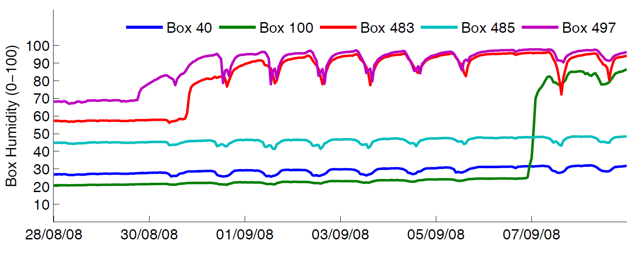
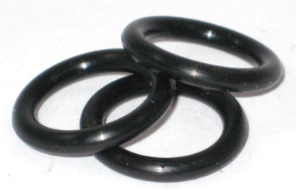
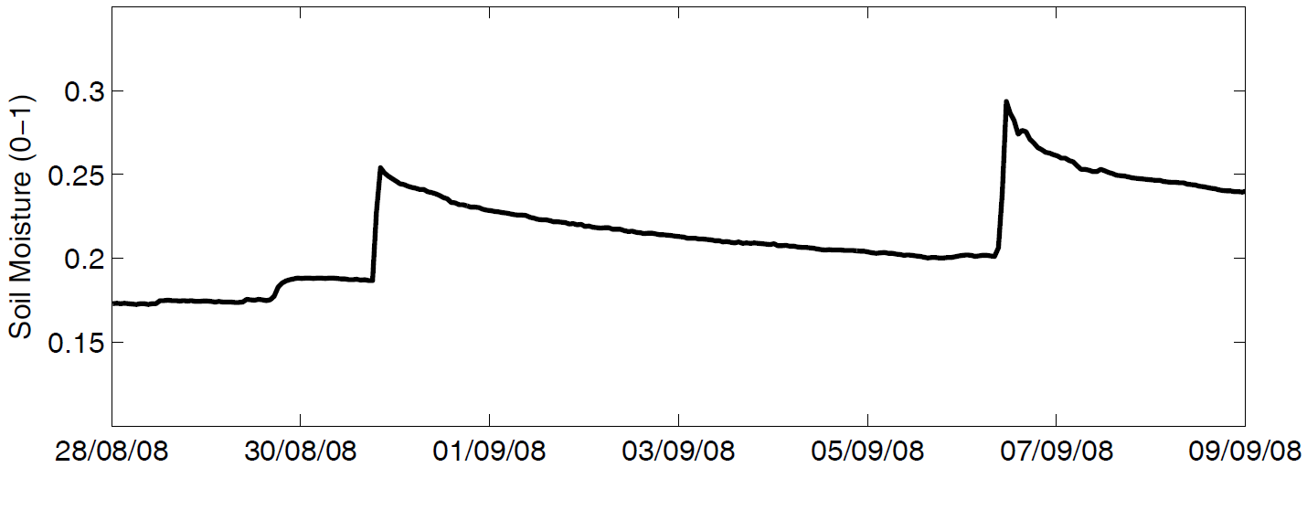
Monitoring
Notes:
One of the things the end to end system allowed us to do was monitor the network regularly. So I wanted to finish this part by presenting an example of a failure that was caught pretty early on. This is data from August 2008 when we just started with the end-to-end system.
The plot at the bottom shows soil moisture and these spikes correspond to rain events. Now, whenever we had big rain events moisture levels inside the box would jump up. For example, the box humidity here goes from nearly 20 to 70 and some boxes are operating at saturation.
This was leading to standing water in the boxes and shorts causing motes to reboot and fail. It turned out that the problem was due to an o-ring that was placed at the wrong location. One we fixed this problem, failures due to moisture in the box went down drastically.

Slide 17
Measurement Timestamping
Notes:
Now, I would like to talk about the challenge of assigning timestamps to sensor measurements

Slide 18
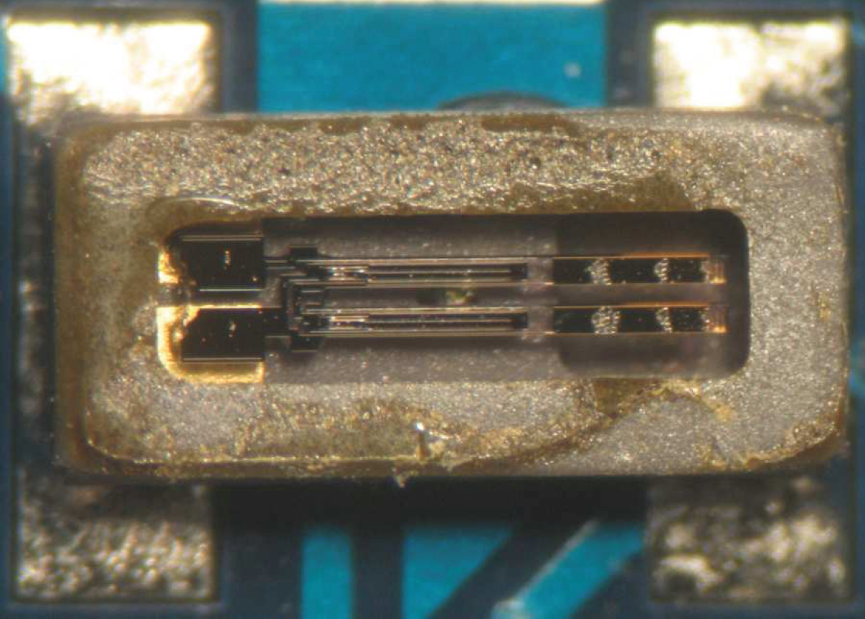
Timing in WSNs
Motes Local Clock
32 kHz quartz crystal
~ 10 – 20 μW
Not a real-time clock
Typical Skews Observed
<1 yr old : 10 – 20 ppm
> 3 yrs old : 60 – 120 ppm
Thomas Schmidt, http://tschmid.webfactional.com/documents/29/
Notes:
Time is kept using the motes local clock. It is a 32 Khz quartz crystal and consumes very little power. In fact, the power consumption scales linearly with frequency which is why a 32 Khz clock is chosen instead of something in the Mhz range. It is not a real-time clock which means that it resets when the device reboots and the typical skews depends on things like the cut and the age of the crystal etc. In our deployments we have seen skews as low as 10 ppm and as high 120 ppm.

Slide 19
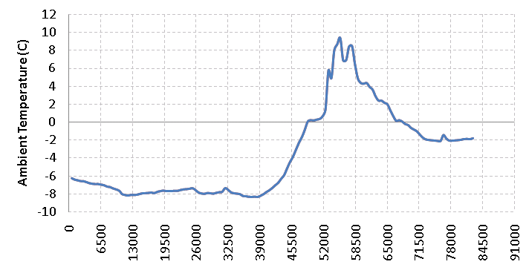
Post Facto Timestamping
Local Clock Ticks
DateTime /
Universal Clock
Notes:
Data is collected and timestamped using the motes’ localclock. In this figure, the x-axis shows the local clock ticks.
A lot of applications such as target tracking employ an in-network time synchronization solution. This requires keeping the radio on all or most of the time for receiving timing packets. They do this because they want accuracy in the order of microseconds.
We, on the other hand, employ a post mortem or post facto timestamping solution where the measurements are assigned a universal timestamp outside of the network. This is done for three reasons – to keep things simple, low power and because accuracy of seconds is acceptable.

Slide 20
Post Facto Approach
Network Time
Protocol Service
Local time
Data
…
Data
Data
Local time
Mote ID : 12
12, <local time₁, global time₁>,
12, <local time₂, global time₂>,
. . .
. . .
12, <local time_{N}, global time_{N}>
“Anchor Points”
Notes:
Lets look at how this process works. Recall that the basestation periodically requests the motes for the outstanding data. Once the data is transferred, the mote sends a packet containing its current local time. When this packet arrives, the basestation uses its system clock and records the global time. A list of such reference points or anchor points are recorded and they are used to translate the measurements. The basestation itself is synchronized using a protocol known as network time protocol. Please note that we are ignoring the delay in wireless communication and interrupt handling because these delays are in the order of milliseconds.

Slide 21
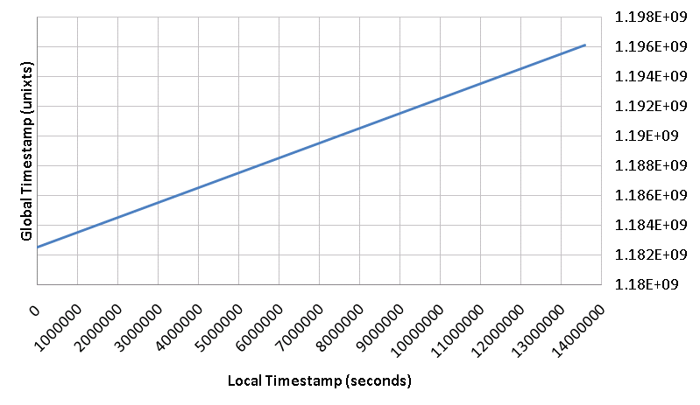
Assigning Global Timestamps
^ ^
GTS = α . LTS + β
“α” (slope) represents
Clock-skew
<LTS, GTS>
“Anchor Points”
“β” (intercept) represents
Node Deployment time
Notes:
Local timestamps and global timestamps are related linearly. These represent the anchor points. Alpha represents the clock skews and beta represents the node deployment time. We use linear regression to estimate alpha and beta.

Slide 22
Timestamping Failures & Challenges
Motes reboot [Indeterminate downtime]
Motes skew changes over time
Basestation can fail
Nodes become disconnected from the network
Basestation clock (global clock source) could have an offset/Drift
Notes:
Okay, so what are the challenges. Failures can happen in unpredictable ways. In our networks, we have seen all of these. Motes reboot and stay down for an indefinite amount of time. Motes skew changes over time. The basestation can fail. The node can get disconnected or cut off from the network. The basestation clock has a drift which corrupts the anchor points.

Slide 23
Leakin Deployment : Motivating Example
The Situation:
Some anchor points were corrupt
Large segments for which there were no anchor points
Can we use the data to reconstruct the measurement timeline ?
Notes:
Here is a real example. Figure shows data from two nodes. In April these nodes are in sync but in Jun, they are out of synch. Some of the anchors were corrupt and there were large segments for which there were no anchor points at all. We were looking for a way to recover from this and started wondering if we could use the data itself to achieve temporal integrity.

Slide 24
Sundial
Jayant Gupchup, Răzvan Musăloiu-E, Alex Szalay, Andreas Terzis.
Sundial: Using Sunlight to Reconstruct Global Timestamps,
6th European Conference on Wireless Sensor Networks (EWSN 2009), Cork Ireland
Notes:
It turns out that the answer is yes. I will now talk about our work titled sundial which was published and presented in the 6th european conference on wireless sensor networks in Ireland. We began by starting to look at whether we can get some information from light measurements

Slide 25
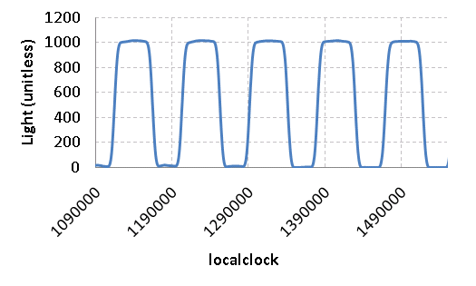
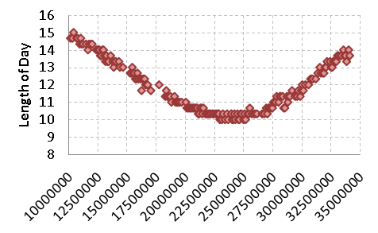
Process Light Measurements
Noon
Length of day (LOD)
Noon [Local clock ticks] →
Notes:
The light measurements collected using the on-board light sensor is shown in the figure. The sensor is very sensitive and is easily able to pick up on the sunrise and sunset. Notice that the x-axis has the local clock because these are collected in terms of the local clock. The difference between sunrise and sunset is the length of the day and the mid point is noon. From this we can construct a figure like this. The x-axis is the noon in terms of the local clock and the y-axis is the length of the day.

Slide 26
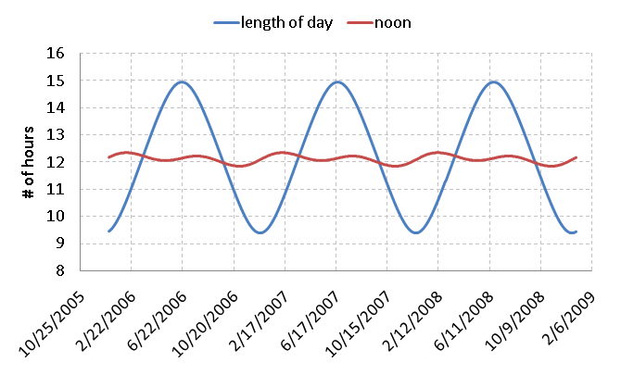
Annual Solar Patterns
<LOD, noon> = f (Latitude, Time of Year)
Notes:
We know from theory that the annual solar patterns are well defined. Given the latitude and time of year, the length of day and noon is fixed. This figure shows the length of day and noon for Baltimore for three years. It is periodic because the pattern remains fixed from one year to the next.

Slide 27
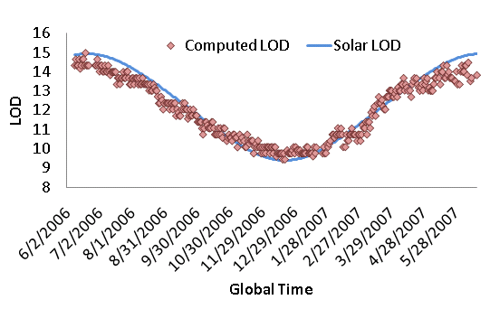
Sundial : Anchor Points
argmax _{lag} Xcorr (LOD _{lts}, LOD _{gts}, lag)
Local Noon | Global Noon
Lts ₁ | Gts ₁
Lts ₂ | Gts ₂
… | …
… | …
Lts _{n} | Gts _{n}
For each data point:
Look up local noon and global noon
“Anchor Points”
Notes:
So we can now correlate this length of day signal with what is obtained from the almanac. We try to obtain a lock so that the two signals are aligned as best as possible. After the alignment, we pair up the noon in terms of the local clock and global clock for each data point. These pair are the anchor points needed to compute the skew and offset.

Slide 28
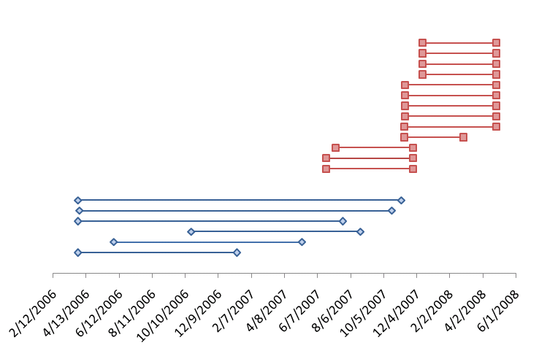
Evaluation
“Jug bay” Deployment
Telos B motes
30 minute sampling
13 boxes
Max Size : 167 days
“Leakin” Deployment
MicaZ motes
20 minute sampling
6 boxes
Max Size : 587 days
Notes:
The evaluation was done using data from two deployments. The leakin deployment consisted of 6 boxes and the jug bay deployment consisted of 13 boxes. The sampling rate for both these deployments was different and they also used different hardware platforms (different crystals)

Slide 29
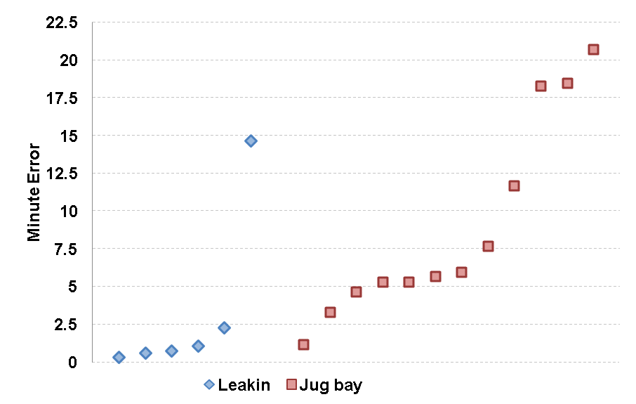
Reconstruction Results (RMSE)
Notes:
For both the deployments, the minute error was within one sample period. The max error for leakin was around 15 and for jug bay was around 20

Slide 30
Discussion
Sun provides a natural time base for environmental processes
LOD and Noon metrics : Validate timestamps
Applied to nearby weather station
One month in December when time was off by an hour
Does not work well for segments that are small
Can we design a system that is
Low Power
Robust to random mote resets
Tolerant to missing global clock sources for ~ days
Notes:
The sun provides a natural time base for environmental processes as most variables vary with the solar cycle.
The LOD and Noon metrics proved to be useful to validate timestamp assignments. At one point, we were correlating some of our data with data obtained from a nearby weather station and we found that the data was not correlating as well as we expected. When we applied the noon metric to the light data of the weather station, we found that its timestamps were off by an hour in one month of December.
One short coming of Sundial is that it does not work well for segments that are small. Sundial is good if there are long segments for which no anchors are available but it is not good if motes are rebooting every 4-5 days.
So instead of a reactive solution, we then started looking for a proactive solution that is low-power, robust to random mote resets and tolerant to missing global clock sources for ~ days.

Slide 31
Phoenix
Jayant Gupchup, Doug Carlson, Răzvan Musăloiu-E, Alex Szalay, Andreas Terzis.
Phoenix: An Epidemic Approach to Time Reconstruction.
7th European Conference on Wireless Sensor Networks (EWSN 2010), Coimbra, Portugal
Notes:
We call this solution Phoenix. It was published and presented at the 7th european conference on wireless sensor networks in Portugal.

Slide 32
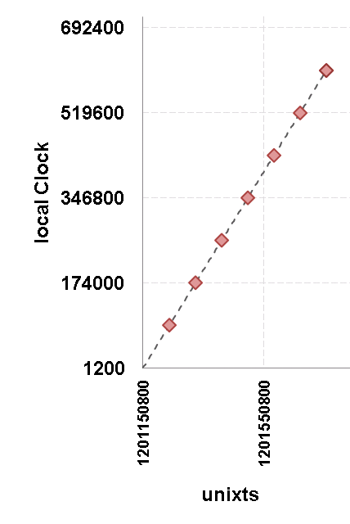
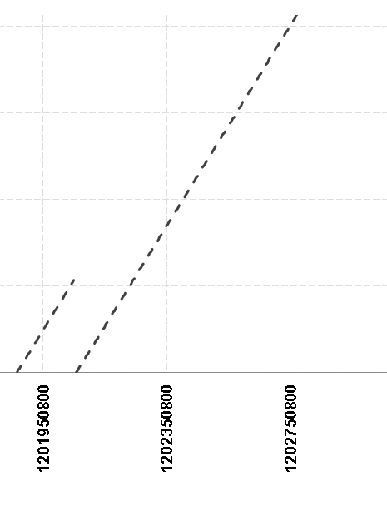
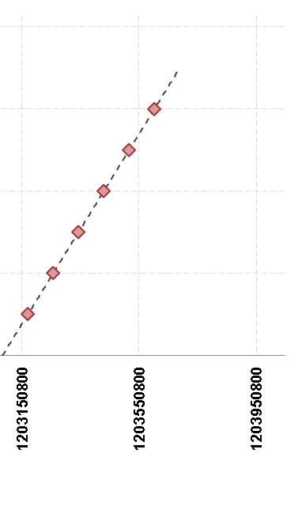
Reboots and Basestation
? ? ?
Notes:
Lets look at why reboots cause problems. Lets consider a segment when the basestation is present. Now the node reboots a couple of times and the basestation has failed during this time. At some point later the basestation comes back again and we are able to timestamp measurements. This period in the middle Is what poses the problem. We are unable to collect anchor points during this period.
Also, the down time might be indefinite. These situations were not uncommon. We actually saw them in practice in our Cub hill deployment

Slide 33
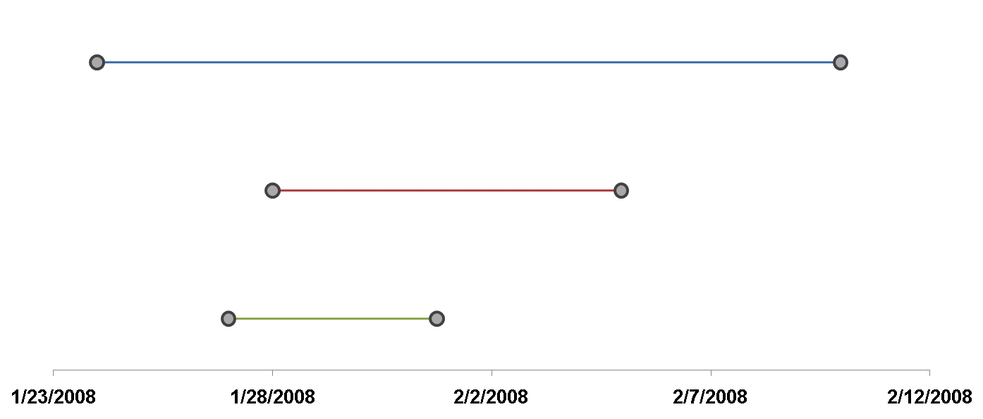
Big Picture
1
χ = 3
<local, local>
<local, global>
2
<local, local>
3
Base Station
Notes:
Let me talk about the high level approach first and then I’ll describe the details.
Segments 1,2 and 3 and the basestation is present only during this time. Timestamps for 1 can be translated because anchor points can be collected but timestamps for 2 and 3 cannot be translated using the classic approach.
If we know the relationship between 1’s local clock and 2’s local clock, 2’s timestamps can be translated by transitivity.
This logic can be applied recursively and if we knew the relationship between 2’s local clock and 3’s local clock, 3’s timestamps can be translated.
These are local, global anchors and the linear fit produced by these anchors is a local, global fit. This fit is known as a local, local fit and the relationship is established by collecting local, local anchors. Each fit has a goodness of fit associated with it. We use the variance of the residual as a measure of the goodness of fit. The main intuition of this approach is that these segments are created because motes reboot and mote reboots are more or less independent from the reboots of another mote so we can leverage that.

Slide 34
Phoenix: 2-Phase
Phase-I : Data Collection
(In-network)
Phase-II : Timestamp Assignment
(Database)
Notes:
There are two phases to Phoenix. The first phase is a data collection phase which happens in-network. The second phase happens outside the network and the in-network data is used to obtain global fits so that timestamps can be assigned to the measurements

Slide 35
Anchor Collection – I : Beaconing
Each Mote:
Beacons time-state periodically
<moteid, RC #, LC>
Beacon interval ~ 30s
Duty-cycle overhead: 0.075%
28 | 3 | 9600000
28
97 | 7 | 3600
43 | 5 | 102400
97
43
Notes:
Each mote beacons its time state periodically. The state consists of the mote id, reboot counter and its local clock value. The beaconing interval is 30s so it wakes up every 30s and broadcasts this value. This broadcasting results in a duty cycle overhead of 0.075%.

Slide 36
Anchor Collection – II : Storage
Each Mote:
Stays up (30s) after reboot
Stays up periodically (~ 6 hrs)
Listens for announcements
Stores <local, local> anchors
Duty-Cycle : 0.14%
Space Overhead : 5%
28
97 | 7 | 3800
43 | 5 | 102800
97
43
Notes:
Motes also stay up 30s to catch these announcements. They stay up after every reboot and after every 6 hours. When they hear an announcement, they store its time state and the sender’s time state in its flash as a local neighbor anchor. This process incurs a duty cycle overhead of 0.14% and a space overhead of 5%

Slide 37
Anchor Collection – III : Global References
28 | 4 | 102435
28 | 4 | 102455, 1217351879
← Local timestamp
← Global timestamp
97 | 7 | 4000
G-Mote:
Connected to a global clock source
Beacon its time-state (30s)
Store Global References (6 hrs)
Global clock source
(GPS, Basestation etc)
97
43
Notes:
One or more motes in the network has access to the global time (this could be the basestation or a GPS mote or whatever). The role of this mote is to collect global time references and store it in its flash. This mote beacons its time state just like other motes and also collects global references and stores it in its flash.

Slide 38
Time Reconstruction (outside the network)
28-4
(G)
<Global Fit>
28-4
(G)
χ = 2
χ = 7
97-7
(A)
97-7
(A)
43-5
(B)
43-5
(B)
<Global Fit>
χ = 2.5
<Global Fit>
Notes:
- This is how the time reconstruction works. All the anchor information stored on the motes flash is retrieved by the basestation. Say we have three segments (mote 28 at rc 4 ,…). Let 28 have access to the global time.
During their active lives these segments have exchanged local neighbor references with each other so we can obtain the local, neighbor fits. The edge weights represent the goodness of fits.
Since 28-4 has collected <local, global> timestamps, it is the first one to get a global fit. We can then use the local fit between 97 and 28 to get a global fit for 97-4. Similarly we can obtain a global fit for 43-5.
Conceptually, this is a shortest path problem where we want to compute the shortest path from every vertex to a node with the global fit. The shortest path for 43-5 may be via A.
The other thing to observe that there are a combinatorial number of paths available to this node. Therefore the failure probability (or the probability of not finding a path) is very low.

Slide 39
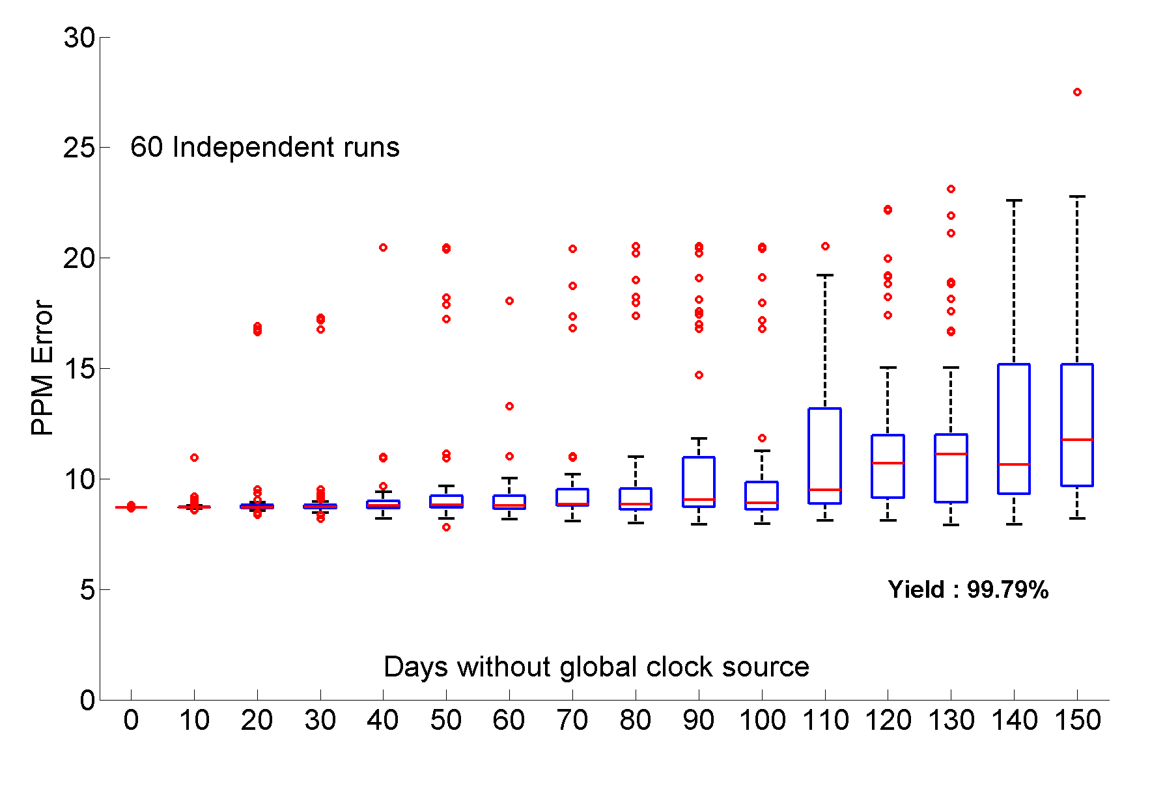
Simulation: Missing Global Clock Source
Simulation Period : 1 Year
Notes:
Phoenix was evaluated in Simulation and in real deployment. Here I wanted to present the impact of a missing global clock source. The x-axis shows the days without a global clock source and the y-axis shows the error in PPM.
Even when the global clock source was missing for days, the PPM error remains within reasonable limits. A more significant result was that the yield (fraction of measurements that can be assigned timestamps) was in excess of 99%.

Slide 40
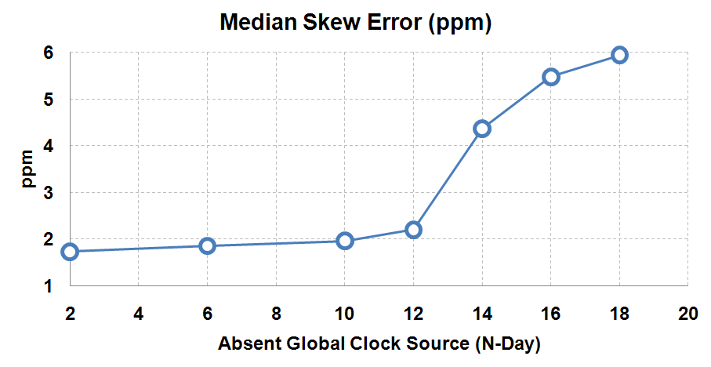
Deployment Accuracy
Notes:
In deployment, wven with 18 days of no global clock source the PPM error was less than 6 PPM. This means that in a million seconds which is roughly 11.5 days. The error is 6 seconds.

Slide 41
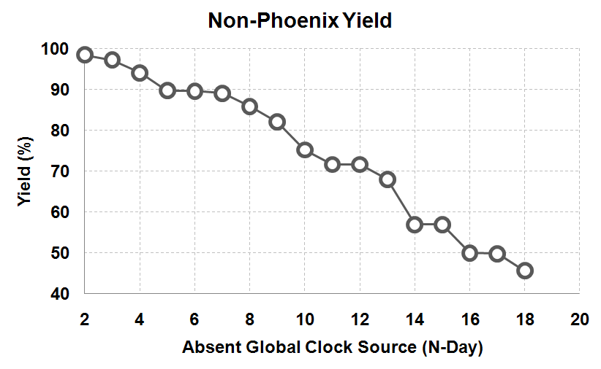
Naïve Yield Vs Phoenix Yield
Phoenix Yield: 99.5%
Notes:
This shows the yield (the fraction of measurements that can be assigned timestamps) if we had use the classic approach. The yield drops as the number of days without a global clock source increases. When the global clock is absent for 18 days, the yield is as low as 40% whereas Phoenix consistently maintained a yield in excess of 99%

Slide 42
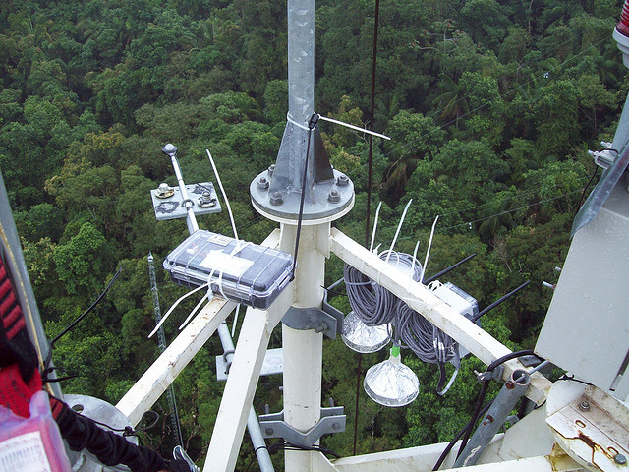
Brazil Deployment
Doug Carlson, Jayant Gupchup, Andreas Terzis, Rob Fatland.
K2: A System for Campaign Deployments of Wireless Sensor Networks.
In proceedings of REALWSN, 2010
Notes:
So, I wanted to finish this part by giving you an anecdote of our brazil deployment where we collected temperature data at different levels of the forest canopy. This was the GPS mote and this was our sensing nodes. An interesting story was that our GPS motes got held up brazil customs. So, out of the 4 weeks, we had them only for 1 week but phoenix was able to timestamp more than 99% of the data.

Slide 43
Data Driven Data Collection
Notes:
This brings me to the last part of my talk where I’ll talk about using correlations in the data to reduce the amount of data that needs to be collected resulting in energy savings.

Slide 44
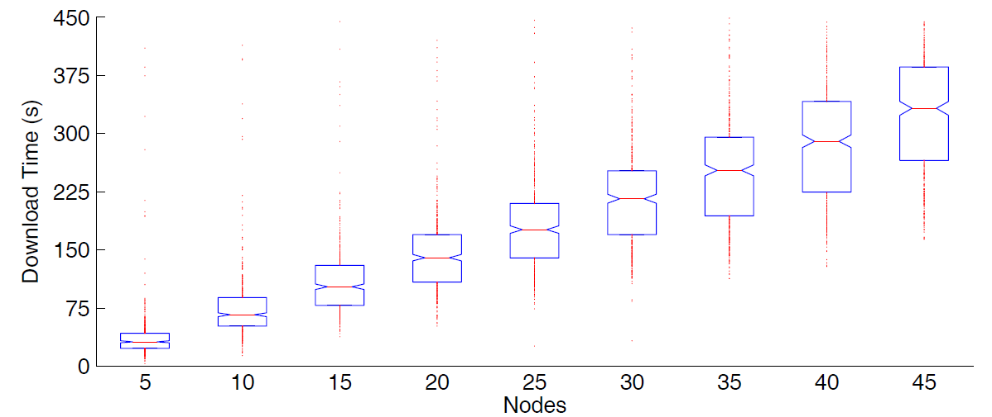
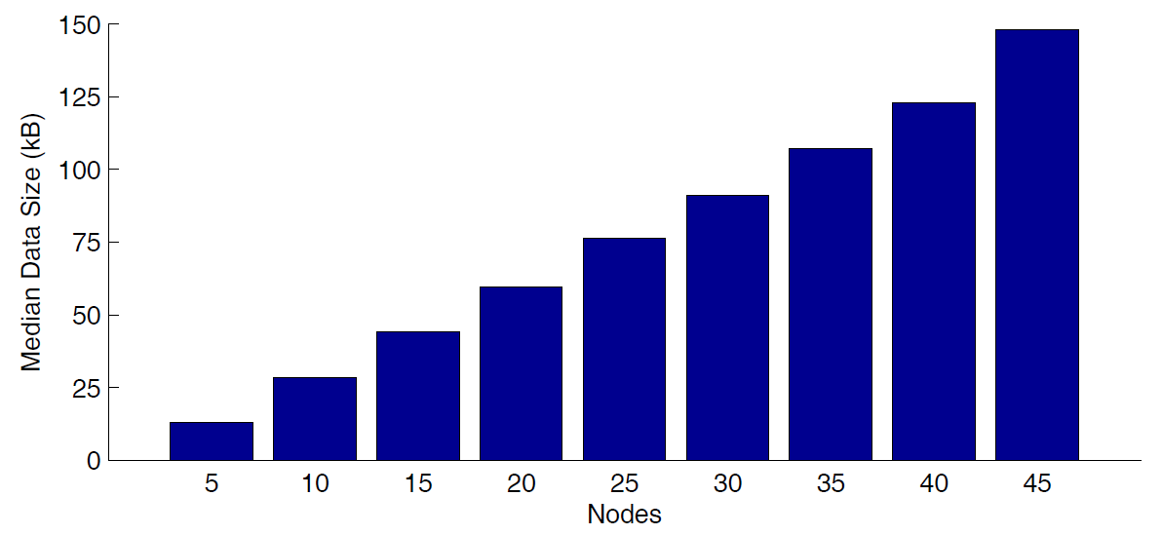
Energy in Data Transfers
Bulk Download Every 12 hours
Summary Information
Measurement Data
Link Information
Cub Hill duty cycle : 3%
Notes:
The biggest consumer of power in motes is the radio.
Transferring the outstanding data from all the motes requires the radio to be on for long periods of time. Download protocols such as the one we use require all the motes to keep their radio on until all the outstanding data has been downloaded from the network.
The energy consumed scales linearly with the amount of downloaded data. Currently at our Cub Hill deployment, the radios are kept on 3% of the time.

Slide 45
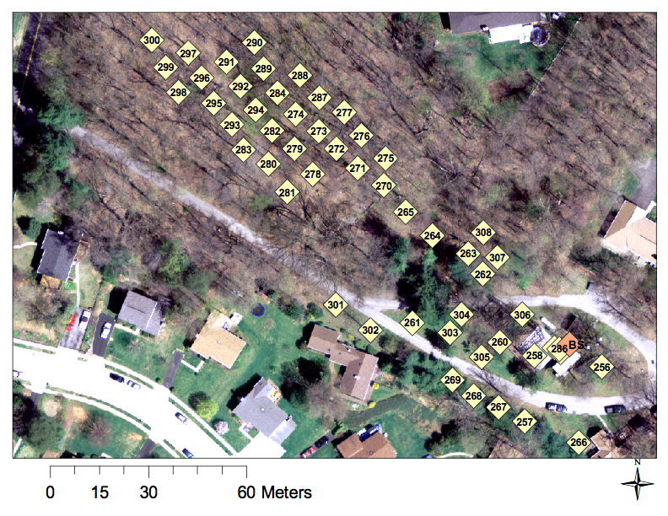
Cub Hill Deployment
Notes:
The Cub hill deployment map looks like this. There are 50 sensing locations that are collecting soil temperature and soil moisture.

Slide 46
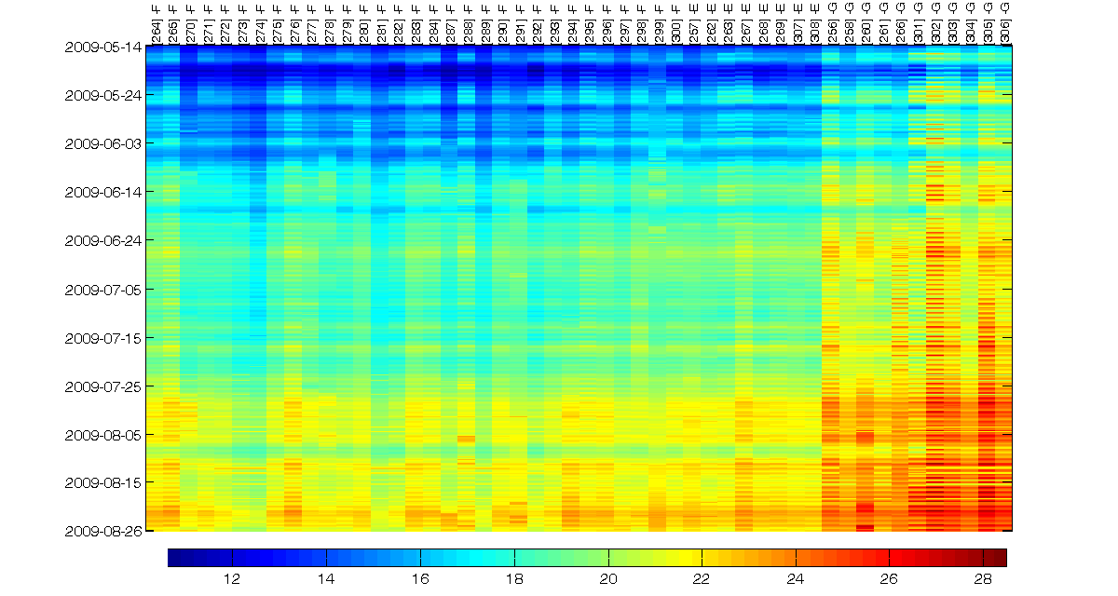
Spatiotemporal Correlations
Notes:
Here is the soil temperature data from these 50 locations. Time is running down this way. Each strip represents a location and the temperature is given by the color. The most striking thing about this plot is that the data is so strongly correlated in time and space. By the way these locations are ordered. These are the forest locations and these are the grass locations.

Slide 47
Question
Download data from everyone is expensive
The data shows a lot of correlations
Could the reduce the amount of data that needs to be downloaded without significant loss in information
Notes:
We’ve seen that downloading data from everyone is expensive and the data shows a lot of correlations. So the question is could we reduce the amount of data that needs to be downloaded without significant loss in information. In many applications, there are periods when you want data from all the locations but at other times an approximation is good enough.

Slide 48
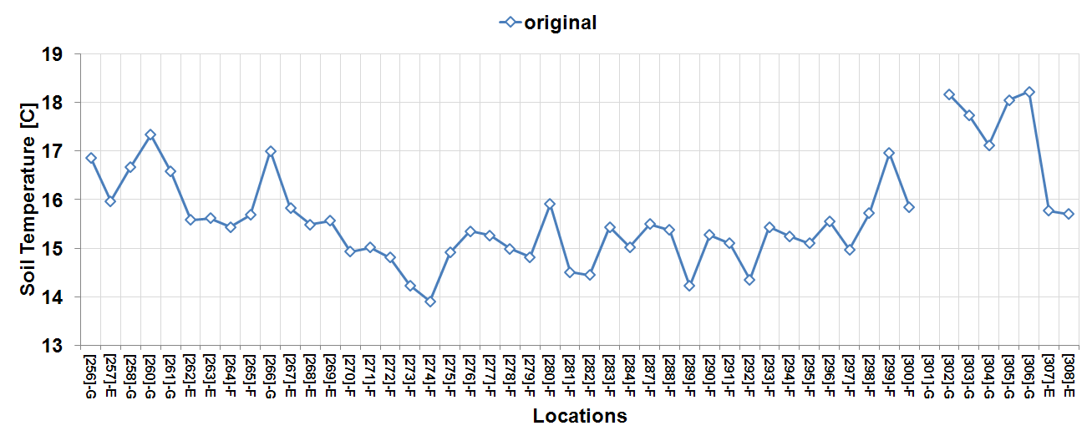
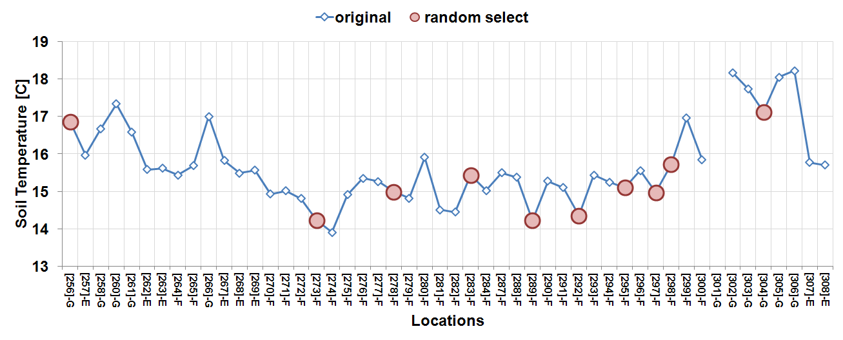
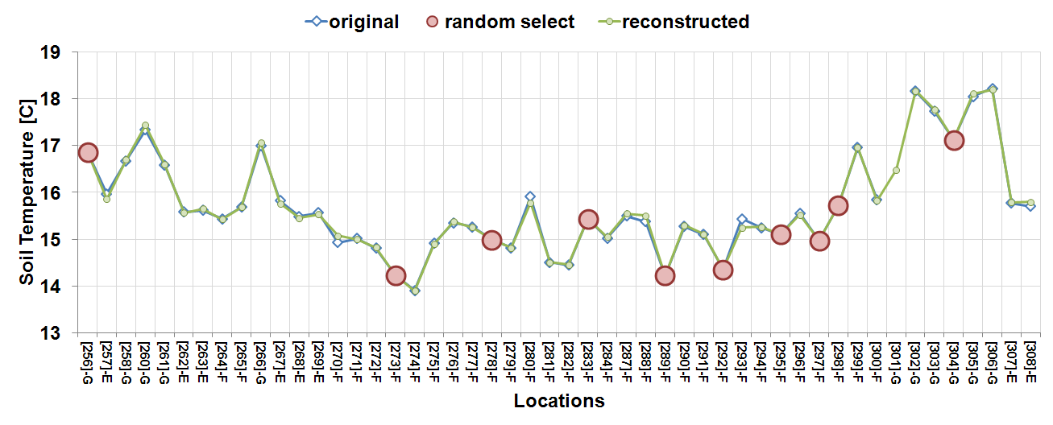
Motivating Example
Carl Edward Rasmussen. Gaussian processes for machine learning. MIT Press, 2006
Notes:
- So we started very simple. This is a snapshot in time (not timeseries).
We picked locations at random (given by these solid balls) and tried to use this data to predict values at other locations
The prediction was done using a standard method where the data is modelled as a multi variate gaussian
The gaussian is conditioned on the observed data and we can obtain mean and covariance matrices for the unobserved locations.
The predicted values track the original values quite well.
Of course, there are cases when this predictions are not good.

Slide 49
Informative Locations
Some locations are more informative than others
Pick locations that are able to predict values at other locations
W. F. Caselton and J. V. Zidek. Optimal monitoring network designs. Statistics and Probability Letters, 2(4):223–227, 1984
Andreas Krause, Ajit Singh, Carlos Guestrin, "Near-Optimal Sensor Placements in Gaussian Processes:
Theory, Efficient Algorithms and Empirical Studies", In Journal of Machine Learning Research (JMLR), vol. 9, pp. 235-284, 2008
Notes:
Then we realized that some locations are more informative than others. So then if we want to pick the top k locations, how do we go about finding these locations. One way to achieve this is to pick locations that are good at predicting values at other locations. Information gain or mutual information is a metric that captures this notion. So the idea is to find k locations that lead to the highest reduction in entropy at the other locations. This was first explored by caselton in zidek in 84 and then andreas krause in 2008.

Slide 50
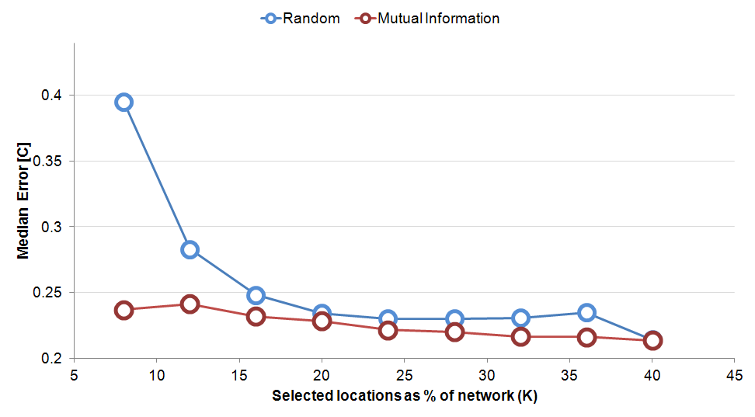
Compare with Random
Train Period : 2 days
Test Period : 7 days
Notes:
The first thing I wanted to establish is how the mutual information method compares with random.
I found that it is significantly better than random for small k. As the number of selected locations increases, the gap narrows.
2 days data was used to train and 7 days to evaluate.

Slide 51
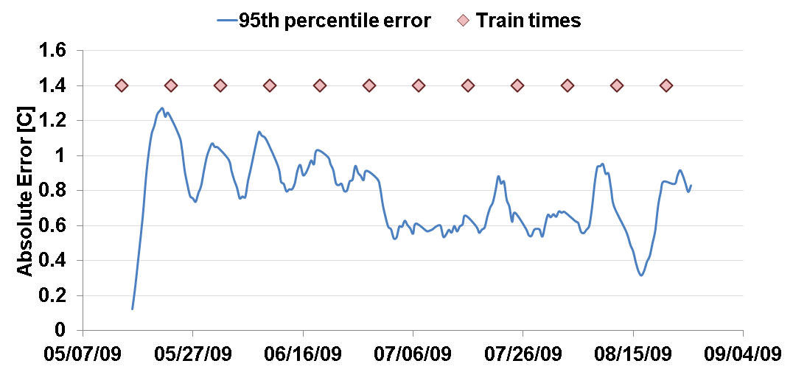
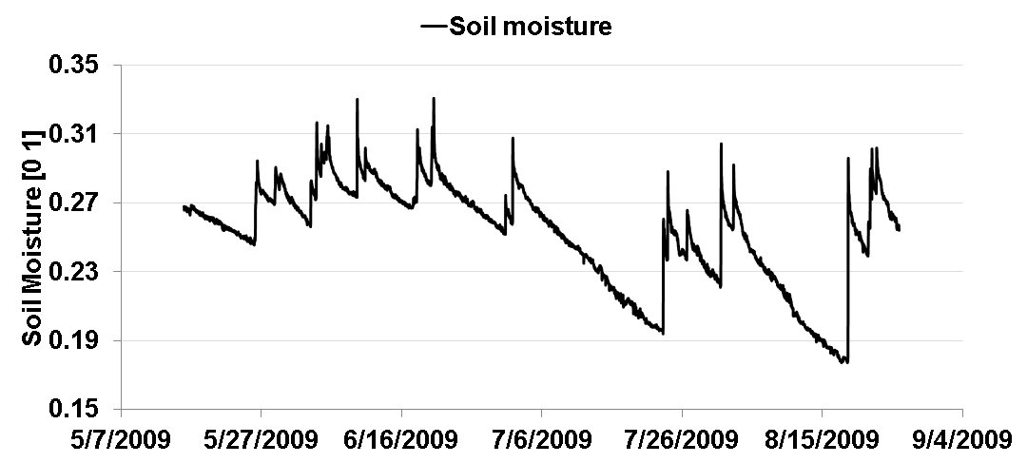
Error Pattern
Train Period : 2 days
Test Period : 7 days
Locations : 10
Observations
High Reconstruction error for period after rain event
Error grows as test period grows
Small number of locations with
large errors
Notes:
- Then I started looking at the error pattern over time.
- The plot shows the 95th percentile of the absolute errors. The diamonds mark the times when a full network download was done and the system was re-trained.
I correlated this pattern with rain events and found that the reconstruction error jumped up significantly after rain events.
Another observation was that the error grows as test period grows so towards the end of the test period the error is significantly higher than at the beginning. This is because the updates are not being done regularly.
The third observation, which I have not shown in this figure is that there were a small number of locations with large errors. The intuition is that these are locations that are not well predicted by the working set and have different characteristics and features.

Slide 52
Improvements
Send hourly snapshots / updates
Discover high error locations
Use hourly snapshots to compute prediction errors at each location
If more than ε% of prediction have error of δ or greater
(E.g. ε = 95%, δ = 0.5 C)
If above true, mark location
Download high error locations
Detect event and retrain
Download from all instrumented locations
Recompute the working set of informative locations.
Notes:
Based on these observations, a few changes were made to the basic approach. Hourly snapshots were used to update the mean and covariance matrices. Using these snapshots, the prediction errors were computer at each location. AT a given location, if more than epsilon % of the predictions are greater than a certain value, that location would be marked. Download data from those high error locations in addition to the working set and finally detect rain events and when these events are detected retrain. The retraining involves downloading data from all instrumented locations and re-computing the working set.

Slide 53
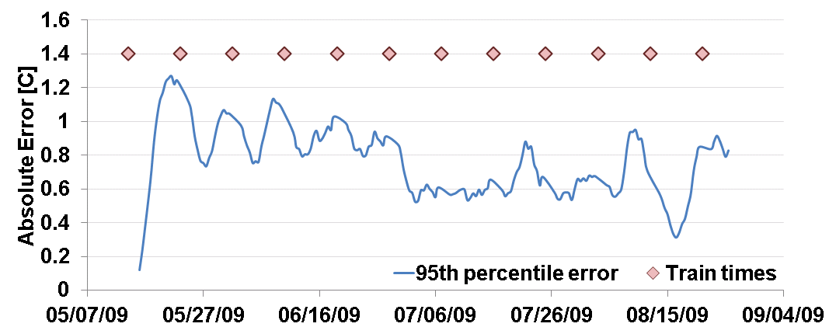
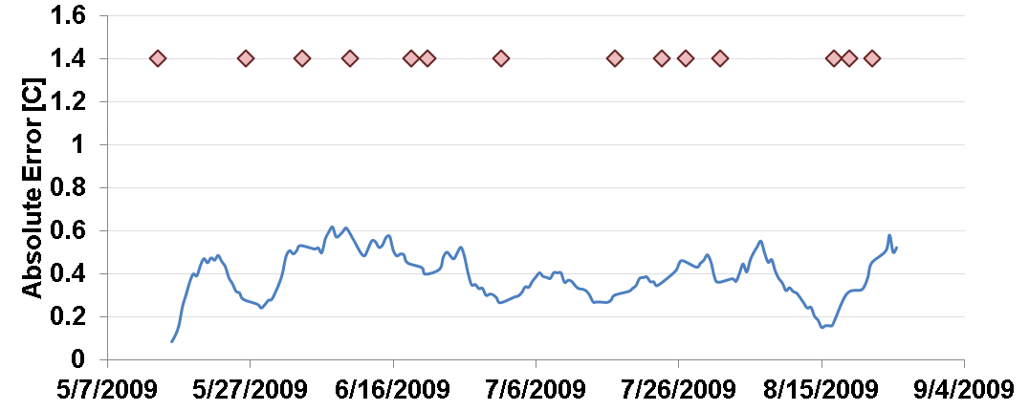
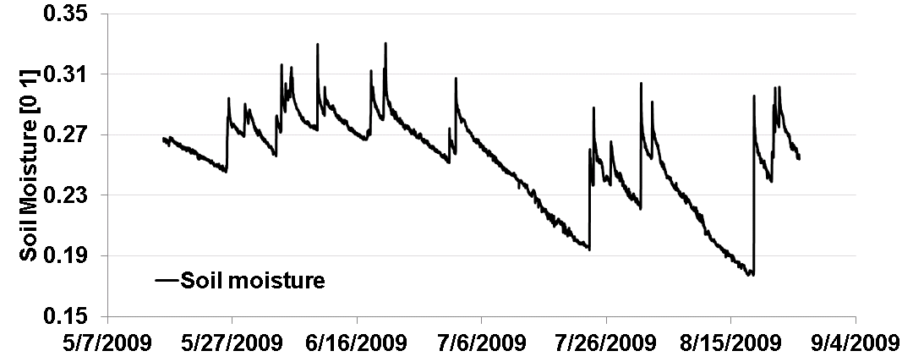
Results
Notes:
After making these changes, the results are significantly better. The 95th percentile error drops by more than 2 folds.

Slide 54
Reconstruction Error Vs Energy Savings
When 50% of data downloaded
Median Error : 0.068 C
20% Reduction in Duty Cycle
Notes:
After all this, one would like to know the tradeoff between reconstruction error and energy savings. On the x-axis I am showing the percentage of data downloaded which is a measure of the energy consumed. On the y-axis I am showing the 95th percentile of the reconstruction error. We see this diminishing returns behavior. After a point, the error starts to flatten out. When 50% of the data is downloaded, the median error is pretty low and the radios duty cycle is lowered by 20%.

Slide 55
Summary

Slide 56
Impact
Data Collection at relevant spatial and temporal scales
Integrity of assigned timestamps
Remove dependence on basestation
20% reduction in radio duty cycle using data driven downloads
Notes:
I’d like to finish by talking about some of the impact of this dissertation.
The end-to-end data processing pipeline has been a major piece in enabling environment scientists to collect and monitor data at relevant spatial and temporal scales.
The noon and length of day metric present a systematic way to assess the integrity of the assigned timestamps.
Phoenix enables networks to operate for days to weeks without a persistent basestation without losing data. This proved vital in our deployments in Brazil and Ecuador where a persistent basestation could not be set up and we could not afford to lose data.
Finally, using spatial correlations we can achieve up to 20% reduction in duty cycle without considerable loss in data quality.

Slide 57
Exciting Adventure
Notes:
So I was thinking about a good way to end this talk and

Slide 58
Support, Advising and Beyond …

Slide 59
For giving some purpose …

Slide 60
For making work fun …

Slide 61
For your mentorship

Slide 62
They should be thanking me …

Slide 63
Family & Friends
HiNRG, LUYF and eScience Teams
Parents
Friends in Baltimore
Cathy Thornton

Slide 64
Thank you and Questions!

