Slide 1
Pig Latin: A Not-So-Foreign Language For Data Processing
Chris Olston Benjamin Reed
Utkarsh Srivastava
Ravi Kumar Andrew Tomkins
Research

Slide 2
Data Processing Renaissance
Internet companies swimming in data
E.g. TBs/day at Yahoo!
Data analysis is “inner loop” of product innovation
Data analysts are skilled programmers

Slide 3
Type of processing for data analysis [My Slide]
Ad-hoc
Large data sets
Scan oriented
offline

Slide 4
Map Reduce V.S. Data Warehousing [My Slide]
Map Reduce | Data Warehouse
Easy to Code (programmers prefer this!) | Everything is a SQL query
Choice of language (java, python …) | Need to use T-SQL (not intuitive)
Parallelism is managed by system | Parallelism is tricky
Open source | Expensive (teradata, Netezza)
Code is difficult to reuse and maintain | Code can be reused
No self describing input/output formats | Formats are defined by schema
Joins are cumbersome | Joins are easy to do

Slide 5
New Systems For Data Analysis
Map-Reduce
Apache Hadoop
Dryad
. . .

Slide 6
Pig Latin … what? [My slide]
Pig “Latin” is the declarative language
Pig is the system that compiles this language down into Map Reduce / Hadoop

Slide 7
Map-Reduce
Input
records
k₁ | v₁
k₂ | v₂
k₁ | v₃
k₁ | v₁
k₁ | v₃
k₁ | v₅
Output
records
map
reduce
map
k₂ | v₄
k₁ | v₅
k₂ | v₂
k₂ | v₄
reduce
Just a group-by-aggregate?
SELECT key, F(value)
FROM Input
GROUP BY key

Slide 8
Example Data Analysis Task
Find the top 10 most visited pages in each category
Visits
Url Info
User | Url | Time
Amy | cnn.com | 8:00
Amy | bbc.com | 10:00
Amy | flickr.com | 10:05
Fred | cnn.com | 12:00
Url | Category | PageRank
cnn.com | News | 0.9
bbc.com | News | 0.8
flickr.com | Photos | 0.7
espn.com | Sports | 0.9

Slide 9
Data Flow
Load Visits
Group by url
Foreach url
generate count
Load Url Info
Join on url
Group by category
Foreach category
generate top10 urls

Slide 10
In Pig Latin [My Slide … somewhat]
visits = load ‘/data/visits’ as (user, url, time);
gVisits = group visits by url;
visitCounts = foreach gVisits generate url, count(visits);
urlInfo = load ‘/data/urlInfo’ as (url, category, pRank);
visitCounts = join visitCounts by url, urlInfo by url;
gCategories = group visitCounts by category;
topUrls = foreach gCategories generate top(visitCounts,10);
store topUrls into ‘/data/topUrls’;
Operate Directly over files,
Optional Schema
Track Progress,
High level (the WHAT not HOW)

Slide 11
Step-by-step Procedural Control
Target users are entrenched procedural programmers
The step-by-step method of creating a program in Pig is much cleaner and simpler to use than the single block method of SQL. It is easier to keep track of what your variables are, and where you are in the process of analyzing your data.
Jasmine Novak
Engineer, Yahoo!
With the various interleaved clauses in SQL, it is difficult to know what is actually happening sequentially. With Pig, the data nesting and the temporary tables get abstracted away. Pig has fewer primitives than SQL does, but it’s more powerful.
David Ciemiewicz
Search Excellence, Yahoo!
Automatic query optimization is hard
Pig Latin does not preclude optimization
Notes:
used to programming and or scripting languages

Slide 12
Nested Data Model
Pig Latin has a fully-nestable data model with:
Atomic values, tuples, bags (lists), and maps
More natural to programmers than flat tuples
finance
yahoo ,
email
news

Slide 13
Compilation into Map-Reduce
Map₁
Every group or join operation forms a map-reduce boundary
Load Visits
Group by url
Reduce₁
Map₂
Foreach url
generate count
Load Url Info
Join on url
Reduce₂
Map₃
Other operations pipelined into map and reduce phases
Group by category
Reduce₃
Foreach category
generate top10(urls)

Slide 14
Other Constructs [My Slide]
LOAD
queries = LOAD `query_log.txt‘ USING myLoad() AS (userId, queryString, timestamp);
FOREACH, GENERATE
expanded_queries = FOREACH queries GENERATE userId, expandQuery(queryString);
FILTER
real_queries = FILTER queries BY NOT isBot(userId);
FLATTEN
map_result = FOREACH input GENERATE FLATTEN(map(*));
STORE
STORE query_revenues INTO `myoutput‘ USING myStore();

Slide 15
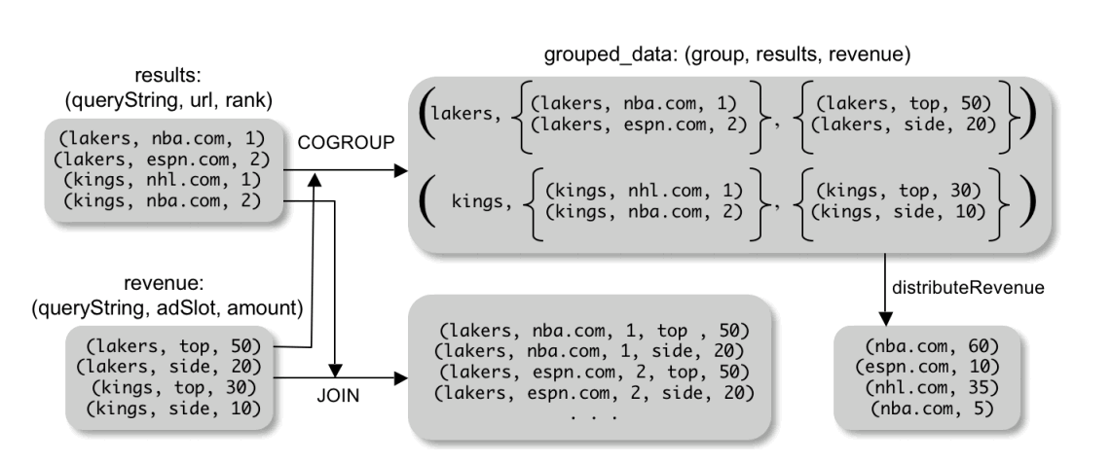
COGROUP [my slide]
If you want to aggregate top differently and side differently, this can
Be done here.
Cumbersome in SQL

Slide 16
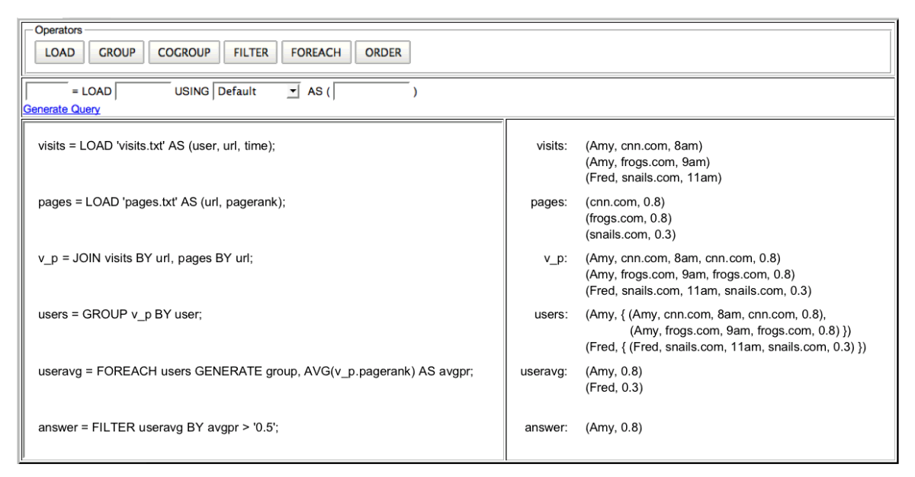
Pig Pen

Slide 17
Discussion
Not great for any kind of matrix/graph operations
Didn’t mention how PIG can be scripted
Useful for redoing processing
The process of obtaining the sandbox dataset is interesting

