Slide 1
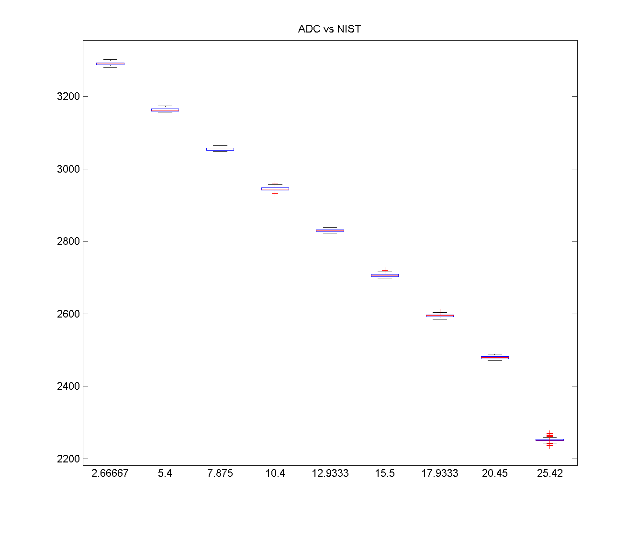
Set Up
NIST was validated
Using another
thermometer

Slide 2
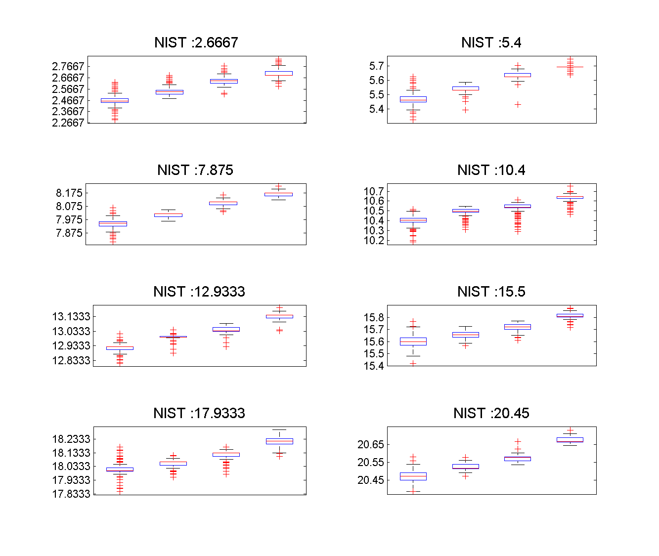
New Calibration
RMSE : 0.16

Slide 3
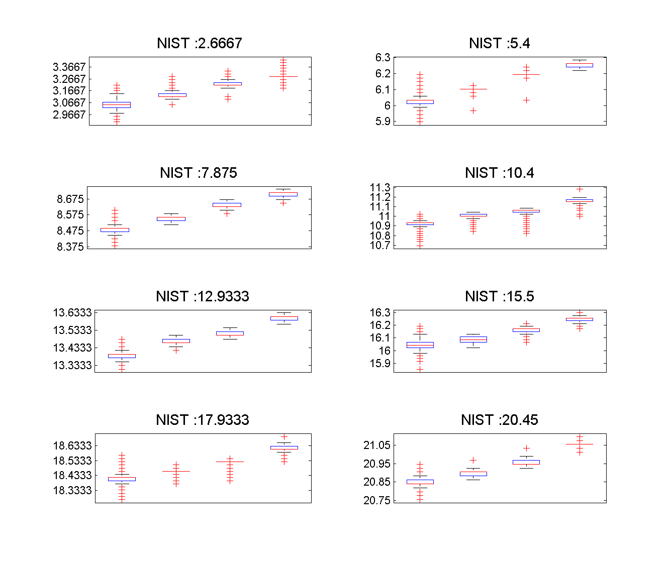
Old Calibration
RMSE : 0.599

Slide 4
Compare

Slide 5
Difference between two calibrations

Slide 6
Fit Comparison

