Slide 1
Life Under Your Feet

Slide 2
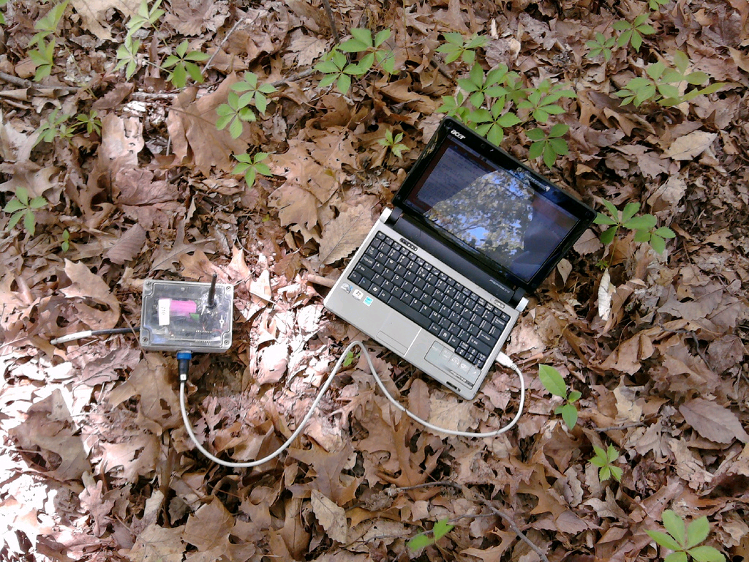
Notes:
Note the small battery
Need to last in the field for ~ 1 year

Slide 3
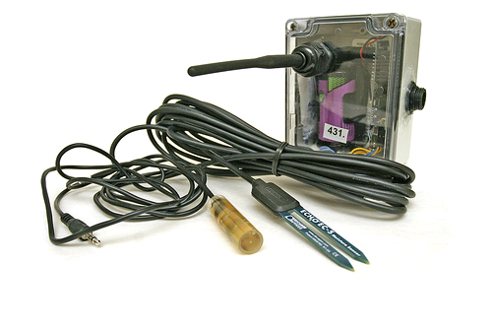
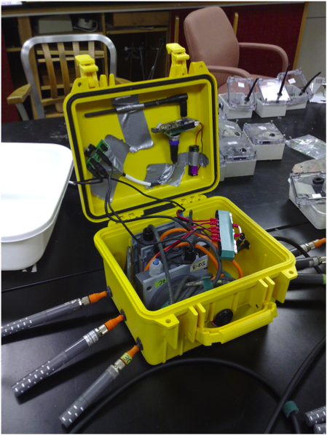
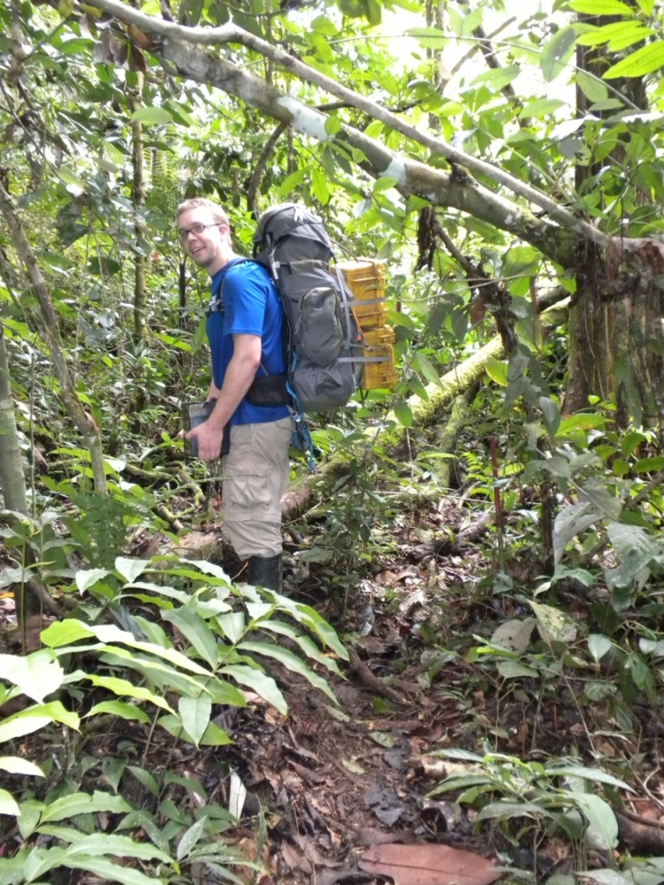

Slide 4
Sensor Network Design Philosophies
Use low cost components
No access to line power
Deployed in remote locations
Radio is the biggest consumer of power
Minimize radio communication
Transfer data in bulk (amortize radio costs)
Data Latency vs. Lifetime tradeoff

Slide 5
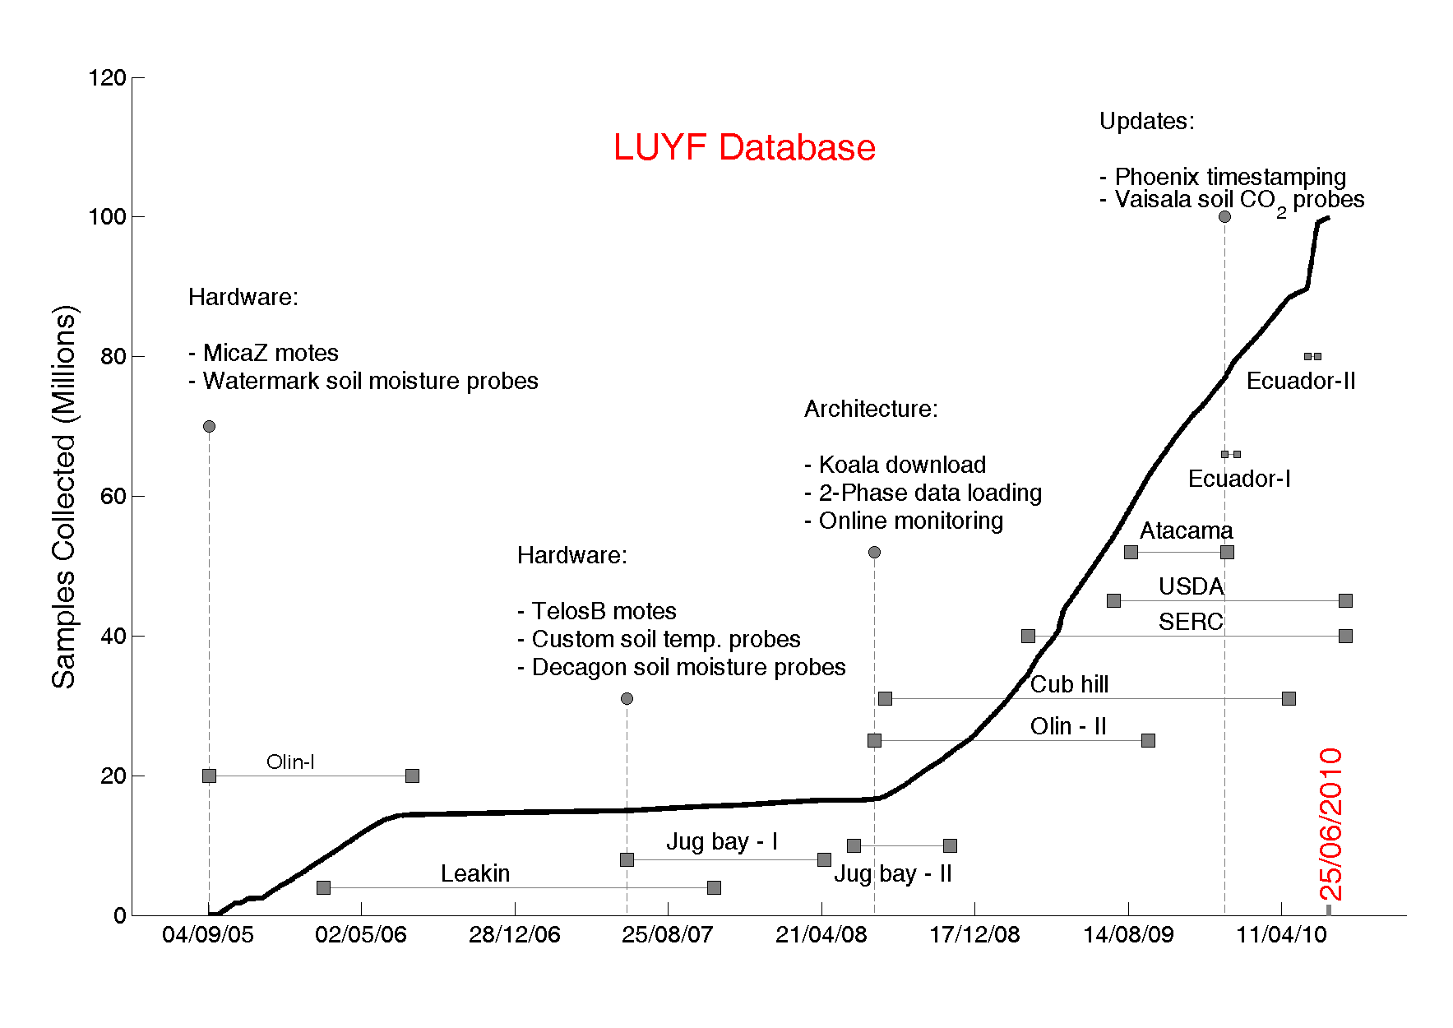

Slide 6
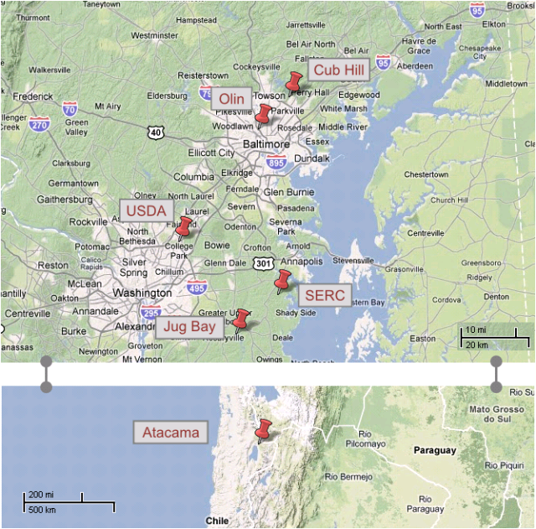
Deployments

Slide 7
All Data Online!
Notes:
Data slide

Slide 8
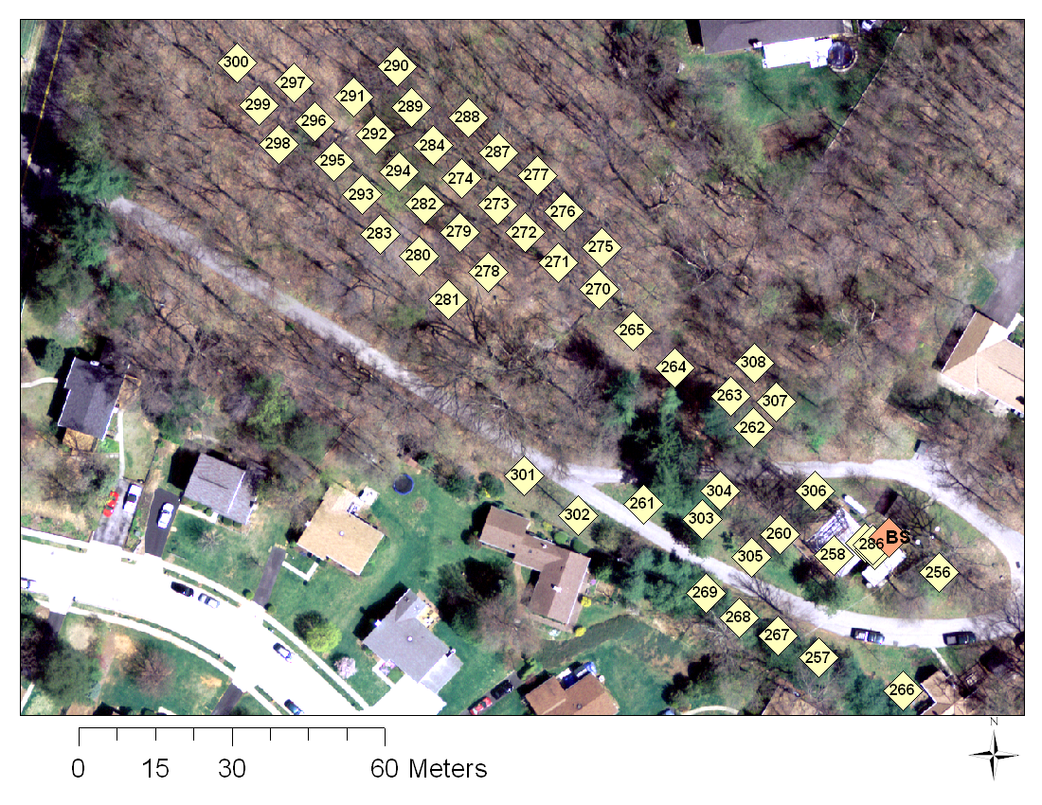
Cub hill locations (50)

Slide 9
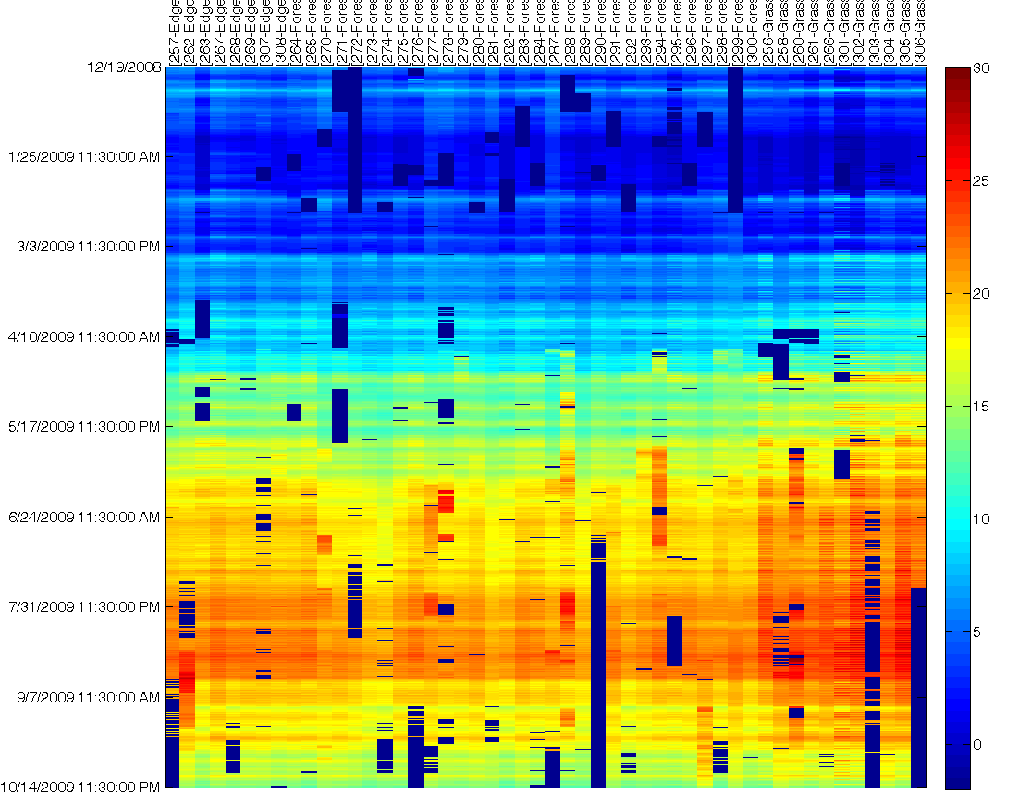
Soil Temperature Dataset
Notes:
- Note the scale. Multiple days worth of data missing and faulty

Slide 10
Data Features
Correlated in time and space
Evolving over time (seasons)
Gappy (Due to hardware failures)
Faulty (Noise, Jumps in values)

Slide 11
Goals
Leverage spatiotemporal correlations:
Model-based fault detection
Increase network lifetime
Tradeoff latency for reduced communication

Slide 12
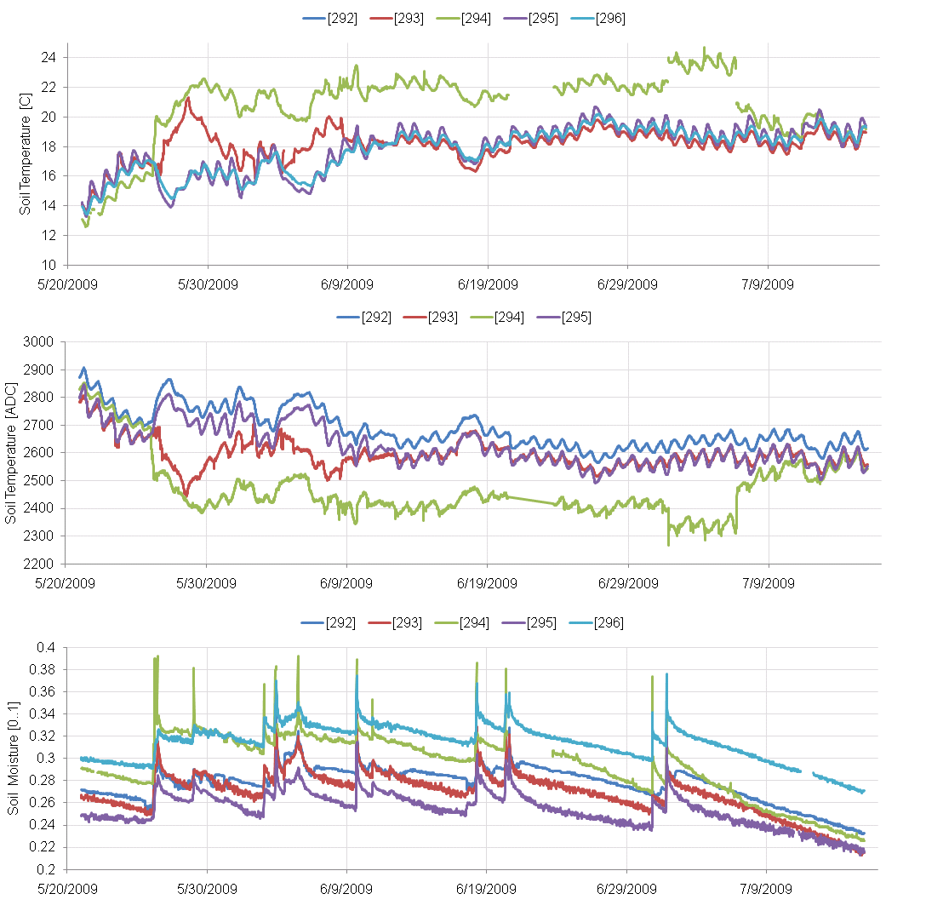
Examples of Faults

Slide 13
Motivation
Environmental Scientists want fault-free data and want to see visualizations
They start looking at the actual data much later
Opportunity to postpone collecting all data
~ 5% of data is faulty

Slide 14
Basic Observations
Hardware failures causes entire “days” of data to be missing
Temporal correlation alone is not enough
If we look in the spatial domain,
For a given time, at least > 50% of the sensors are active

Slide 15
Initialization
Good
Period

Slide 16
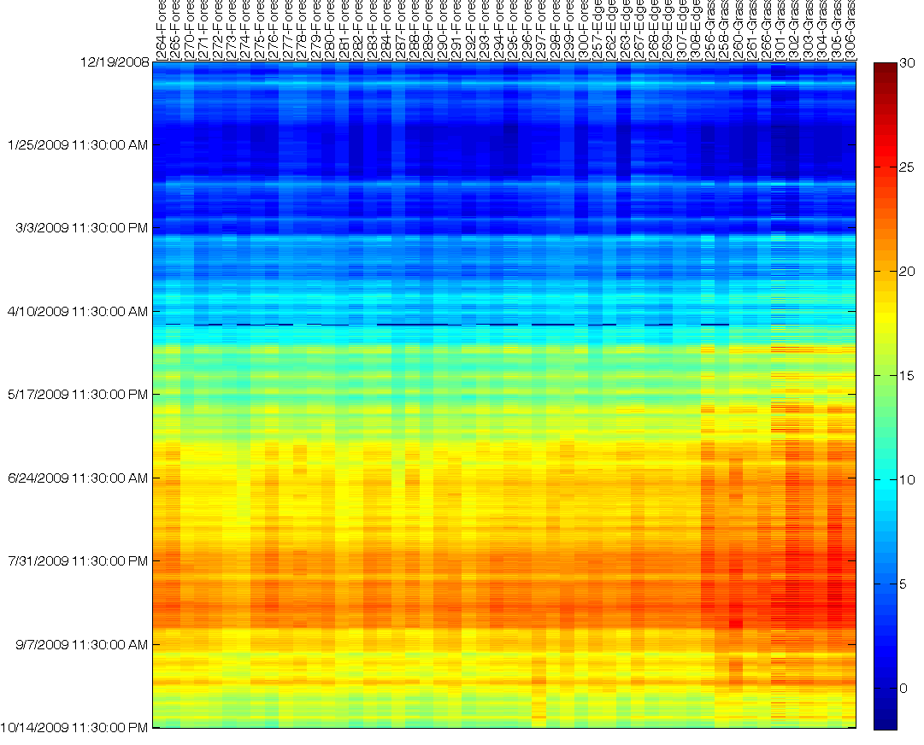
Tamas’ Iterative and Robust gap-filling (MATLAB)
Notes:
2 purposes
Visualization
Detect faults

Slide 17
Sketch
Estimate fixed common effect (daily median)
Subtract location-specific deviation from common effect
Model residuals using PCA
Basis defined in the spatial domain
Initialized using good data
Vectors are randomized and fed one by one
Gaps corrected using L2 minimization
Use reprojection error to remove outliers

Slide 18
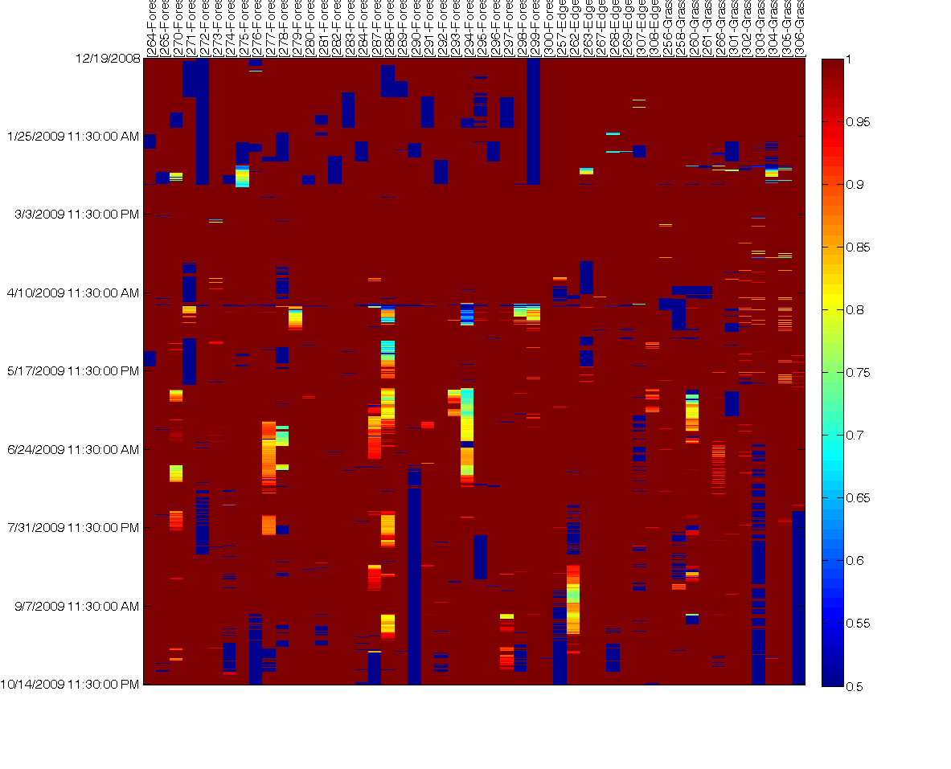
Smooth / Original

Slide 19
Original and Ratio

Slide 20
Moving forward
Better way to model these correlations?
How do we pick a subset of locations that are informative:
2 phase operation
Periodically download from everyone
In between, use correlations to produce maps and movies
Extend network lifetime

Slide 21
Soil Moisture and Ratio

Slide 22
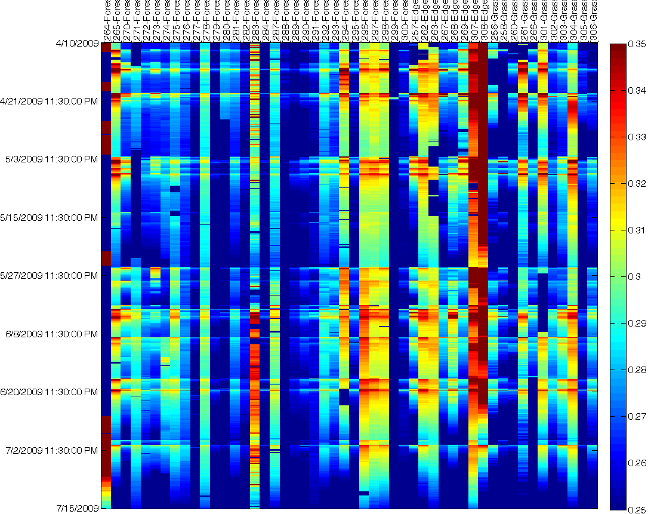
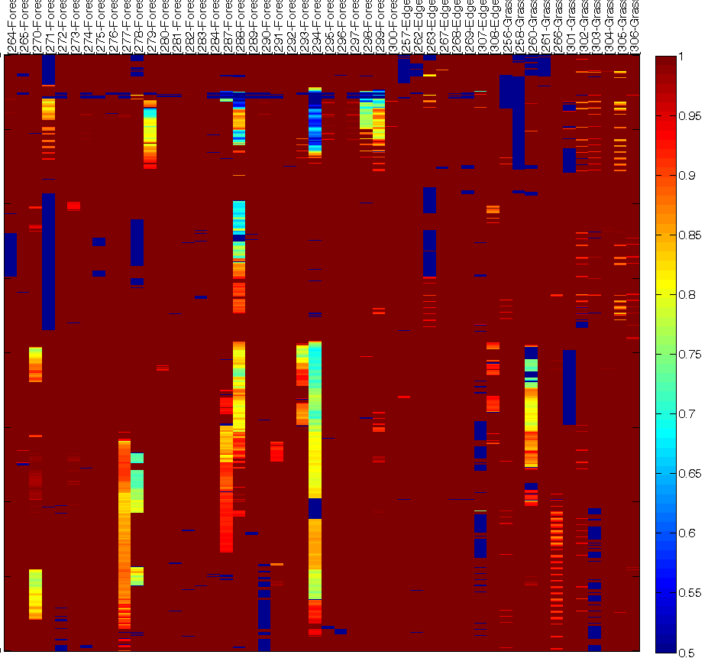
Moisture vs Ratio (zoom in)

