Slide 1
Life Under Your Feet
Johns Hopkins University
Computer Science
Earth and Planetary Sciences
Physics and Astronomy
http://www.lifeunderyourfeet.org

Slide 2
Today
Introduce Life Under Your Feet
Show some data
Our current goals and future directions

Slide 3
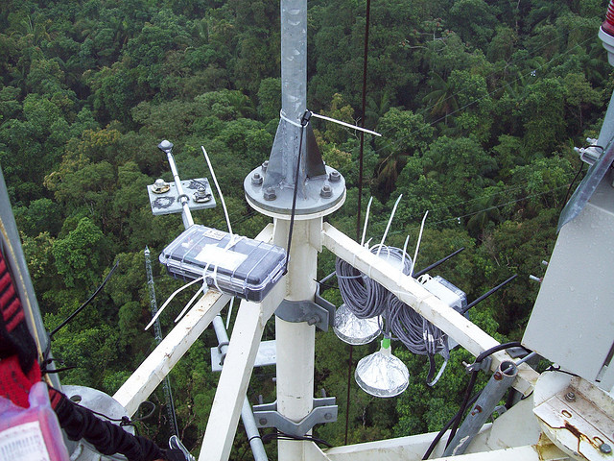
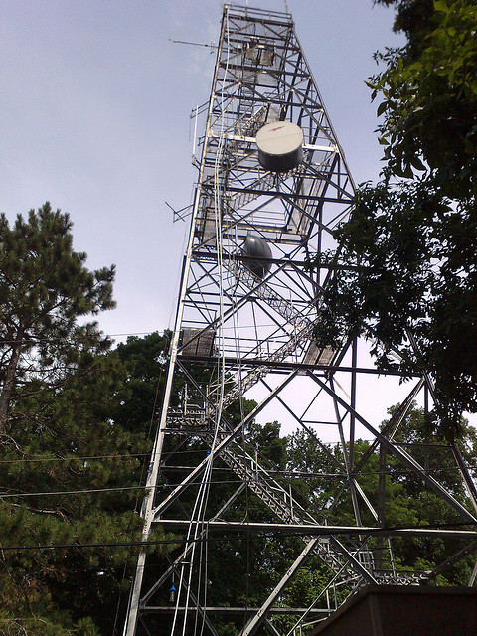
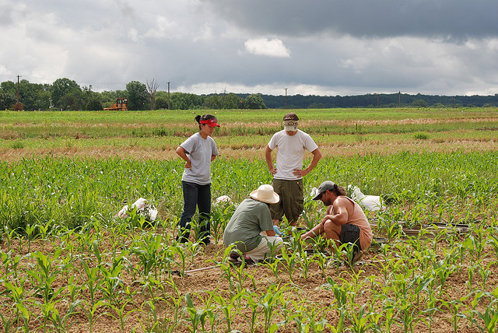
Long-Term Environmental Monitoring

Slide 4
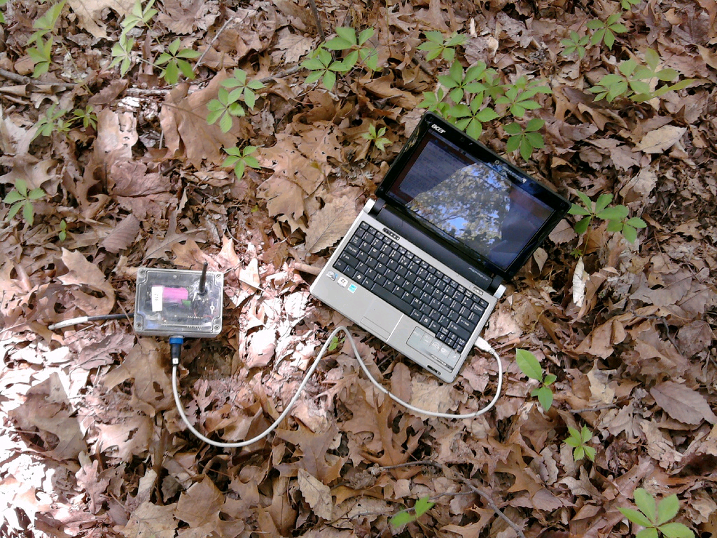
Notes:
Note the small battery
Need to last in the field for ~ 1 year

Slide 5
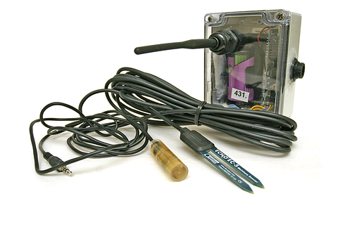
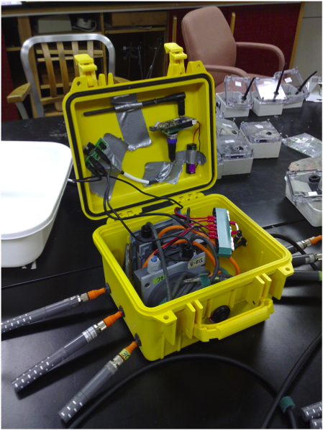
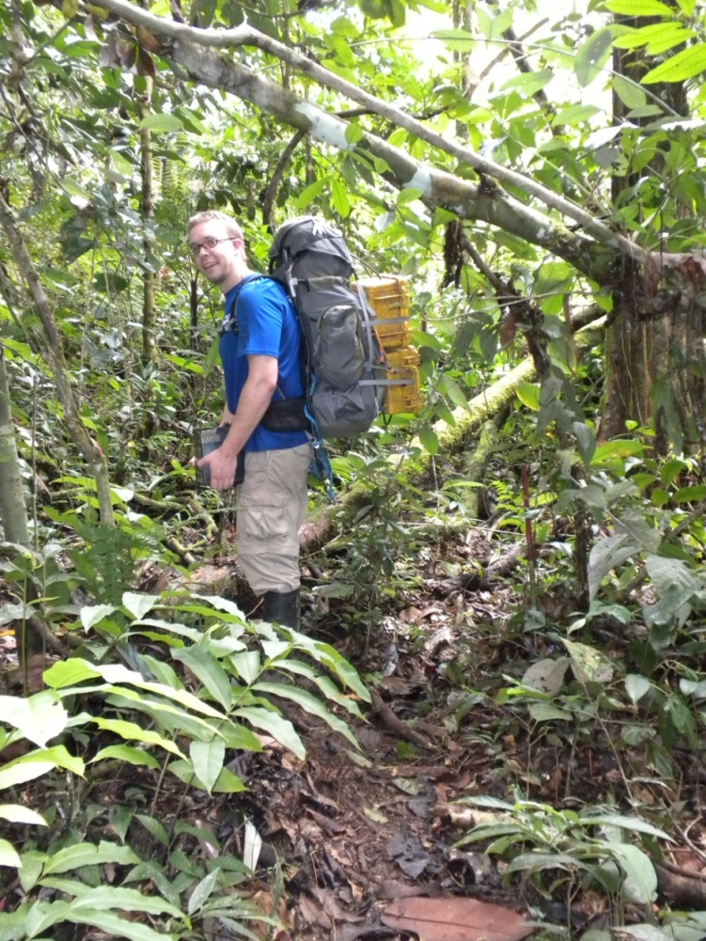

Slide 6
Sensor Network Design Philosophies
Use low cost components
No access to line power
Deployed in remote locations
Radio is the biggest consumer of power
Minimize radio communication
Transfer data in bulk (amortize radio costs)
Data Latency vs. Lifetime tradeoff

Slide 7
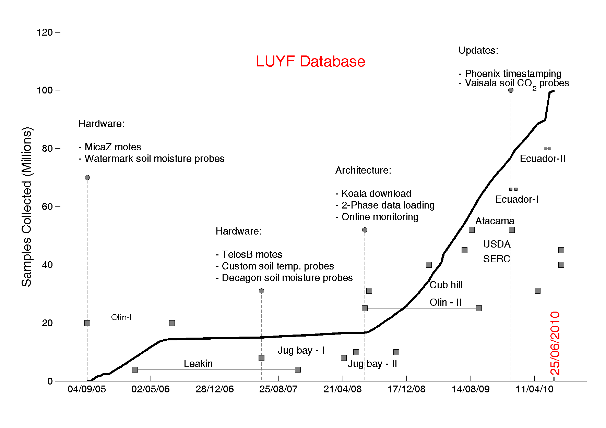

Slide 8
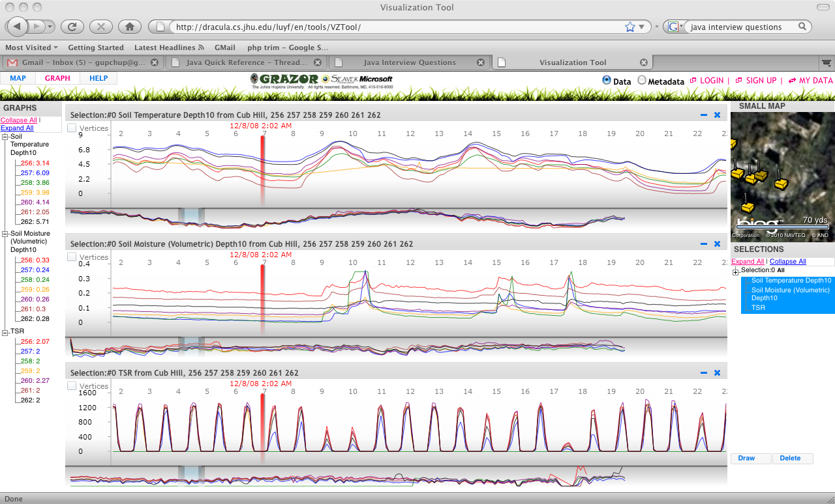
All Data Online and available!
http://dracula.cs.jhu.edu/luyf/en/tools/VZTool/
Notes:
Data slide

Slide 9
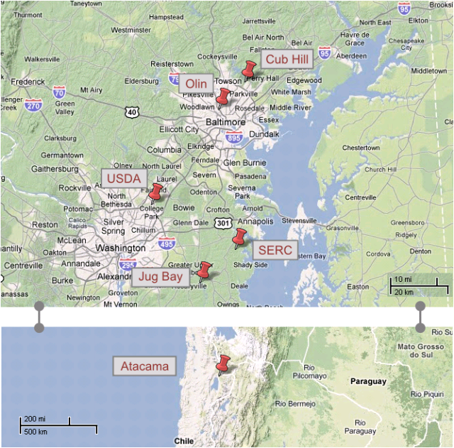
Deployments

Slide 10
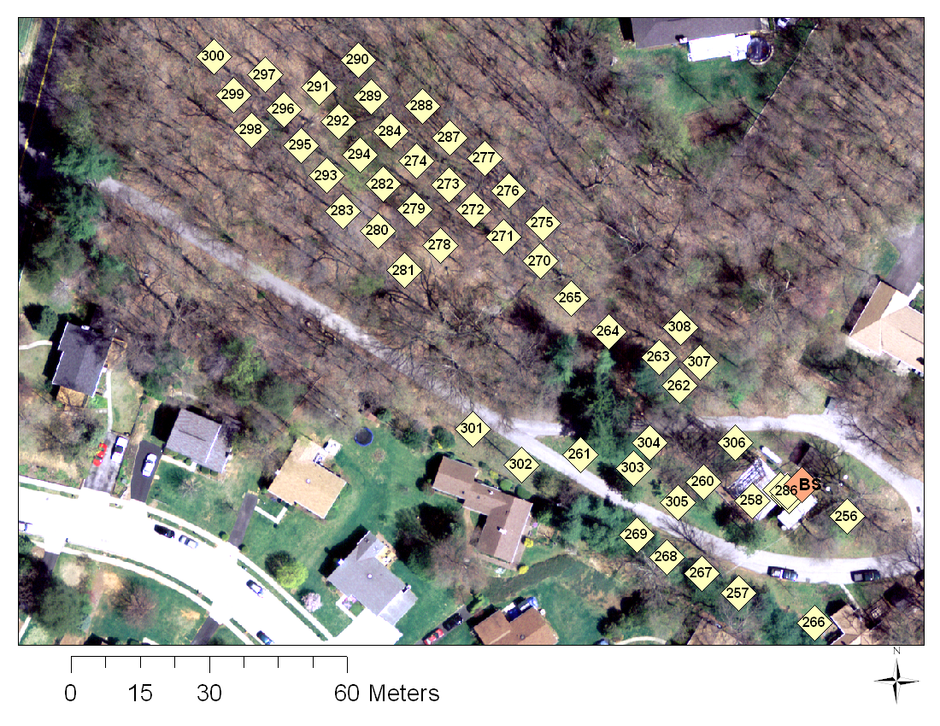
Cub hill locations (50)

Slide 11
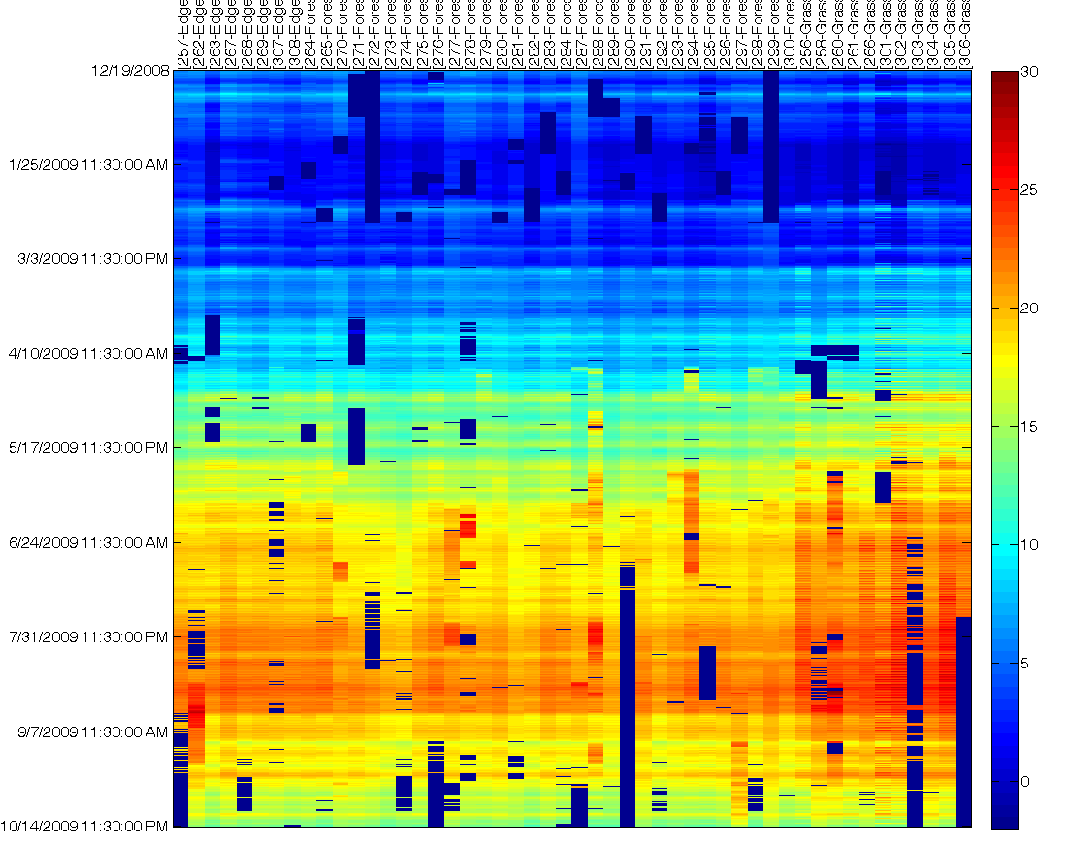
Soil Temperature Dataset
Notes:
- Note the scale. Multiple days worth of data missing and faulty

Slide 12
Data Features
Correlated in time and space
Evolving over time (seasons)
Diurnal patterns
Gappy (Due to hardware failures)
Faulty (Noise, Jumps in values)

Slide 13
Goals
Leverage spatiotemporal correlations:
Model-based fault detection
Increase network lifetime
Retrieving data from representative locations
Use model to interpolate at other locations
Tradeoff latency for reduced communication

Slide 14
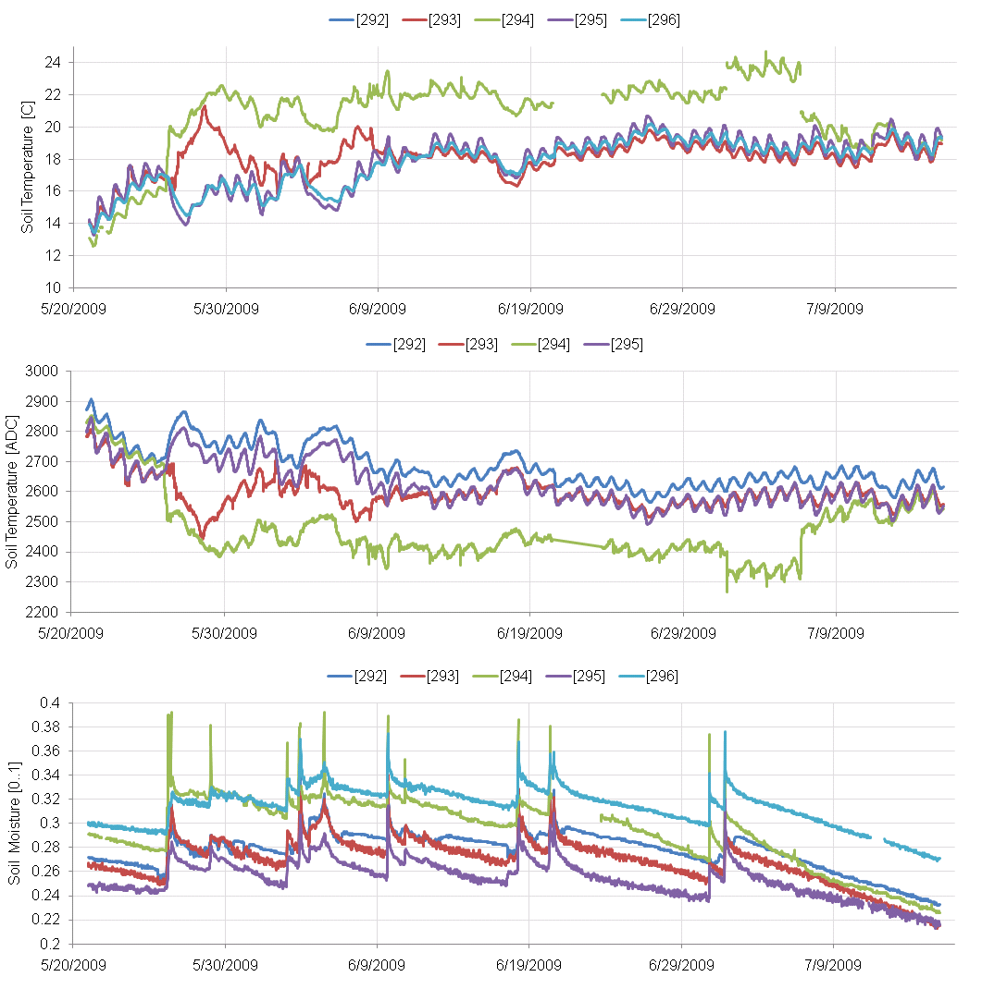
Examples of Faults

Slide 15
Motivation for both goals
Environmental Scientists want fault-free data and want to see visualizations
~ 5% of data is faulty
Networks need to last a year or more
They start looking at the actual data much much later
Opportunity to postpone collecting all data

Slide 16
Soil Temperature Dataset
Notes:
- Note the scale. Multiple days worth of data missing and faulty

Slide 17
Sketch
Estimate fixed common effect (daily median)
Subtract location-specific deviation from this common effect
Model residuals using PCA
Basis defined in the spatial domain
Initialized using good data
Vectors are randomized and fed one by one
Tamas’ incremental robust PCA
Gaps corrected using L2 minimization
Outlier rejection
Robust function downweights outlier vectors
Threshold reprojection error to remove outlier measurements

Slide 18
Initialization
Good
Period

Slide 19
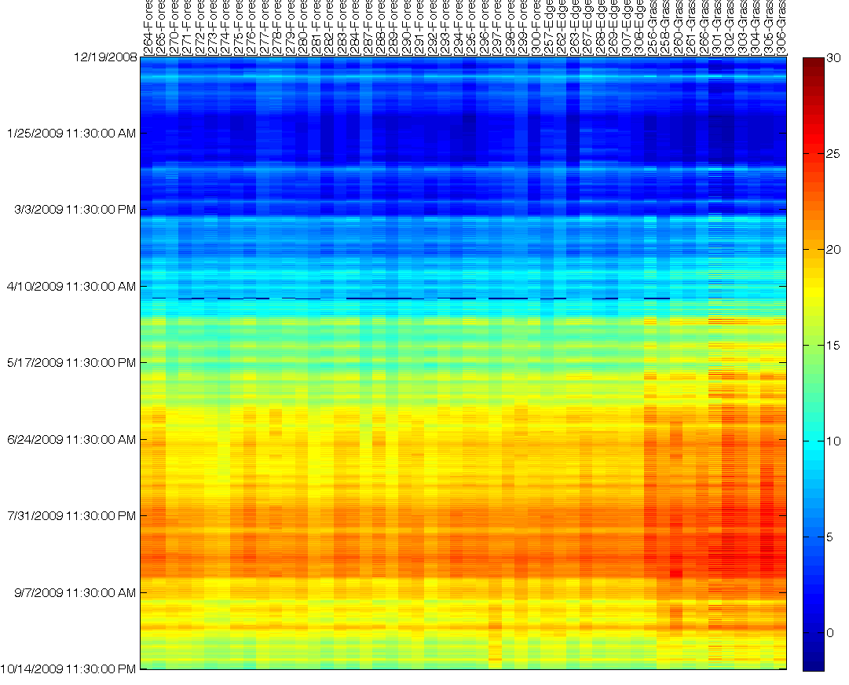
Tamas’ Iterative and Robust gap-filling (MATLAB)
Notes:
2 purposes
Visualization
Detect faults

Slide 20
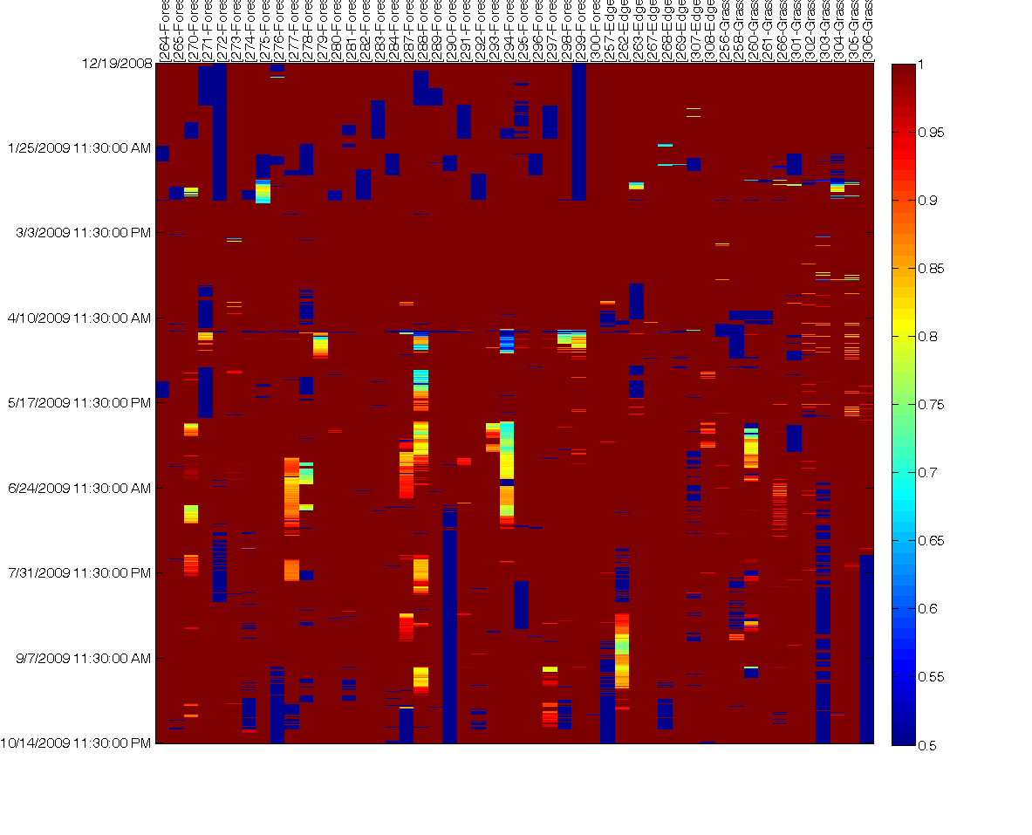
Smooth / Original

Slide 21
Original and Ratio

Slide 22
Moving forward
Better way to model these correlations?
Use some of your methods
How do we use correlations to redesign our data collection subsystem
2 phase operation
Periodically download from everyone (infrequent)
In between, download from representative locations
Use correlations to interpolate and present to scientists
Postpone downloading all data in bulk much later
Extend network lifetime

