Slide 1
Gap-filling and Fault-detection
for the
life under your feet dataset

Slide 2
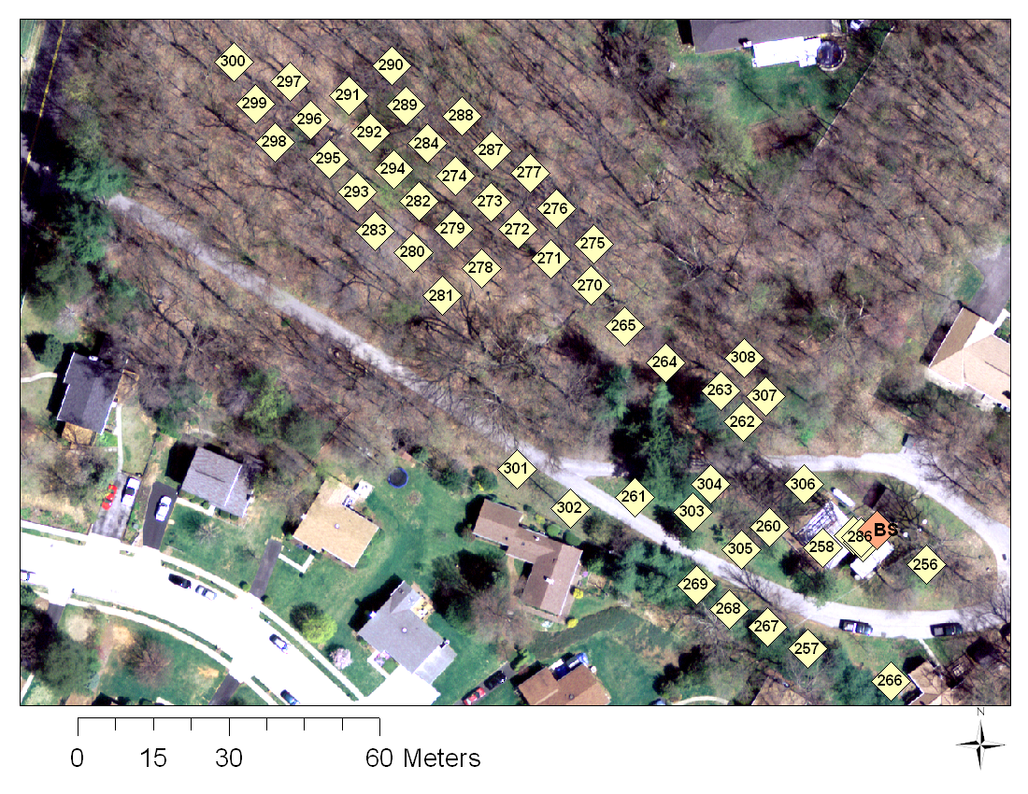
Locations

Slide 3
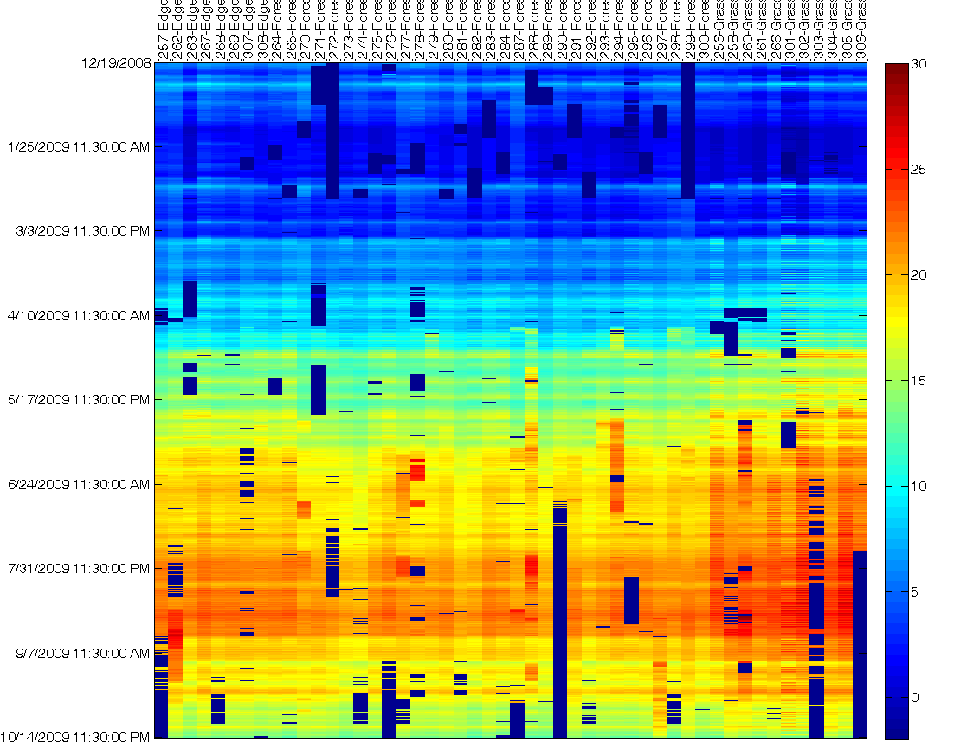
Soil Temperature Dataset

Slide 4
Observations
Data is
Correlated in time and space
Evolving over time (seasons)
Gappy (Due to failures)
Faulty (Noise, Jumps in values)

Slide 5
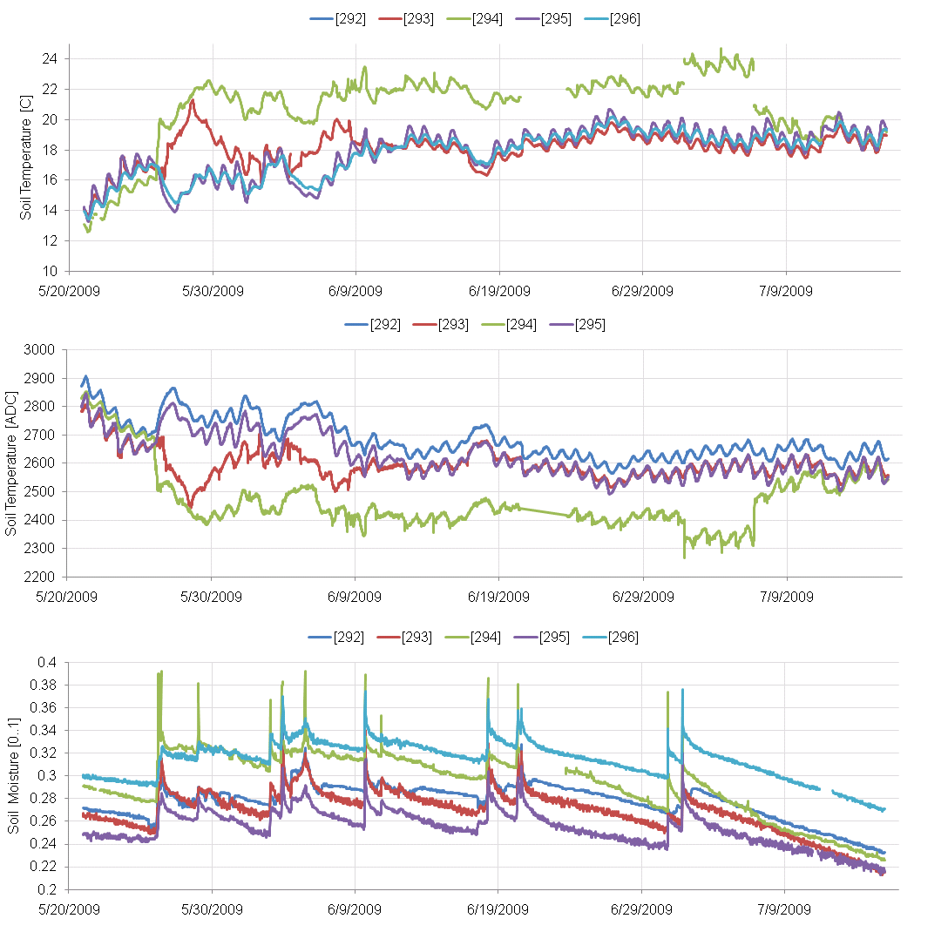
Examples of Faults

Slide 6
Motivation
Environmental Scientists want gap-filled and fault-free data
8% of the data is missing
Of the available data, 10% is faulty
Scientific libraries such as covariance, SVD etc do not handle gaps and faults well

Slide 7
Basic Observations
Hardware failures causes entire “days” of data to be missing
Temporal correlation for integrity is less effective
If we look in the spatial domain,
For a given time, at least > 50% of the sensors are active
Use the spatial basis instead.
Initialize spatial basis using the period marked “good period” in previous slide

Slide 8
Basic Methods

Slide 9
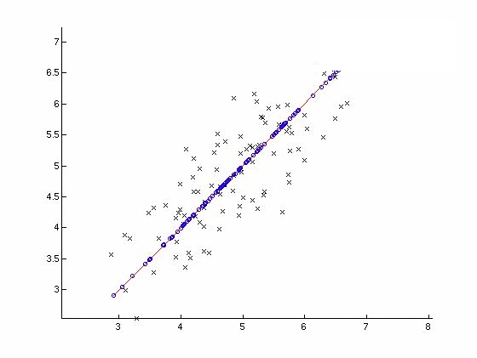
Principal Component Analysis (PCA)
PCA :
Finds axes of
maximum
variance
Reduces original
dimensionality
(In e.g. from
2 variables =>
1 variable)
X : Points original space
O : Projection on PC1
Variable #2
First Principal Component
Variable #1

Slide 10
Gap Filling (Connolly & Szalay)⁺
Original signal representation as a linear combination of orthogonal vectors
Optimization function
- W_{λ} = 0 if data is absent
Find coefficients, a_{i}’s, that minimize function.
⁺ Connolly et al., A Robust Classification of Galaxy Spectra: Dealing with Noisy and Incomplete Data, http://arxiv.org/PS_cache/astro-ph/pdf/9901/9901300v1.pdf

Slide 11
Initialization
Good
Period

Slide 12
Naïve Gap-Filling

Slide 13
Observations & Incremental Robust PCA *
Faulty Data
Undesirable
Pollutes the PCA model
Impacts the quality of gap-filling
Basis is time-dependent
Correlations are changing over time
Simultaneous fault-detection & gap-filling
Initialize basis using reliable data
Using basis at time t,
Detect and remove faulty readings
Weight new vectors depending on residuals
Use weights to update bases
Gap fill using the current basis
Update thresholds for declaring faults
Iterate over data to improve estimates
⁺ Budavári, T., Wild, V., Szalay, A. S., Dobos, L., Yip, C.-W. 2009 Monthly Notices of the Royal Astronomical Society, 394, 1496, http://adsabs.harvard.edu/abs/2009MNRAS.394.1496B

Slide 14
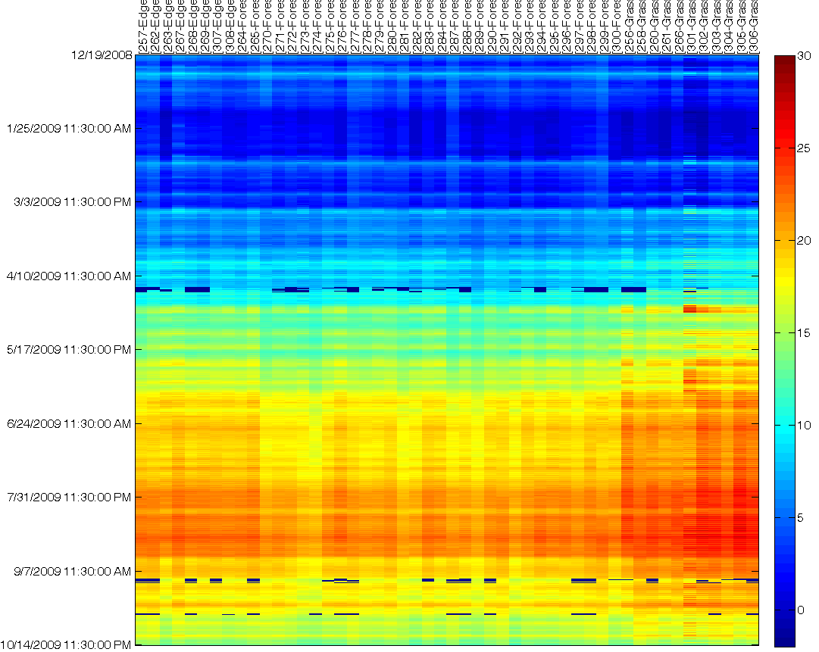
Iterative and Robust gap-filling

Slide 15
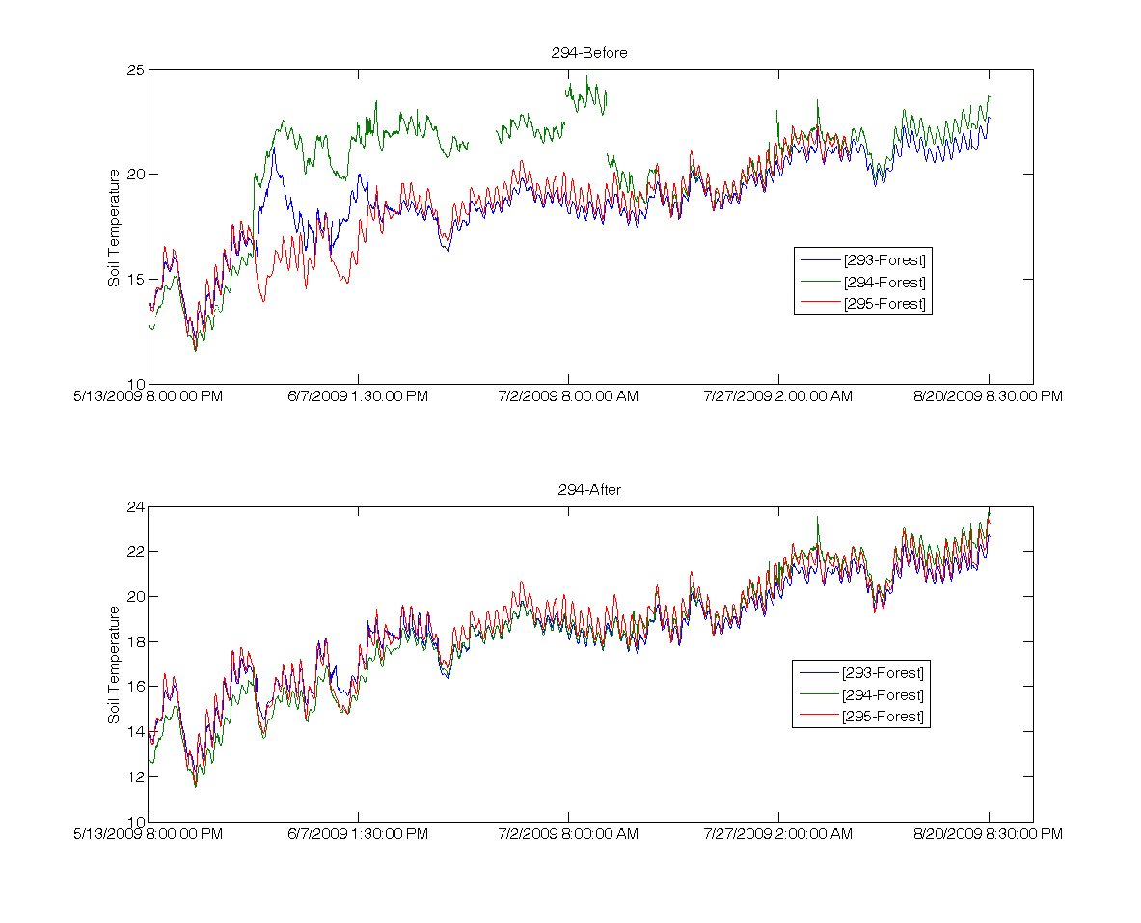
Example 1

Slide 16
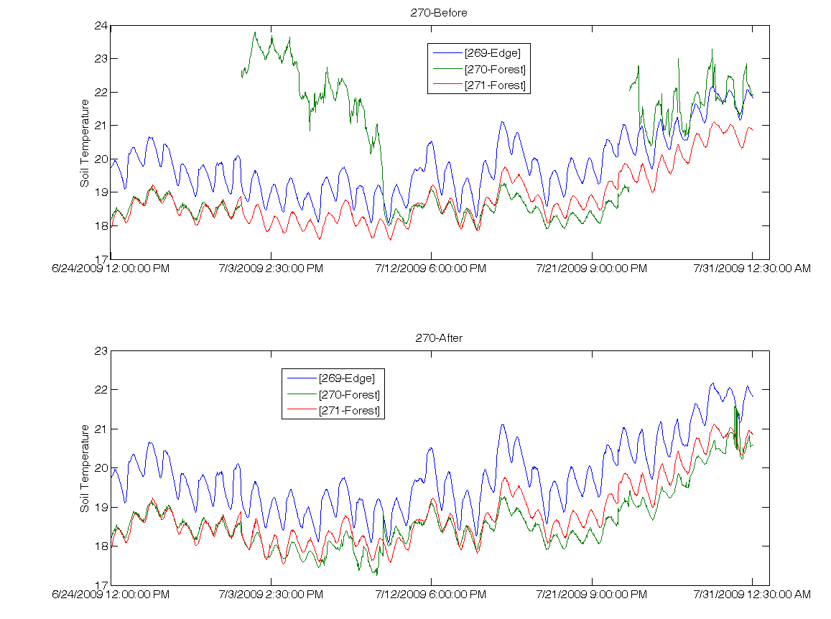
Example 2

Slide 17
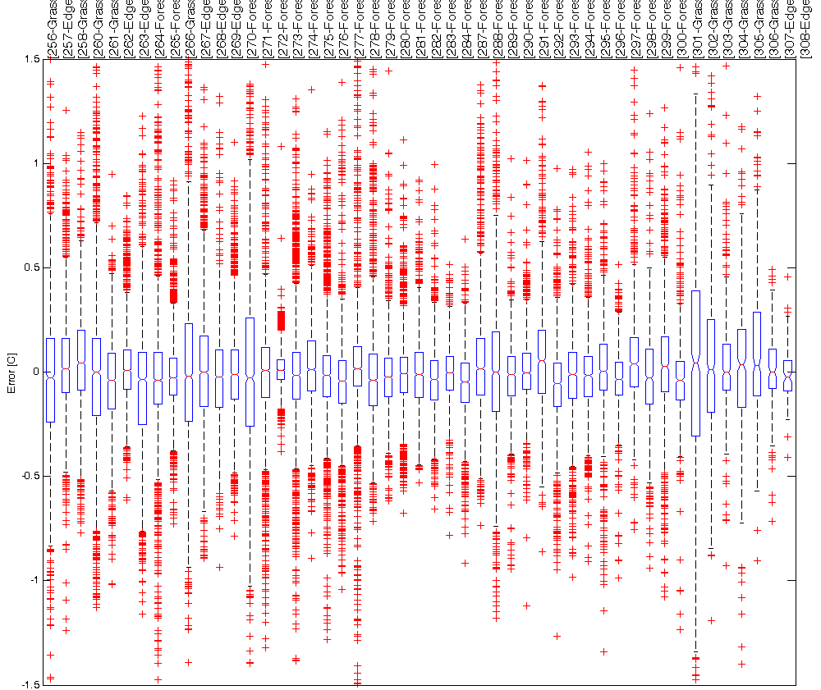
Error Distribution in Location

Slide 18
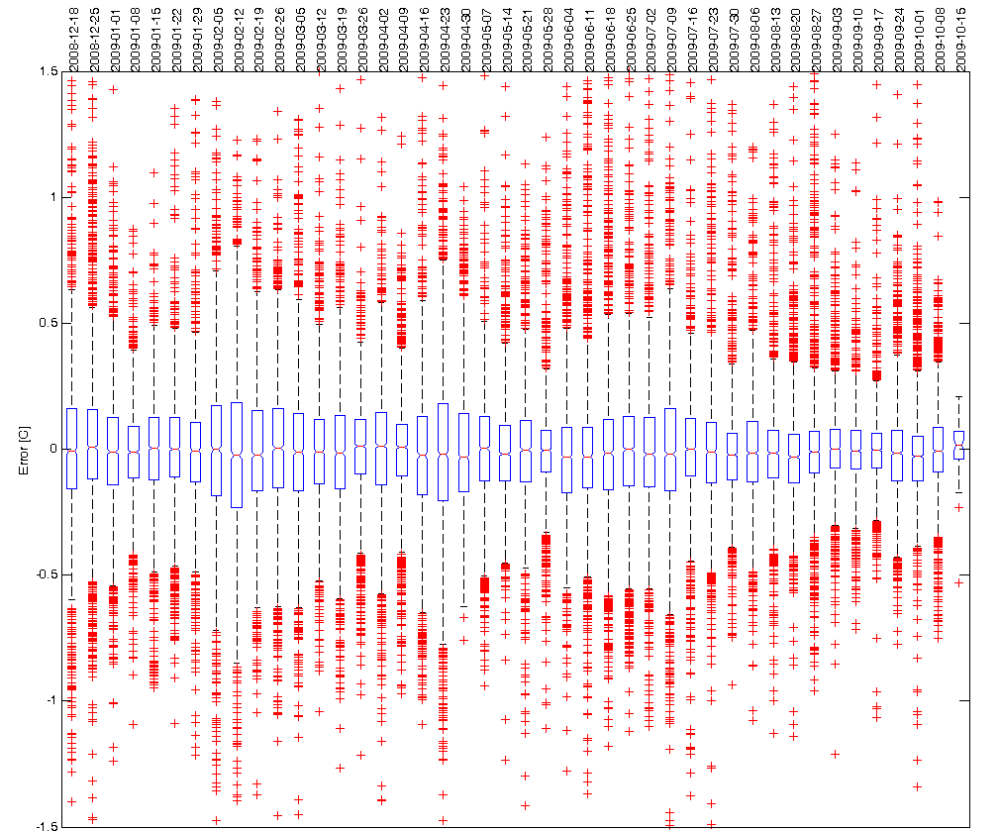
Error Distribution in Time

Slide 19
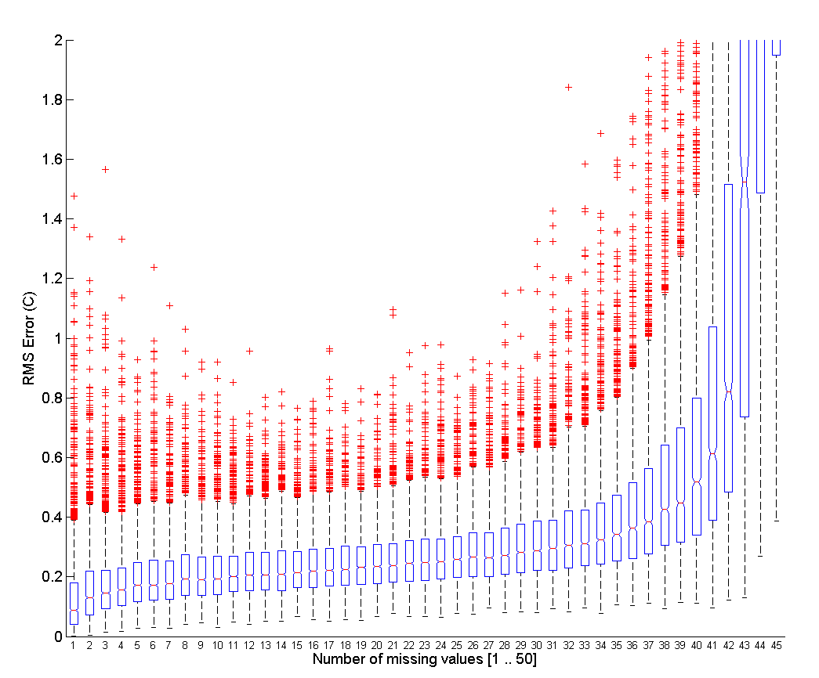
Impact of number of missing values
Even when > 50% of the values are missing
Reconstruction is fairly good

Slide 20
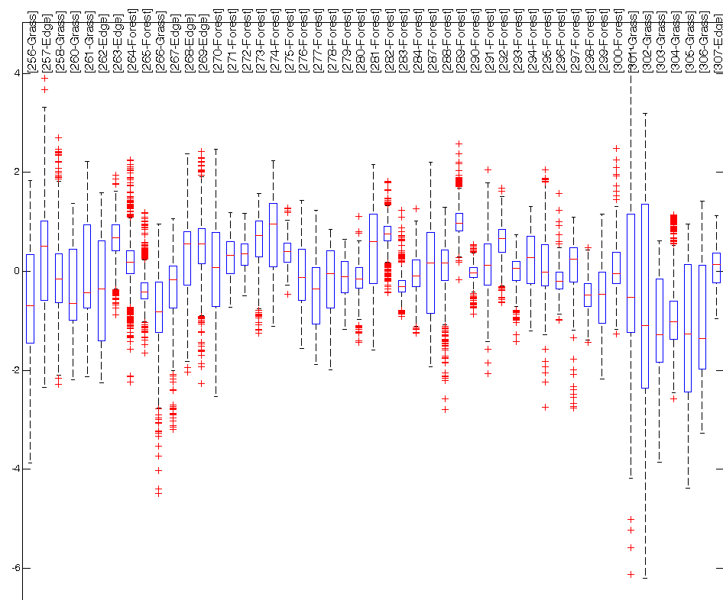
Error Distribution IDW (Location)

Slide 21
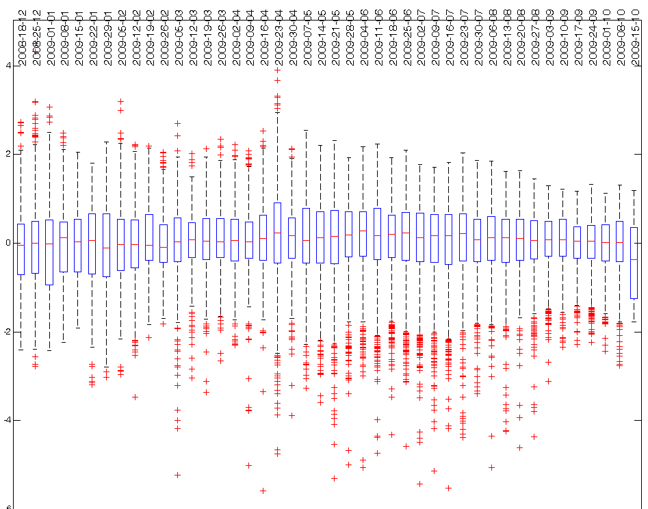
Error Distribution IDW (time)

Slide 22
Discussion
Reception of this work by sensor network community
Compare with other approaches
K-nn interpolation
Other model based methods such as BBQ
Reconstruction depends
Number of missing values
Estimation of basis (seasonal effects)
Use the tradeoff between reconstruction accuracy and power savings

Slide 23
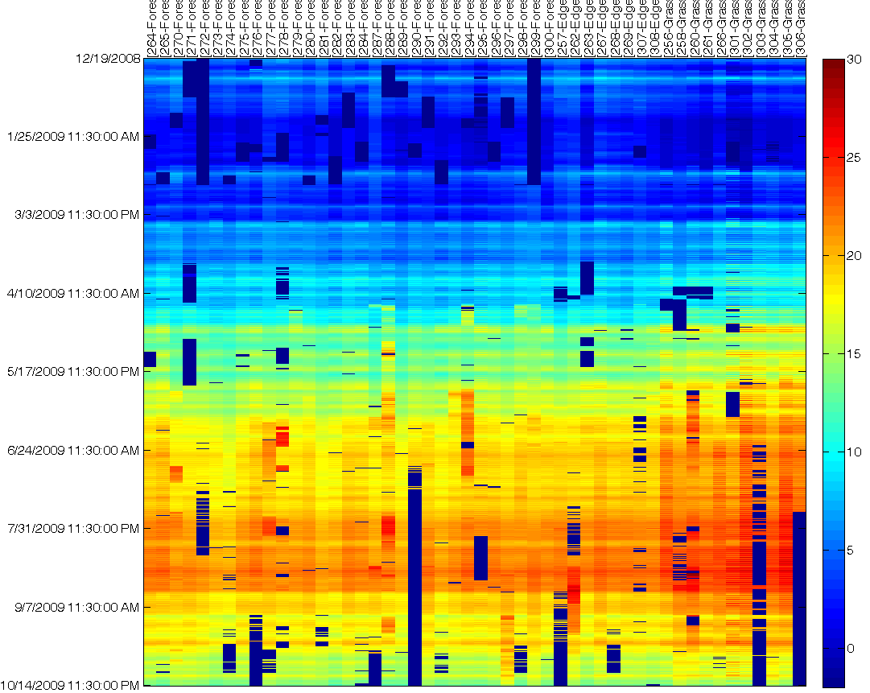
original

Slide 24
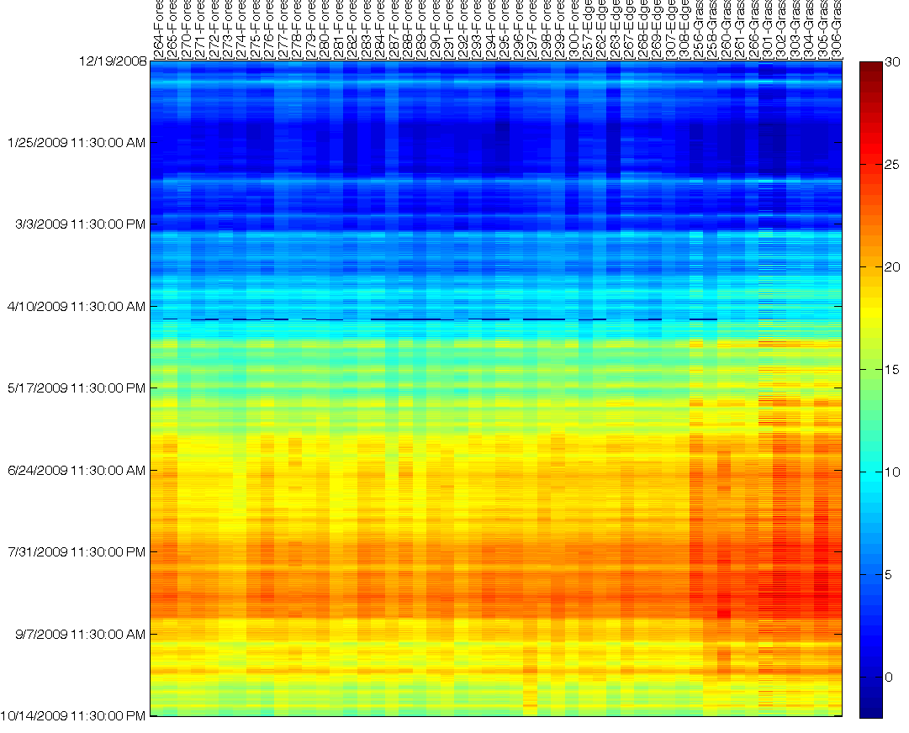
Iterative and Robust gap-filling

Slide 25
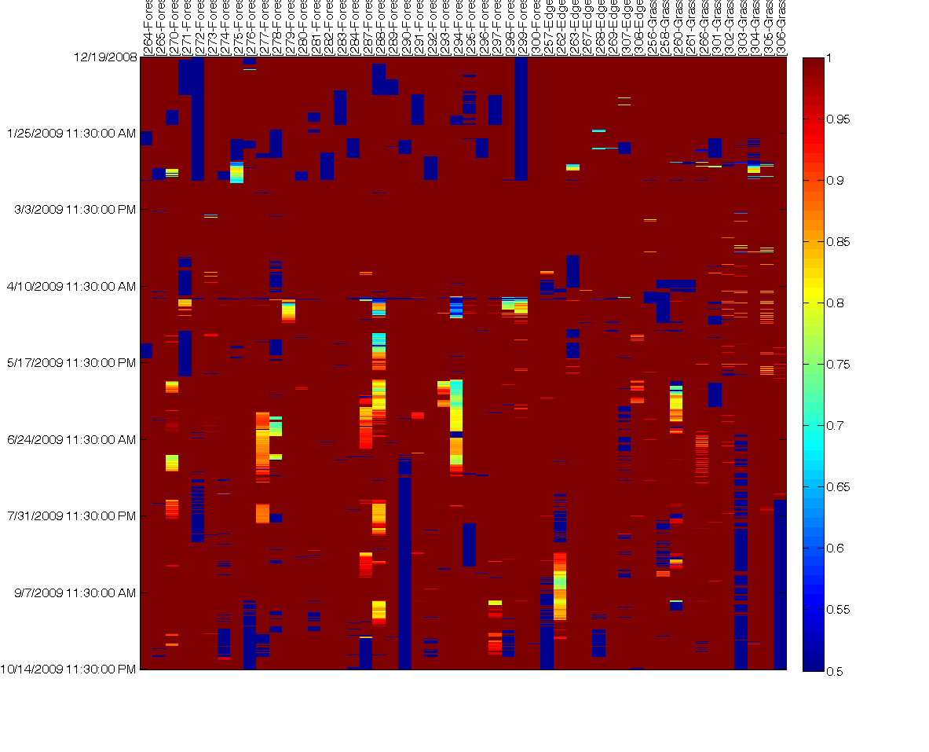
Smooth / Original

Slide 26
Original and Ratio

Slide 27
Soil Moisture and Ratio

Slide 28
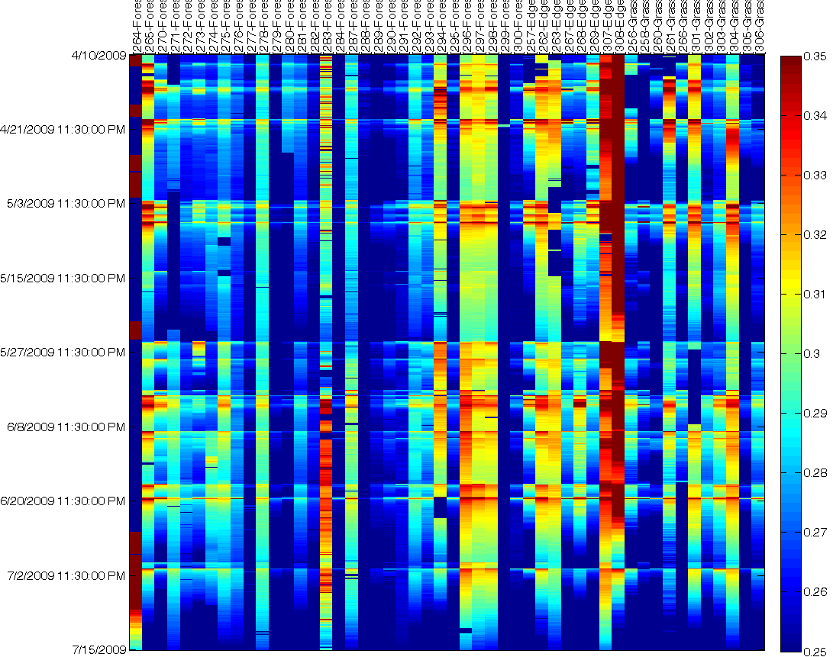
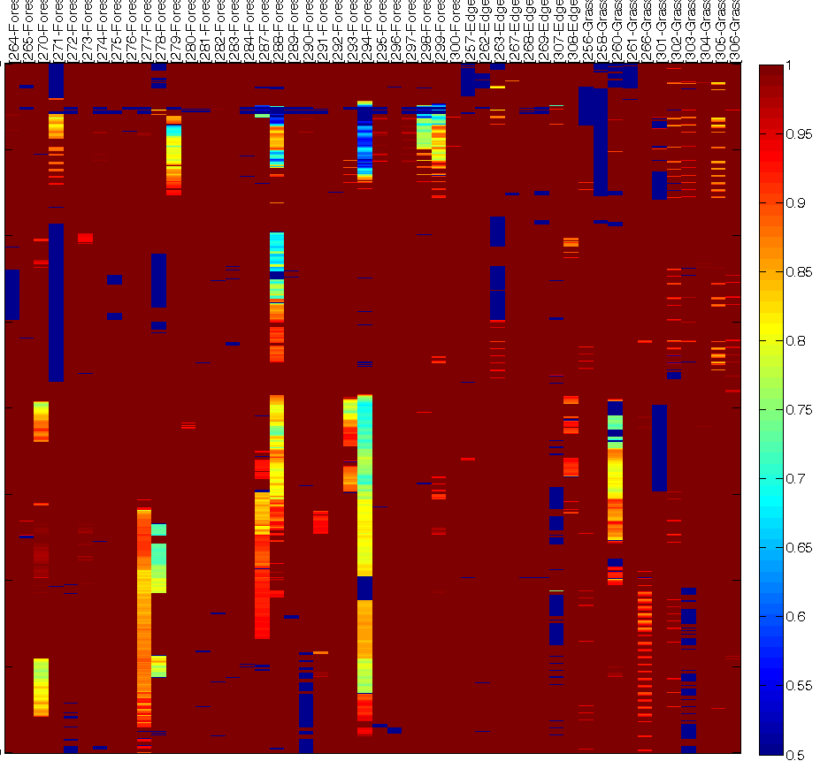
Moisture vs Ratio (zoom in)

Slide 29
Statistics

Slide 30
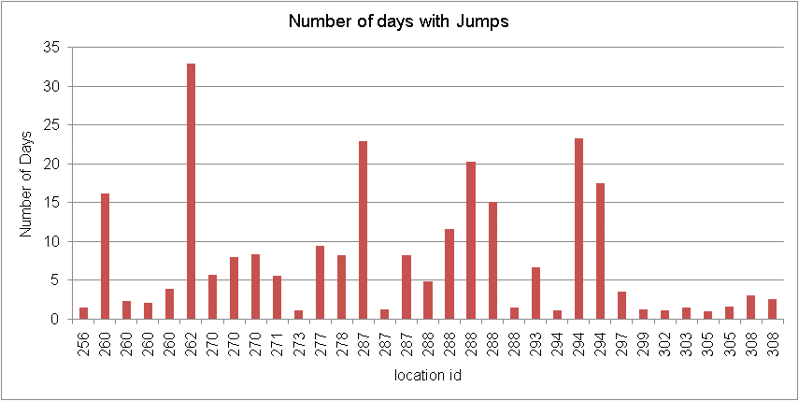
Locations and Durations

Slide 31
Olin

Slide 32
Principal Components

Slide 33
original

Slide 34
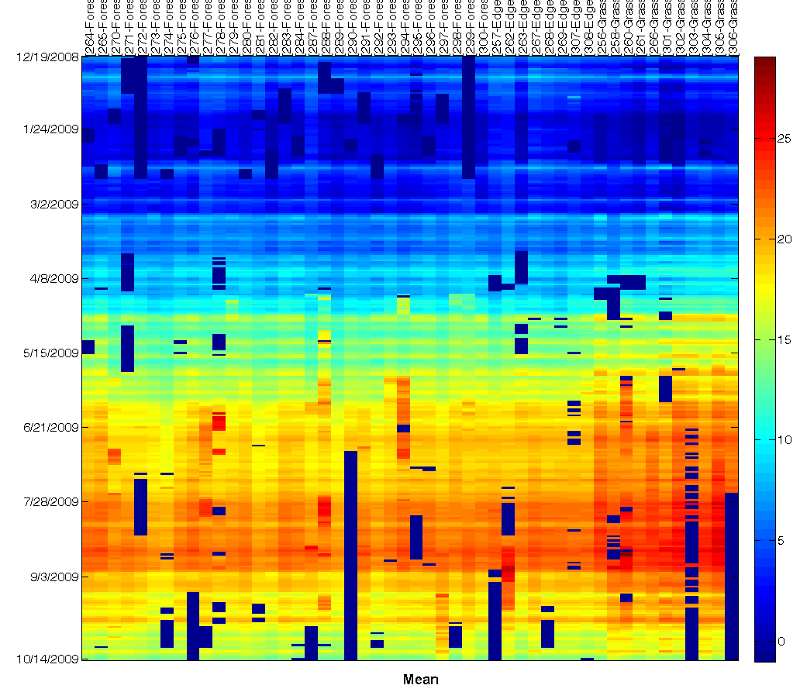
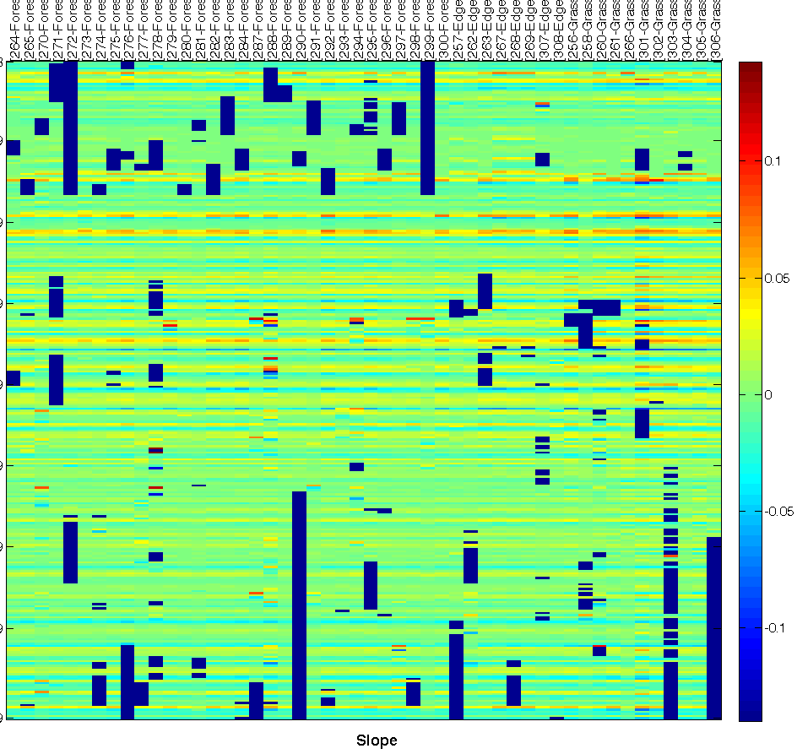
Slope and Intercept

Slide 35
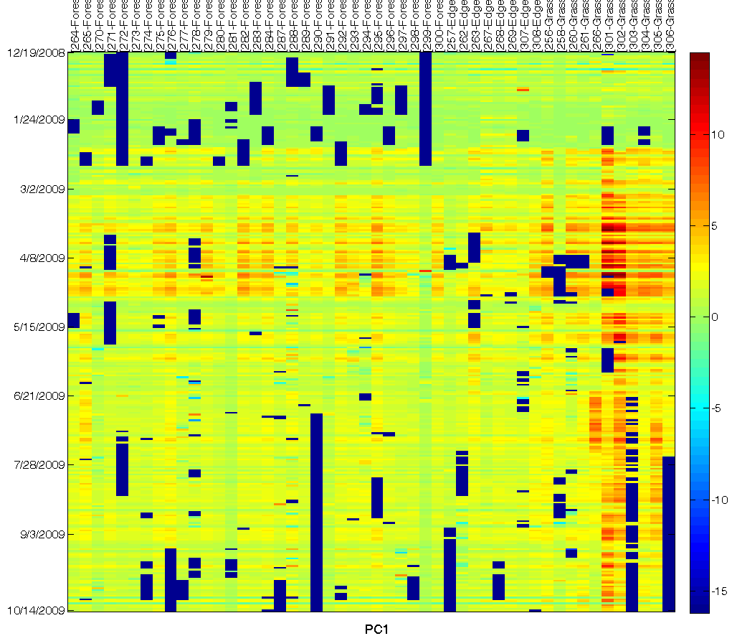
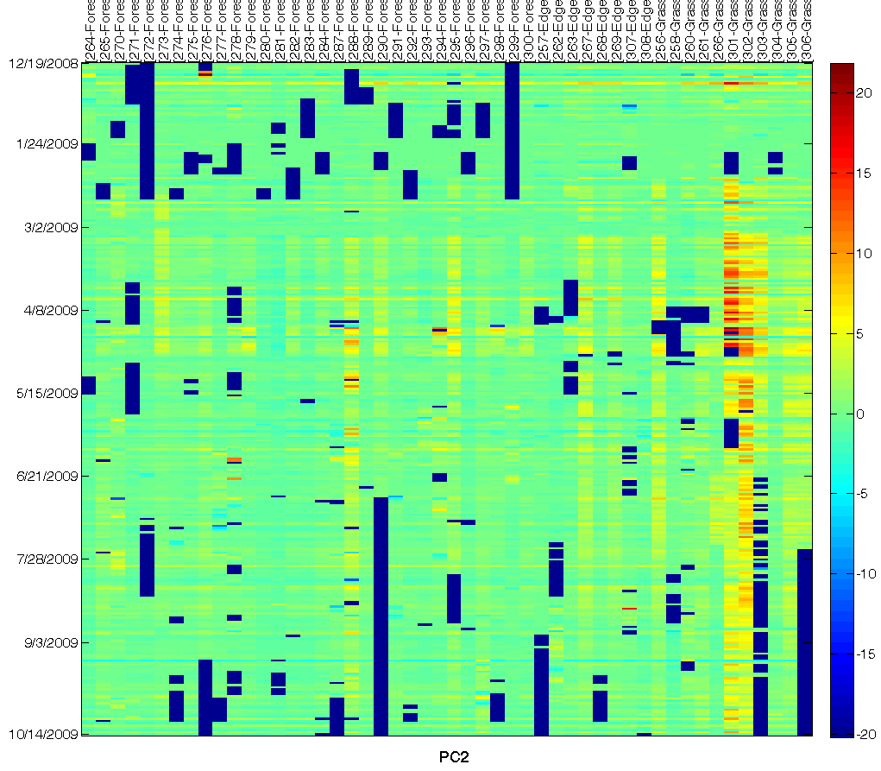
PC1 and PC2

Slide 36
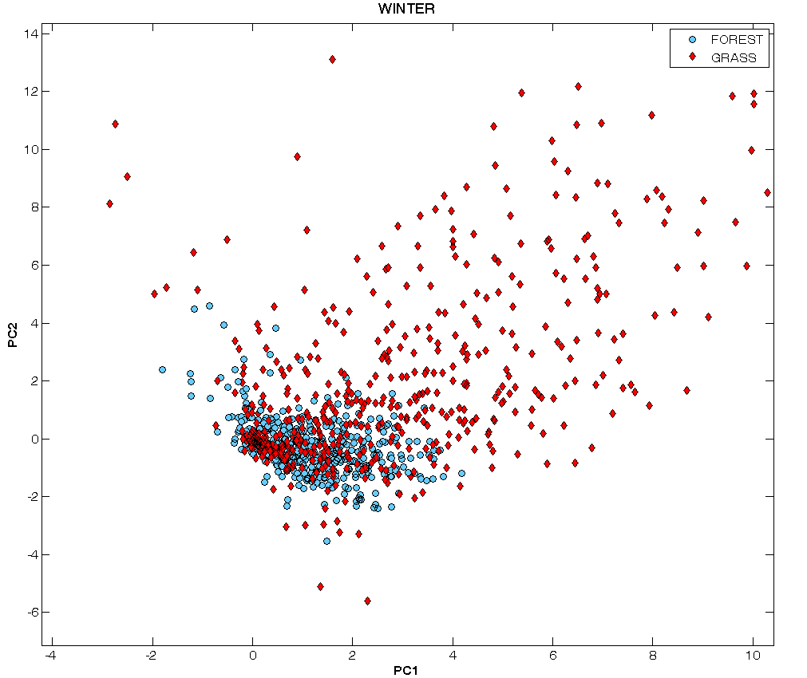
Forest Grass Winter

Slide 37
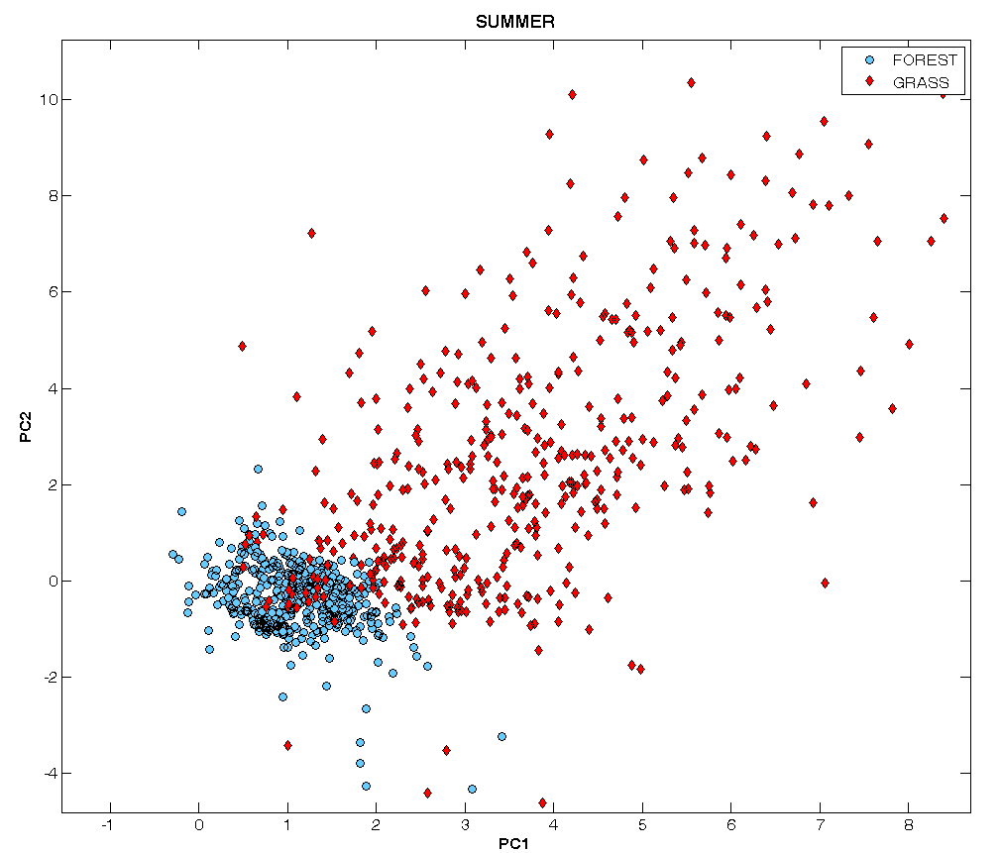
Forest Grass Summer

Slide 38
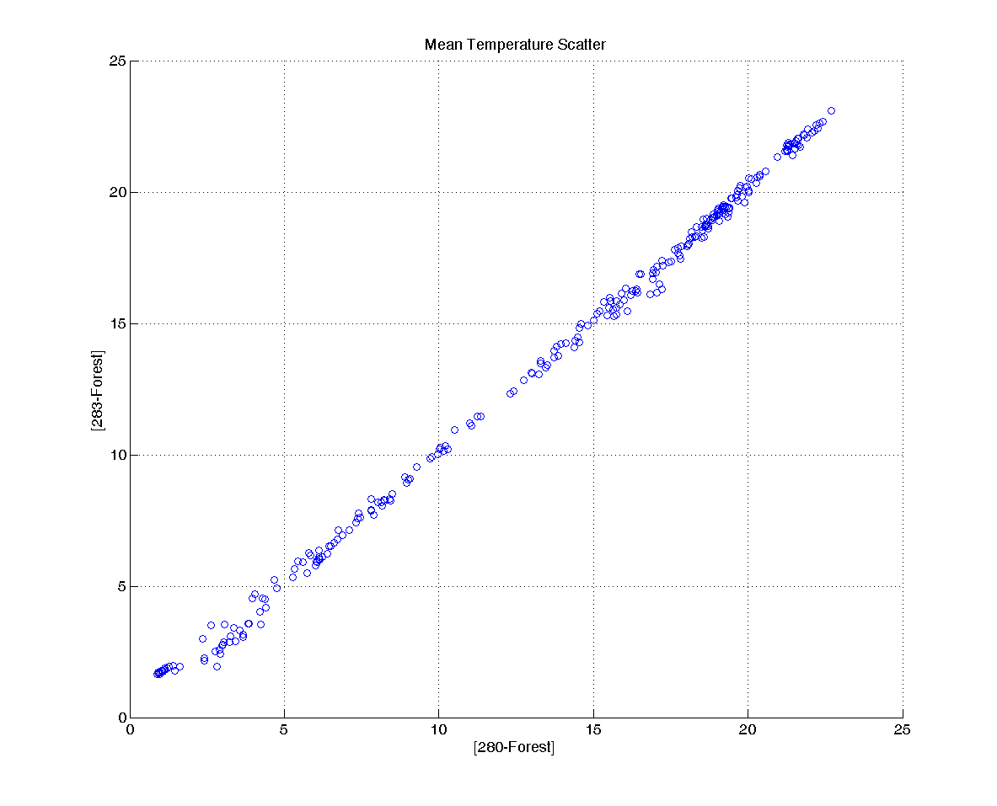
Mean scatter good locations

Slide 39
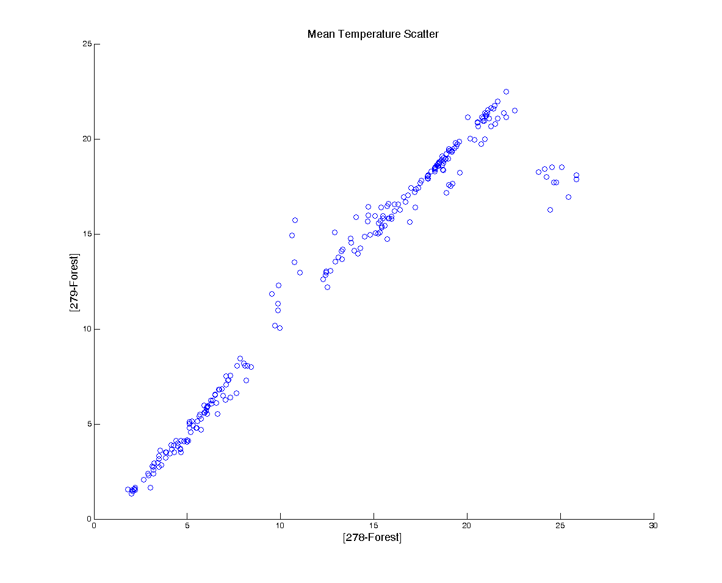
Mean scatter 1 bad location

Slide 40
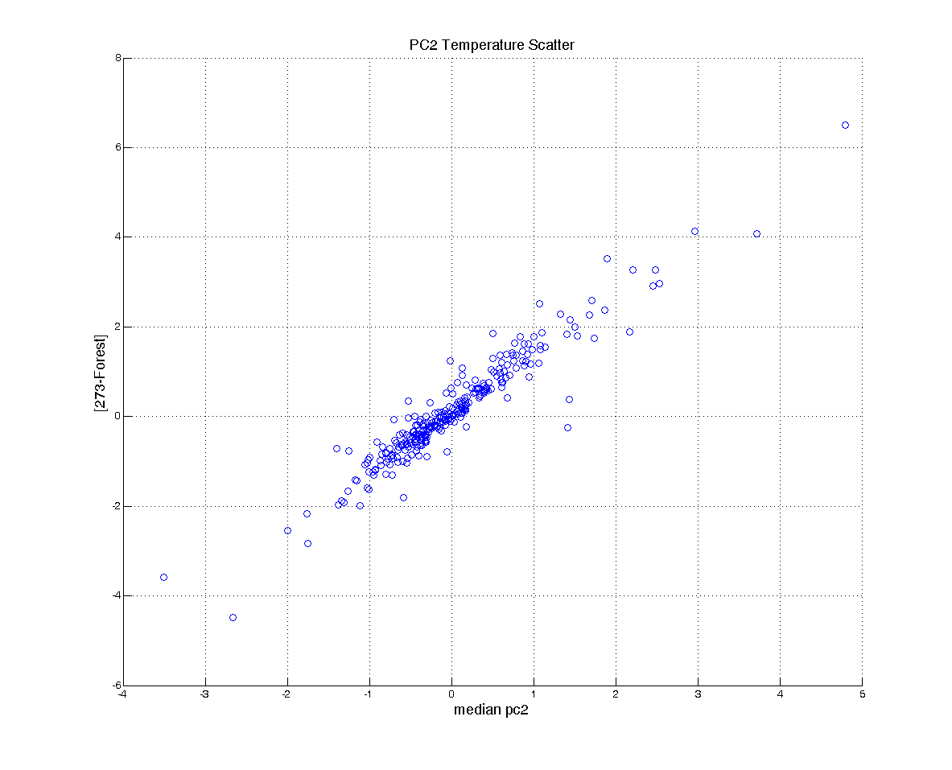
2st component good scatter

Slide 41
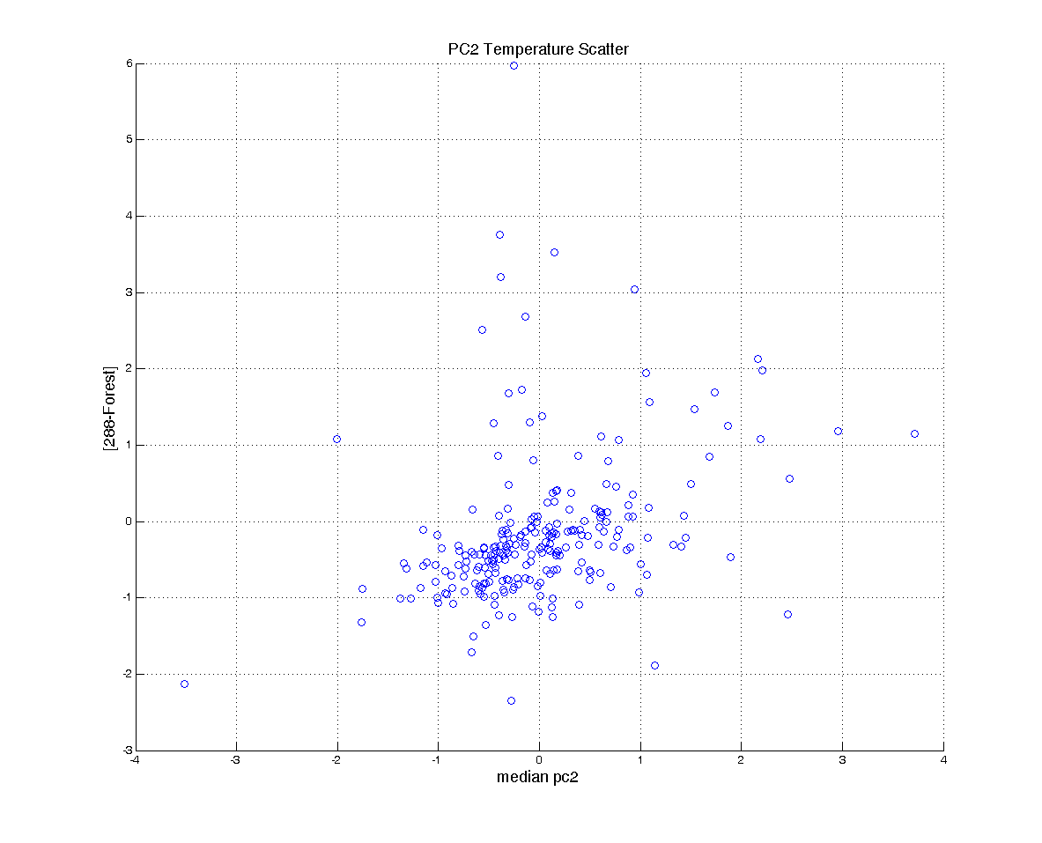
2nd component bad scatter

Slide 42
Extra

Slide 43
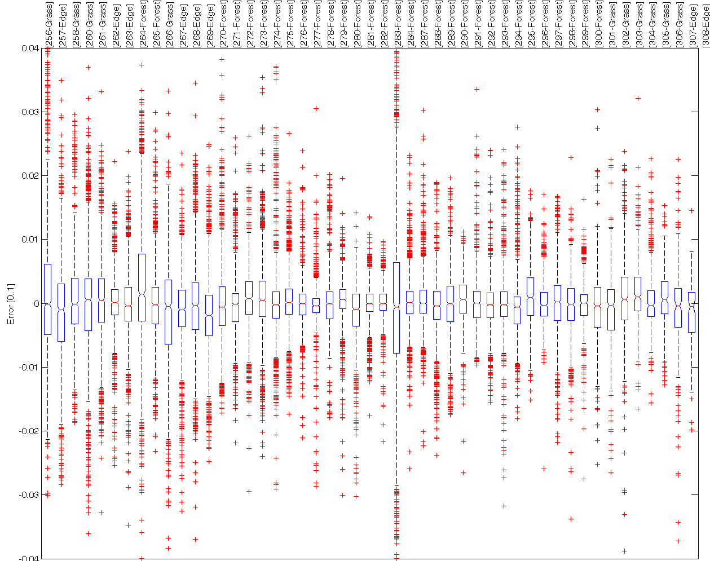
Soil Moisture Error (Location)

Slide 44
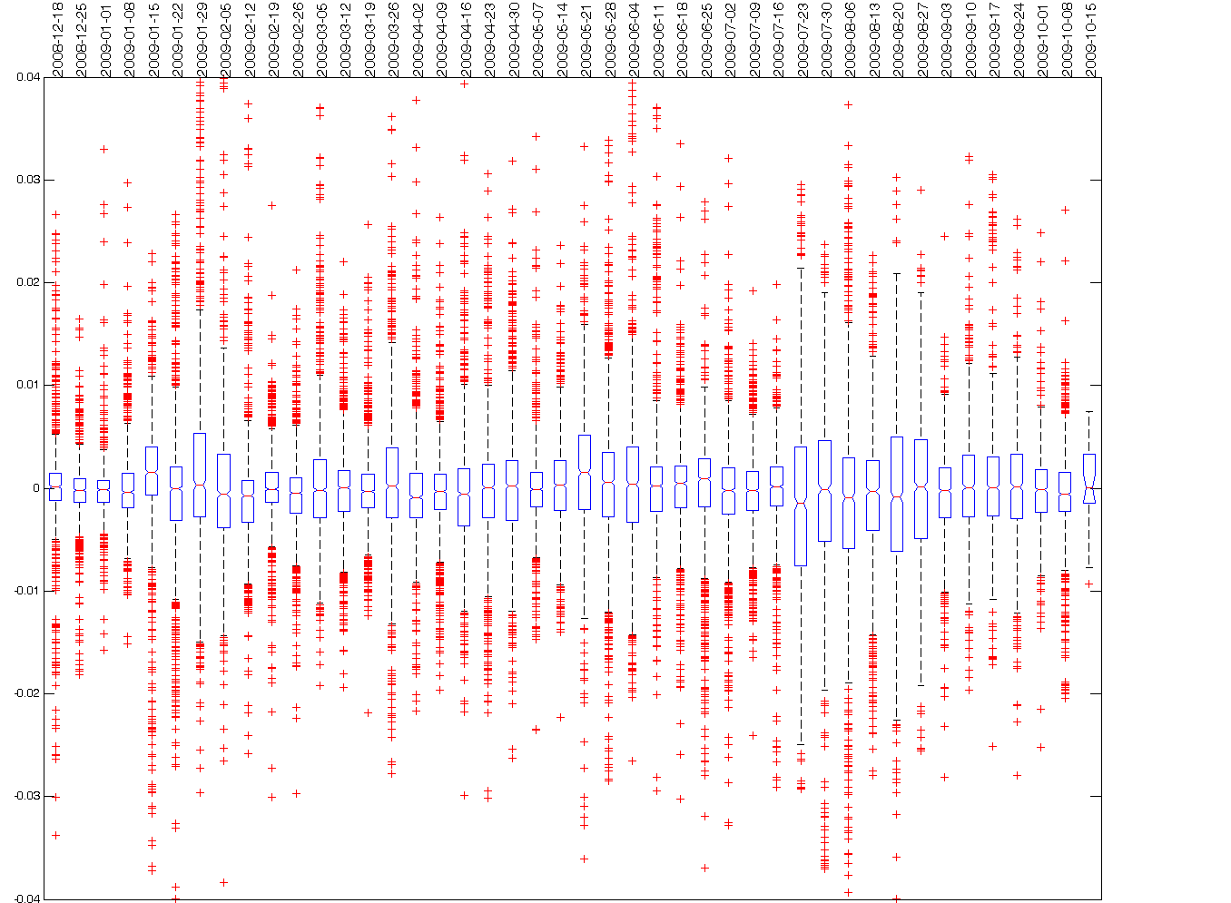
Soil Moisture in Time

Slide 45
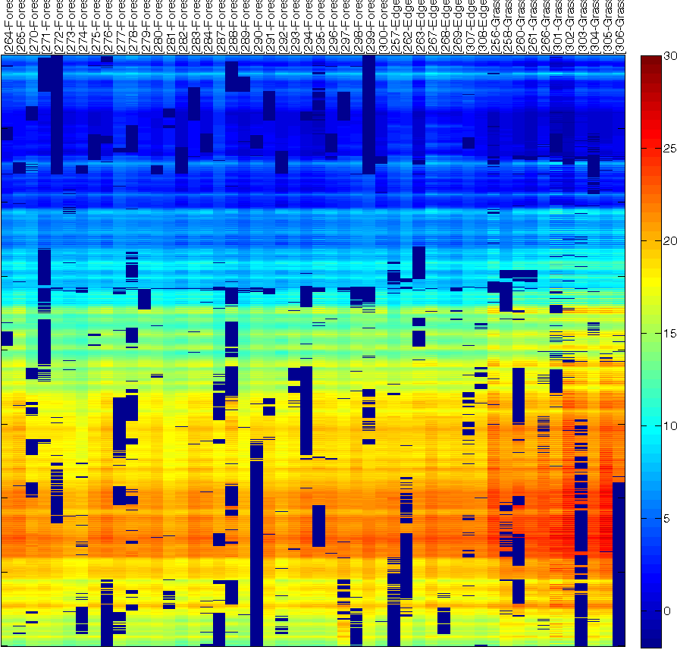
Original Vs Fault Removed

Slide 46
Example of running algorithm

Slide 47
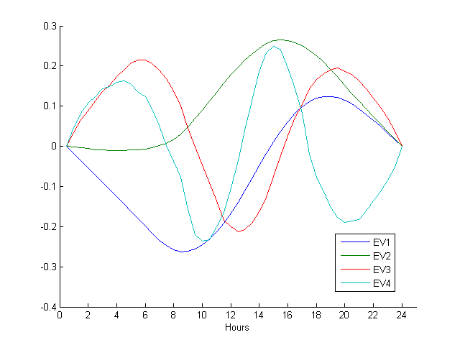
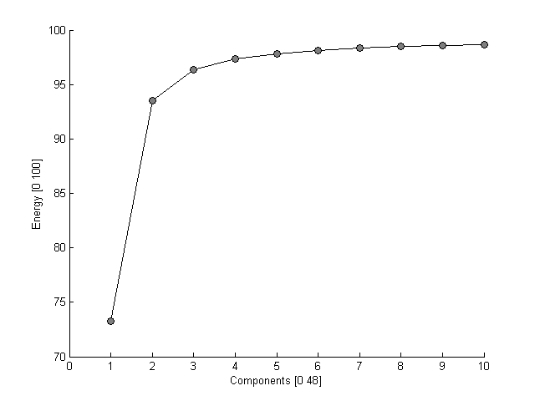
Daily Basis

Slide 48
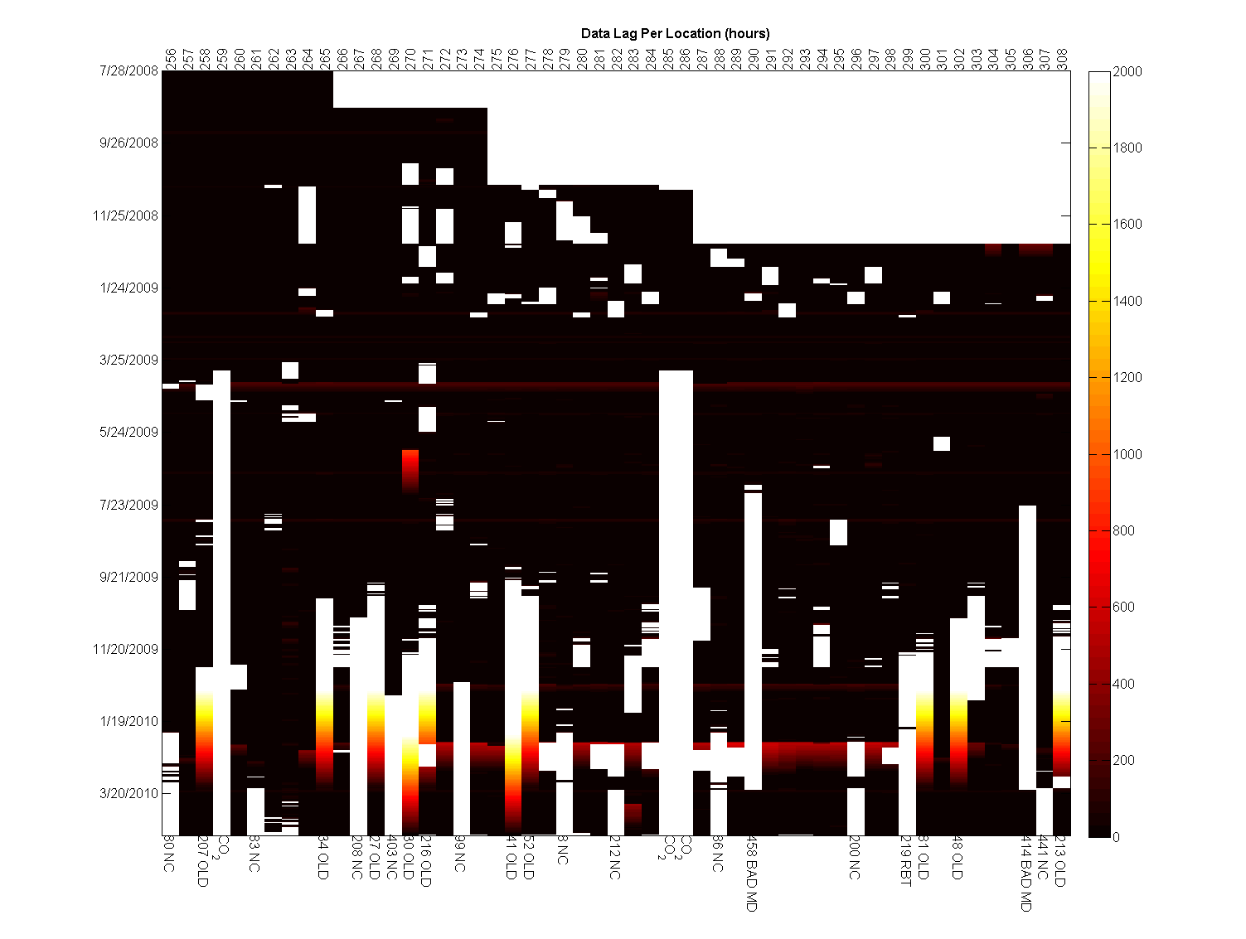
Collected measurements

Slide 49
Temporal Gap Filling
Data is correlated in the temporal domain
Data shows
Diurnal patterns
Trends
Trends are modeled using slope and intercept
Correlations captured using functional PCA

Slide 50
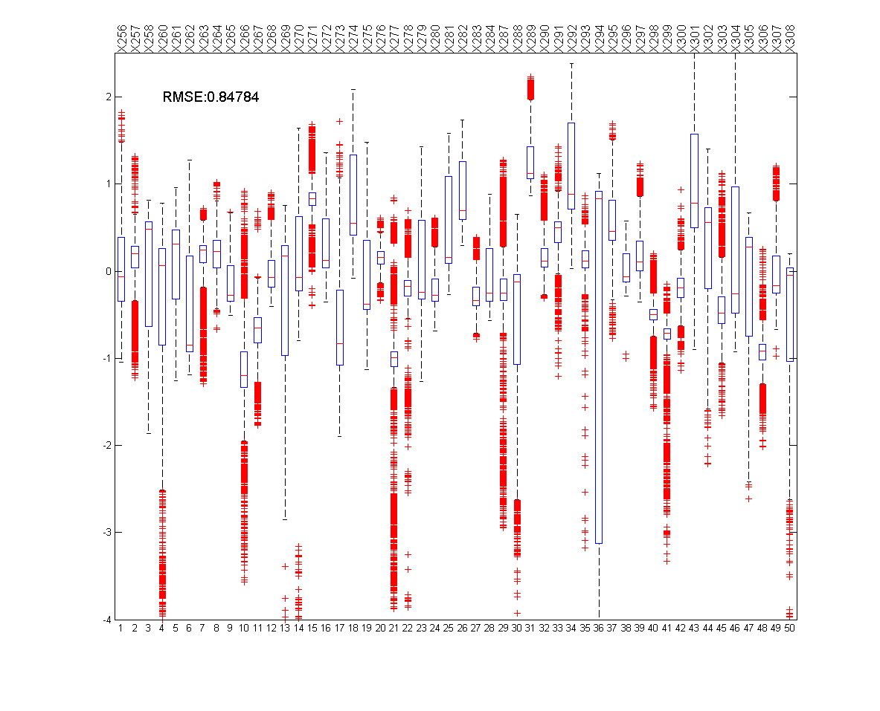
Accuracy of gap-filling
High Errors for some locations are actually due to faults
Not necessarily due to the gap-filling method

