Slide 1
Questions
Impact of number of locations on reconstruction error using eSPASS
Summer vs. Winter
eSPASS vs. Random
Impact of frequency of download

Slide 2
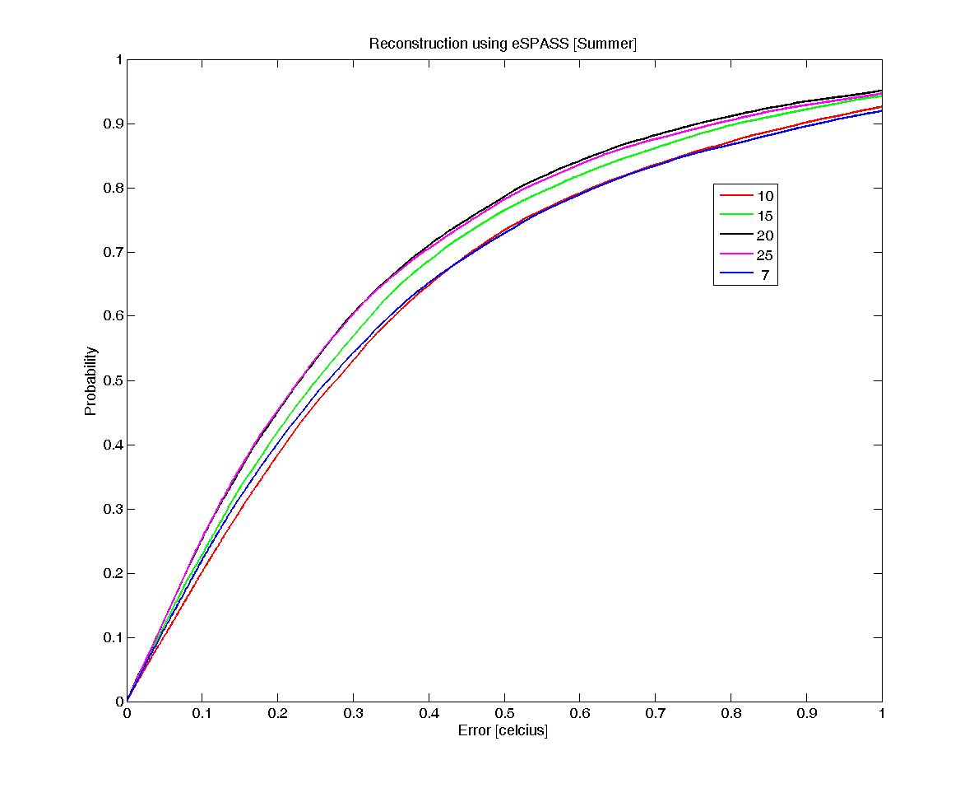

Slide 3
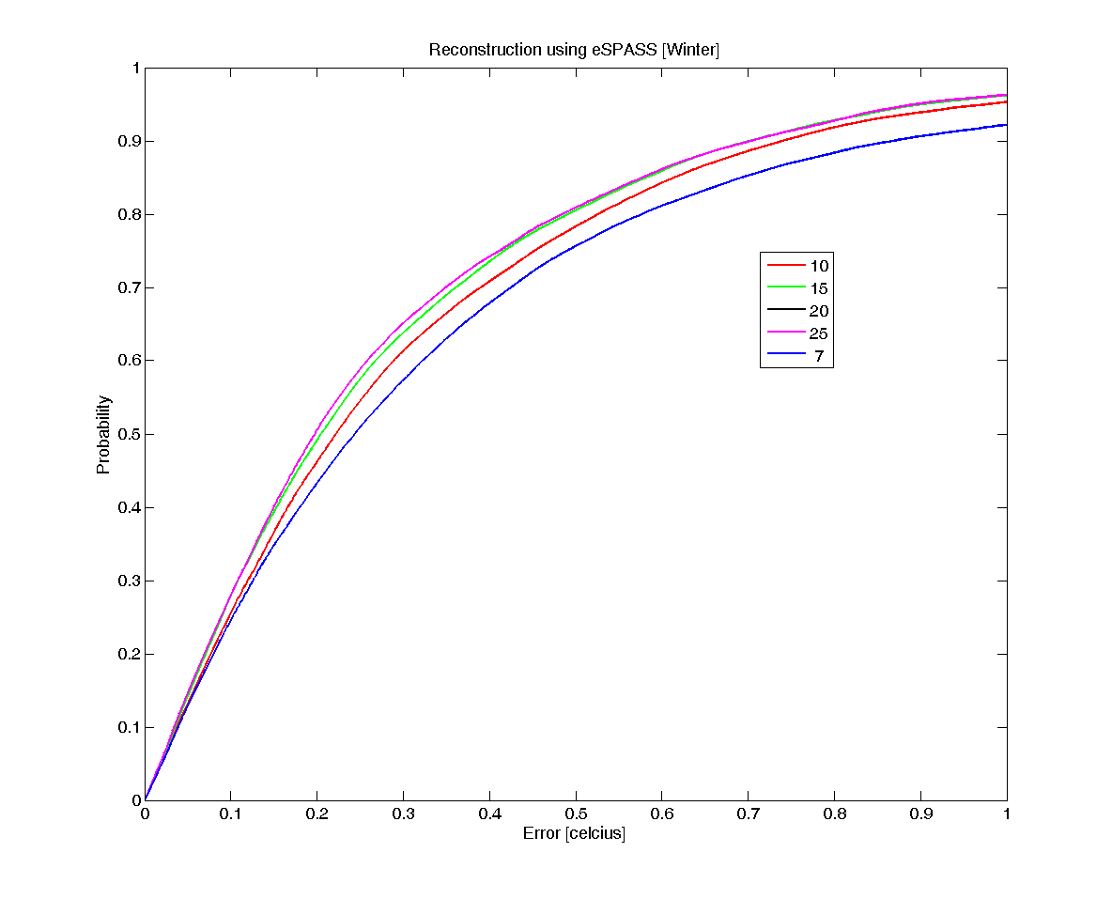

Slide 4
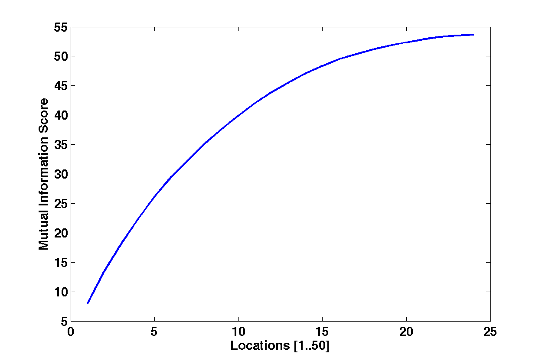
Mutual Information Criteria

Slide 5
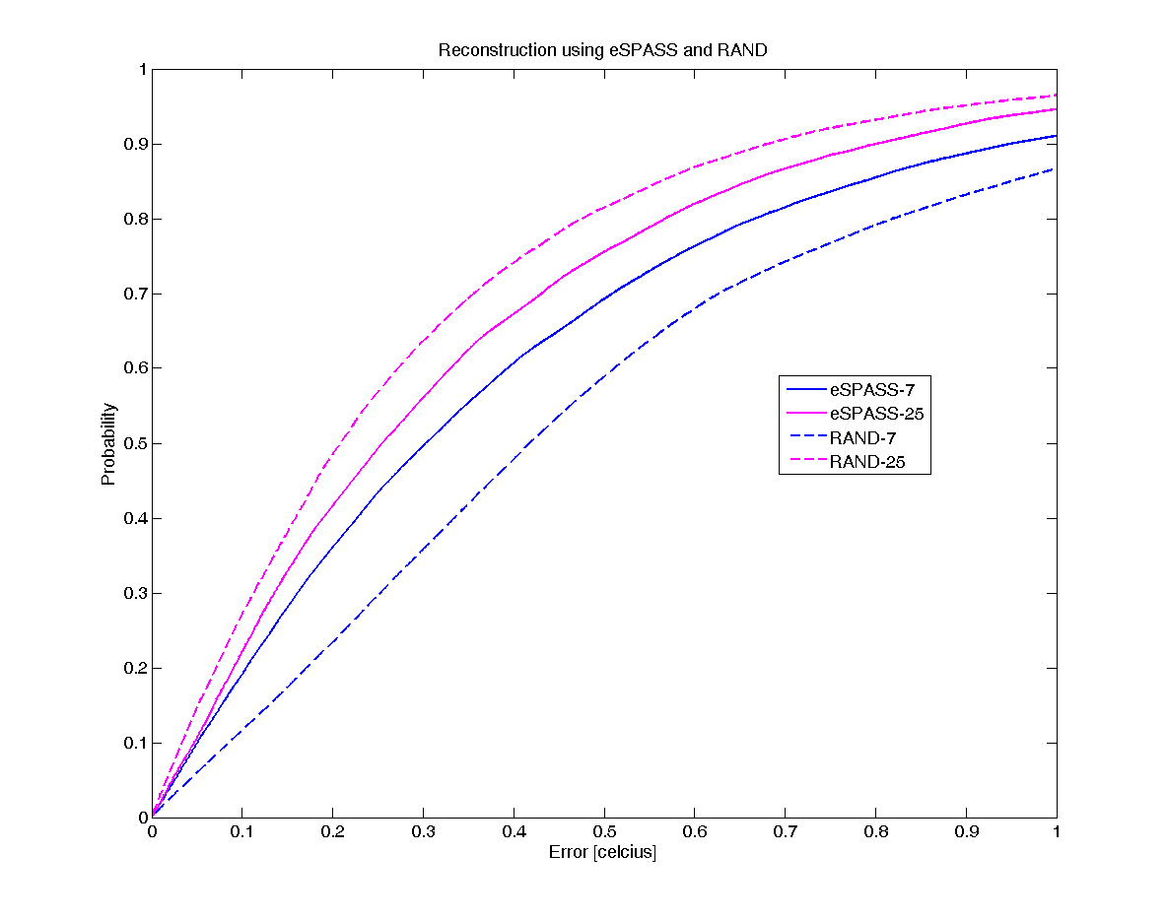

Slide 6
