Slide 1
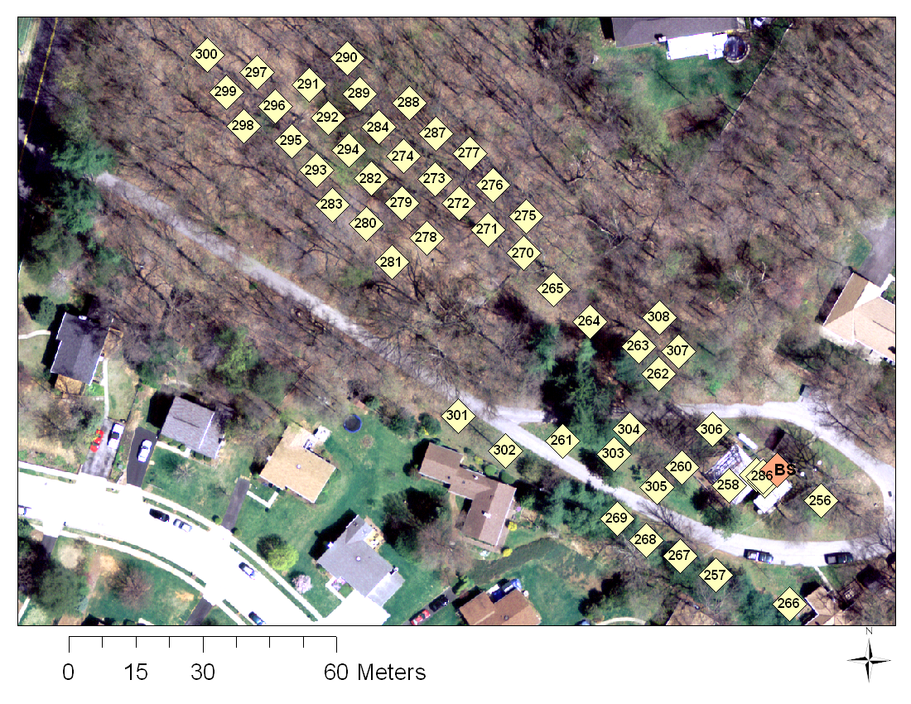
Locations

Slide 2
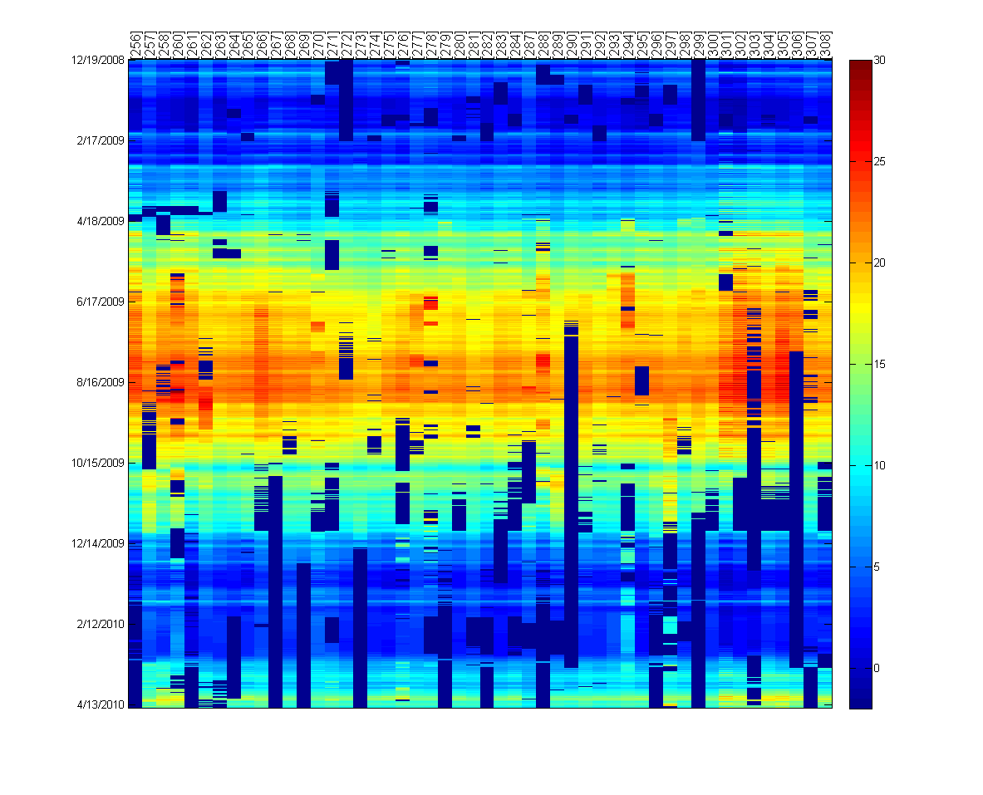
Soil Temperature Dataset

Slide 3
Observations
Data is
Correlated in time and space
Evolving over time (seasons)
Gappy (Due to failures)
Faulty (Noise, Jumps in values)

Slide 4
Temporal Gap Filling
Data is correlated in the temporal domain
Data shows
Diurnal patterns
Trends
Trends are modeled using slope and intercept
Correlations captured using functional PCA

Slide 5
Gap Filling (Connolly & Szalay)⁺
Original signal representation as a linear combination of orthogonal vectors
Optimization function
- W_{λ} = 0 if data is absent
Find coefficients, a_{i}’s, that minimize function.
⁺ Connolly et al., A Robust Classification of Galaxy Spectra: Dealing with Noisy and Incomplete Data, http://arxiv.org/PS_cache/astro-ph/pdf/9901/9901300v1.pdf

Slide 6
Soil Temperature Dataset (same as slide 2)

Slide 7
Gap-filling using Daily Basis
Good
Period
Only 2% of the data could be filled using daily model

Slide 8
Observations
Hardware failures causes entire “days” of data to be missing
Temporal method (only using temporal correlation) is less effective
If we look in the spatial domain,
For a given time, at least > 50% of the sensors are active
Use the spatial basis instead.
Initialize spatial basis using the period marked “good period” in previous slide

Slide 9
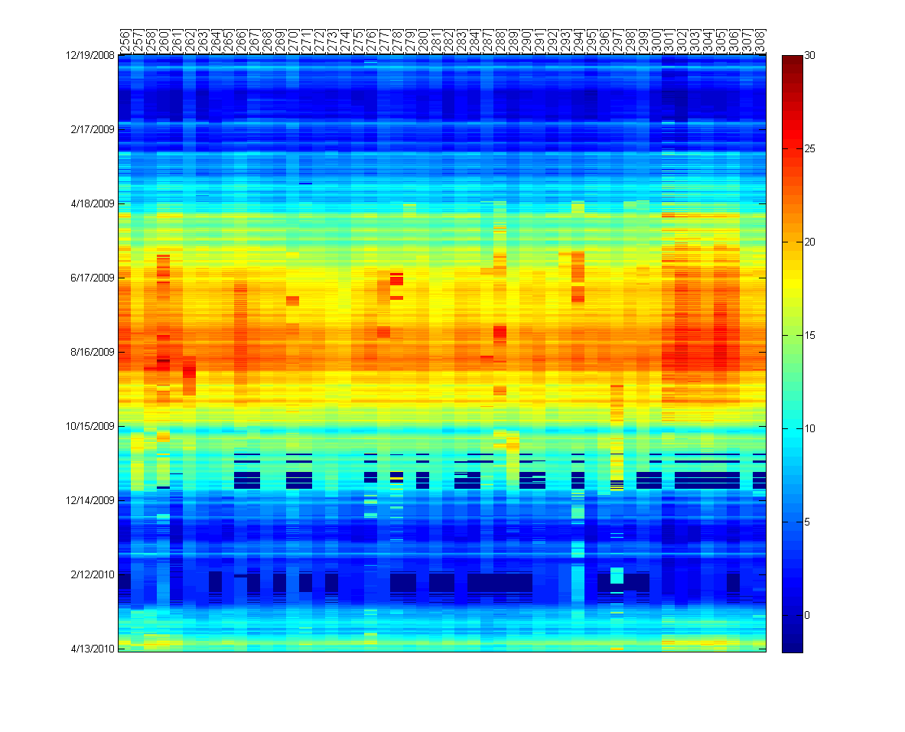
Gap-filling using sensor correlations
Faulty data
Too many missing readings for this period (Snow storm!)

Slide 10
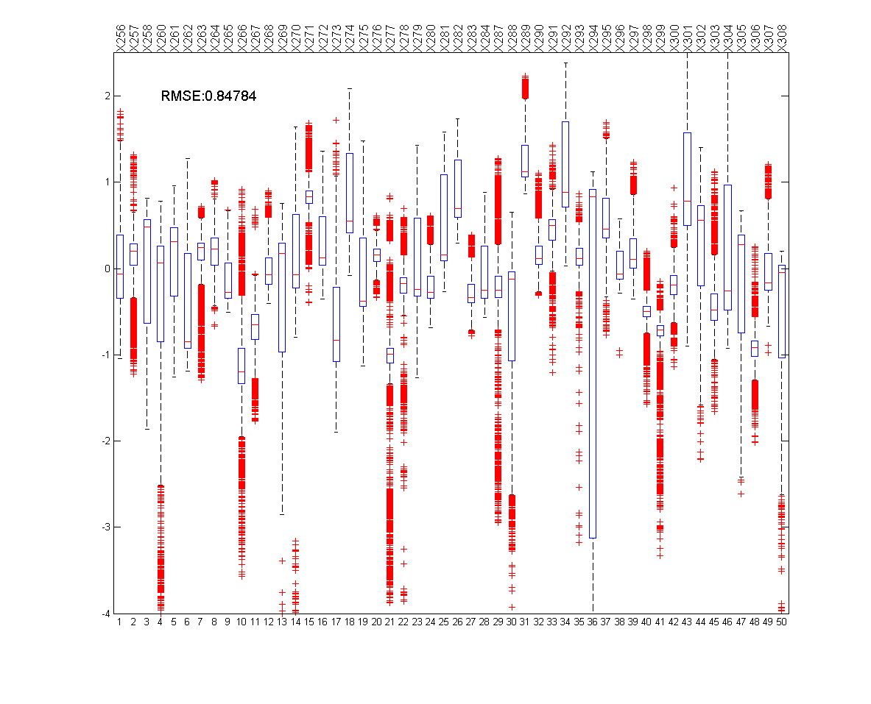
Accuracy of gap-filling
High Errors for some locations are actually due to faults
Not necessarily due to the gap-filling method

Slide 11
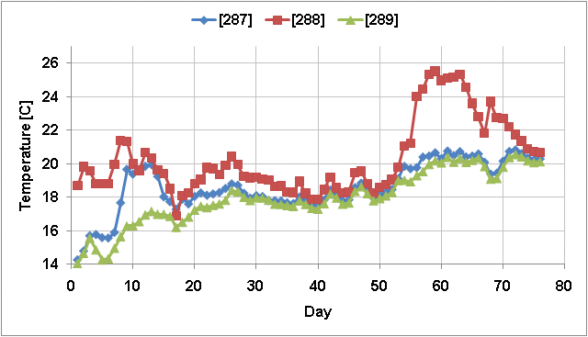
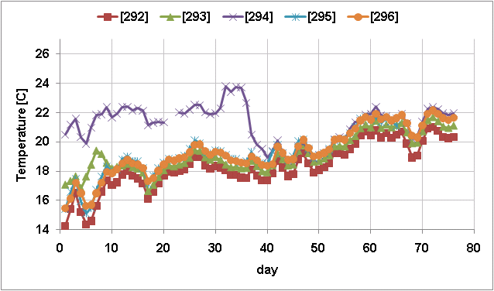
Examples of Faults

Slide 12
Observations & Incremental Robust PCA *
Data are faulty
Pollutes the basis
Impacts the quality of gap-filling
Basis is time-dependent
Correlations are changing over time
Simultaneous fault-detection & gap-filling
Initialize basis using reliable data
Using basis at time t,
Detect and remove faulty readings
Weight new vectors depending on residuals
Update thresholds for declaring faults
Iterate over data to improve estimates
⁺ Budavári, T., Wild, V., Szalay, A. S., Dobos, L., Yip, C.-W. 2009 Monthly Notices of the Royal Astronomical Society, 394, 1496, http://adsabs.harvard.edu/abs/2009MNRAS.394.1496B

Slide 13
Gap-filling using sensor correlations (same as slide 8)

Slide 14
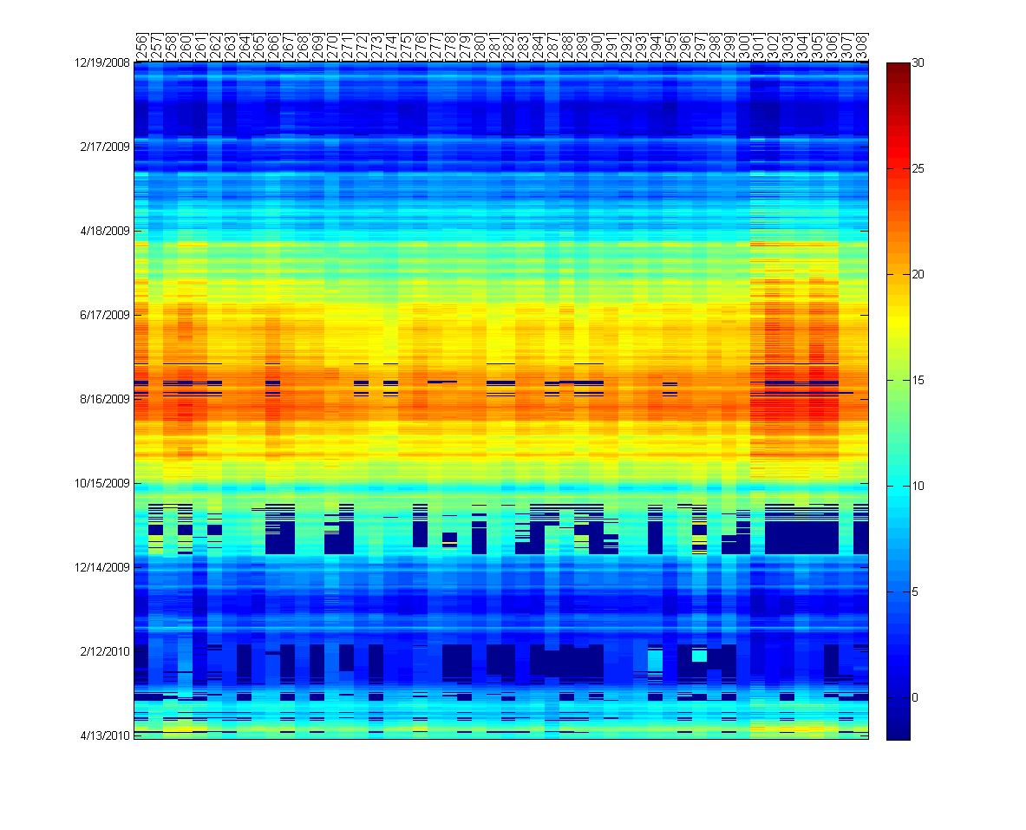
Iterative and Robust gap-filling
Fault removal leads to more gaps and less data to work with
However, data looks much cleaner.

Slide 15
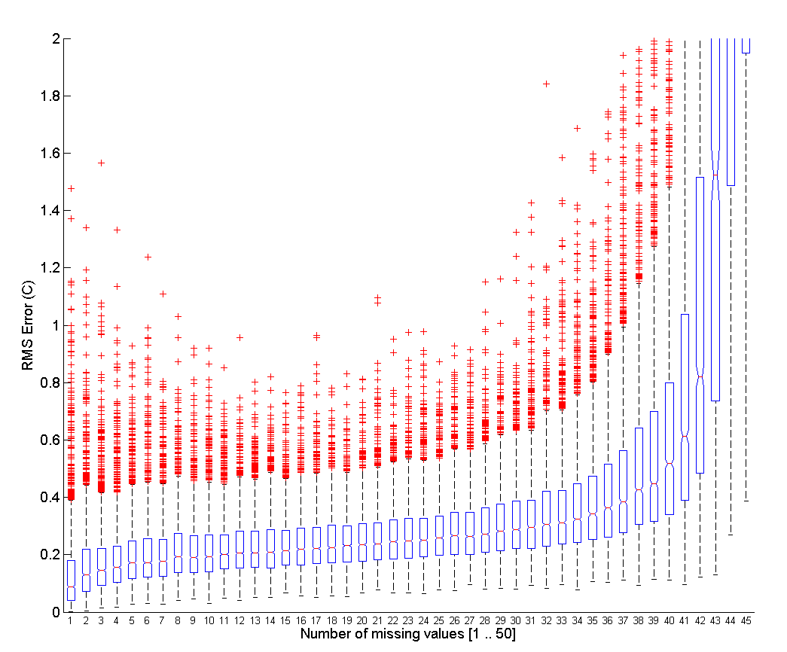
Impact of number of missing values
Even when > 50% of the values are missing
Reconstruction is fairly good

Slide 16
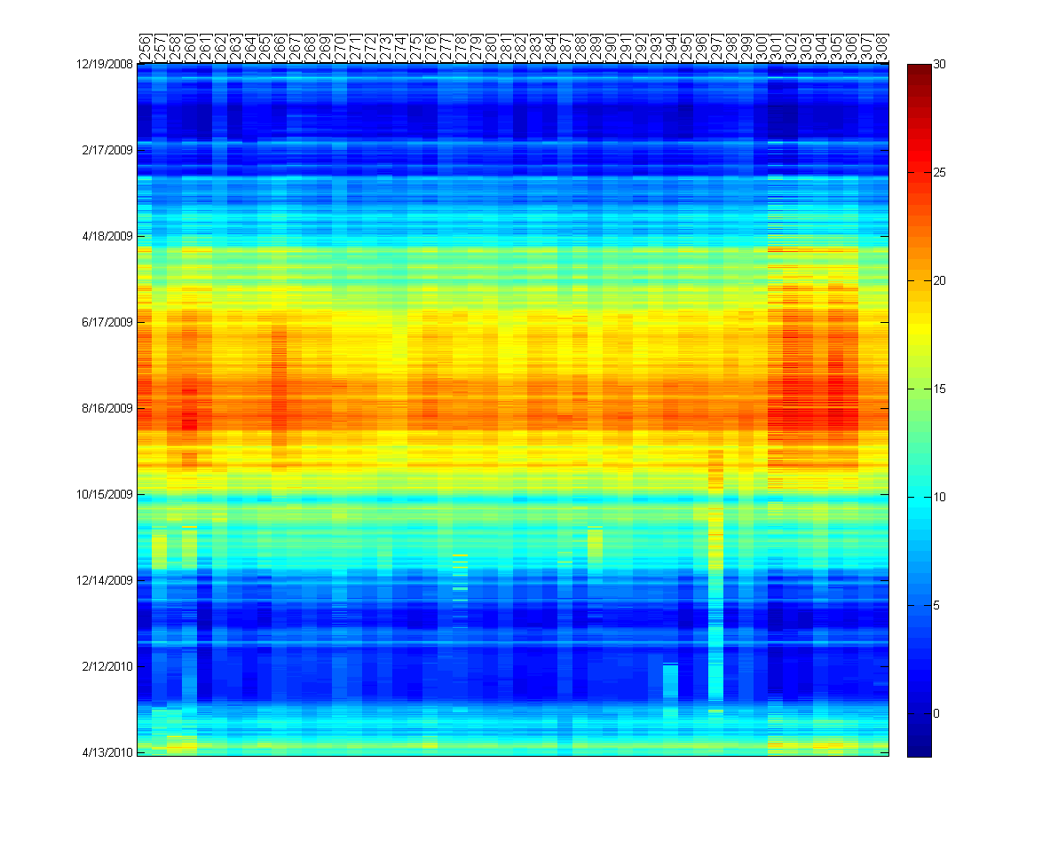
Iteration - I

Slide 17
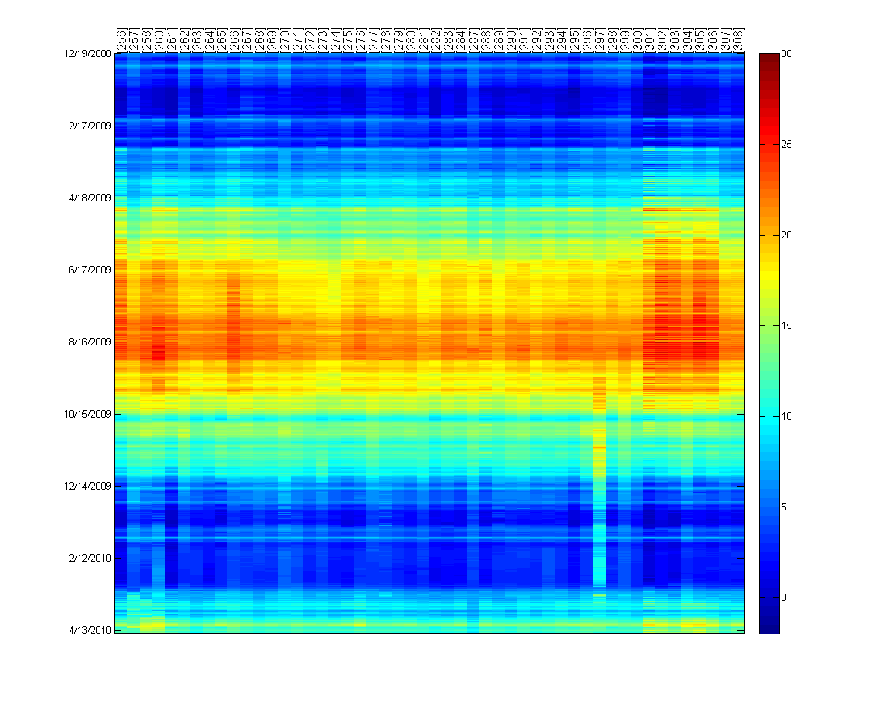
Iteration - II

Slide 18
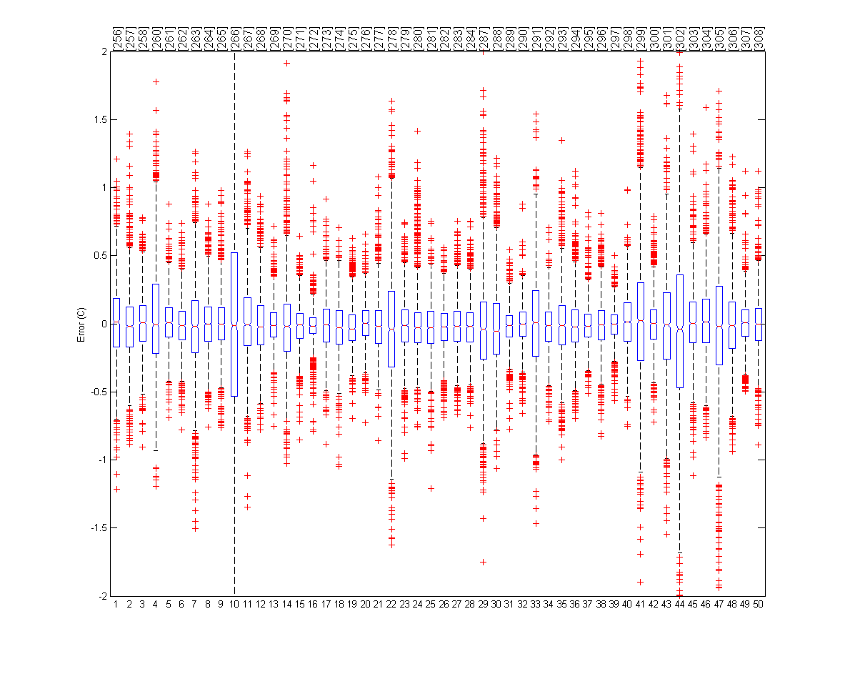
Accuracy using spatiotemporal gap-filling
Locations

Slide 19
Example of running algorithm

Slide 20
ETC

Slide 21
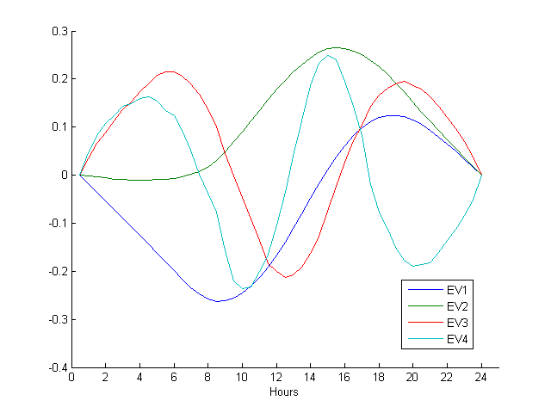
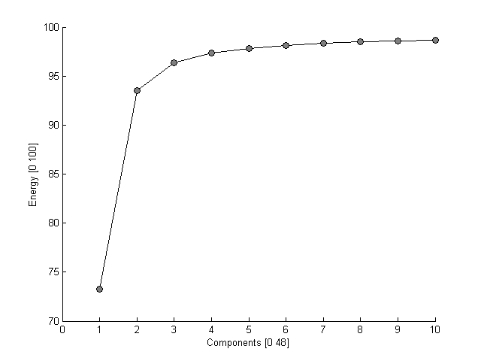
Daily Basis

Slide 22
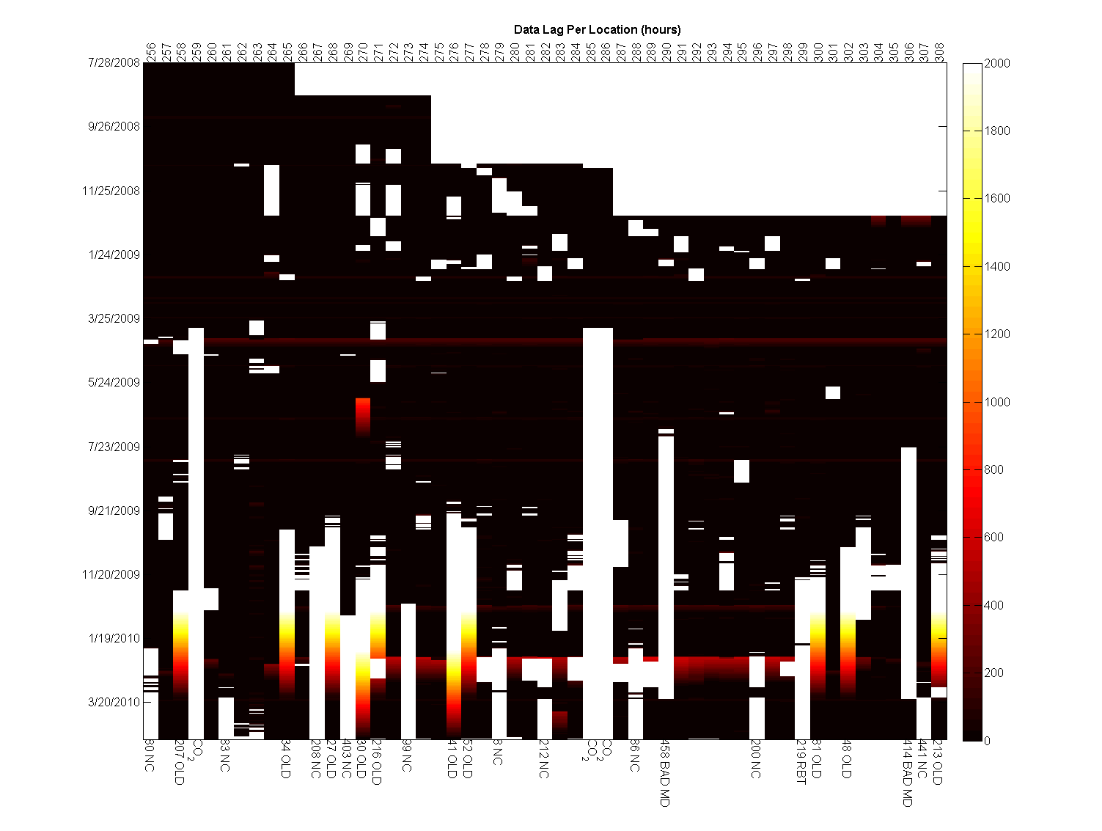
Collected measurements

