Slide 1
Brazil Timestamp Reconstruction

Slide 2
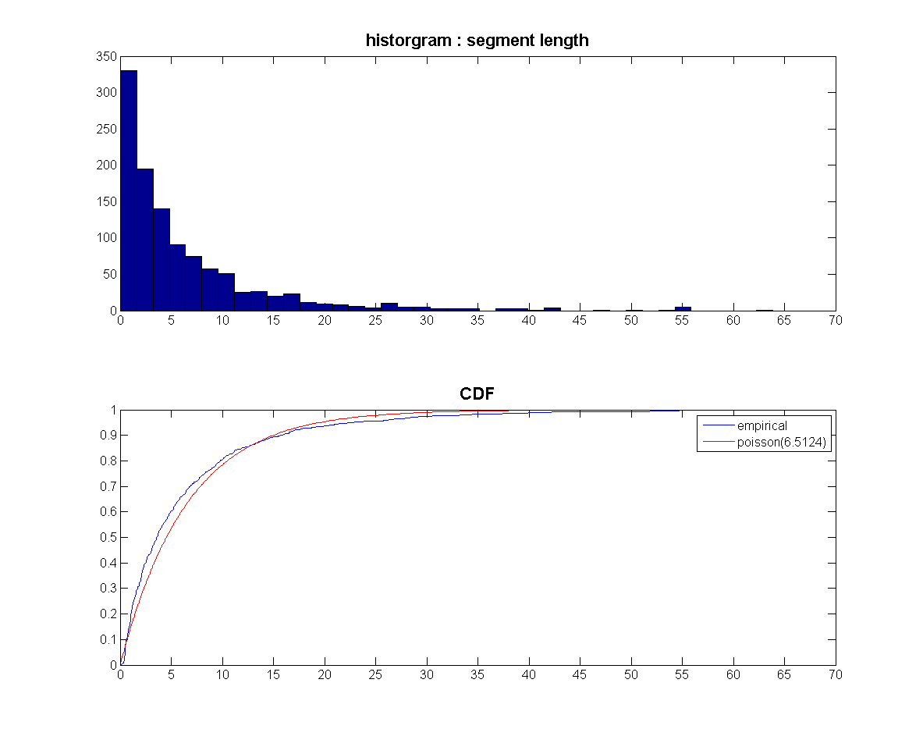
Problem: Reboots
Too many Reboots!

Slide 3
Existing Issues
Reboots happen
unable to trace bug(s) causing them
Current Time reconstruction
Heavily dependent on the basestation
BS can go down
BS can drift even if synced to NTP periodically. Possibly due to network outages
FIX : Need to resort to tricks and magic to reconstruct segments with no anchors and multiple reboots.

Slide 4
Better Fix : Friends of Friends
Assume one of the nodes knows the global clock (e.g. A dedicated GPS node)
Each nodes beacons the following periodically
<nodeid, rbtCounter, localclock>
Listening nodes record these advertisements and form a local-local anchor pair
<node1, rc1, lc1, node2, rc2, lc2>
Listen After reboots
Periodically (once a day/ 12 hrs/ 6hrs depending on reboot rate!)
Eventually someone will know how to get to the globalclock

Slide 5
Example
<node2, lc2, rbt2>
<node2, lc2, rbt2, globalclock>
<node1, lc1, rbt1>
<node1, lc1, rbt1, globalclock>
GPS
Node
Data
Node

Slide 6
Example
1
Chi (1,2)
Chi (1,3)
2
Chi (2,3)
3
Chi (2,4)
Chi (3,4)
4
Time
Recovered

Slide 7
Example

Slide 8
Example

Slide 9
Example

Slide 10
Node States & Events
Sample
SENSE
(final)
DOWN
(final)
Turning off
Multiple
Reboots
beacon
Sleep
Turning off
Periodic
Anchor
collection
Power up
LISTEN
Receive

Slide 11
Simulation Parameters
Topology : Cub hill
Segment Model : Poisson (mu) [ ~ 2 days ]
Prob (stay down for a while) = 0.05
Amount of time node stays down ~ U (0 12hrs)
Beacon frequency (30s)
Wake up / Listen (after reboot & every “x” hours)
Communication Model
Neighbor : Anyone within 30m of another node
Communication delay ~ U(10ms, 20 ms)
Prob (success) = 0.95
Clock Drift : x ppm ( typically, 40 ppm)
GPSSync : On Reboot & every 6 hours
Known sensing process : Sine (1 day) + trend
Sampling Frequency : 30s

Slide 12
Data
Fake Data value (Sine + trend) →
Unixts →

Slide 13
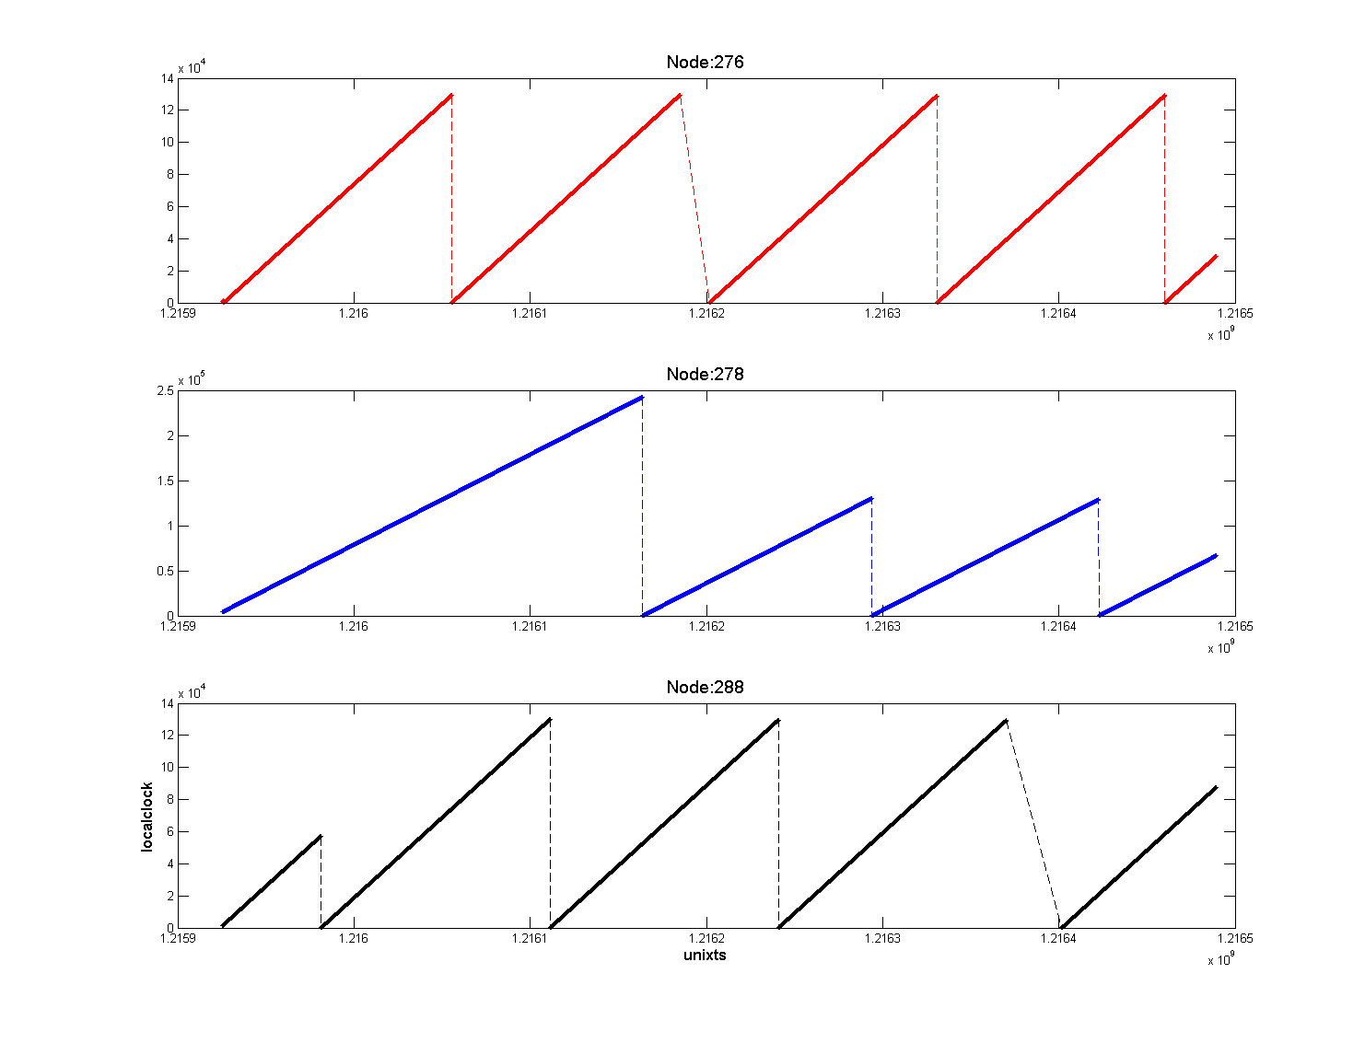
Segments
Localclock →
Unixts →

Slide 14
Implementation
Java 1.5
Used priority queues to simulate time

Slide 15
Timestamp Reconstruction (C#)
Form a forest of <nodes, rbt#> pairs
Form all <local, local> fits
record the goodness of fit (ChiSquare)
Create fit for the GPS segments
curr = {gpsSegments}
While (!empty(curr))
a = Dequeue(curr)
If exists(globalFit(a) & localFit(a,b)) // for all neighbors of a
currFit(b) = Map (a,b) // use <a,b> local fit to get a global fit for b
If ChiSquare(currFit (b) < globalFit(b))
globalFit (b) = currFit (b) // if new fit is better, update!
Update ChiSquare (b)
Parent(b) = a // update new parent of a
Enqueue(curr, b) // Add b to curr list
End of While

Slide 16
1 week simulation - No Drift
54 nodes (1 GPS node + 53 Sensing nodes)
214 segments
Anchors collection scheme
All neighbors
6 hour collection
0 s err

Slide 17
Reconstruction with Clock Drift

Slide 18
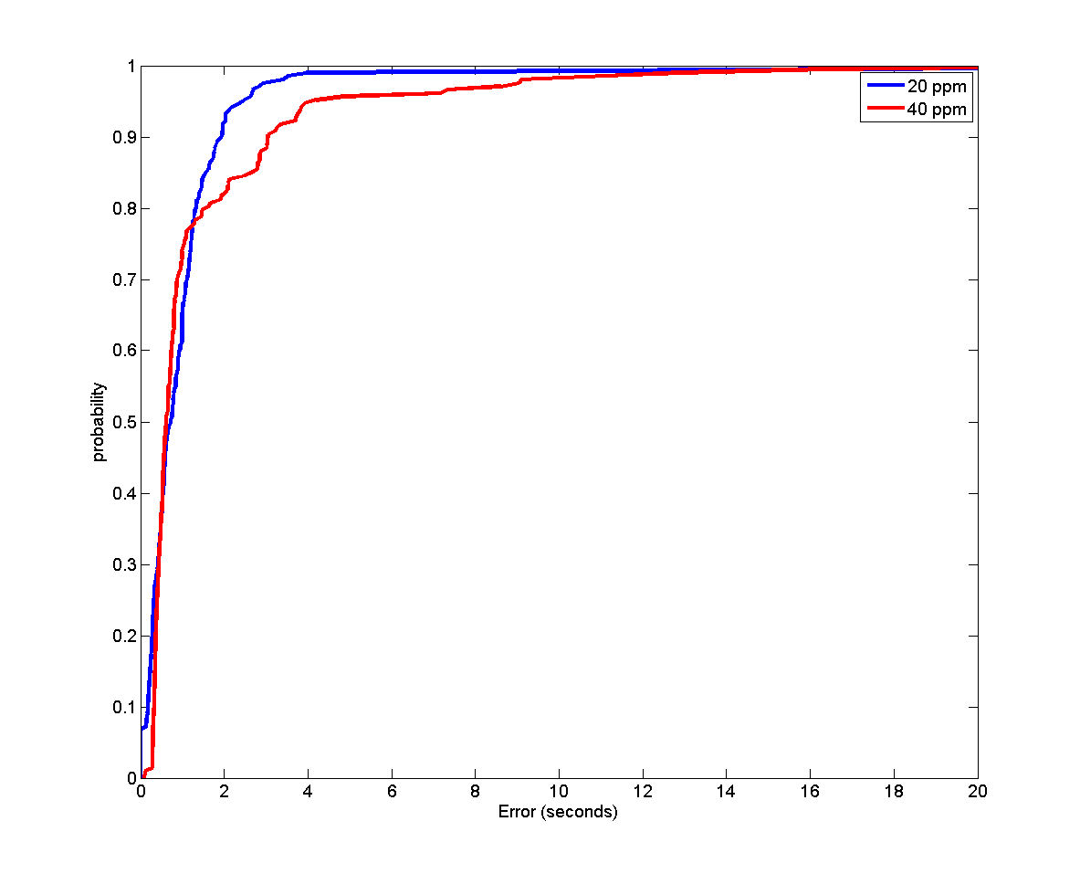
Error CDF

Slide 19
Explore Further
More sophisticated drift in localclock
Add a random noise to the process (sine + trend + noise)
Optimal # of anchors needed for a given accuracy
Space-accuracy tradeoff
Collecting anchors from all neighbors is costly (space wise)
Is it really needed?
More anchors from a few reliable neighbors with long segments should be better
Earliest reconstruction (online case) Vs Best reconstruction
Currently Djiktra-like algorithm used for reconstruction
Reboots are not random
Link reboots to download times

