Slide 1
Adaptive Data Collection in Environmental Sensor Networks
Jayant Gupchup
gupchup@jhu.edu

Slide 2
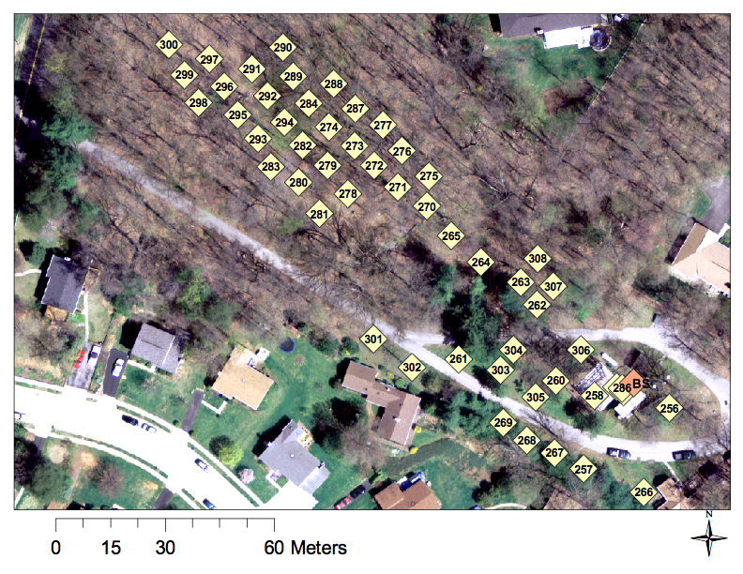
Cub Hill Network

Slide 3
Question
Downloading data from everyone is expensive
Radio usage consumes power
Most of the time nothing interesting is happening
Data is strongly correlated

Slide 4
Proposal
Download data from a representative set that captures the variation in data
Minimizes communication costs
Extends the lifetime of the network
Reconstruct data using a model and the representative sensors

Slide 5
Challenges
How do you pick informative locations
How many do we need?
How stable is the working set?
How do you reconstruct data for the “unobserved” locations
How do we estimate/measure the reconstruction error

Slide 6
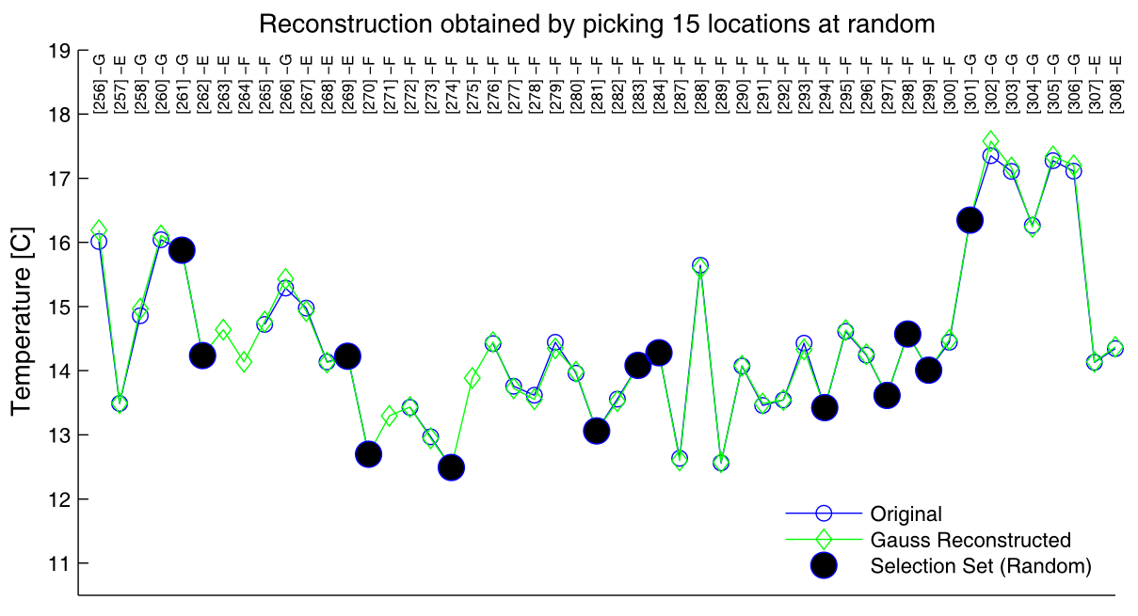
Example

Slide 7
Information Theoretic Approach

Slide 8
How many locations ?

Slide 9
Questions?

Slide 10
Data

Slide 11
Reconstruction using PCA basis

Slide 12
Working set frequency

Slide 13
Number of location

Slide 14
Smarter way?
Information gain criteria
A represents working set of locations
V\A represents locations NOT selected

Slide 15
Compare with Random

Slide 16
Scree plot (median)

Slide 17
Scree Plot (95th percentile)

