Slide 1
Temporal Integrity Challenges
in Long-term Environmental
Monitoring Sensor Networks.
Jayant Gupchup†
Alex Szalay±, Andreas Terzis†
Department of Computer Science, Johns Hopkins University†
Department of Physics and Astronomy, Johns Hopkins University±

Slide 2
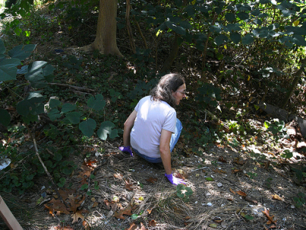
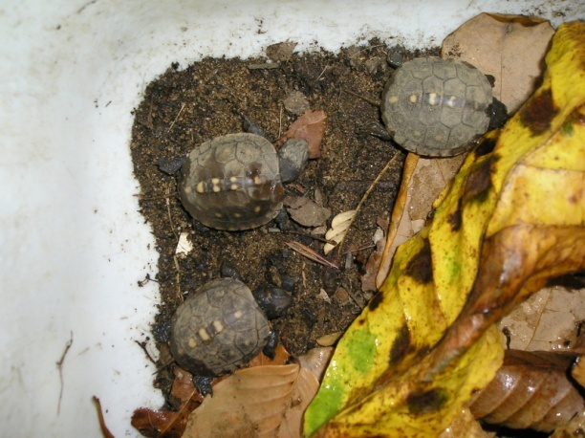
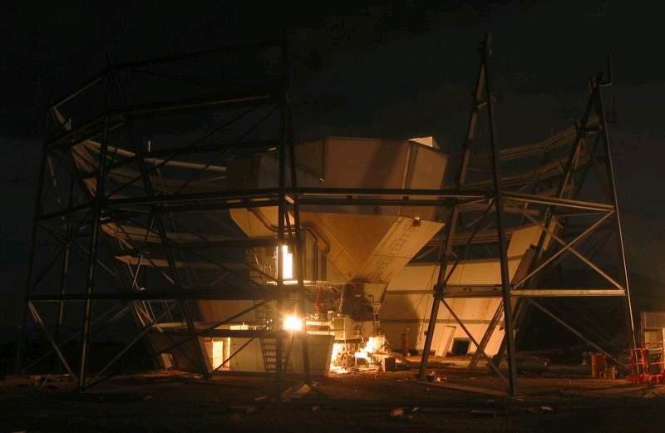
Data Collection History

Slide 3
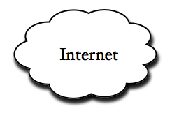
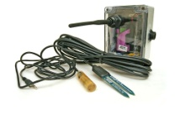
A Typical Sensor Network
Stable
Storage
Gateway/
Basestation
…….
3.6 V
19.0 Ah
Notes:
Bring a box and explain the contents. Leave out optimization stuff. Operate for long periods of line.

Slide 4
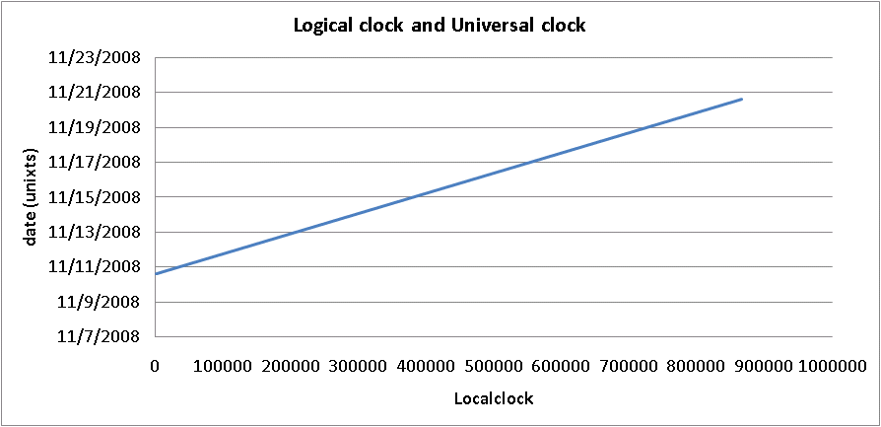
Post Mortem Time Reconstruction
Clock-Synchronization is expensive (power-wise)
Motes operate asynchronously
Each mote uses a local clock
Measurements are marked using local clock (LTS)
GTS = α * LTS + β
GTS is the global timestamp (unixts)
α is the clock skew
β is the start time
Periodically collect (LTS,GTS) pairs. “Anchor Points”
Estimate [α β]
Slope (α ):
Clock Skew
β
Notes:
Expand Anchor points

Slide 5
Sources of Errors & Effects
Motes Reboot (data comes in segments)
Low Battery
High Moisture
Software bugs
Motes stay down for indefinite period
Global clock source can be off
Sync Global clock source (GPS, Network time protocol)
After every reboot < α , β > needs to be re-estimated

Slide 6
Bitten by the clock
Lessons Learnt
Synchronize global clock source(s)
Collect more anchor points for reliability and robustness

Slide 7
Validation and Extreme cases
Reconstruct timestamps if no anchor points are collected
Global clock source goes down
Nodes get disconnected from the network

Slide 8
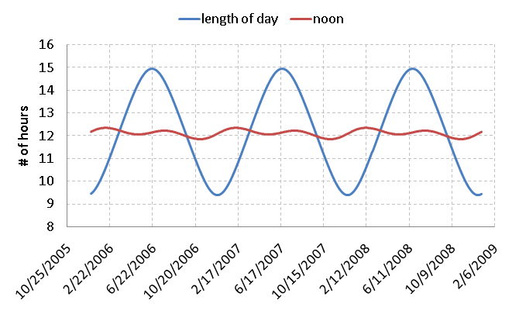
Annual Solar Patterns
<LOD, noon> = f (Latitude, Time of Year)

Slide 9
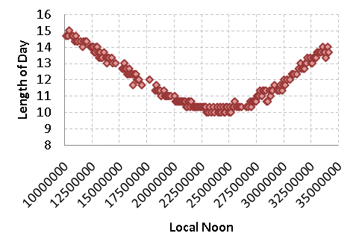
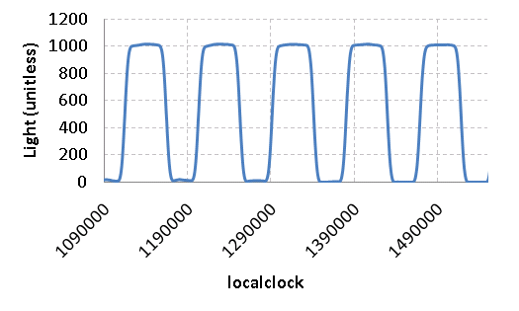
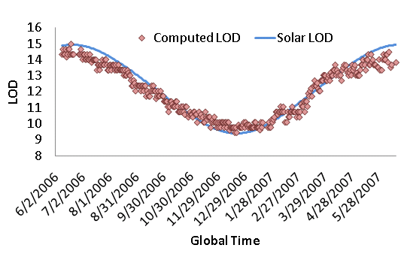
“Sundial”
Noon
Length of day (LOD)
argmax _{lag} Xcorr (LOD _{lts}, LOD _{gts}, lag)
Local Noon | Global Noon
Lts ₁ | Gts ₁
Lts ₂ | Gts ₂
… | …
… | …
Lts _{n} | Gts _{n}
“Anchor Points”

Slide 10
Summary
Postmortem timestamp reconstruction can be non-trivial
Thought needs to go in during system design
Fall back on data-driven reconstruction methods when all else fails.

Slide 11
Questions
Courtesy : http://upload.wikimedia.org/wikipedia/commons/4/46/Atacama_cosmology_telescope_night.jpg

Slide 12
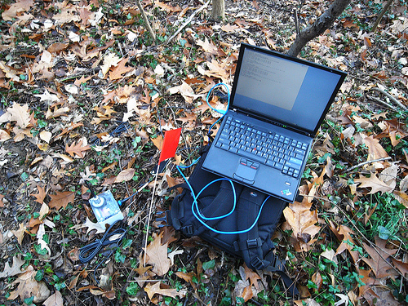
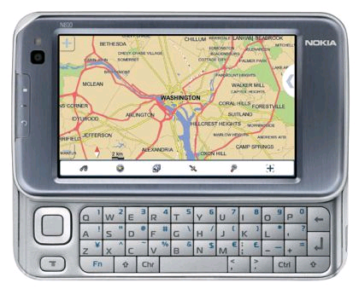
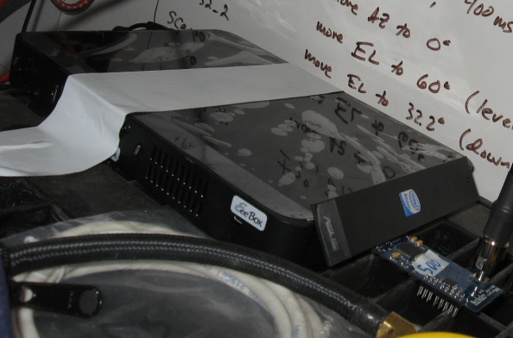
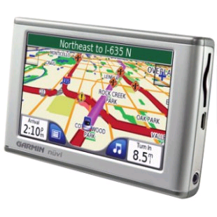
Collecting Anchors (<local, global>)
2009

Slide 13
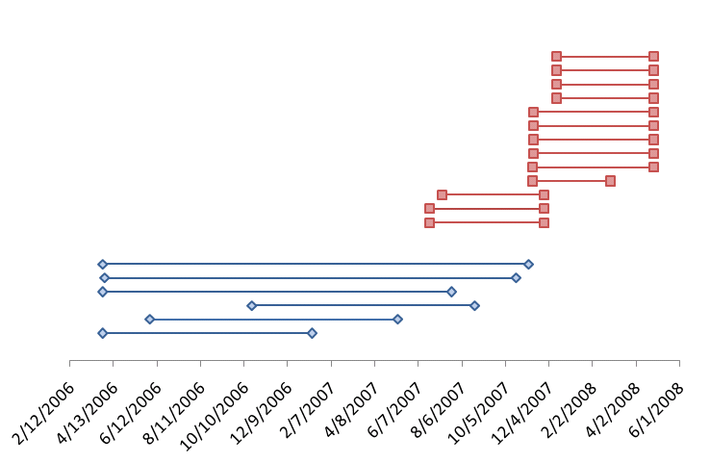
Segments
“Jug bay” Deployment
Telos B motes
30 minute sampling
13 boxes
Max Size : 167 days
“Leakin” Deployment
MicaZ motes
20 minute sampling
6 boxes
Max Size : 587 days

Slide 14
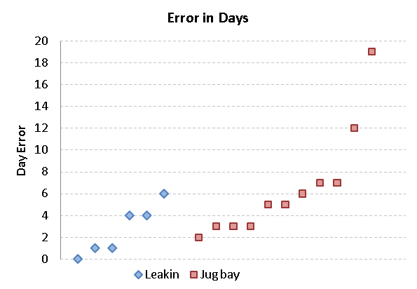
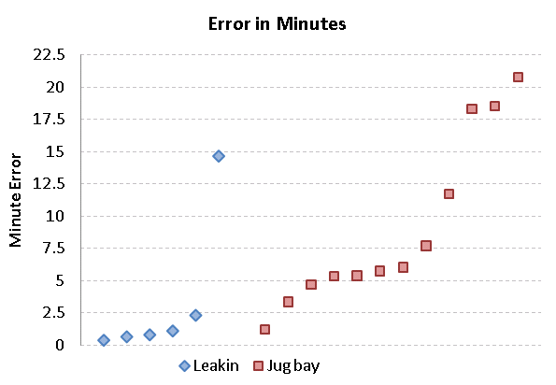
Reconstruction Results
Day Error
Offset in days
Proportional to Error in
Intercept (β)
Minute Error
RMSE Error in minute within the day
Proportional to Error in slope/clock
drift (α)

