Slide 1
Statistical challenges
In Sensor Networks
Jayant Gupchup,
Advised by:
Alex Szalay, Andreas Terzis

Slide 2
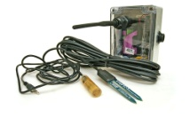
A Typical Sensor Network
Stable
Storage
Gateway/
Basestation
…….
3.6 V
19.0 Ah
Notes:
Bring a box and explain the contents. Leave out optimization stuff. Operate for long periods of line.

Slide 3
Collect-All Methodology
Nodes collect data
Basestation retrieves “All data”
In many scenarios – Wasteful
Most of the time nothing interesting is happening
More communications means more power consumption

Slide 4
Approaches
Adapt the sampling rate
Online solution
Collect data from fewer locations during non-interesting times
Offline solution

Slide 5
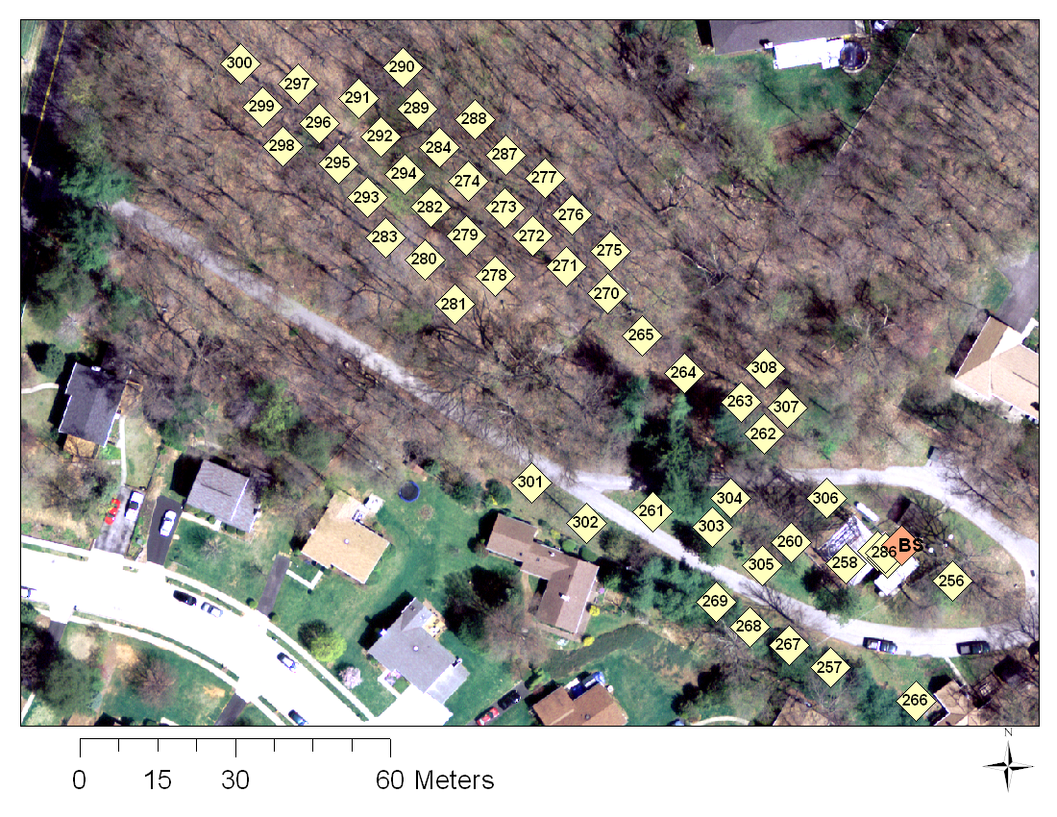
Informative location?

Slide 6
Mutual Information
Notes:
Formulas for entropy and mutual information

Slide 8
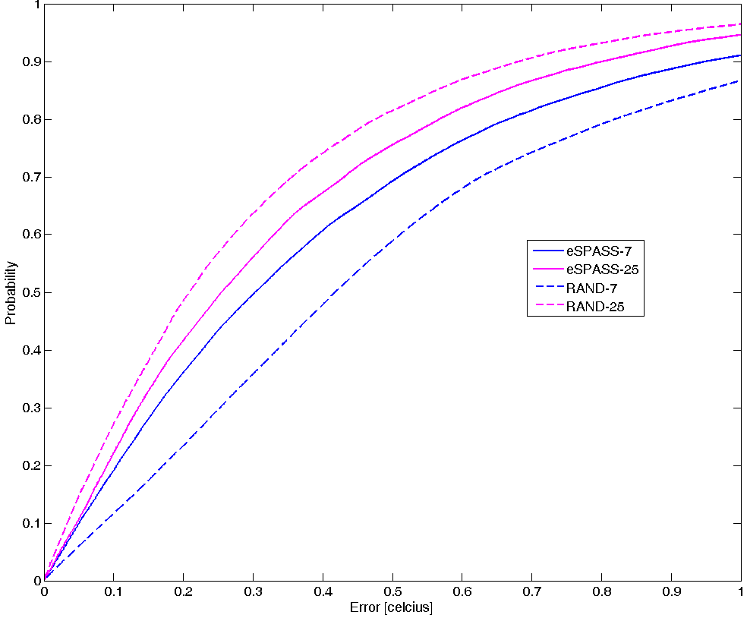
Compare with random

Slide 10
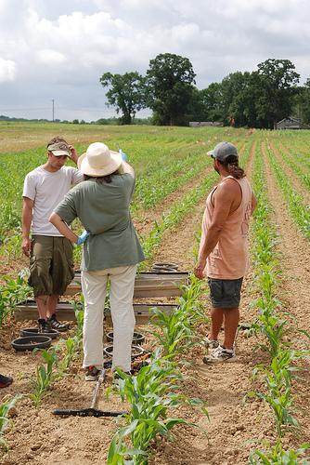
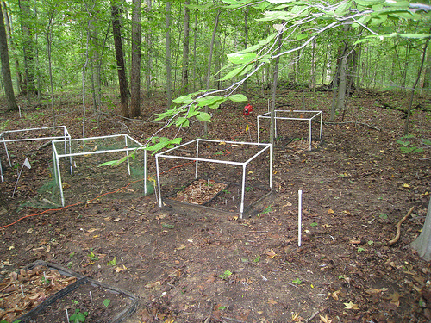
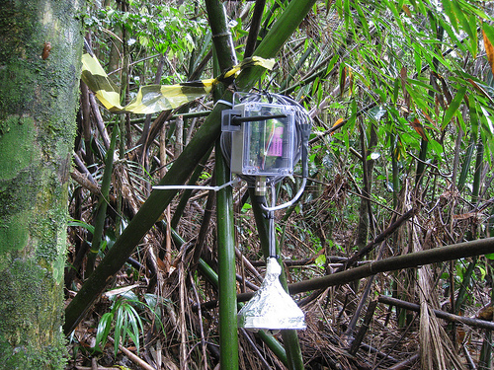
Questions

Slide 11
Gap Filling (Connolly & Szalay)⁺
Original signal representation as a linear combination of orthogonal vectors
Optimization function
- W_{λ} = 0 if data is absent
Find coefficients, a_{i}’s, that minimize function.
⁺ Connolly et al., A Robust Classification of Galaxy Spectra: Dealing with Noisy and Incomplete Data, http://arxiv.org/PS_cache/astro-ph/pdf/9901/9901300v1.pdf

Slide 12
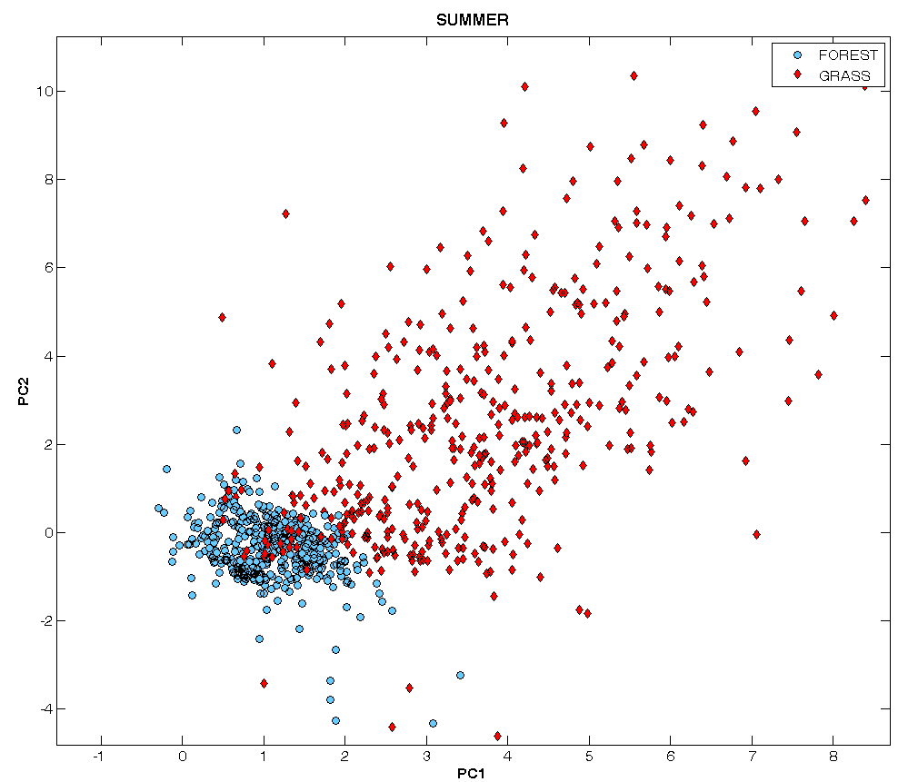
Forest Grass Summer

Slide 14
