Slide 1
Phoenix:
An Epidemic Approach to
Time Reconstruction
Jayant Gupchup†, Douglas Carlson†, Răzvan Musăloiu-E.†,* ,
Alex Szalay±, Andreas Terzis†
Department of Computer Science, Johns Hopkins University†
Department of Physics and Astronomy, Johns Hopkins University±
Google *

Slide 2
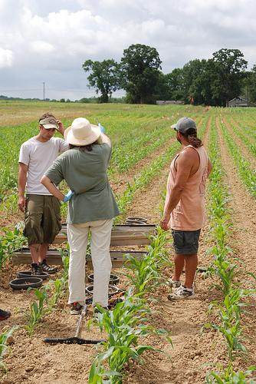
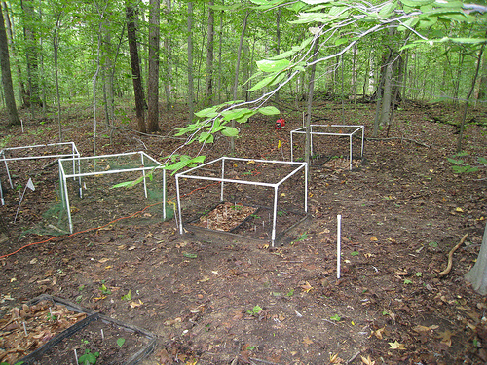
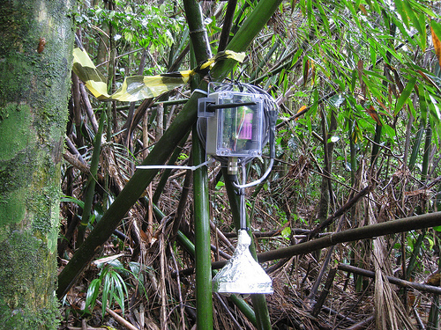
where: Environmental Monitoring

Slide 3
Design Goals and Targets
Target Lifetime : 1 year
Duty-cycle (~ 5%)
Accuracy Requirements
Milliseconds (ms) - Seconds (s)
Online Synchronization not needed
Delay-tolerant networks
Basestation collects data opportunistically
NOT “sample-and-send”
All measurements require timestamps
Not just events
Notes:
JG : goes to the front along with application. Explain why not FTSP

Slide 4
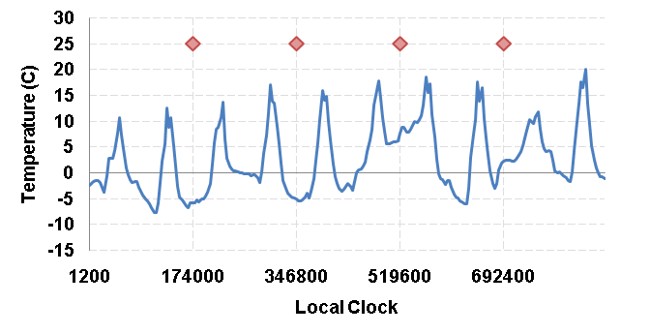
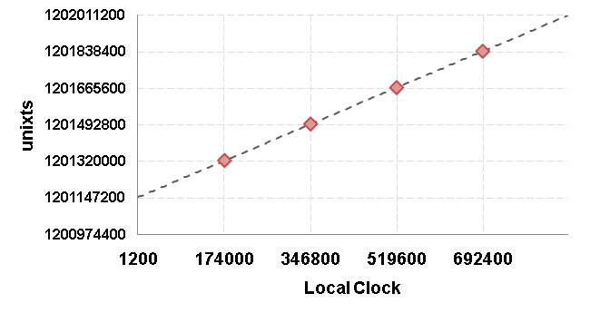
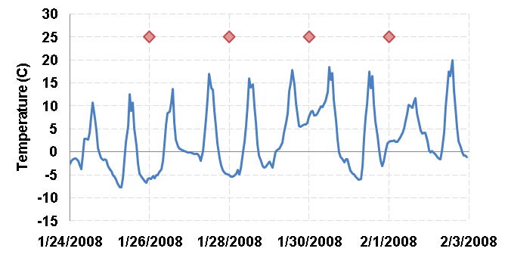
Naïve Time Reconstruction
Measurements are timestamped using motes local clock
Basestation collects data
Time reconstruction algorithm: Assigns measurements a global timestamp
Notes:
Does not run at the BS. Motes timestamp measurements using the localclock. 2 panels. Add the mapping slide here.

Slide 5
Reconstruction is NOT Synchronization
Asynchronous operation
Each mote has its own operation schedule
No attempt to match schedules
Motes
Agnostic of network time / global time
Do not process time information
Do not have an onboard Real-Time Clock (RTC)
(E.g. Telos, Mica2, MicaZ, IRIS)

Slide 6
Phoenix Performance
Accuracy
Order of seconds, ~ 6 PPM (ignoring temperature effects)
Yield : Fraction of measurements assigned timestamps
≥ 99%
Overheads:
Duty-Cycle : 0.2%
Space : 4%
Yield performance maintained:
Presence of random, frequent mote reboots
Absence of global clock source for months
Notes:
JG : Write down the definition of Yield

Slide 7
Background
and
Related Work

Slide 8
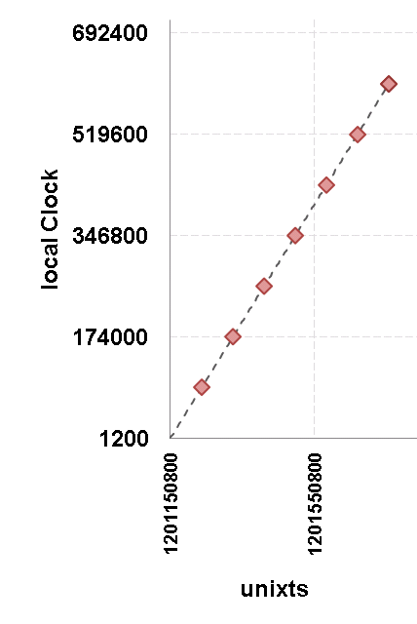
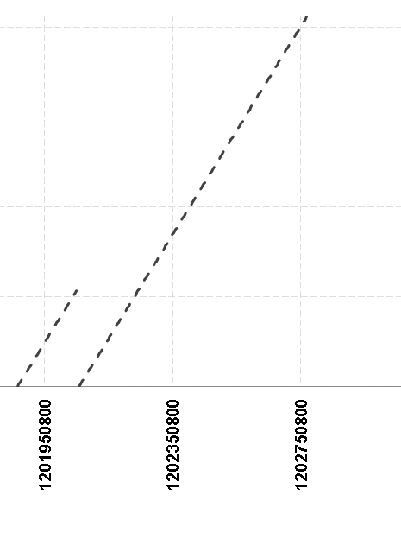
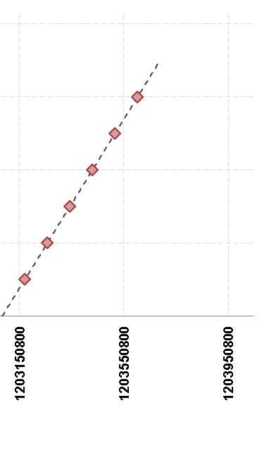
Reboots and Basestation
? ? ?
Notes:
Simplify the graph.

Slide 9
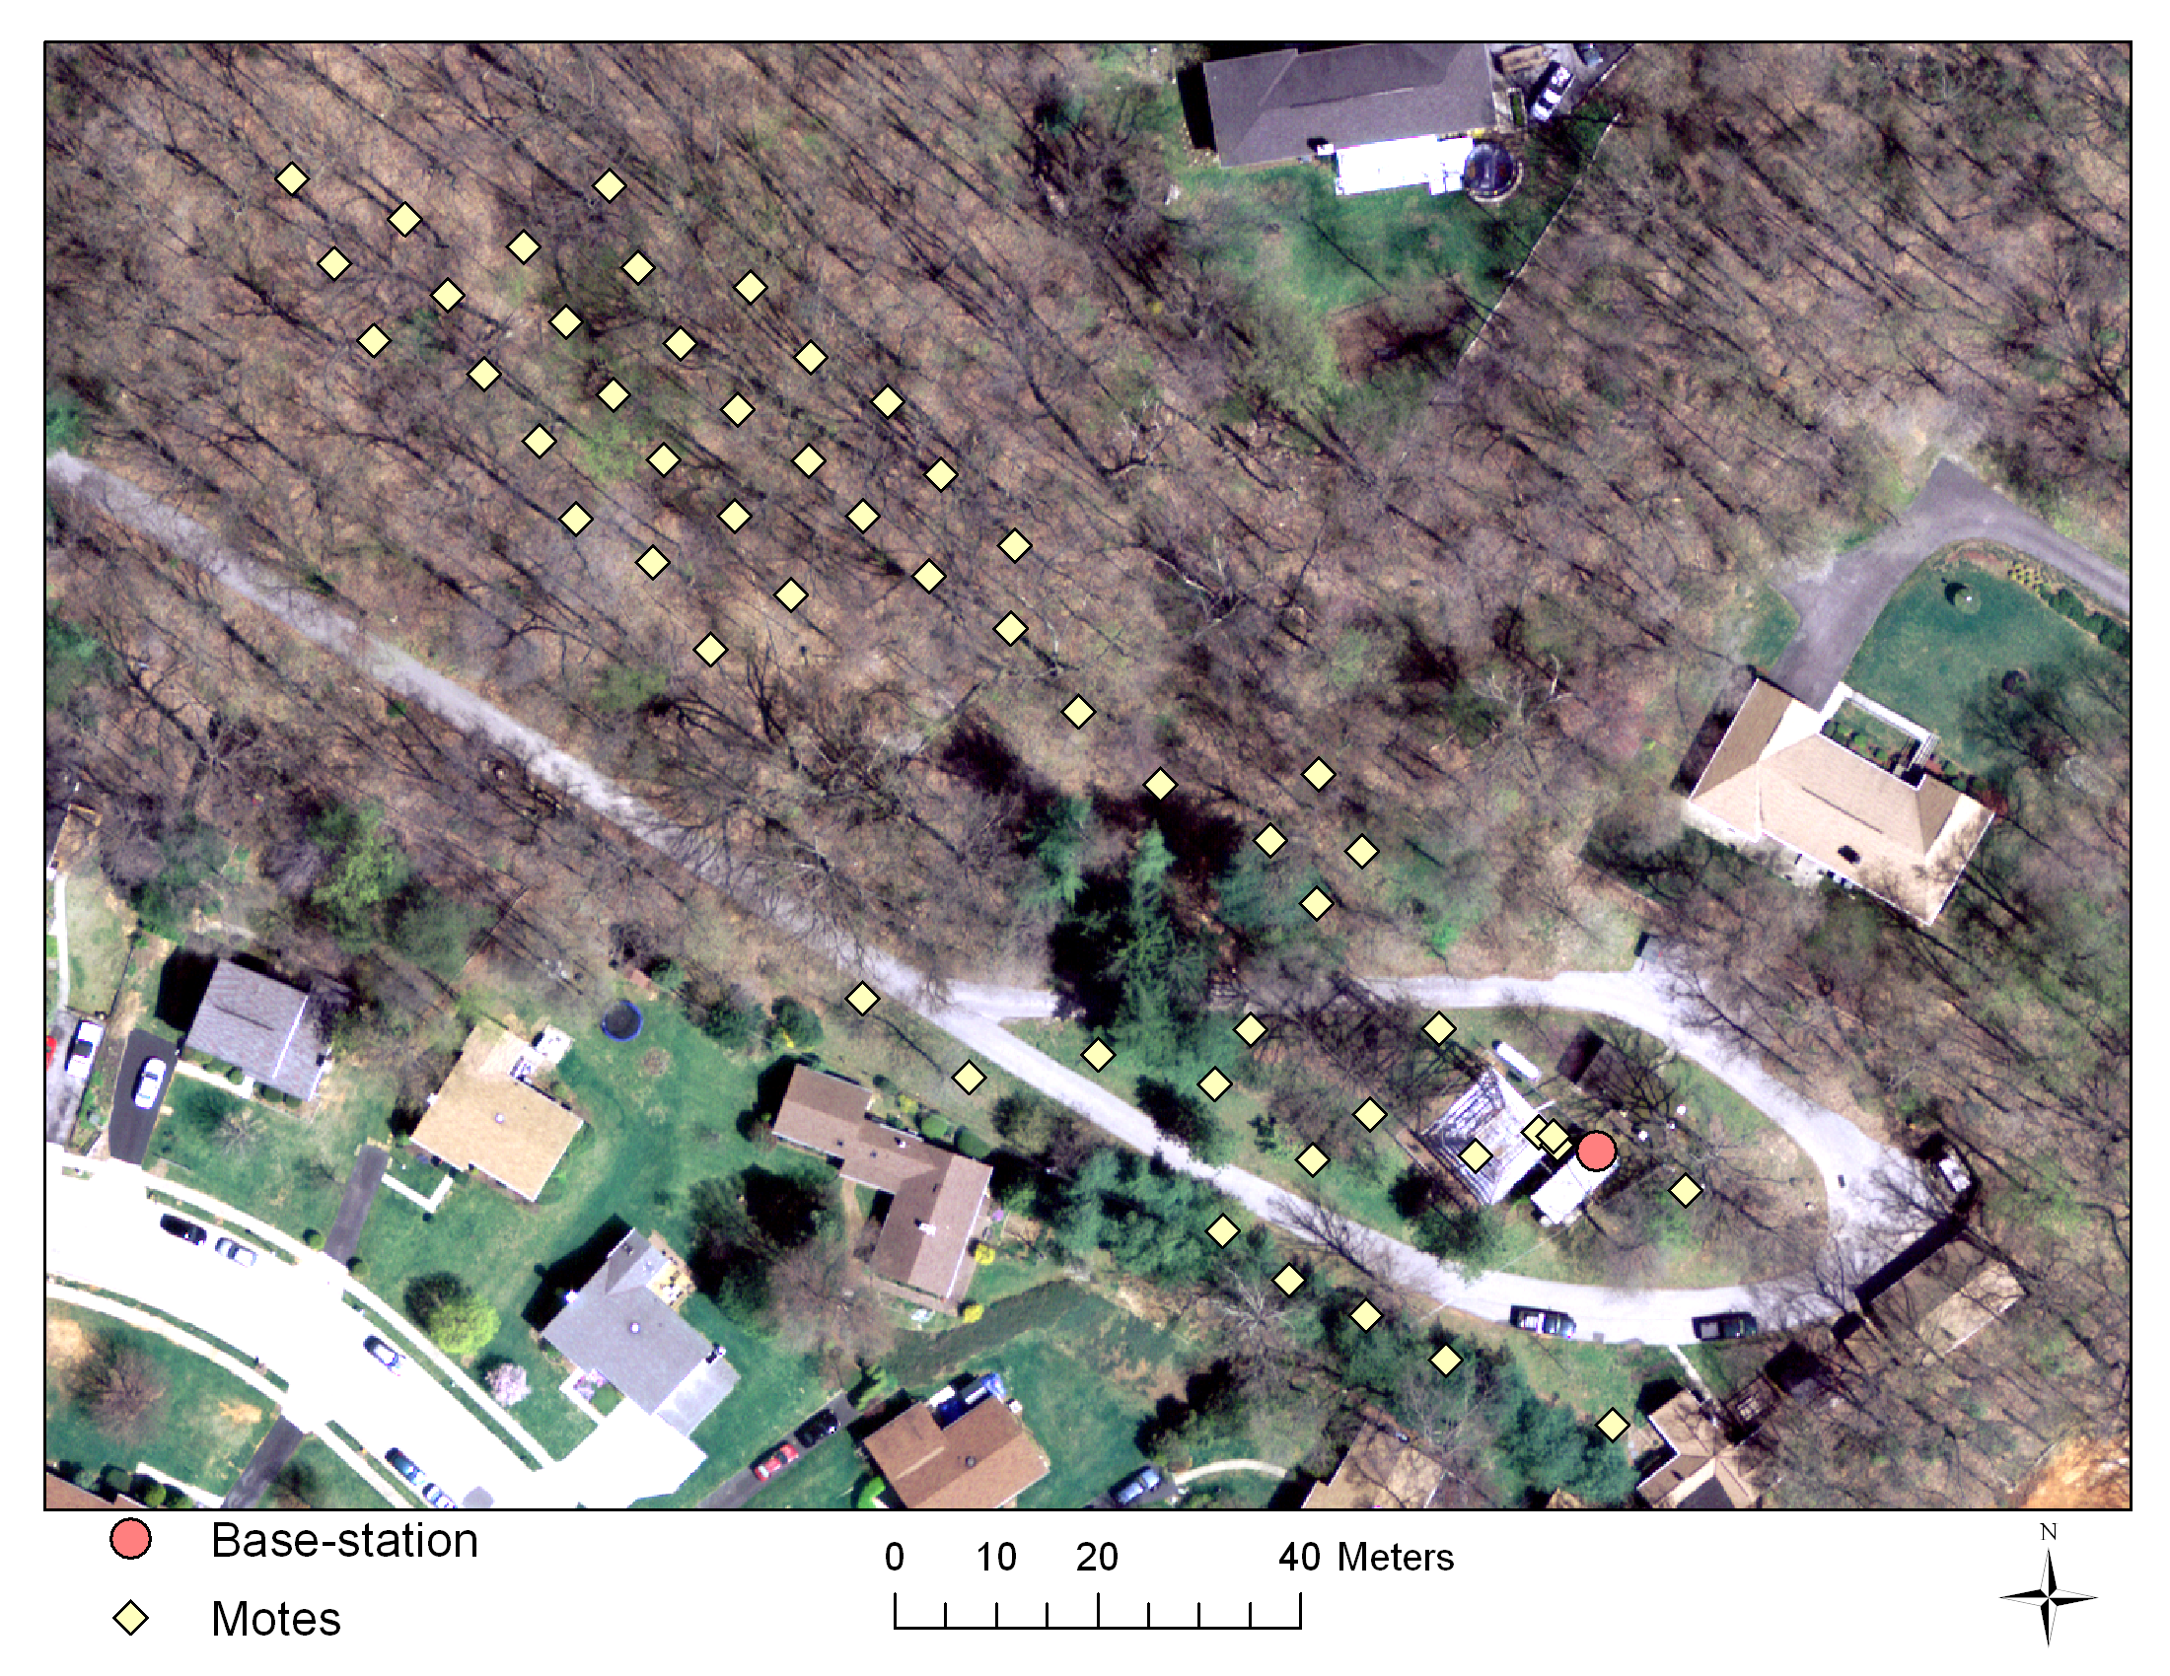
Cub Hill – Year long deployment
Notes:
Soil monitoring application.

Slide 10
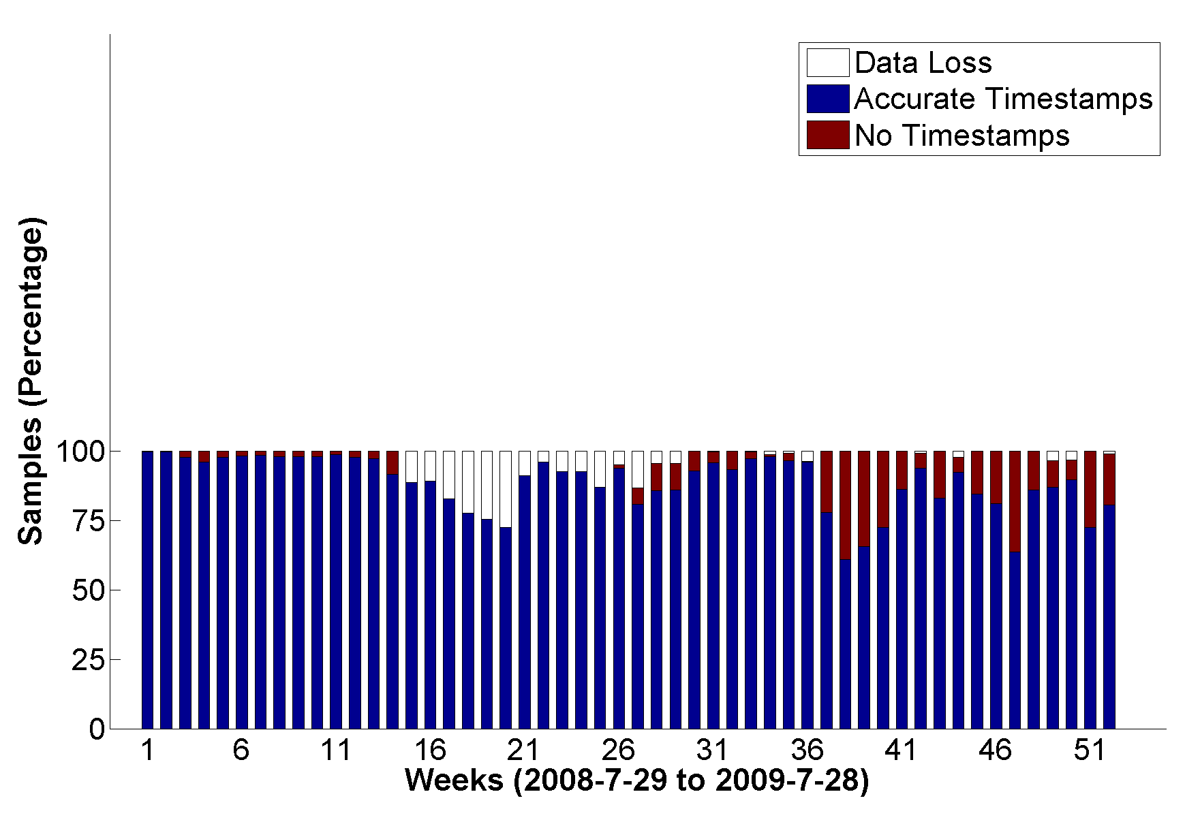
Cub Hill : Time Reconstruction
Watchdog Fix
Nodes Stuck
(Data Loss)
Basestation Down
Reboot Problems
Notes:
Watchdog to reboot stuck state or memory violations. Practise more

Slide 11
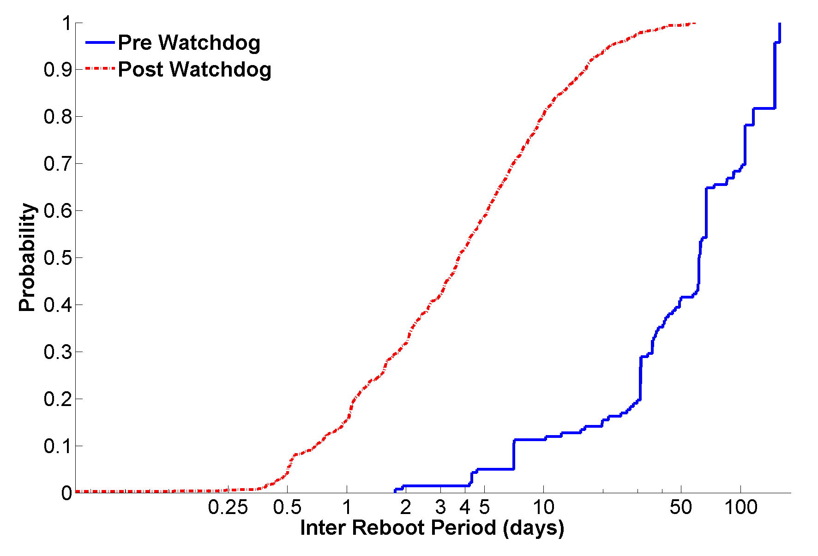
Rate of Reboots
Notes:
Point out extremes

Slide 12
Reconstruction Challenges
Motes reboot at random
Downtime is non-deterministic
Dependence on basestation
Temporary network partitions
Mote clock
Varies per mote
Skew changes over time

Slide 13
Related Work
Linear Regression for Time Rectification
Fidelity and Yield in a Volcano Monitoring Sensor Network, Werner-Allen et al., OSDI 2006
Reboot Problems
Lessons from the Hogthrob Deployments, Chang et al., WiDeploy 2008
Trio: Enabling sustainable and scalable outdoor wireless sensor network deployments, Dutta et al., SPOTS 2006
State preservation after reboots
Surviving sensor network software faults, Chen et al., SIGOPS 2009
Data-driven Temporal Integrity
Recovering temporal integrity with data driven time synchronization, Lukac et al., IPSN 2009
Sundial: Using sunlight to reconstruct global timestamps, Gupchup et al., EWSN 2009
Notes:
Go faster. Don’t mention the names … just the work and what they do.

Slide 14
Phoenix
Notes:
High level of what the hell phoenix does !

Slide 15
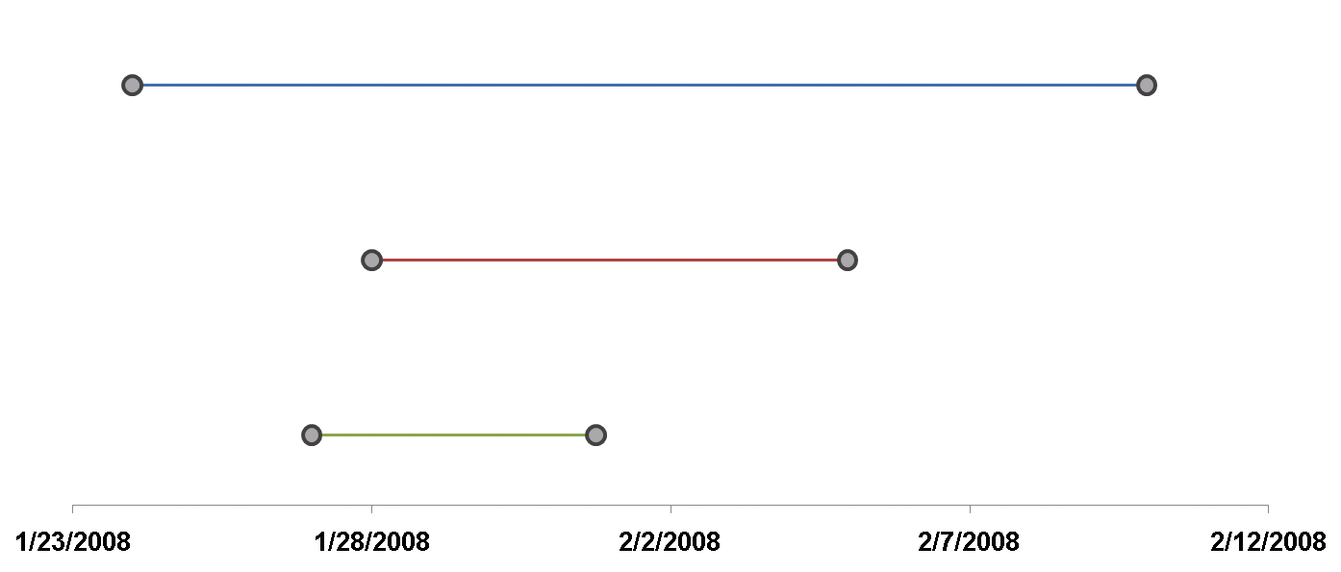
Big Picture
1
2
3
Base Station
Notes:
1 has references to the global clock. 2 and 3 do not.

Slide 16
Terminology
Segment: State defined by a monotonically increasing local clock (LC)
Comprises <moteid, reboot counter>
Anchor:
<local,neighbor> : Time-references between 2 segments
<local,global> : Time-references between a segment and global time
Fit : Mapping between one time frame to another
Defined over <local,neighbor> : Neighbor Fit
Defined over <local,global> : Global fit
Fit Parameters
Alpha (α) : Skew
Beta (β) : Offset
Goodness of Fit : Metric that estimates the quality of the fit
E.g. : Variance of the residuals

Slide 17
2-Phase
Phase-I : Data Collection
(In-network)
Phase-II : Timestamp Assignment
(Database)
Notes:
NOT basestation (outside)

Slide 18
Architecture Summary
Motes
Global Clock Source
Basestation
Notes:
Components. Explain each component

Slide 19
Anchor Collection – I : Beaconing
Each Mote:
Beacons time-state periodically
<moteid, RC #, LC>
Beacon interval~ 30s
Duty-cycle overhead: 0.075%
28 | 3 | 9600000
28
97 | 7 | 3600
43 | 5 | 102400
97
43
Notes:
Get rid of so many motes

Slide 20
Anchor Collection – II : Storage
Each Mote:
Stays up (30s) after reboot
Listens for announcements
Wakes up periodically (~ 6 hrs)
Stays up (30s)
Listens for announcements
Stores <local, neighbor> anchors
Duty-Cycle : 0.14%
28
97 | 7 | 3800
43 | 5 | 102800
97
43
Notes:
Get rid of so many motes

Slide 21
Anchor Collection – III : Global References
28 | 4 | 102435
28 | 4 | 102455, 1217351879
97 | 7 | 4000
G-Mote:
Connected to a global clock source
Beacon its time-state (30s)
Store Global References (6 hrs)
Global clock source
(GPS, Basestation etc)
97
43
Notes:
Get rid of so many motes

Slide 22
Time Reconstruction (outside the network)
28-4
(G)
<Global Fit>
28-4
(G)
Segment Graph
χ = 2
χ = 7
97-7
(A)
97-7
(A)
43-5
(B)
43-5
(B)
<Global Fit>
χ = 2.5
<Global Fit>
Notes:
Mention segments not motes

Slide 23
Evaluation:
Simulation & Experiments
Notes:
Mention parameters using cub hill

Slide 24
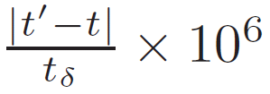
Evaluation Metrics
Yield:
Fraction of samples assigned timestamps (%)
Average PPM Error:
PPM Error per measurement:
Duty Cycle Overhead:
Fraction of time radio was on (%)
Space Overhead:
Fraction of space used to store anchors (%)
Notes:
Explain the formula

Slide 25
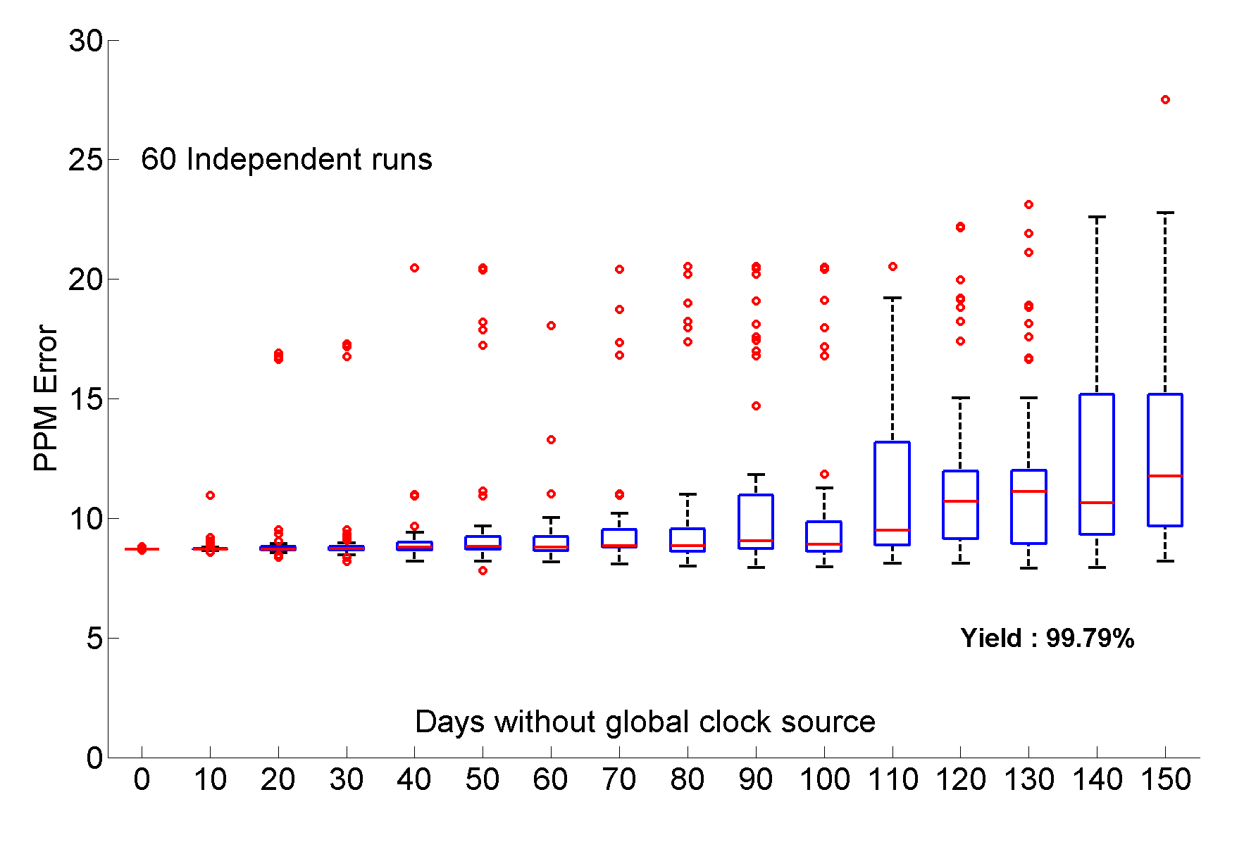
Simulation: Missing Global Clock Source
Simulation Period : 1 Year

Slide 26
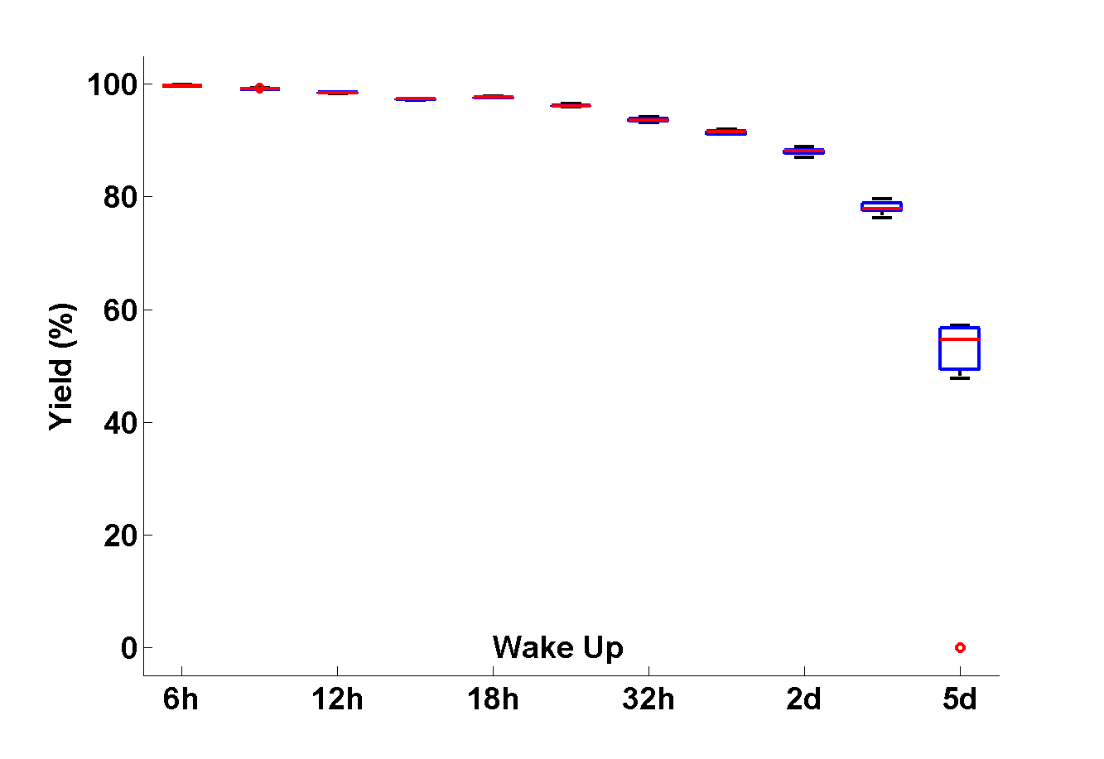
Simulation: Wake Up Interval
Anchor collection rate should be significantly faster than the rate of reboots

Slide 27
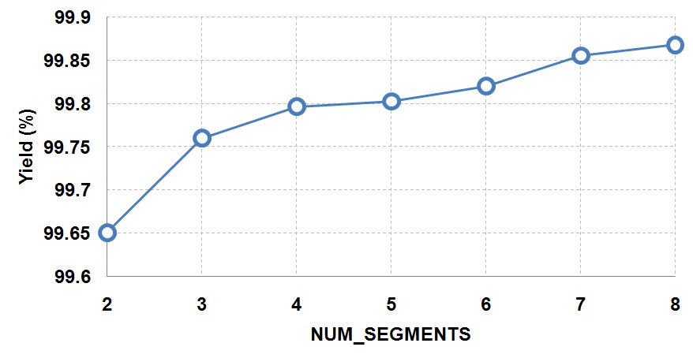
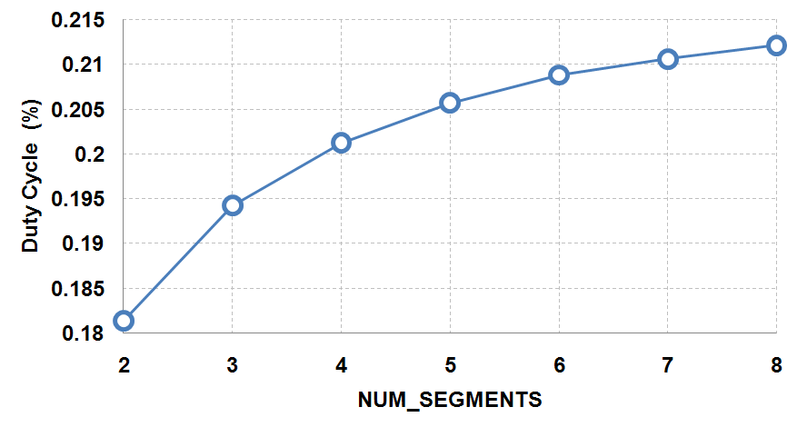
Simulation: Segments to anchor with
Notes:
Just put them together and say this is the price you pay … Introduce DL first

Slide 28
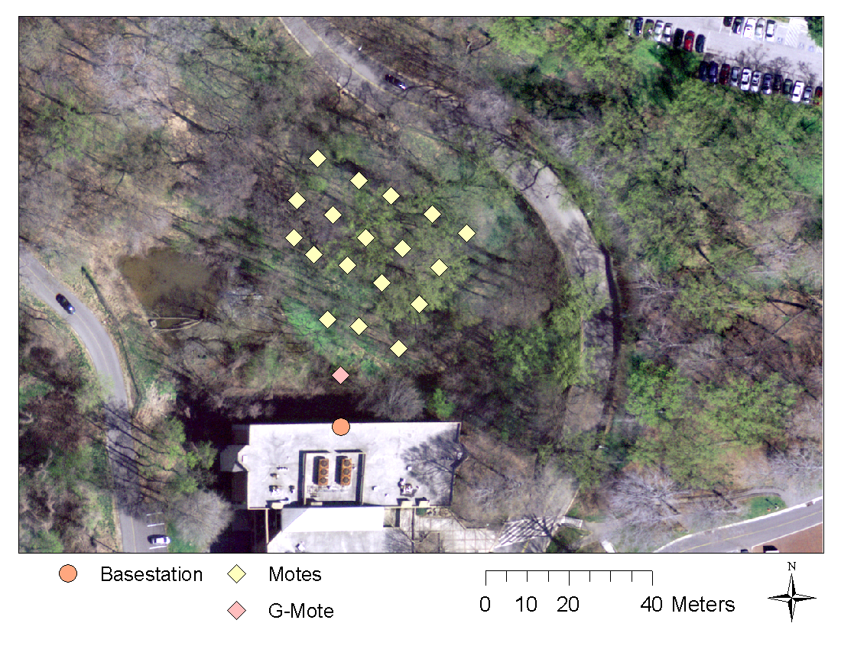
Olin Deployment
- 19 Motes - 21 Day Deployment - 62 segments - One Global clock mote

Slide 29
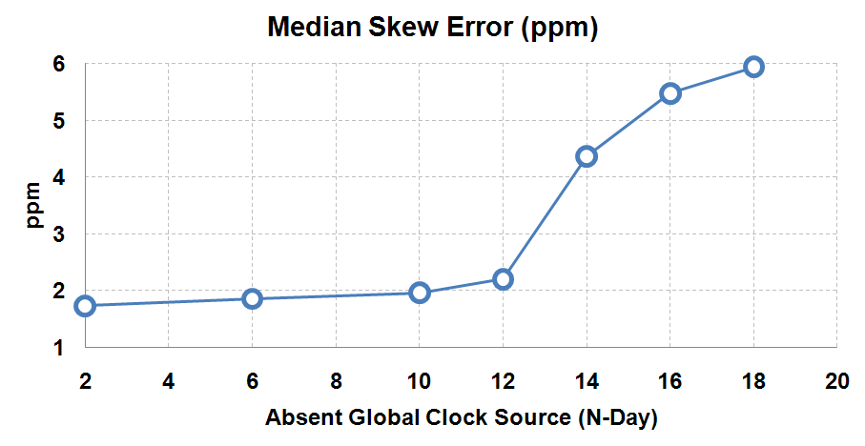
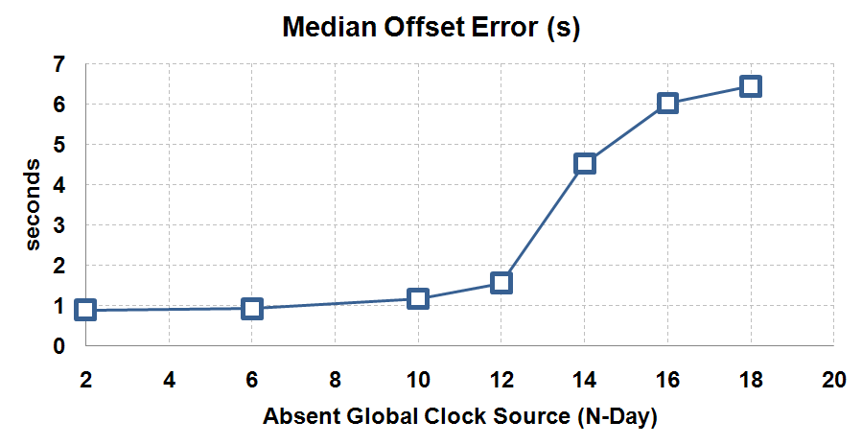
Deployment Accuracy
Notes:
Non-phoenix reconstruction. DON’T MENTION GROUND TRUTH!

Slide 30
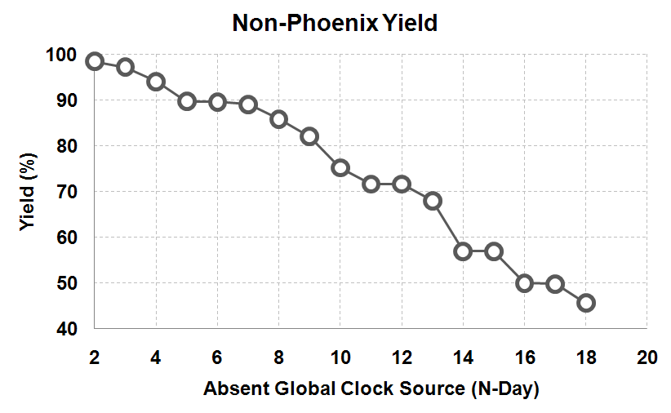
Naïve Yield Vs Phoenix Yield
Phoenix Yield: 99.5%
Notes:
Non-phoenix reconstruction. DON’T MENTION GROUND TRUTH!

Slide 31
Conclusion
Phoenix timestamps:
> 99% of the collected measurements
With accuracy in order of seconds
Phoenix is Robust to:
Basestation failures for days-months
Random mote reboots
Paying a price of:
0.2% increase in duty cycle
4% space overhead
Notes:
26 bytes every 10 minutes

Slide 32
Questions ?

Slide 33
Extra:

Slide 34
Discussion / Future Work
Choosing the right link metric
Factor number of anchor points
Temporal separation of anchors
Combining the metrics along a “fit” path
Adaptive anchor collection
If rate of reboots is unknown
Compare with online timestamping (FTSP)
Notes:
Pick the right Goodness of fit

Slide 35
Simulation Parameters
Parameter | Type | Default Value
Clock Skew | Uniform Distribution | ~ U (40 70) [ppm]
Segment Model | Non-Parametric (Cub Hill) | median : 4 days
Topology | Cub Hill (53 nodes)
Communication Delay (end-to-end) | Uniform Distribution | ~ U (5 15) [ms]
Packet Reception Ratio | Log-Normal Path Loss | Pr(2.0) = -59.28 η = 2.04 σ = 6.28
<beacon, Wakeup> | Constant | <30s, 6h>
<listen, synch> | Constant | <30s, 6h>
NUM_SEGMENTS | Constant | 4
Sampling Frequency (measurements) | Constant | 10 mi

Slide 36
Reboots: Long downtimes

Slide 37
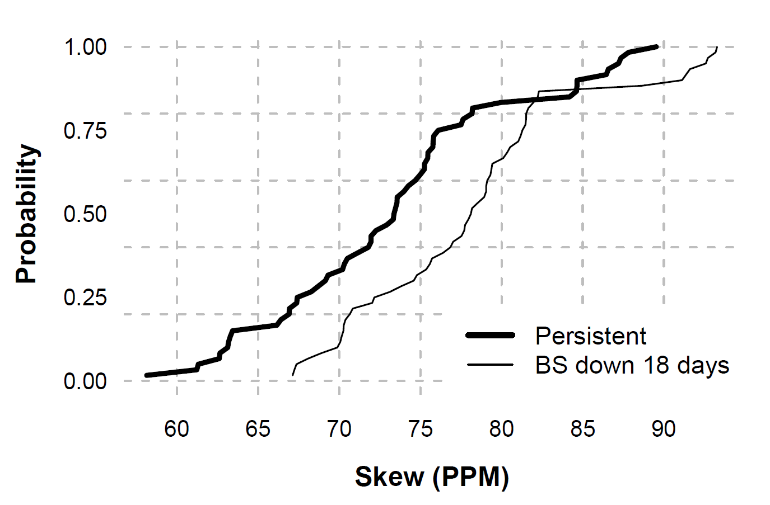
Clock Skews

Slide 38
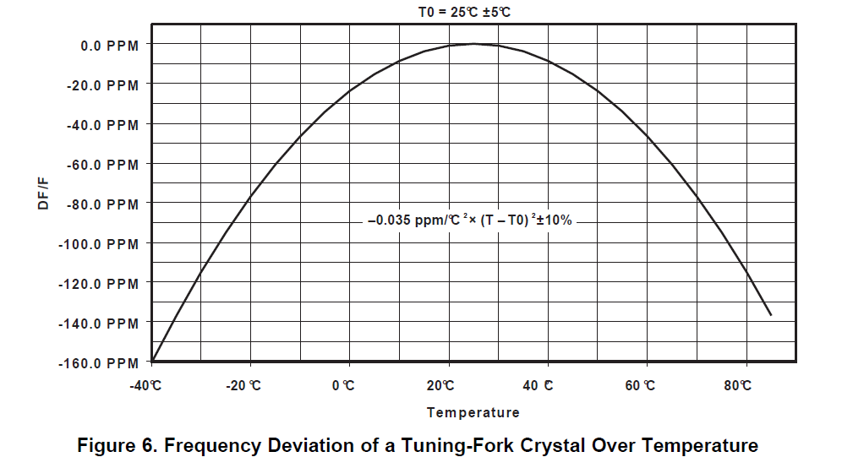
Temperature dependence
Source: http://focus.ti.com/lit/an/slaa322b/slaa322b.pdf

