Slide 1
CS450 Network Embedded Sensing Systems Week 11: Time Synchronization and Reconstruction
Jayant Gupchup

Slide 2
Outline
Introduction
Motivation
Challenges
Accuracy/Application Requirements
Online (Synchronization)
Offline (Postmortem Time Reconstruction)
Reconstruction in Environmental Networks (work done at Hopkins)
Sundial
Phoenix

Slide 3
Motivation

Slide 4
Motivation - I
Target Tracking
Intrusion Detection
Any kind of real-time event detection
Slide : Yanos Saravanos, www.cse.unt.edu/~rakl/Yanos_thesis.ppt

Slide 5
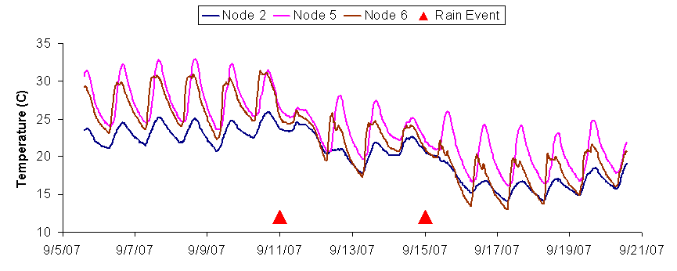
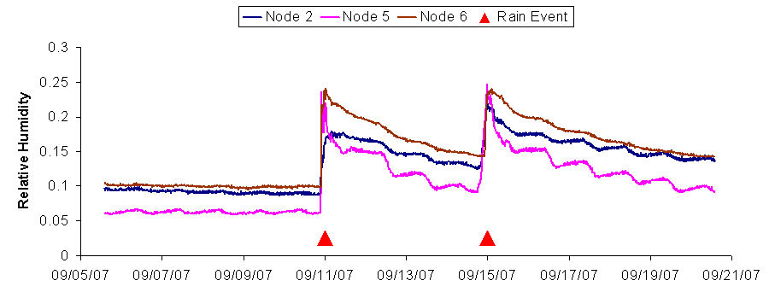
Motivation - II
Environmental Monitoring

Slide 6
Challenges

Slide 7
Challenges
Clock Skew
Varies per mote
Varies with Temperature
Varies due to aging
Accurate crystals consume more power (and cost more!)
Communication
Send, Receive, Transit Time
Reboots (offline)
No Real-Time Clock
Motes loose time-state
Absence Global Clock Source (offline)
Network Time Protocol (NTP)
GPS

Slide 8
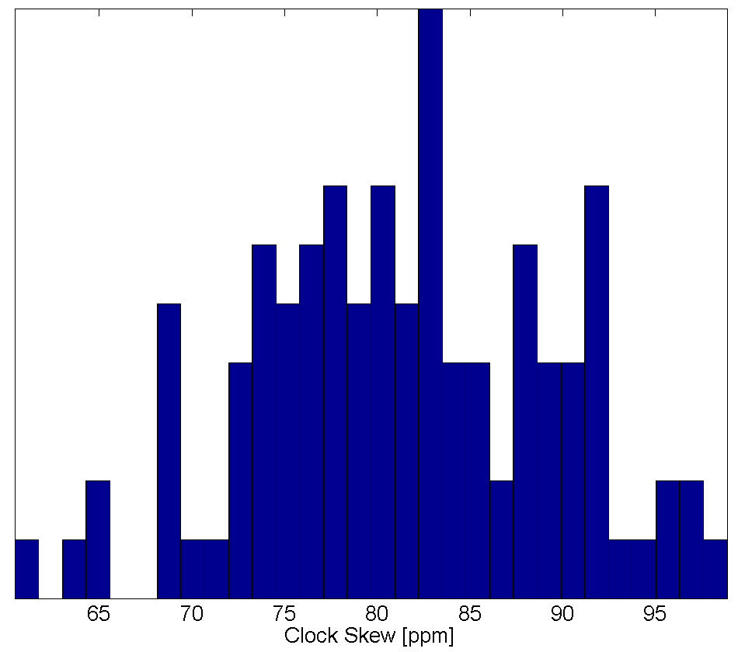
Challenges - I
E.g. :
Clock Skew : 80 ppm
Error in 1 day (ignore skew)
= 80 * 1.0E6 * 3600 * 24
= 6s !!!

Slide 9
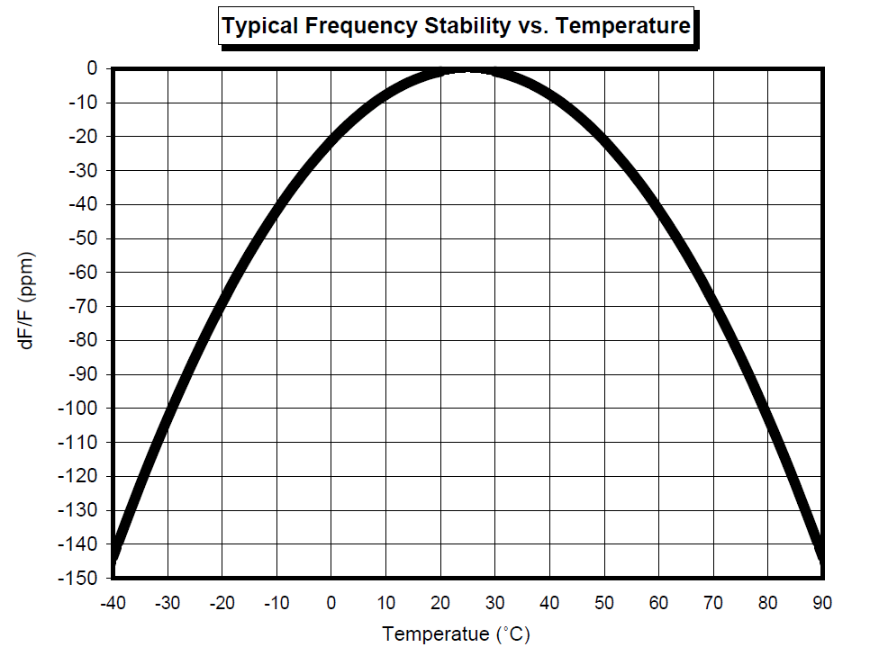
Challenges – II (Temperature)
Source : http://www.abracon.com/Resonators/ABS09.pdf

Slide 10
Challenges – III Accuracy – Power Tradeoff
Device | Granularity | Stability | Power
Tuning Fork XO | Coarse | 25ppm | <50uW
AT-cut Quartz XO | Fine | 25ppm | 200uW
DS32KHZ 32K TCXO | Coarse | 7.5ppm | 750uW
DS3232 32KHz TCXO | Coarse | 2ppm | 1mW
DS4026 10MHz TCXO | Fine | 1ppm | 6mW
Slide :Thomas Schmid, nesl.ee.ucla.edu/fw/zainul/islped08_1_1_3_4.ppt

Slide 11
Example of Inaccurate time in data

Slide 12
Online Time Synchronization

Slide 13
Online Time Synchronization
Used in real-time monitoring systems
Accuracy ~ μs
Many applications require relative synch.
Time-Difference of Arrival of events
Power-intensive
Radio are on most of the time

Slide 14
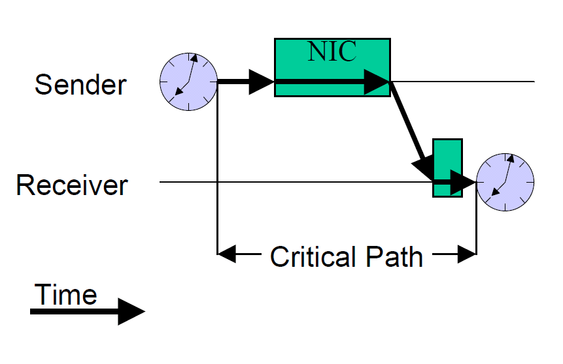
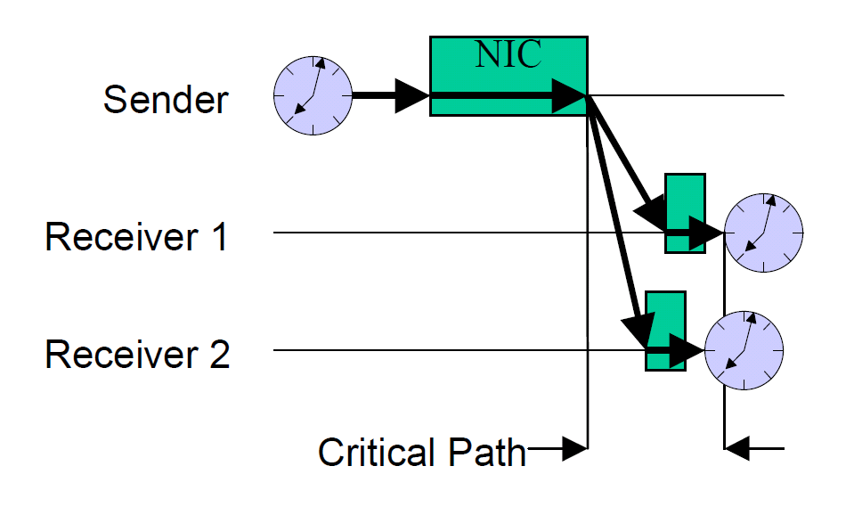
Reference Broadcast Protocol (RBS)*
Sender sends a reference beacon
“n” receivers hear this
The receivers exchange the “reception time”
* J. E. Elson, L. Girod, and D. Estrin. Fine-grained network time synchronization
using reference broadcasts. In OSDI, pages 147–163, Dec. 2002

Slide 15
RBS – Advantages/Disadvantages
Advantages:
Eliminates communication time delays and uncertainties
Accuracy : μS
Disadvantages
Does not extend well to multi-hop nodes
Does not provide global-time synchronization
Power-intensive (unavoidable in real-time systems)

Slide 16
Flooding Time Synchronization Protocol (FTSP) ⁺
Root node is elected
lowest numbered node
Root injects reference points
Format: <seqid,local,global>
Nodes accept messages from the root
Discard if seqid <= last seq. id
After receiving enough reference points
Estimate skew, offset w.r.t root
+ M. Marot, B. Kusy, G. Simon, and A. Ledeczi. The flooding time synchronization
protocol. In SenSys, pages 39–49, Nov. 2004.

Slide 17
FTSP – Advantages/Disadvantages
Advantages
Synchronizes motes to a global clock
Achieves multi-hop synchronization
Accuracy : μs
Disadvantages
If root goes does, election can take time
Error grows exponentially with radius of the network
No Temperature correction

Slide 18
Postmortem Time Reconstruction
(offline)

Slide 19
Challenges
Clock Skew (online, offline)
Varies per mote
Varies with Temperature
Varies due to aging
Accurate crystals consume more power (and cost more!)
Communication (online, offline)
Send, Receive, Transit Time
Reboots (offline)
No Real-Time Clock
Motes loose time-state
Absence Global Clock Source (offline)
Network Time Protocol (NTP)
GPS

Slide 20
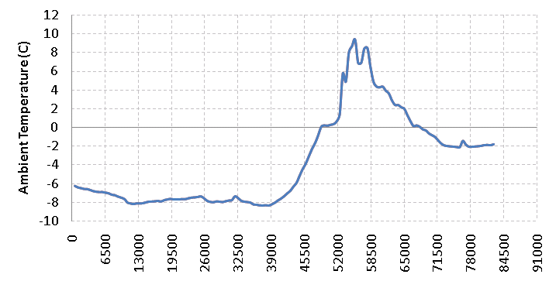
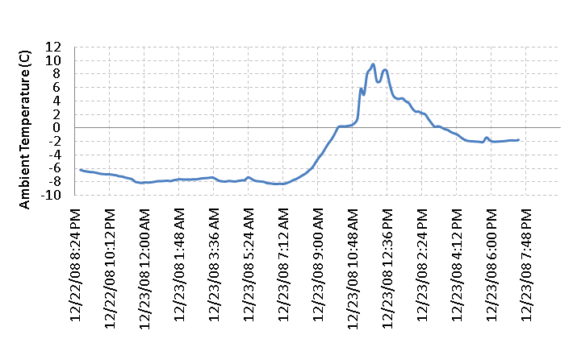
Postmortem Methodology
Local Clock
DateTime /
Universal Clock

Slide 21
Postmortem Timestamp Reconstruction
Commonly used by environmental monitoring networks
Time-Synchronization is expensive
Increase network lifetime
Measurements are recorded in “Local timestamps”
Global Timestamps are assigned/mapped retro-actively
collect pairs of <local ts, global ts>, i.e. “anchor points”
Typically sampled by accurate gateway/basestation
Timestamp assignment happens OUTSIDE the network

Slide 22
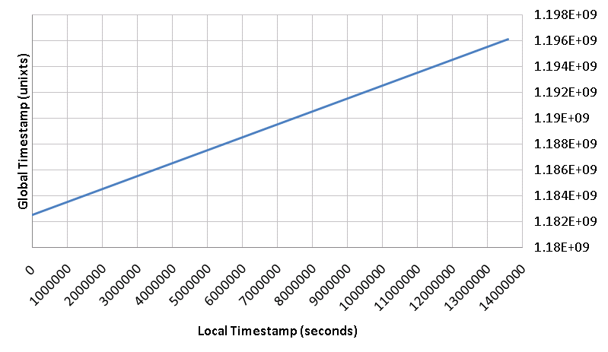
^ ^
GTS = α . LTS + β
… Linear Regression
“α” (slope) represents
Clock-skew
<LTS, GTS>
“Anchor Points”
“β” (intercept) represents
Node Deployment time

Slide 23
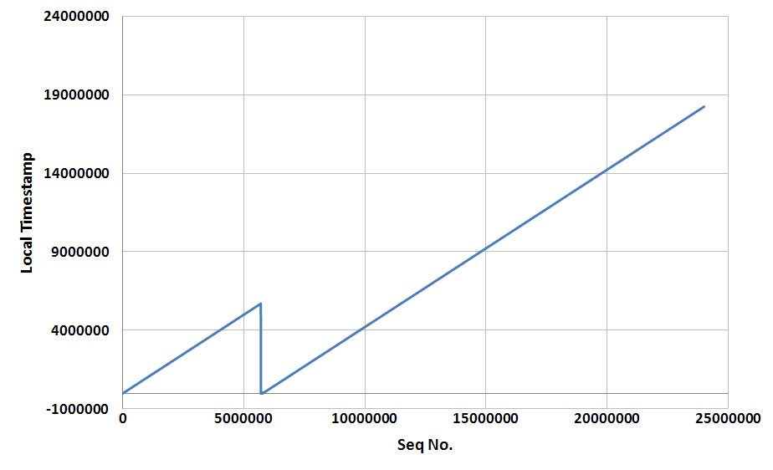
Reboots - I
Segment 1
Segment 2

Slide 24
Reboots - II
Segment 1
Segment 2
<α2, β2>
<α1, β1>
1. Detect Segments 2. Collect anchors more frequently

Slide 25
Reboots – III (Network Partition)
Segment 1
Segment 2
Cutoff
From N/w
<α1, β1>

Slide 26
Data-Driven Time Reconstruction
Data contains some information about global time
Can we leverage that?
Correlate with known models?
Correlate with another source
Weather station
How accurate would the reconstruction be?

Slide 27
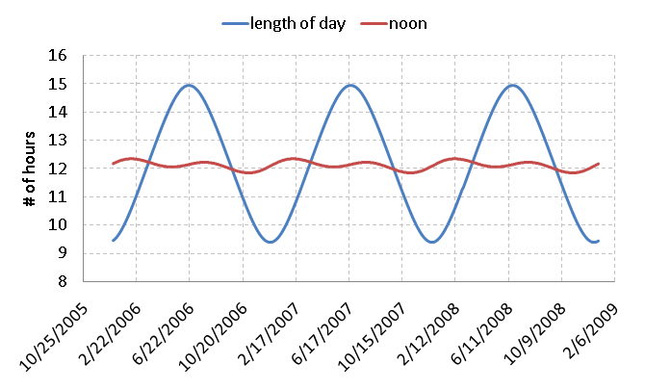
Annual Solar Patterns
<LOD, noon> = f (Latitude, Time of Year)
How can me make use of this information?

Slide 28
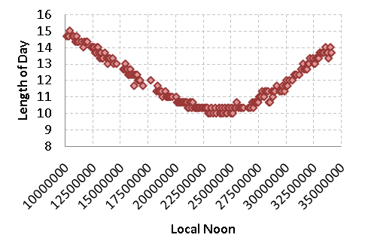
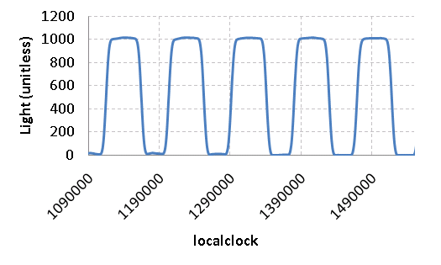
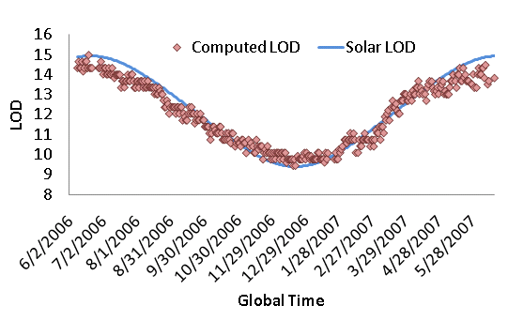
“Sundial”
Noon
Length of day (LOD)
argmax _{lag} Xcorr (LOD _{lts}, LOD _{gts}, lag)
Local Noon | Global Noon
Lts ₁ | Gts ₁
Lts ₂ | Gts ₂
… | …
… | …
Lts _{n} | Gts _{n}
“Anchor Points”

Slide 29
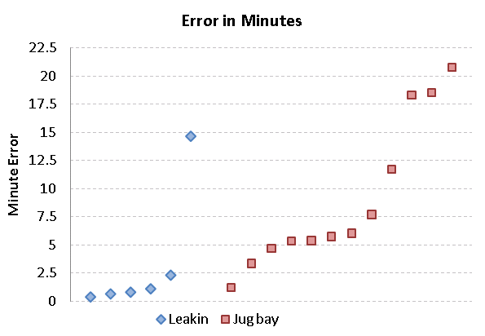
Results

Slide 30
Drawbacks?
Accuracy: Minutes
Okay for some environmental applications
Need the segments to be large (~ months)
Does not work for Rapid reboots (~ days)

Slide 31
Design Requirements
High fraction of accurate timestamps
Accurate
Robust
Random mote reboots (reboot rate : ~ days)
Tolerates Basestation / Global clock absence
Low-power

Slide 32
Phoenix
9
7
6
G
every “X” hrs
<4, rc_{4,}, LC_{4,}
5, rc₅, LC_{5,}>
8
5
4
every 30 s
<4, rc₄, LC₄>

Slide 33
Phoenix - II
- Green Nodes
+ Announce <id, rc, LC> every 30 seconds (T_{on} <<< 30s)
+ Wake up every 6 hours
+ Keep radio on for 30 s
+ store overheard time-beacons
- GPS Node
+ Wake up every 6 hours
+ Get GPS time
+ Store <id, rc, LC, GPS>
9
7
G
6
8
5
4

Slide 34
Phoenix – III (post-facto reconstruction)
9
7
6
G
<α₅₋₆, β₅₋₆>
<α_{8-GPS}, β_{8-GPS}>
<α₆₋₈, β₆₋₈>
8
5
<α₄₋₅, β₄₋₅>
4

Slide 35
Phoenix – IV (shortest path problem)
9
7
6
G
<α₅₋₆, β₅₋₆>
<α_{8-GPS}, β_{8-GPS}>
<α₆₋₈, β₆₋₈>
8
5
<α₄₋₅, β₄₋₅>
4

Slide 36
Robustness
Accuracy : Seconds
Power : Very low (duty cycle : < 0.2%)
Reconstruction fraction > 99%
Robust to Basestation failures, reboots

Slide 37
Discussion
Design Consideration for Timestamping:
Accuracy requirement(s)
Tradeoff between power-accuracy
Data-Latency (online vs. offline)
Rate of reboots, Persistent global clock source

Slide 38
Questions?

