Slide 1
Data Management in Environmental Monitoring Sensor Networks
Jayant Gupchup
gupchup@jhu.edu
Dissertation Committee:
Alex Szalay
Andreas Terzis
Carey Priebe

Slide 2
Background & Introduction

Slide 3
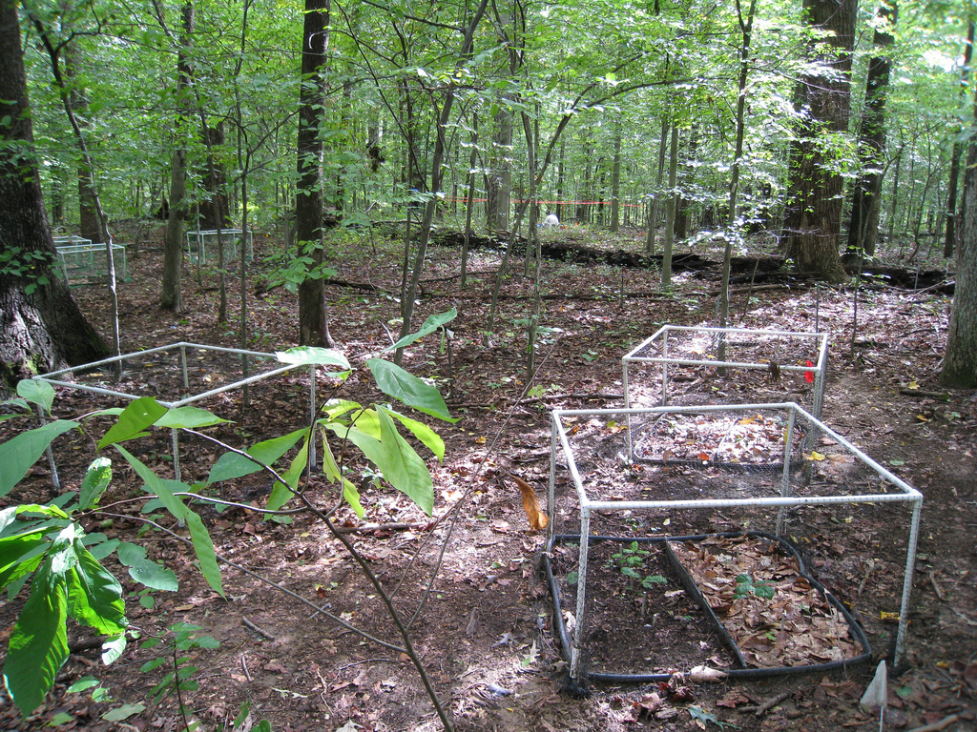
Environmental Monitoring
Smithsonian Environmental Research Center, Edgewater, MD

Slide 4
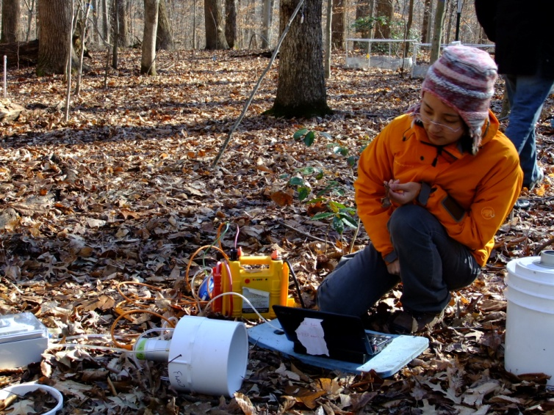
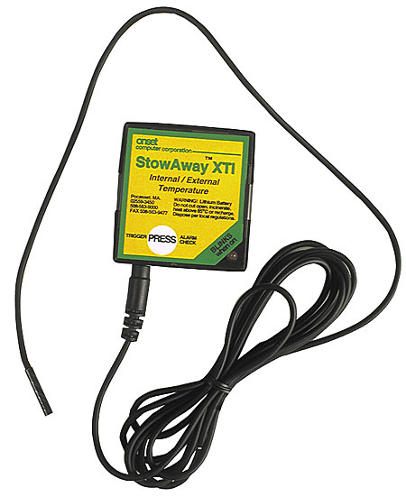
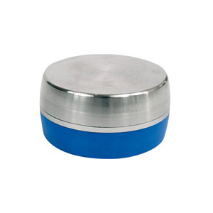
Traditional Approaches
Handheld Devices
High Manual labor
Limited data collection
Difficult in harsh conditions
Disturb the sensing environment
Data Loggers
No real-time collection
Limited programmability
No fault diagnosis
Courtesy : Lijun Xia, Earth & Planetary Sciences, JHU
http://www.benmeadows.com/HOBO-H8-Data-Loggers_31227329/
http://globalw.com

Slide 5
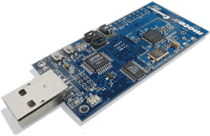
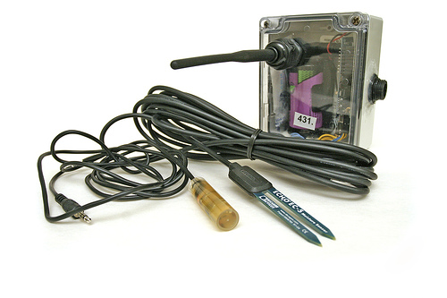
Wireless Sensor Networks (WSNs)
A Network of Nodes + Sensors
Nodes
Radio (~ 30m)
Microcontroller (16 bit, 10kB RAM)
1 MB External Flash
Expansion board (4 external sensors)
Battery Operated (~ 19 Ah)
Programming environment (TinyOS, nesC)

Slide 6
Why WSNs
Non Intrusive
Continuous collection of data
Data collection at varying temporal and spatial scales
Reduction in manual labor
Ability to reprogram network

Slide 7
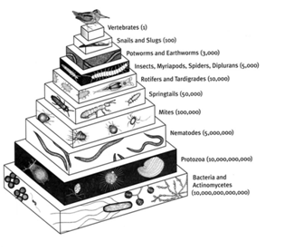
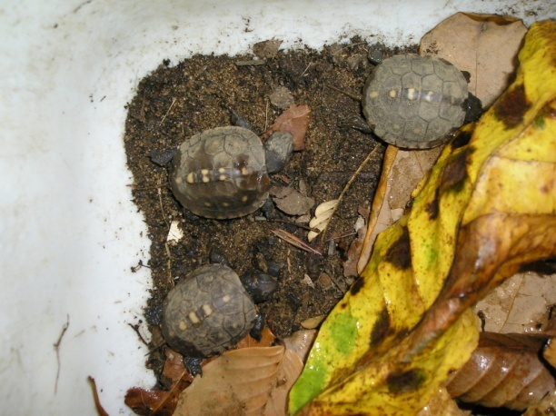
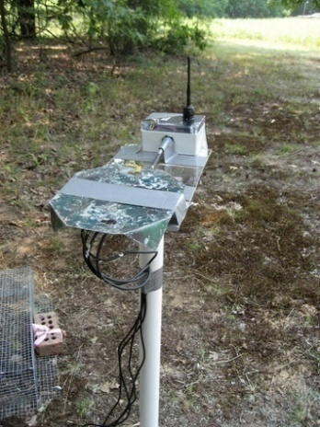
Life Under Your Feet
JHU Collaboration
Computer Science
Earth and Planetary Sciences
Physics and Astronomy
Understand spatial and temporal heterogeneity of soil ecosystems
Correlate ecology data with environmental variables (E.g. Soil Temperature)

Slide 8
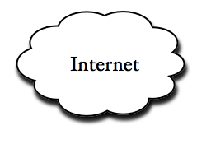
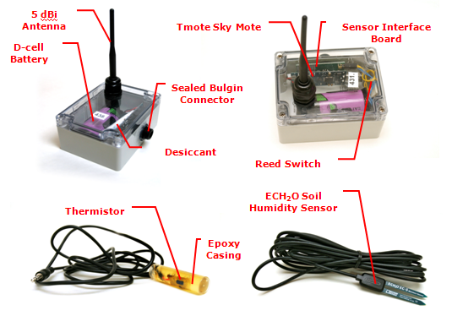
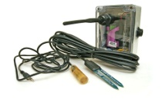
A Typical Sensor Network
Stable
Storage
Gateway/
Basestation
19 Ah
….
Notes:
Bring a box and explain the contents. Leave out optimization stuff. Operate for long periods of line.

Slide 9
Dissertation Goals
Data Processing
Pipeline Design
Measurement
Timestamping
* Sundial * Phoenix
Data Driven
Data Collection

Slide 10
Data Processing Pipeline Design

Slide 11
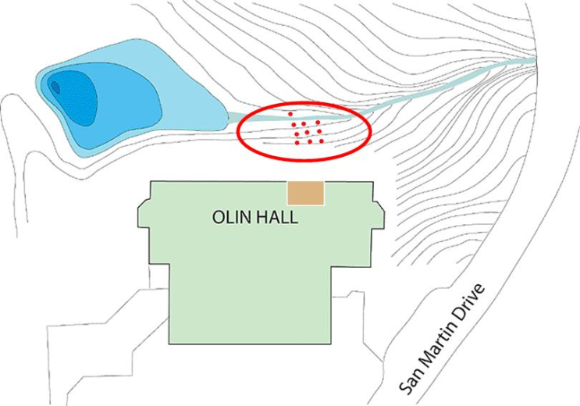
Pilot Deployments (2005)
Two Deployments
JHU Campus (behind Olin Hall)
September 2005 – July 2006
Leakin Park (largest unofficial graveyard in MD)
March 2006 – Nov 2007
Soil Moisture, Box Temperature, Box Humidity, Light
No Persistent Basestation
Motes served as glorified data loggers
One hop download using laptop
Data was emailed / copied on USB

Slide 12
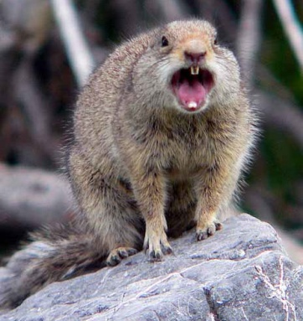
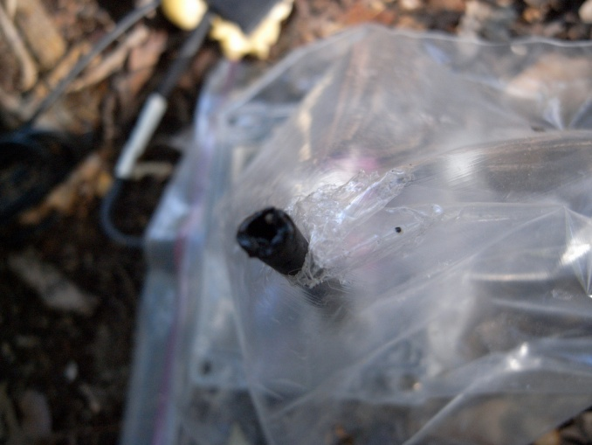
Lessons Learned
Constant monitoring required
Failed components lead to data loss
Need end-to-end system
Hardware tracking became important
Faulty components needed replacement
Store all kinds of metadata!
Data Provenance
Accurate Low-Power Measurement Timestamping is a challenge
Part II of the talk
Notes:
Hardware tracking example. Sensorid associated with each sensor. When deployment is over, equipment came back and needs to be refurbished, save a lot of time in knowing which ones survived and can be reused and which ones cant by correlating data and sensor id. If a sensor has undesirable charachteristics, don’t use it for replacements.

Slide 13
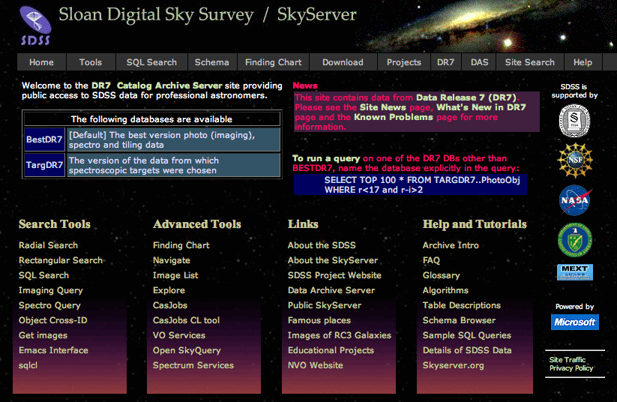
Original Database Design
Alex Szalay and Jim Gray
Based on the SDSS and SkyServer Experience [1]
Delete-nothing philosophy
Modularized components, retrace steps, reprocess from raw data
Built on top
Protocol for the basestation to talk directly to the DB
Support for multiple deployments
Design Schema to store
Measurements as stored on mote’s flash
Summary information about network health
Network links and paths used to download data
[1] : http://skyserver.sdss.org/public/en/
Notes:
Network links can be used to figure out if a mote is still active

Slide 14
2 Phase Design
Some details/tasks are deployment specific
Due to network configurations
Some details/tasks are deployment independent
In the end its all timeseries data!
2-phase Loading
Phase I : Staging
Meta Information
Deployment Specific
Computer Scientists care about deployments details
Phase II : Science
Hardware Agnostic
Deployment Agnostic
Scientists interested in data (not deployments details)

Slide 15
Pipeline Features
Upload Application
Robust transfer of outstanding data from Basestation to Remote Database
Store Measurements, networking history, component health data
Support multiple deployments
Metadata Management
Incorporate new sensor types
Maintain history of hardware replacements
Enforce Hierarchy and manage keys for
Site → Patch → Location → Node → Sensor

Slide 16
Pipeline Features - II
Stage Database (one per deployment)
Assign Timestamps to sensor measurements
Identify sensor streams using metadata information
Generate reports to monitor status and health
Science Database (Unified database)
Resample data to meet needs of experiments
Create indexes and pre-computations for speeding up access
Expose data to consumers and visualization services

Slide 17
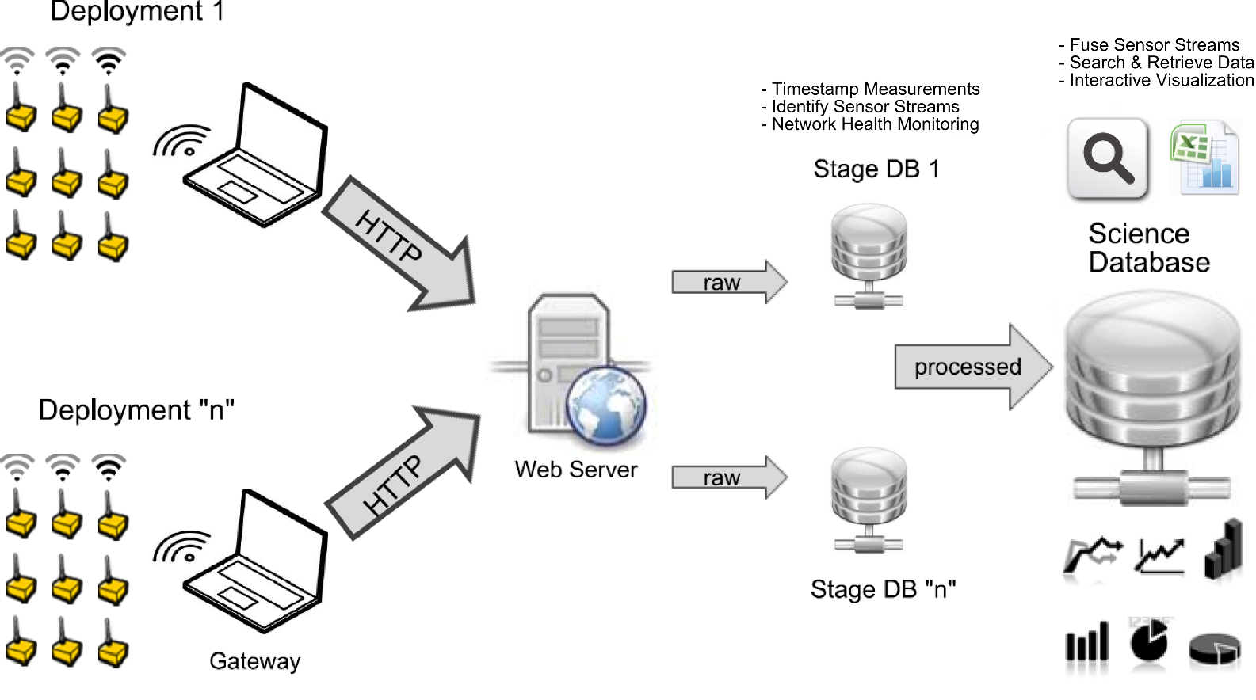
End-to-End Architecture (2008)

Slide 18
Statistics July 2008 -
Deployment (Nodes) | Start | Days | # of transfers | # of replacements | Size (GB)
Olin (18) | July, 2008 | 421 | 3432 | 42 | 1.8 GB
Cub Hill (53) | July, 2008 | 1256 | 8419 | 55 | 15 GB
USDA (22) | July, 2009 | 500 | 3963 | 13 | 3.1 GB
SERC (37) | March, 2009 | 631 | 4301 | 70 | 3.7 GB
Atacama (3) | August, 2009 | 152 | 2564 | - | 0.2 GB
Ecuador | May 2010 | 18 | 171 | 43 | 2 GB

Slide 19
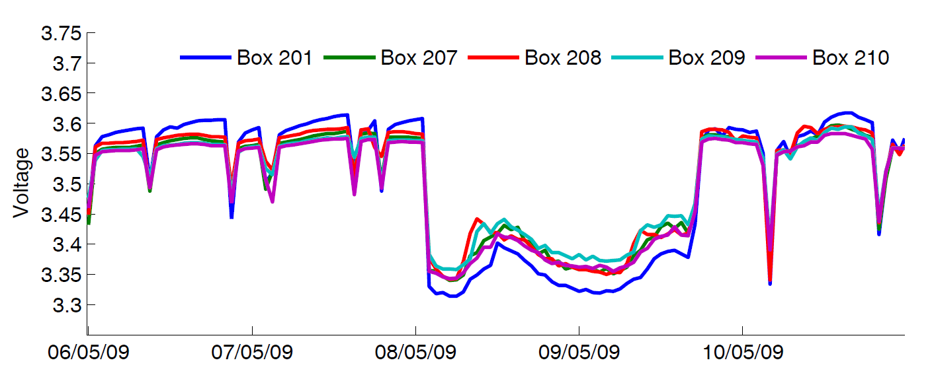
Monitoring
Mote Radio On
Periodic Downloads

Slide 20
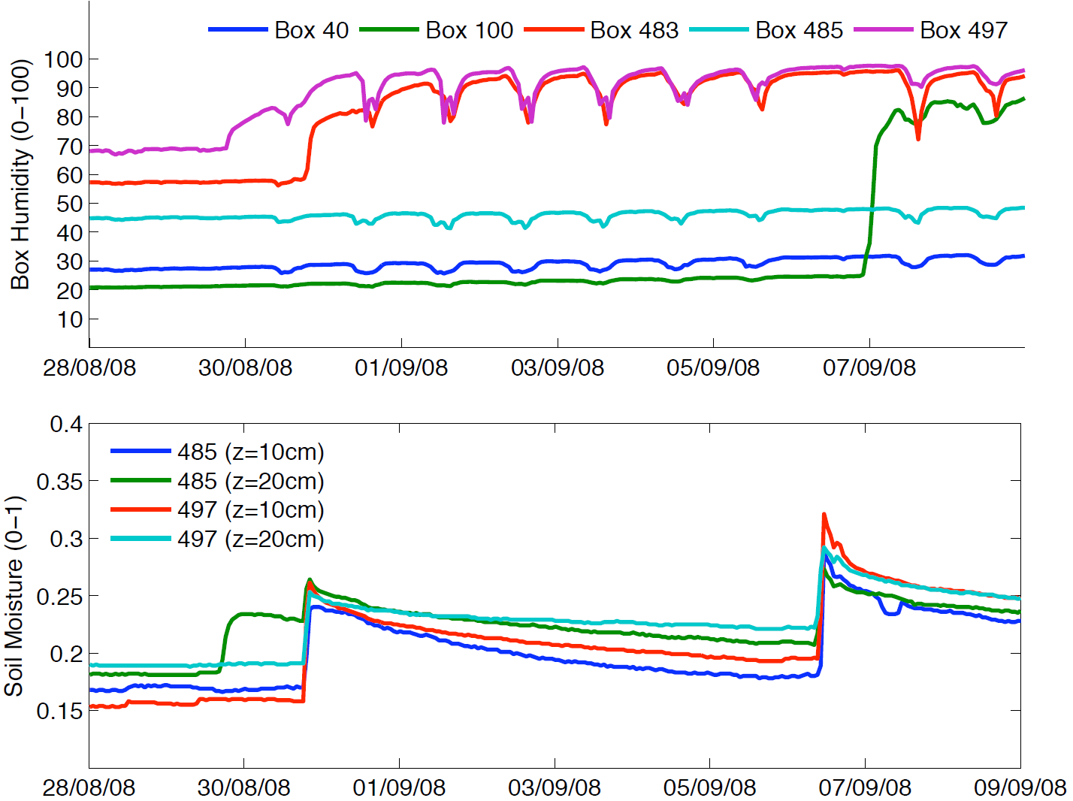
Monitoring - II

Slide 21
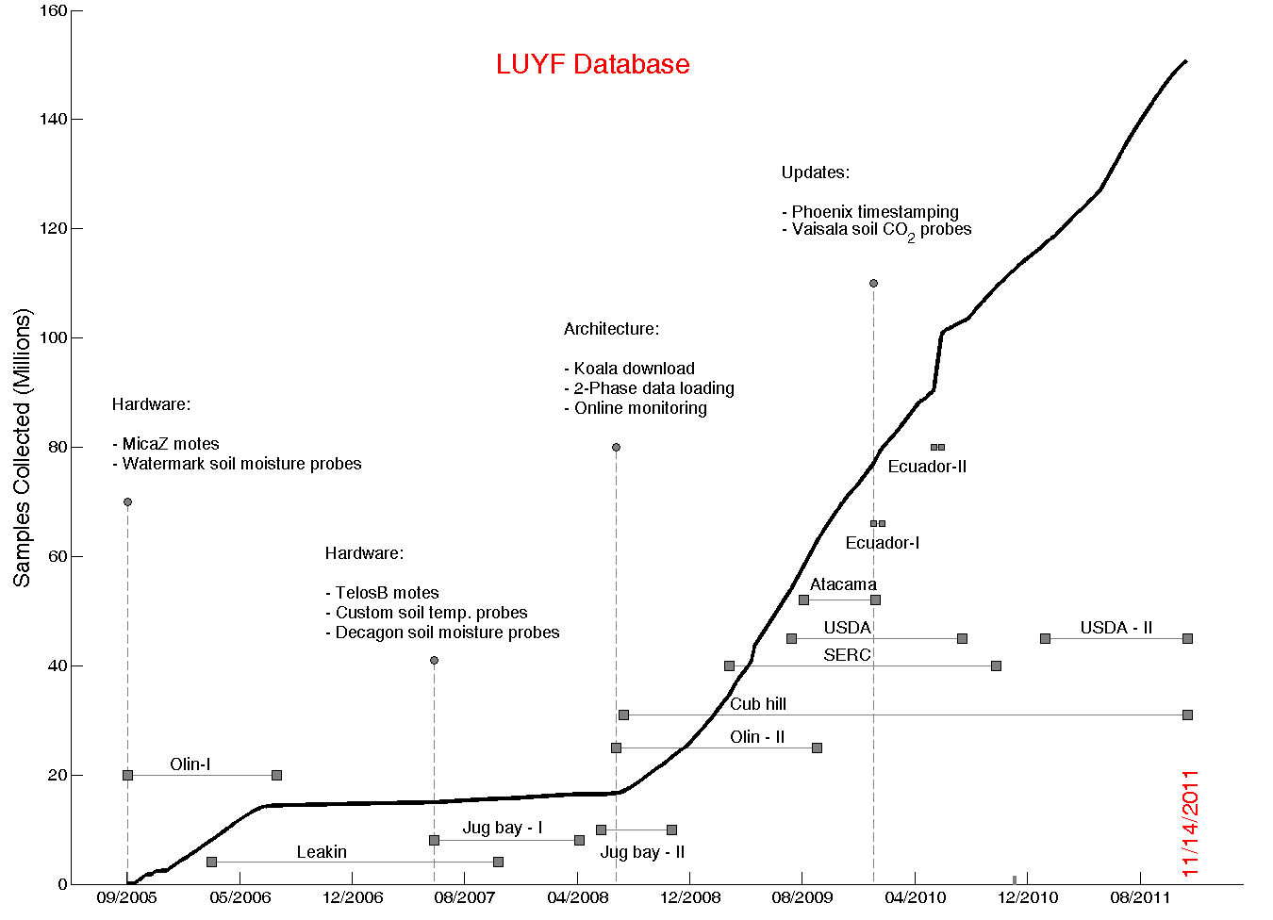
Data Avalanche

Slide 22
Measurement Timestamping

Slide 23
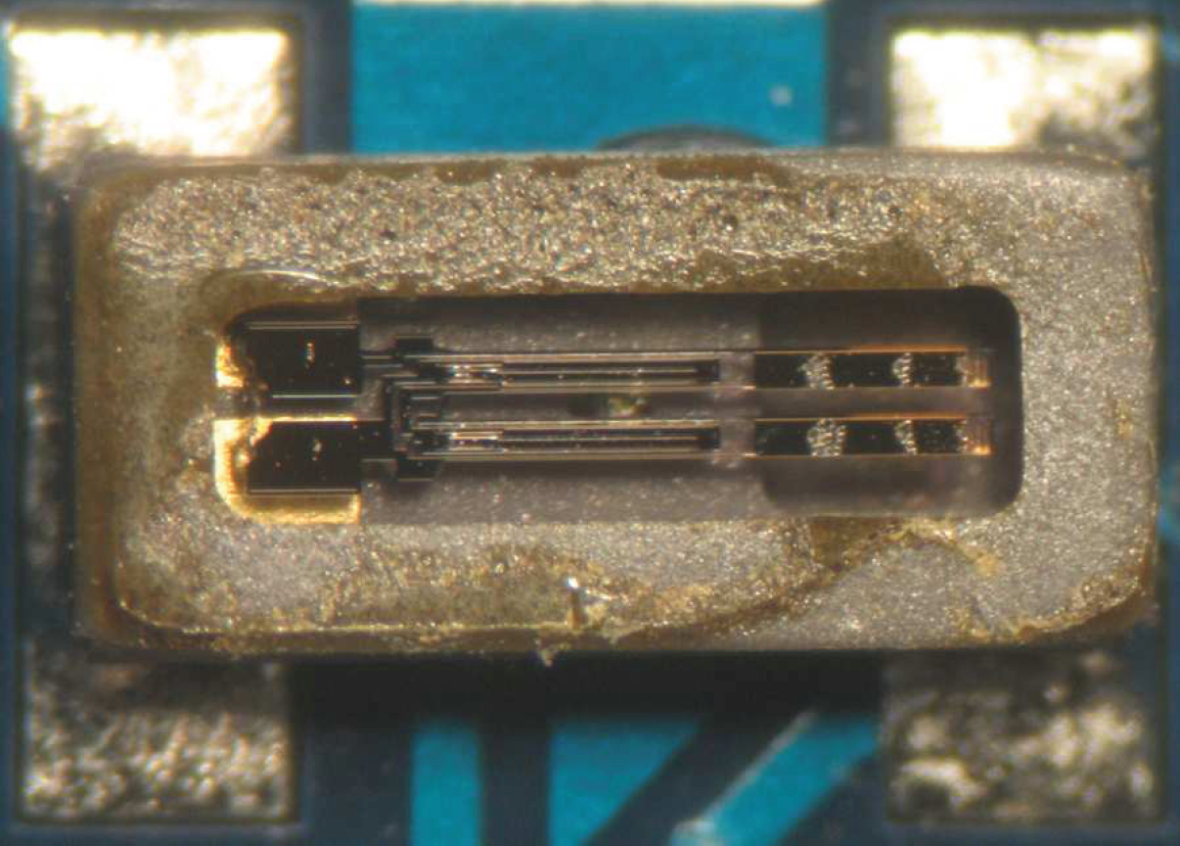
Timing in WSNs
Mote Clock
32 kHz quartz crystal
~ 10 – 20 μW
Not a real-time clock
Typical Skews Observed
<1 yr old : 10 – 20 ppm
> 3 yrs old : 60 – 120 ppm
Thomas Schmidt, http://tschmid.webfactional.com/documents/29/

Slide 24
Timing Methodologies
 | In-network Timestamping | Post-Facto Timestamping
Accuracy | μS Range | mS : S
Latency | Real time | Done after the fact
Reference | Time Difference of Arrival (TDOA) | Universal Time (UTS)
Energy | High [Radio in use a lot] | Low [Radio used sparingly]
Complexity | High | Simple
Implementation | Completely on the mote | 10% Mote, 90% Outside
Reprocess | No | Yes
Applications | Target Tracking, Intrusion Detection | Long-term Environmental Monitoring

Slide 25
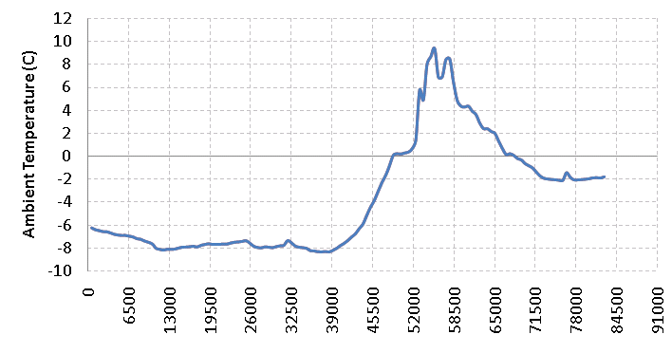
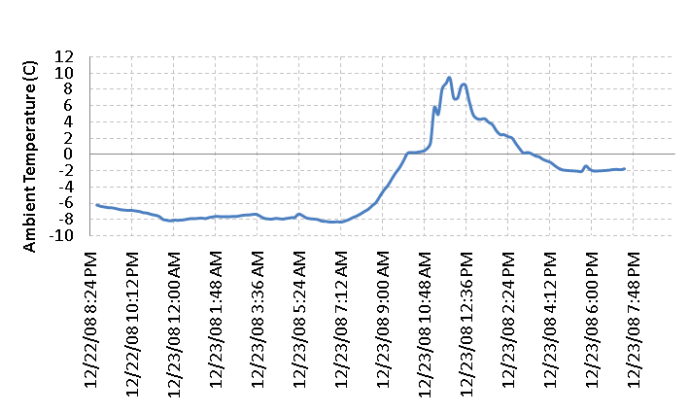
Introduction
Local Clock
DateTime /
Universal Clock

Slide 26
Translating Measurements
Network Time
Protocol Service
Local time
Data
…
Data
Data
Local time
1, <local time, global time>,
2, <local time, global time>,
. . .
. . .
N,<local time, global time>

Slide 27
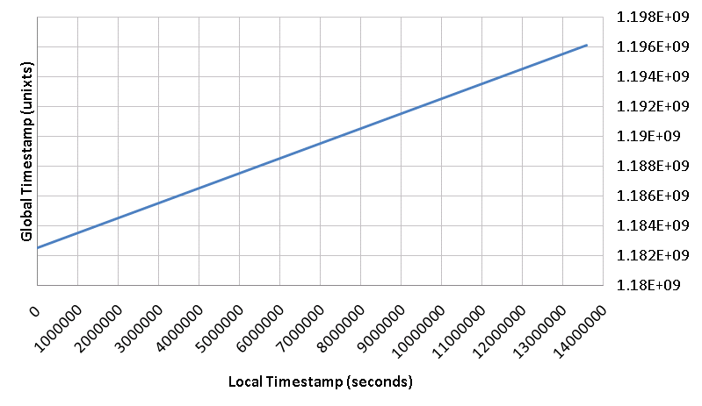
Basic Approach
^ ^
GTS = α . LTS + β
“α” (slope) represents
Clock-skew
<LTS, GTS>
“Anchor Points”
“β” (intercept) represents
Node Deployment time

Slide 28
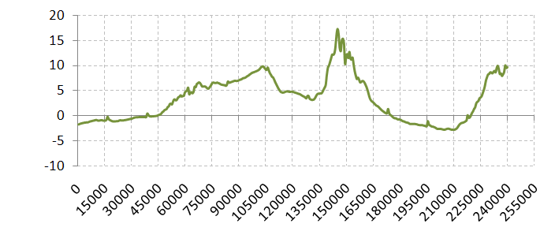
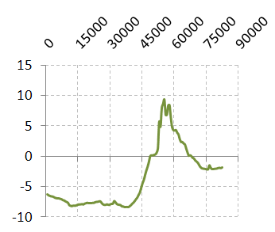
Reboots
Segment 2
Segment 1

Slide 29
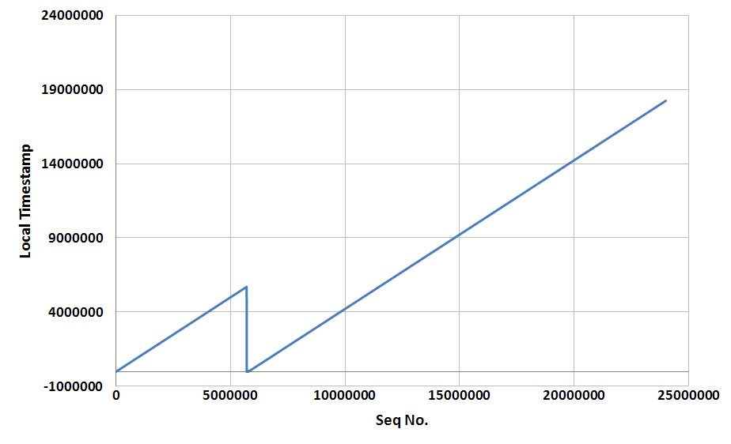
Reboots
Segment 1
Segment 2

Slide 30
Failures & Challenges
Basestation can fail
Network is in “data-logging” mode
Nodes become disconnected from the network
Mote is in data-logging mode
Basestation clock (global clock source) could have an offset/Drift
Corrupt “anchor points”
Bad estimates for α and β
Motes have variable skews

Slide 31
Leakin Deployment : Motivating Example
The Situation:
Some anchor points were corrupt
Large segments for which there were no anchor points
Can we use the data to reconstruct the measurement timeline ?

Slide 32
Sundial

Slide 33
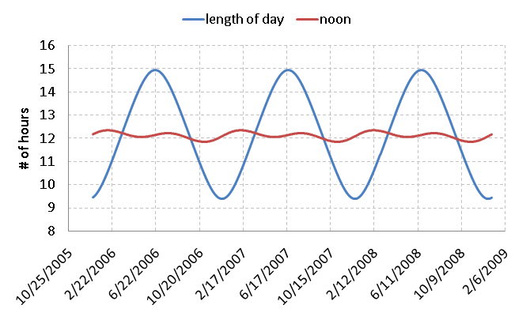
Annual Solar Patterns
<LOD, noon> = f (Latitude, Time of Year)

Slide 34
On-board Light Data
Smooth

Slide 35
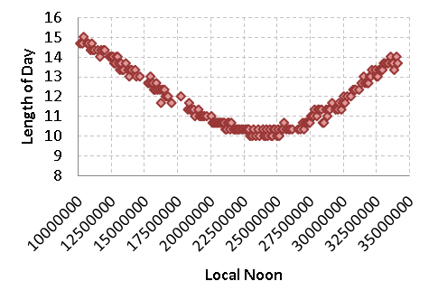
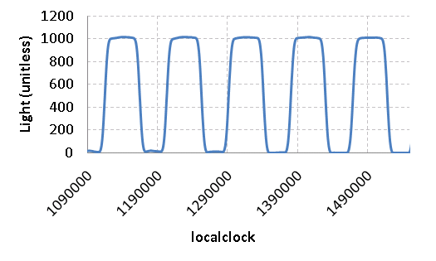
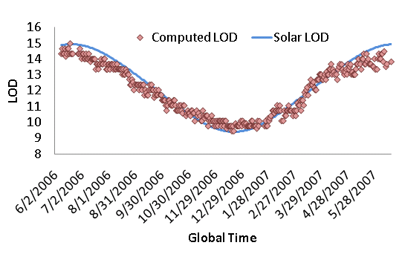
“Sundial”
Noon
Length of day (LOD)
argmax _{lag} Xcorr (LOD _{lts}, LOD _{gts}, lag)
Local Noon | Global Noon
Lts ₁ | Gts ₁
Lts ₂ | Gts ₂
… | …
… | …
Lts _{n} | Gts _{n}
“Anchor Points”

Slide 36
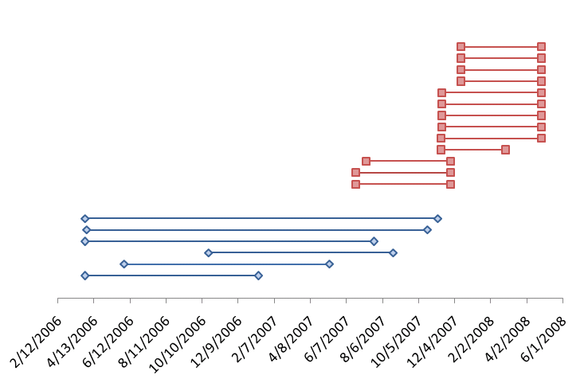
Segments
“Jug bay” Deployment
Telos B motes
30 minute sampling
13 boxes
Max Size : 167 days
“Leakin” Deployment
MicaZ motes
20 minute sampling
6 boxes
Max Size : 587 days
Notes:
fonts

Slide 37
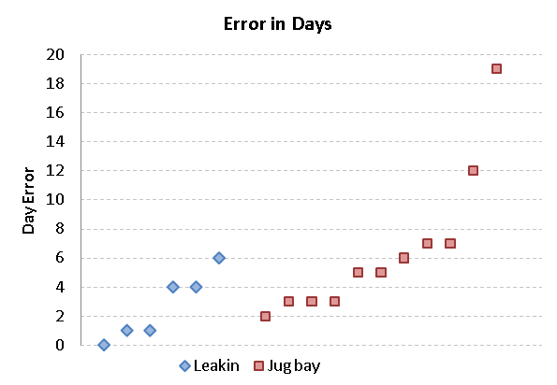
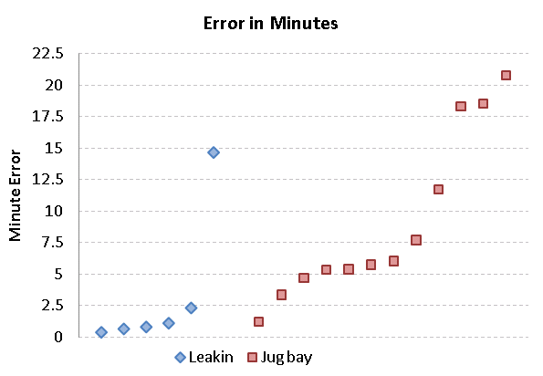
Reconstruction Results
Day Error
Offset in days
Proportional to Error in
Intercept (β)
Minute Error
RMSE Error in minute within the day
Proportional to Error in slope/clock
drift (α)

Slide 38
Discussion
Sun provides a natural time base for environmental processes
LOD and Noon metrics : Validate timestamps
Applied to nearby weather station
One month in December when time was off by an hour
Can we design a system that is
Low Power
Robust to random mote resets
Tolerant to missing global clock sources for ~ days

Slide 39
Phoenix

Slide 40
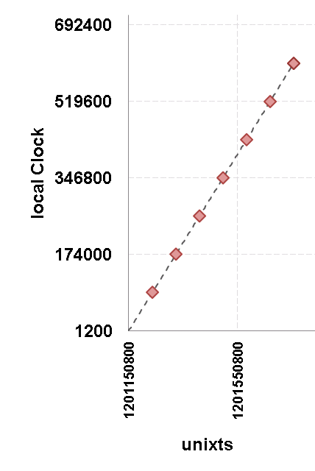
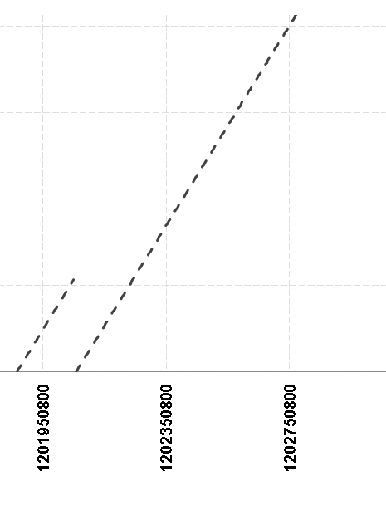
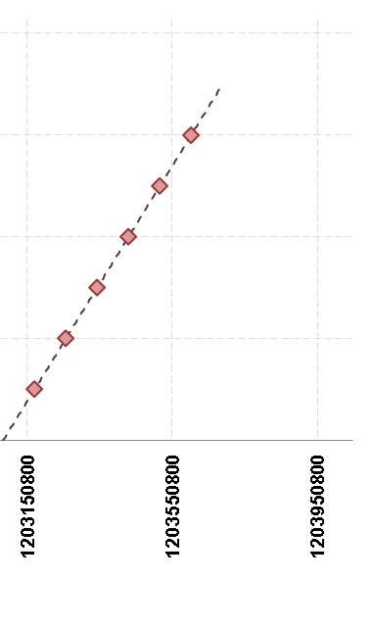
Reboots and Basestation
? ? ?
Notes:
Simplify the graph.

Slide 41
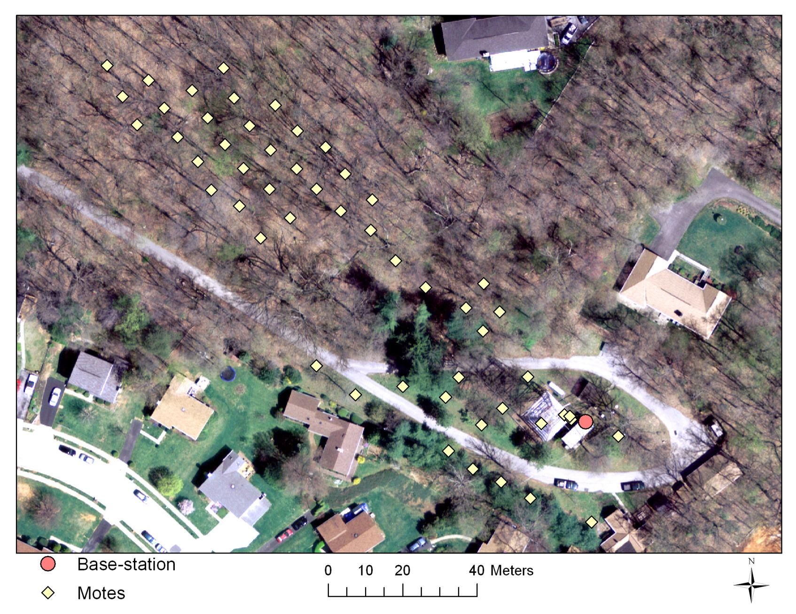
Cub Hill – Year long deployment
Notes:
Soil monitoring application.

Slide 42
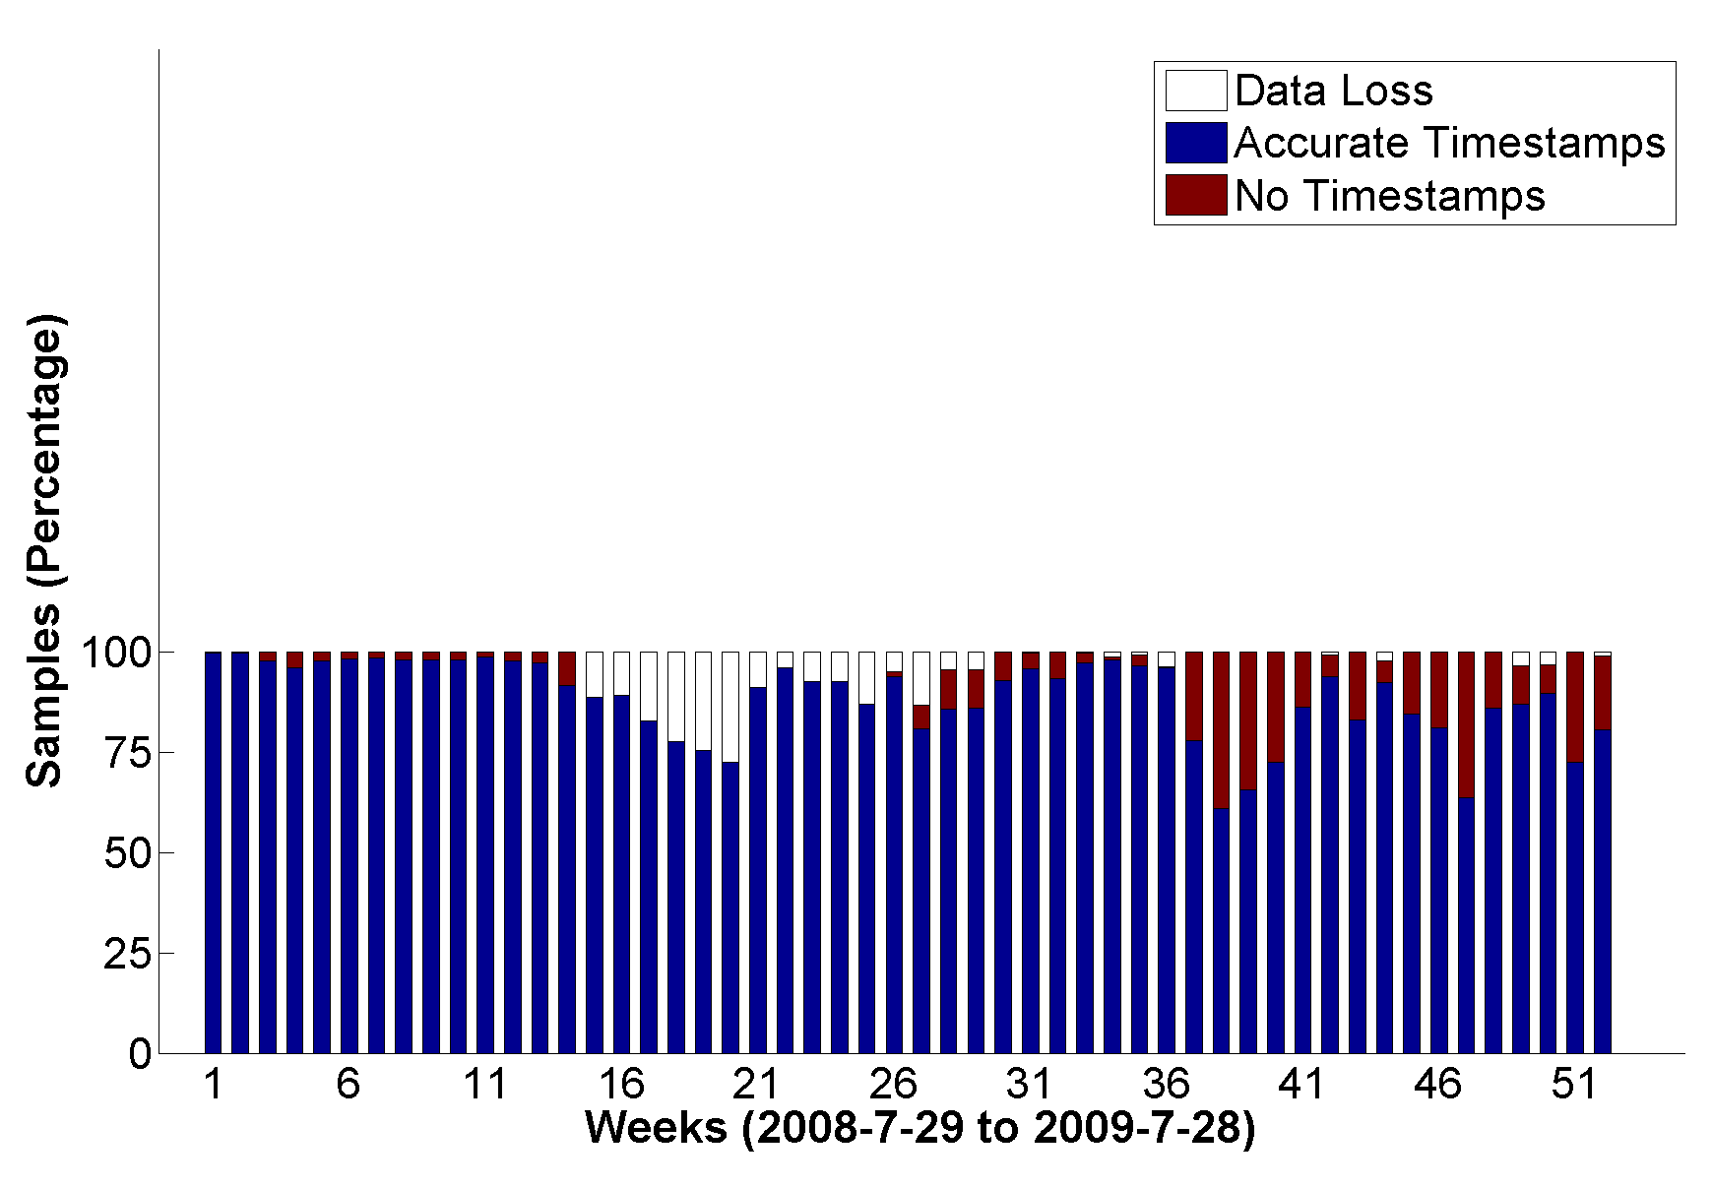
Cub Hill : Time Reconstruction
Watchdog Fix
Nodes Stuck
(Data Loss)
Basestation Down
Reboot Problems
Notes:
Watchdog to reboot stuck state or memory violations. Practise more

Slide 43
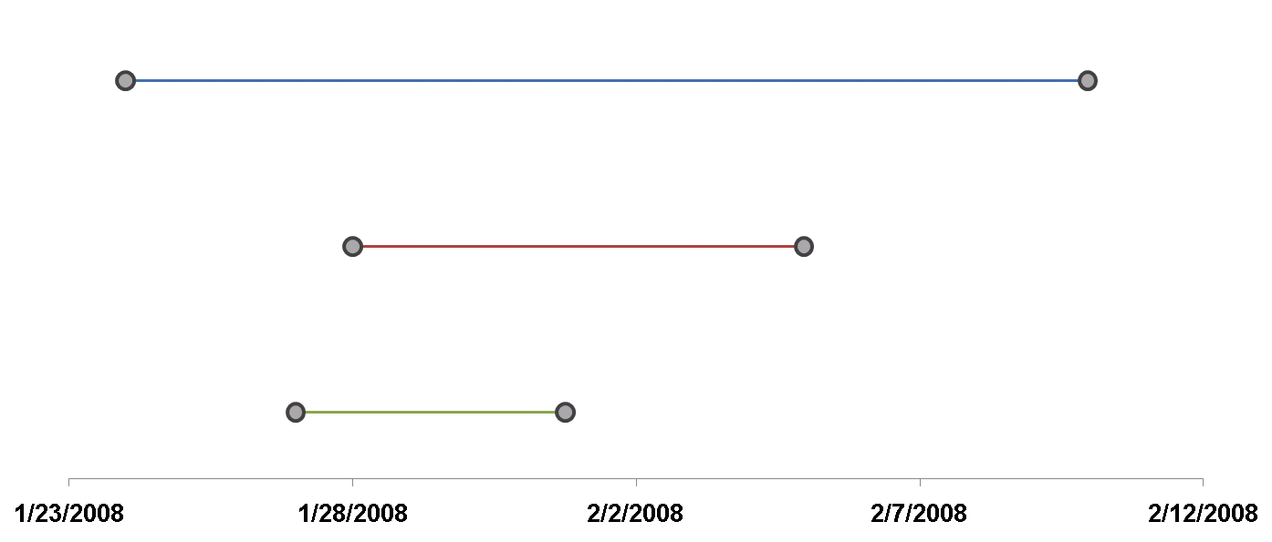
Phoenix: Big Picture
1
<local, local>
<local, global>
2
<local, local>
3
Base Station
Notes:
1 has references to the global clock. 2 and 3 do not.

Slide 44
Terminology
Segment: State defined by a monotonically increasing local clock (LC)
Comprises <moteid, reboot counter>
Anchor:
<local,neighbor> : Time-references between 2 segments
<local,global> : Time-references between a segment and global time
Fit : Mapping between one time frame to another
Defined over <local,neighbor> : Neighbor Fit
Defined over <local,global> : Global fit
Fit Parameters
Alpha (α) : Skew
Beta (β) : Offset
Goodness of Fit : Metric that estimates the quality of the fit
E.g. : Variance of the residuals

Slide 45
2-Phase
Phase-I : Data Collection
(In-network)
Phase-II : Timestamp Assignment
(Database)
Notes:
NOT basestation (outside)

Slide 46
Architecture Summary
Motes
Global Clock Source
Basestation
Notes:
Components. Explain each component

Slide 47
Anchor Collection – I : Beaconing
Each Mote:
Beacons time-state periodically
<moteid, RC #, LC>
Beacon interval~ 30s
Duty-cycle overhead: 0.075%
28 | 3 | 9600000
28
97 | 7 | 3600
43 | 5 | 102400
97
43
Notes:
Get rid of so many motes

Slide 48
Anchor Collection – II : Storage
Each Mote:
Stays up (30s) after reboot
Listens for announcements
Wakes up periodically (~ 6 hrs)
Stays up (30s)
Listens for announcements
Stores <local, neighbor> anchors
Duty-Cycle : 0.14%
28
97 | 7 | 3800
43 | 5 | 102800
97
43
Notes:
Get rid of so many motes

Slide 49
Anchor Collection – III : Global References
28 | 4 | 102435
28 | 4 | 102455, 1217351879
97 | 7 | 4000
G-Mote:
Connected to a global clock source
Beacon its time-state (30s)
Store Global References (6 hrs)
Global clock source
(GPS, Basestation etc)
97
43
Notes:
Get rid of so many motes

Slide 50
Time Reconstruction (outside the network)
28-4
(G)
<Global Fit>
28-4
(G)
χ = 2
χ = 7
97-7
(A)
97-7
(A)
43-5
(B)
43-5
(B)
<Global Fit>
χ = 2.5
<Global Fit>
Notes:
Mention segments not motes

Slide 51
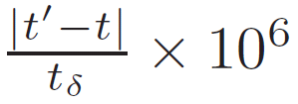
Evaluation Metrics
Yield:
Fraction of samples assigned timestamps (%)
Average PPM Error:
PPM Error per measurement:
Duty Cycle Overhead:
Fraction of time radio was on (%)
Space Overhead:
Fraction of space used to store anchors (%)
Notes:
Explain the formula

Slide 52
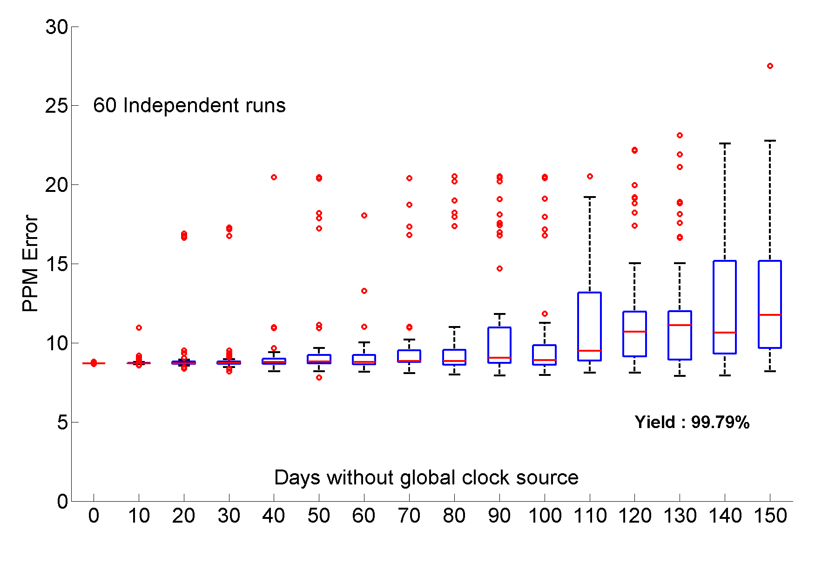
Simulation: Missing Global Clock Source
Simulation Period : 1 Year

Slide 53
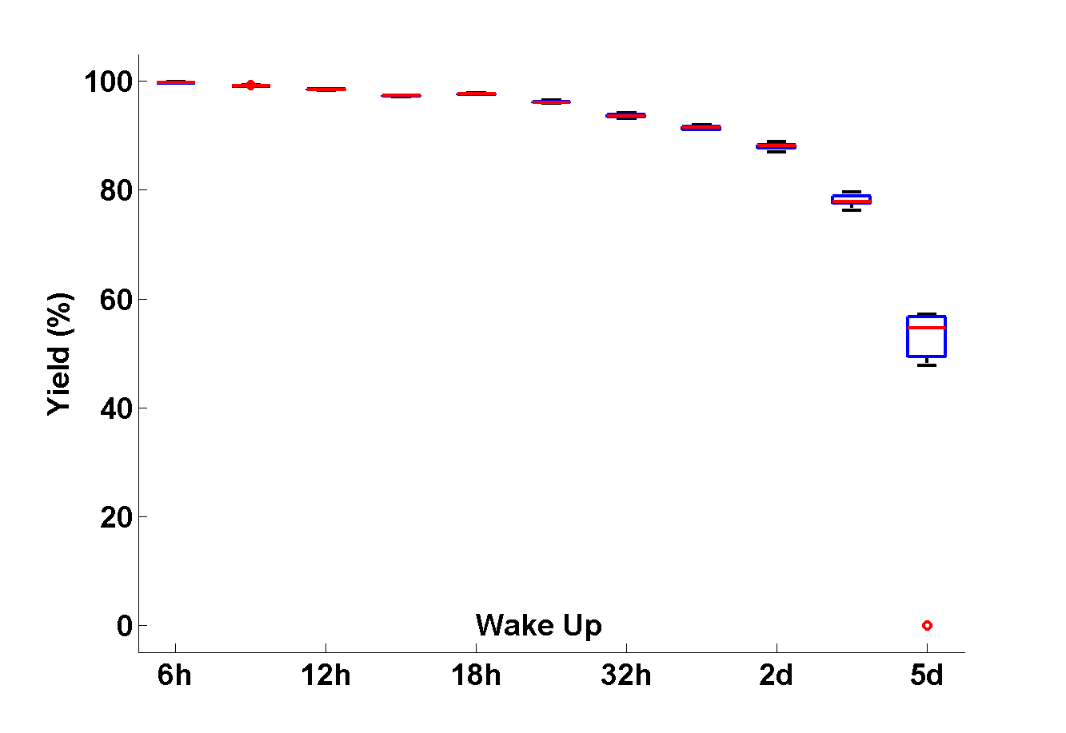
Simulation: Wake Up Interval
Anchor collection rate should be significantly faster than the rate of reboots

Slide 54
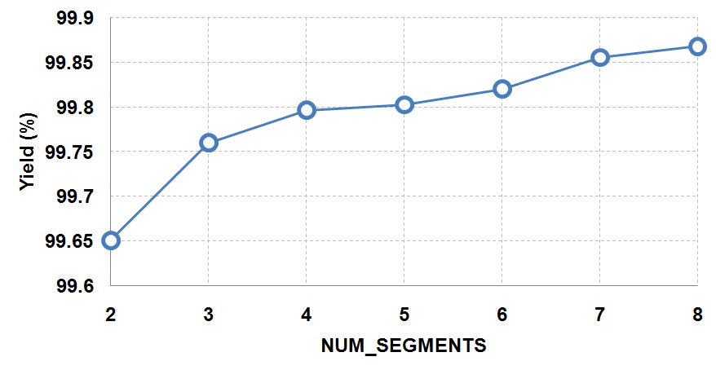
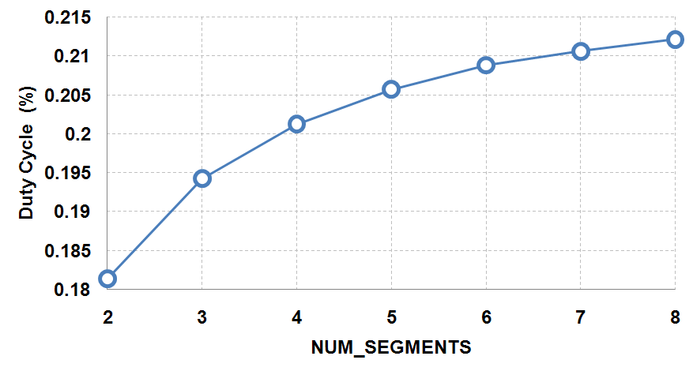
Simulation: Segments to anchor with
Notes:
Just put them together and say this is the price you pay … Introduce DL first

Slide 55
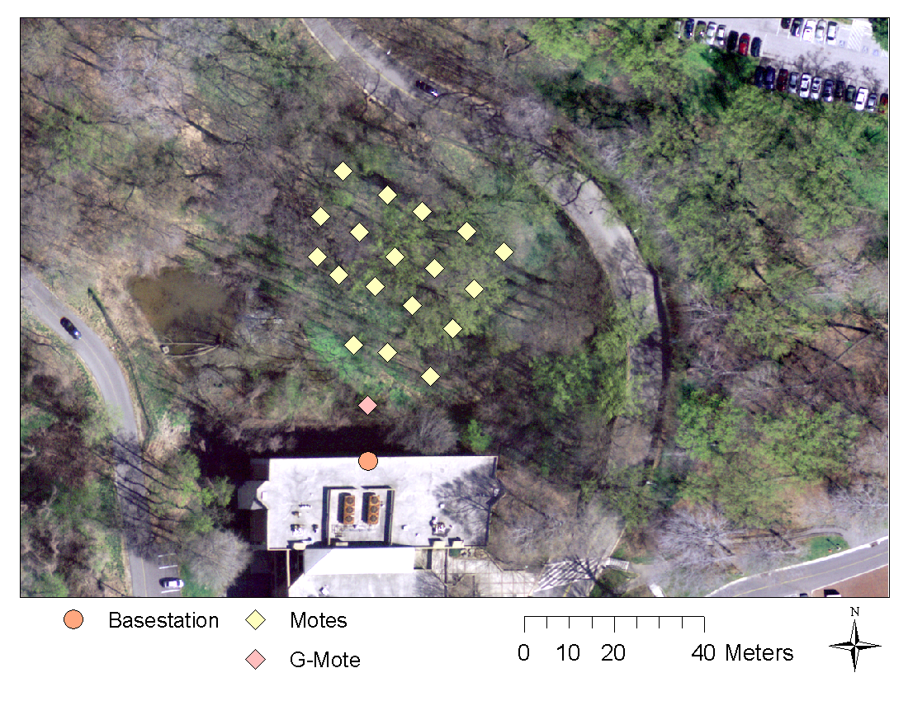
Olin Deployment
- 19 Motes - 21 Day Deployment - 62 segments - One Global clock mote

Slide 56
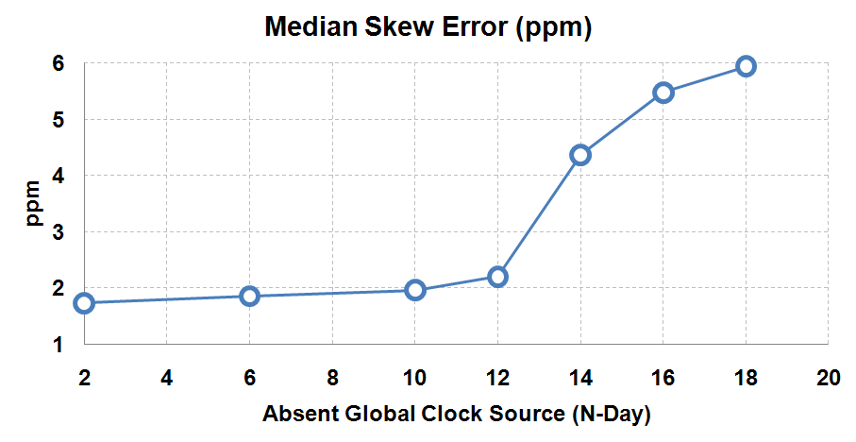
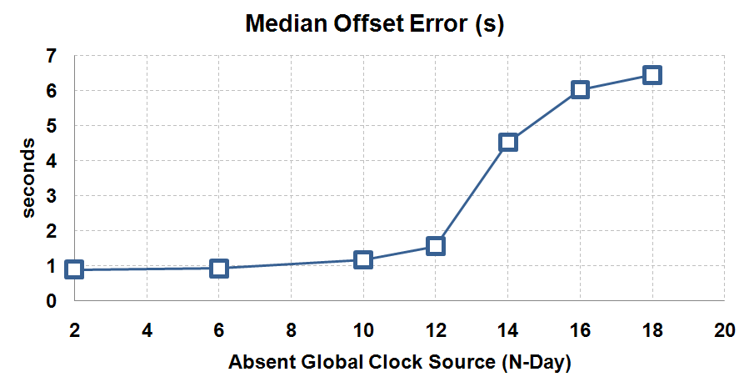
Deployment Accuracy
Notes:
Non-phoenix reconstruction. DON’T MENTION GROUND TRUTH!

Slide 57
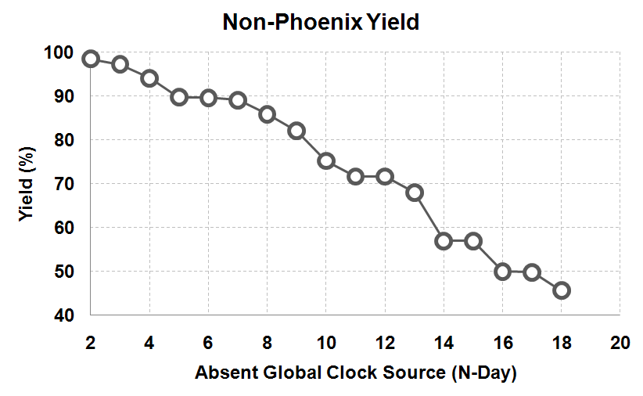
Naïve Yield Vs Phoenix Yield
Phoenix Yield: 99.5%
Notes:
Non-phoenix reconstruction. DON’T MENTION GROUND TRUTH!

Slide 58
Data Driven Data Collection

Slide 59
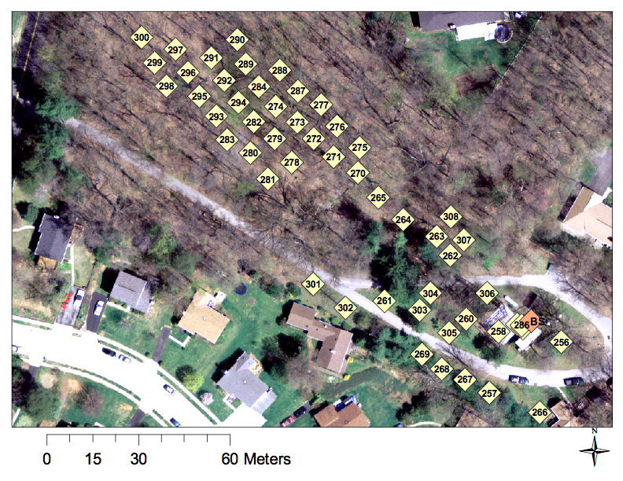
Cub Hill Deployment

Slide 60
Spatiotemporal Correlations

Slide 61
Energy in Data Transfers
Bulk Download Every 12 hours
Summary Information
Measurement Data
Link Information
Cub Hill duty cycle : 3%

Slide 62
Question
Download data from everyone is expensive
Could the amount of downloaded data be reduced without sacrificing information

Slide 63
Motivating Example

Slide 64
Informative Locations
Some locations are more informative than others
Pick locations that are able to predict values at other locations
Andreas Krause, Ajit Singh, Carlos Guestrin, "Near-Optimal Sensor Placements in Gaussian Processes:
Theory, Efficient Algorithms and Empirical Studies", In Journal of Machine Learning Research (JMLR), vol. 9, pp. 235-284, 2008

Slide 65
Basic Methodology
Collect Data from U
for T_{train}
Find Informative
Set (S)
Selectively Collect
from S for T_{test}
Reconstruct for
Set U \ S

Slide 66
Compare with Random

Slide 67
Impact of Test Period

Slide 68
Error Pattern
Observations
High Reconstruction error for period after rain event
Error grows as test period grows
Small number of locations with
large errors

Slide 69
Update Methodology
Send hourly snapshots / updates
Discover high error locations
Use hourly snapshots to compute prediction errors at each location
If more than ε% of prediction have error of δ or greater
(E.g. ε = 95%, δ = 0.5 C)
If above true, mark location
Downloaded high error locations
Detect event and retrain after detecting event
Download from all instrumented locations
Recompute the working set of informative locations.

Slide 70
Results

Slide 71
Reconstruction Error Vs Energy Savings
When 50% of data downloaded
Median Error : 0.068 C
20% Reduction in Duty Cycle

Slide 72
Summary

Slide 73
Summary

Slide 74
Extras

Slide 75
Crystal Accuracy - Power Requirements
10⁻¹²
Cs
1s/day
10⁻¹⁰
1ms/year
Rb
10⁻⁸
Accuracy
OCXO
1s/year
1ms/day
10⁻⁶
TCXO
1s/day
10⁻⁴
XO
0.001
0.01
0.1
1
10
100
Power (W)
Quartz and Atomic Clocks, John R. Vig, , US Army Communications-Electronics Research, Development & Engineering Center, 2007

Slide 76
Outline
Introduction [10 mins]
- Monitoring Environment, Old Approach, Shortcomings, Need, WSNs, Architecture, Data avalanche, Dissertation Goal
System Design [10 mins]
- Pilot deployments, PD lessons learnt, Two phase Deployments (upload, stage, science), Health Monitoring, Lessons learned.
Sundial [10 mins]
- Choose 10 slides from Sundial ppt
Phoenix [10 mins]
- Choose 10 slides from Phoenix ppt
Adaptive Data Collection [10]
Spatiotemporal correlation, radio consumption, Reconstruction example, Mutual Information, Reconstruction, Basic Plots, TS Error, using updates, using event detection

